Slide 1


javaScript basics

Slide 2


javascript

Slide 3


javascript
JavaScript: it is an object-oriented, dynamically typed scripting language.
Unlike more familiar object-oriented languages such as Java, C#, and C++, functions in JavaScript are also objects.
JavaScript is dynamically typed (also called weakly typed) in that variables can be easily (or implicitly) converted from one data type to another.

Slide 4
javascript
Client Side Scripting
Client-side scripting refers to the client machine (i.e., the browser) running code locally rather than relying on the server to execute code and return the result.

Slide 5

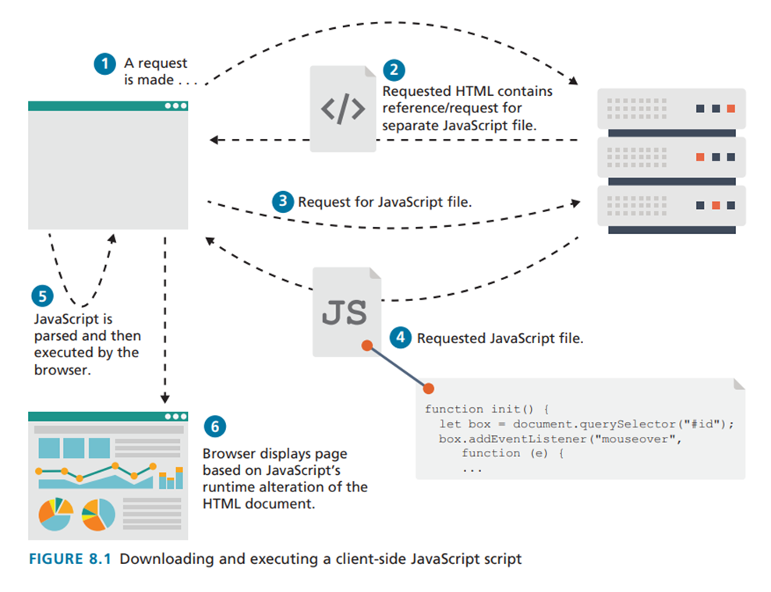
javascript

Slide 6
javascript
Advantages of client-side scripting:
  Processing can be off-loaded from the server to client machines, thereby reducing the load on the server.
  The browser can respond more rapidly to user events than a request to a remote server ever could, which improves the user experience.

Slide 7
javascript
Advantages of client-side scripting:
  JavaScript can interact with the downloaded HTML in a way that the server cannot, creating a user experience more like desktop software than simple HTML ever could.

Slide 8
javascript
Disadvantages of client-side scripting:
  There is no guarantee that the client has JavaScript enabled, meaning any required functionality must be implemented redundantly on the server.
  JavaScript-heavy web applications can be complicated to debug and maintain.

Slide 9
javascript
Disadvantages of client-side scripting:
  JavaScript is not fault tolerant. Browsers are able to handle invalid HTML or CSS. But if your page has invalid JavaScript, it will simply stop execution at the invalid line.
  While JavaScript is universally supported in all contemporary browsers, the language (and its APIs) is continually being expanded.

Slide 10
javascript history

Slide 11
javascript history
History of JavaScript
JavaScript was introduced by Netscape in their Navigator browser back in 1996.
It originally was called LiveScript but was renamed partly because one of its original purposes was to provide a measure of control within the browser over Java applets.

Slide 12
javascript history
History of JavaScript
Internet Explorer (IE) at first did not support JavaScript but instead had its own browser-based scripting language (VBScript).
Netscape submitted JavaScript to Ecma International, a private, nonprofit standards organization.

Slide 13
javascript history
History of JavaScript
In 1997, ECMAScript is simultaneously a superset and subset of the JavaScript programming language. That is, the JavaScript that is supported by your browser contains language features not included in the current ECMAScript specification while also missing certain language features from that specification.

Slide 14
javascript history
History of JavaScript
The Sixth Edition (or ES6) was the one that introduced many notable new additions to the language (such as
classes, iterators, arrow functions, and promises).
Editions 7 through 11 added only a relatively modest number of additions in comparison.

Slide 15
javascript history
History of JavaScript
In the middle of the 2000s with the emergence of so-called Web 2.0 or AJAX-enabled sites that JavaScript became a much more important part of web
development. AJAX is both an acronym as well as a general term. As an acronym it means Asynchronous JavaScript and XML, which was accurate for some time.

Slide 16
javascript history
History of JavaScript
Over the past decade, JSON (JavaScript Object Notation) has almost completely displaced XML as the most common format for data transport in interactive web
sites, thus making the AJAX acronym less and less meaningful today.

Slide 17
javascript history
History of JavaScript
While JavaScript is still predominately used to create user interfaces in browser based applications, its role has expanded beyond the constraints of the browser
JavaScript has migrated into other nonbrowser applications. It can be used as the language within server-side runtime environments such as Node.js.

Slide 18
javascript history
History of JavaScript
Some newer non-relational database systems such as MongoDB use JavaScript as their query language.
Complex desktop applications such as Adobe Creative Suite and OpenOffice use JavaScript as their end-user scripting language

Slide 19
javascript history
History of JavaScript
A wide variety of hardware devices such as the Oculus Rift headset and the Arduino and Raspberry Pi microcontrollers make use of an embedded JavaScript engine. Indeed, JavaScript appears poised to be the main language for the emerging Internet of Things.

Slide 20
javascript history
History of JavaScript
Part of the reason for JavaScript’s emergence as one of, or perhaps even, the most important programming languages in software development is the vast programming ecosystem that has developed around JavaScript in the past decade.

Slide 21
javascript history
History of JavaScript
These ecosystem of libraries of JavaScript functions and objects are generally referred to as JavaScript frameworks. Some of these frameworks extend the JavaScript language; others provide functions and objects to simplify the creation of complex user interfaces

Slide 22
javascript history
History of JavaScript
User interface frameworks such as React and Vue.js simplify the process of creating Single-Page Applications (SPA), while more complex MVC frameworks such as Angular and Ember allow developers to construct applications using software engineering best practices

Slide 23
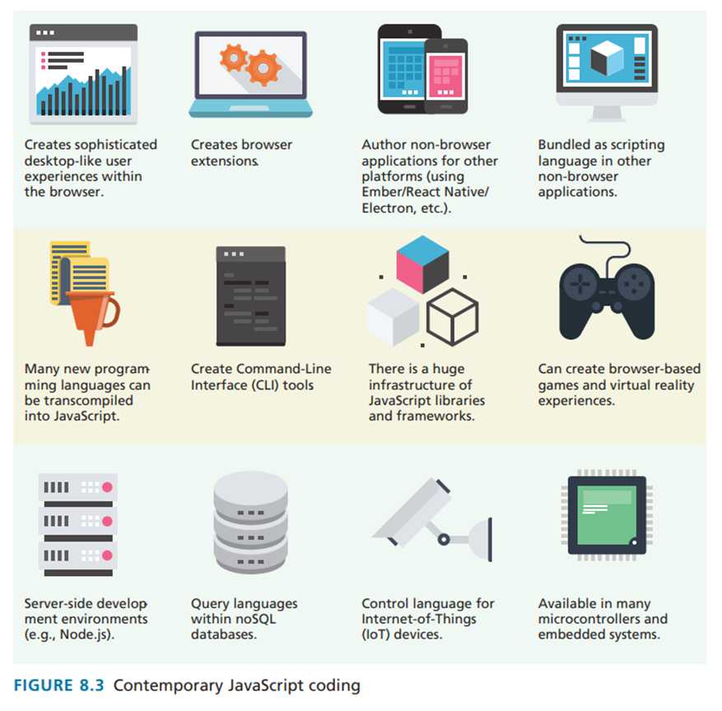
javascript history

Slide 24
USING JAVASCRIPT

Slide 25
USING JAVASCRIPT
Inline JavaScript refers to the practice of including JavaScript code directly within some HTML element attributes
Embedded JavaScript refers to the practice of placing JavaScript code within a <script> element
The recommended way to use JavaScript is to place it in an external file (external JavaScript). You do this via the <script> tag

Slide 26
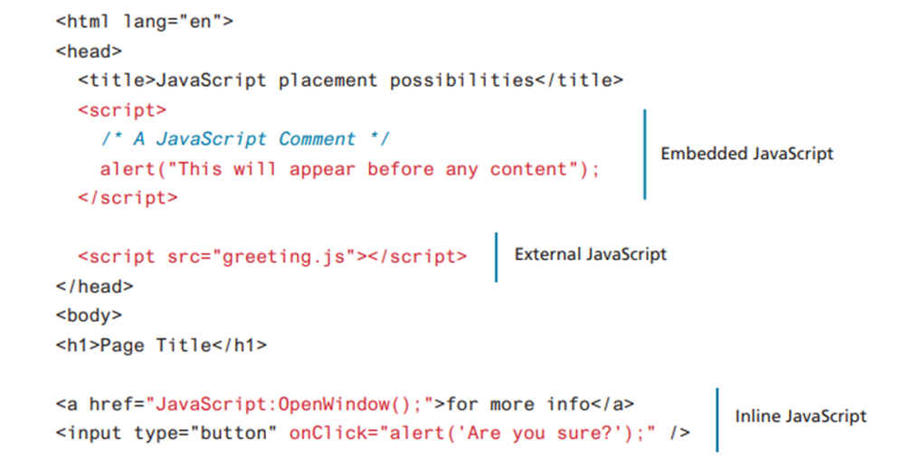
USING JAVASCRIPT

Slide 27
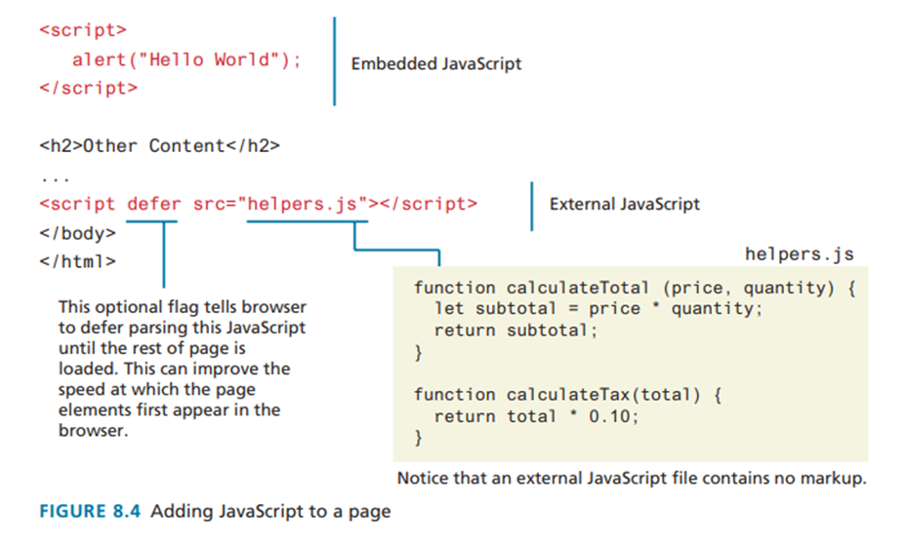
USING JAVASCRIPT

Slide 28
VARIABLES AND DATA TYPES

Slide 29
VARIABLES AND DATA TYPES
To declare a variable in JavaScript, you can use either the var, const, or let keywords.
If you do not specify an initial value, its initial value will be undefined.
*JavaScript is a case sensitive language

Slide 30
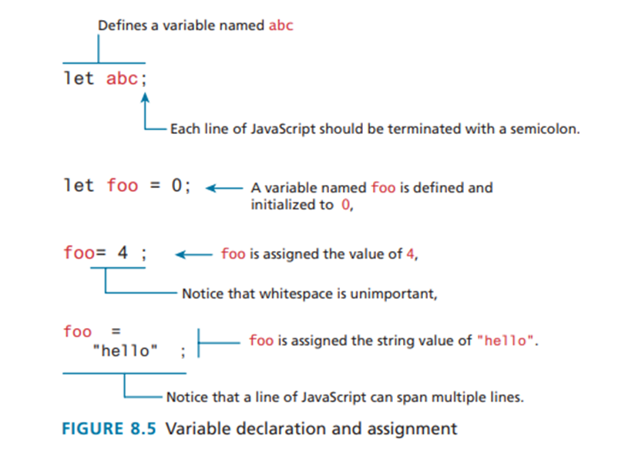
VARIABLES AND DATA TYPES

Slide 31
VARIABLES AND DATA TYPES
Variables can be defined without using one of the keywords, doing so may give that variable global scope.
The let and const keywords were added in ES6 and are now usually to be preferred over var
Assignment can happen at declaration time by appending the value to the declaration, or at runtime with a simple right-to-left assignment

Slide 32
VARIABLES AND DATA TYPES
Each line of JavaScript is terminated with a semicolon.
If you forget to add the semicolons, the JavaScript engine will still automatically insert them.
Notice that whitespace around variables, keywords, and other symbols has no meaning.

Slide 33
VARIABLES AND DATA TYPES
When to use const (Use this 80-90% of the time)
Use const when the variable identifier should not be reassigned after its initial declaration.
  Primitives (numbers, strings, booleans): Always use const unless the value itself will change.
  Objects and Arrays: Use const for them by default, even if you change their contents.
  Functions and Imports: Use const for function expressions and imported modules.

Slide 34
VARIABLES AND DATA TYPES
When to use let (Use this only when necessary)
Use let when you need to reassign the variable to a completely new value later in the code.
  Loop counters: The classic use case.
  Accumulators / Aggregators: Variables that build up a total.
  Conditional reassignment: When a variable's value depends on a condition.

Slide 35
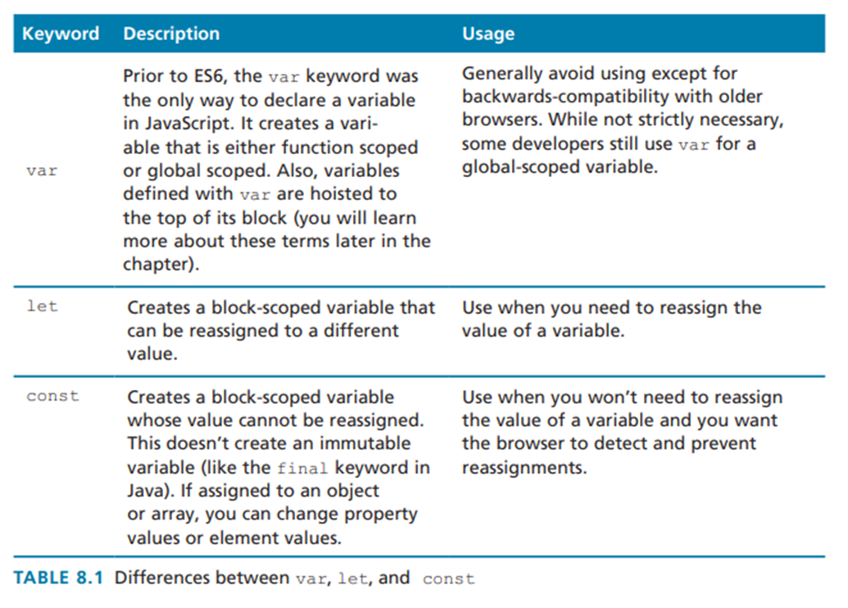
VARIABLES AND DATA TYPES

Slide 36
VARIABLES AND DATA TYPES
JavaScript Output
alert() function instructs the browser to display a pop-up or modal dialog window (that is, the user cannot interact with the page until dismissing the dialog) displaying the string passed to the function.
console.log() method (or one of its related cousins, such as console.warn() or console.dir()) since console output doesn’t interfere with the display of HTML content

Slide 37
VARIABLES AND DATA TYPES
JavaScript Output
document.write() method can be a useful way to output markup content from within JavaScript. This method is often used to output markup or to combine markup with JavaScript variables

Slide 38
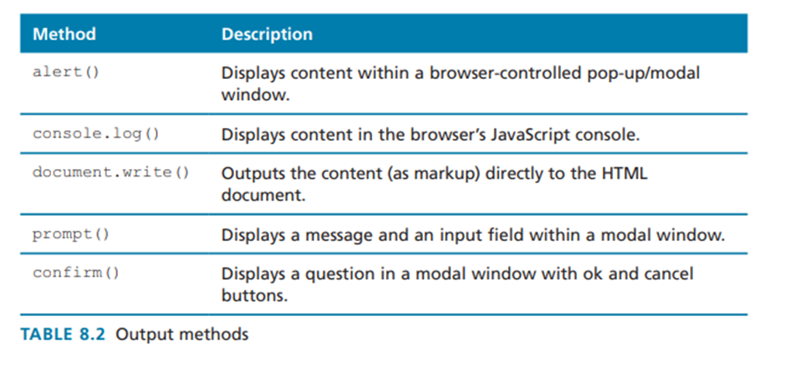
VARIABLES AND DATA TYPES

Slide 39
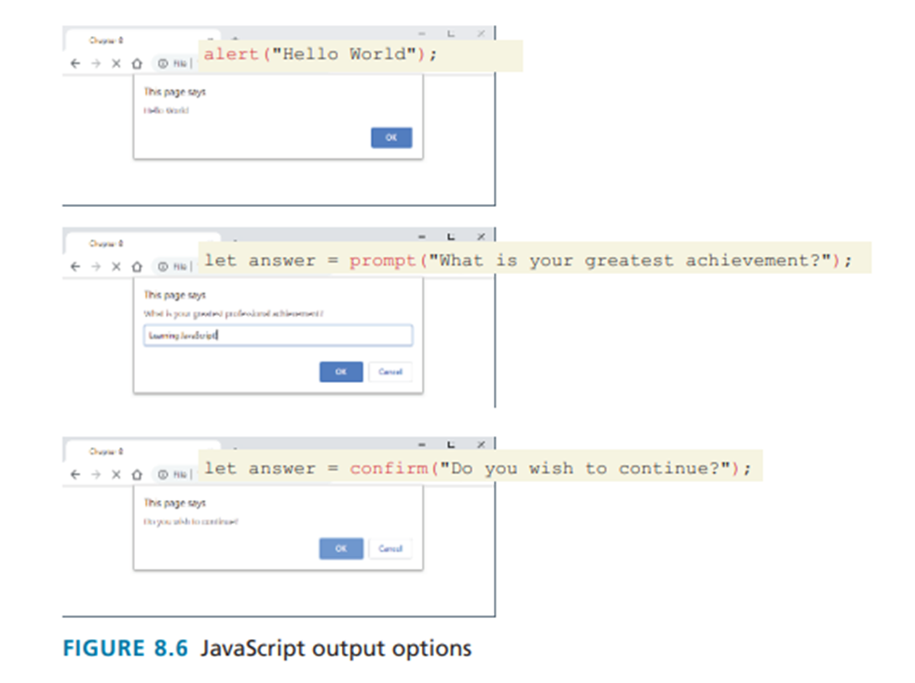
VARIABLES AND DATA TYPES

Slide 40
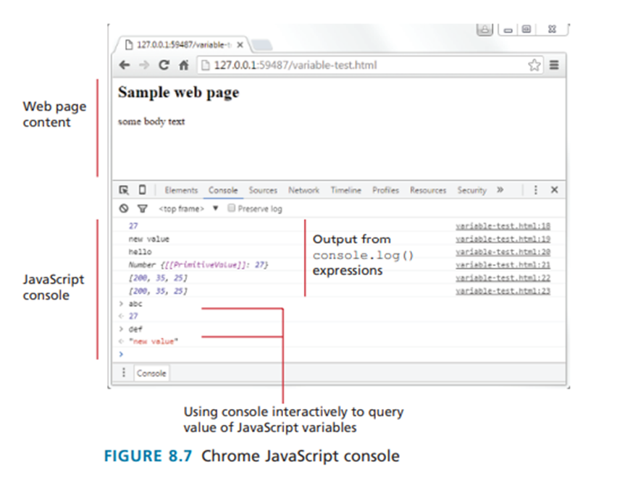
VARIABLES AND DATA TYPES

Slide 41
VARIABLES AND DATA TYPES
Data Types
JavaScript has two basic data types: reference types (usually referred to as objects) and primitive types (i.e., nonobject, simple types).

Slide 42
VARIABLES AND DATA TYPES
Data Types
Primitive variables contain the value of the primitive directly within memory. In contrast, object variables contain a reference or pointer to the block of memory associated with the content of the object

Slide 43
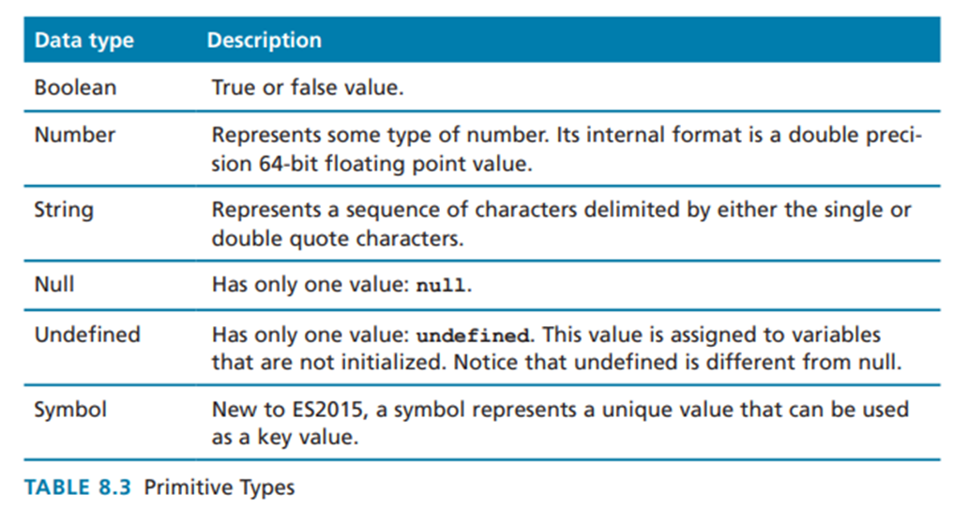
VARIABLES AND DATA TYPES

Slide 44
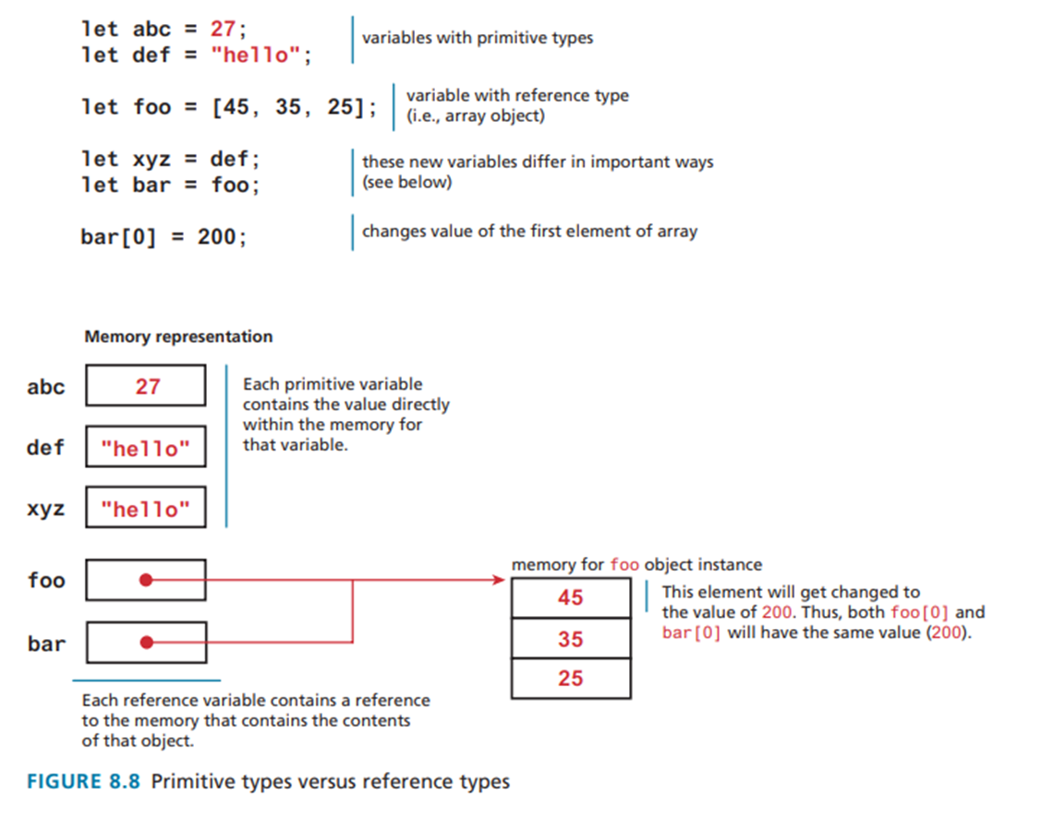
VARIABLES AND DATA TYPES

Slide 45
VARIABLES AND DATA TYPES
Data Types
You cannot reassign the value of a variable defined with a const. However, for a const variable that is assigned to a reference type (such as an object or array), its properties or elements can be changed.

Slide 46
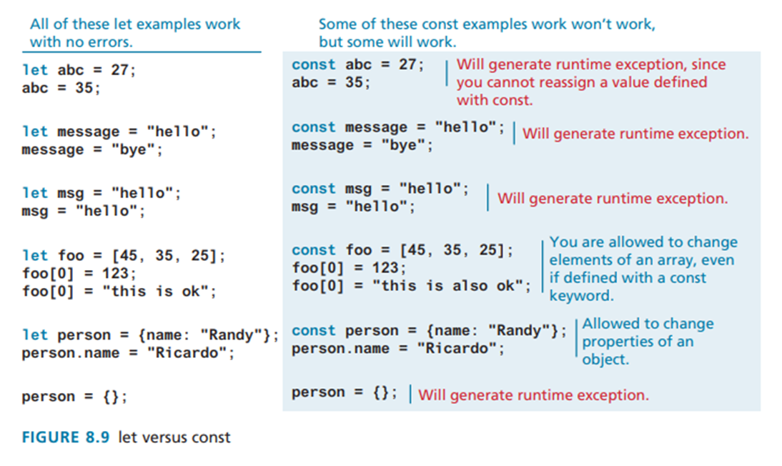
VARIABLES AND DATA TYPES

Slide 47
VARIABLES AND DATA TYPES
Built in Objects
JavaScript has a variety of objects you can use at any time, such as arrays, functions, and the built-in objects. Some of the most commonly used built-in objects include Object, Function, Boolean, Error, Number, Math, Date, String, and Regexp

Slide 48
VARIABLES AND DATA TYPES
Concatenation
One of the most basic programming tasks in JavaScript is to combine string literals together with other variables. This is accomplished using the concatenate operator (+).

Slide 49
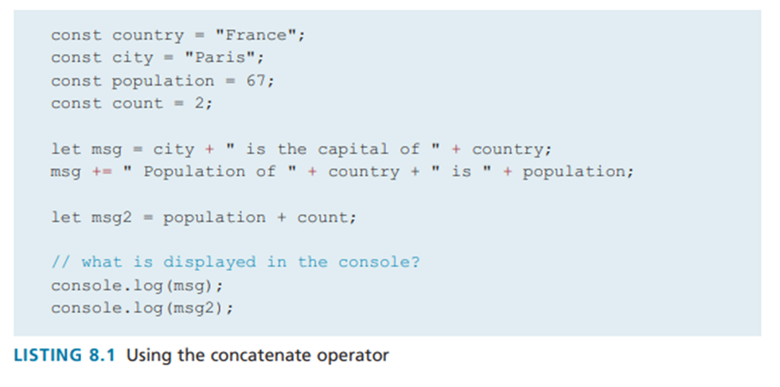
VARIABLES AND DATA TYPES

Slide 50
VARIABLES AND DATA TYPES
Concatenation
Newer versions of JavaScript have added an alternative technique for concatenation, namely, template literals

Slide 51
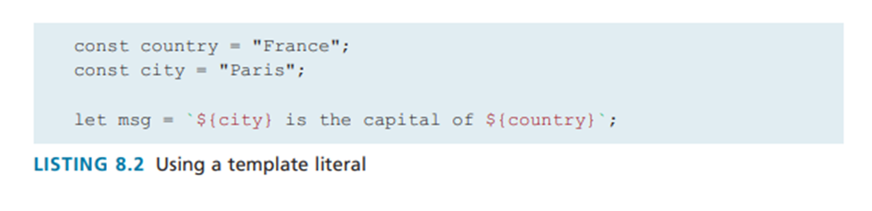
VARIABLES AND DATA TYPES

Slide 52
conditionals

Slide 53
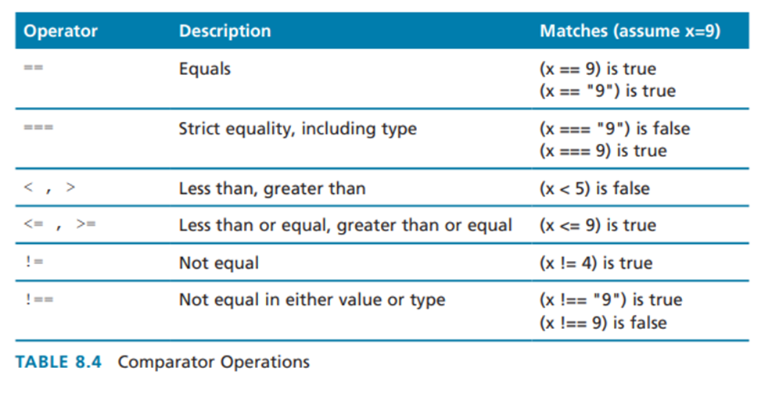
conditionals

Slide 54
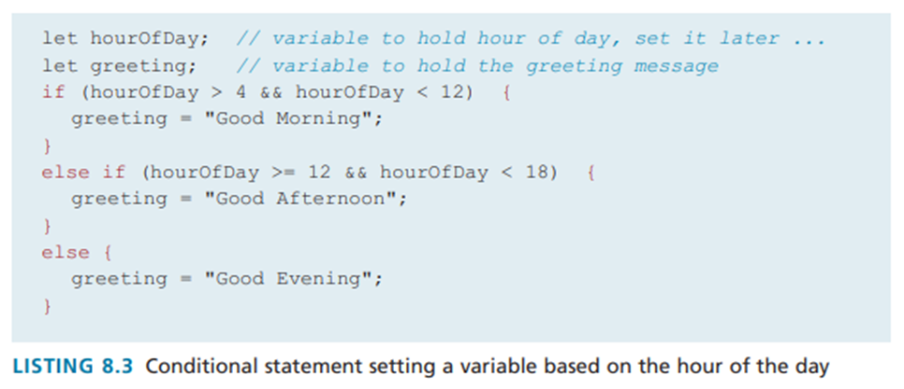
conditionals

Slide 55
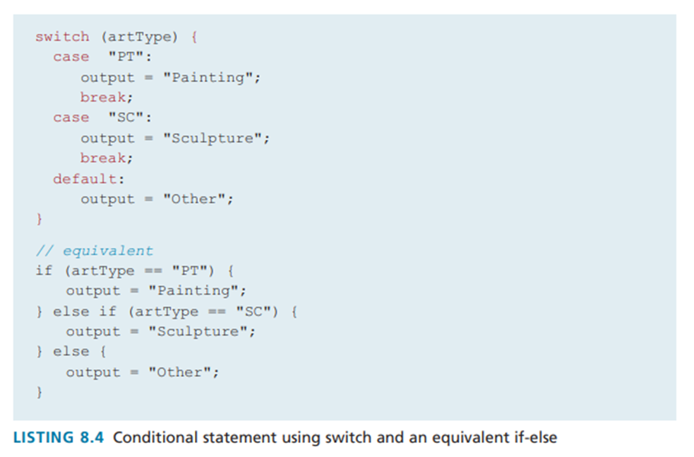
conditionals

Slide 56
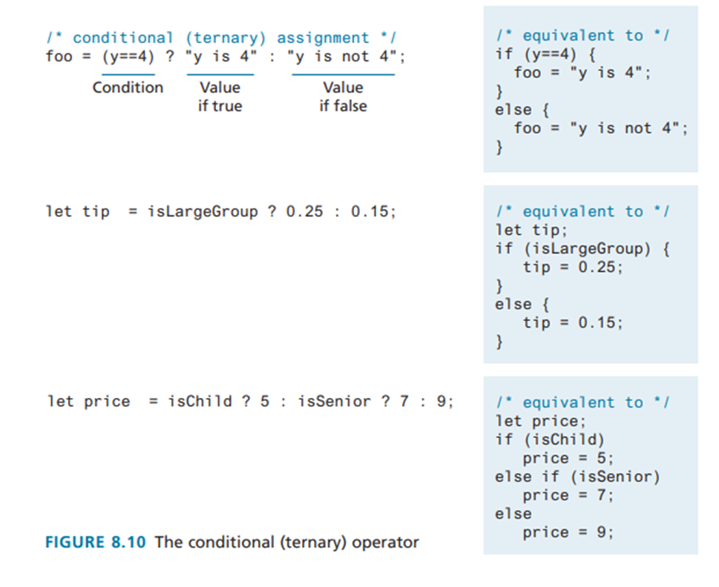
conditionals

Slide 57
loops

Slide 58
Loops
Loops are used to execute a code block repeatedly. JavaScript defines three principal statements for executing loops: the while statement, the do...while statement, and the for statement.

Slide 59
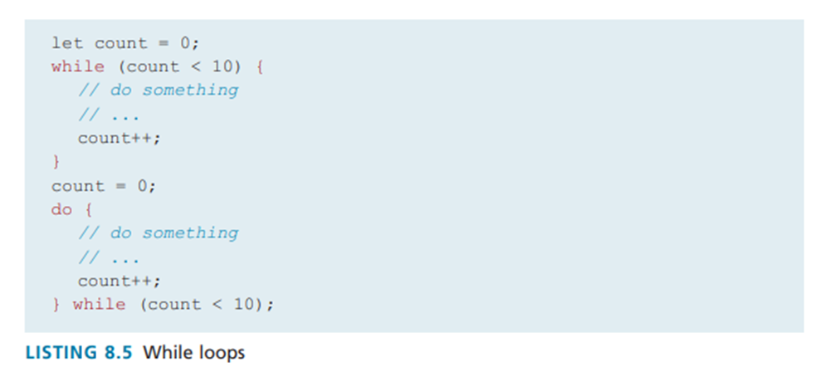
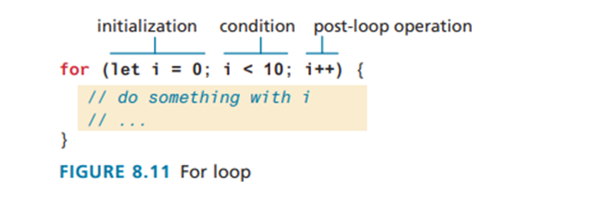
loops

Slide 60
ARRAYS

Slide 61
arrays
Array is a data structure that allows the programmer to collect a number of related elements together in a single variable. JavaScript provides two main ways to define an array.
The most common way is to use array literal notation
const name = [value1, value2, ... ];
The second approach to creating arrays is to use the Array() constructor:
const name = new Array(value1, value2, ... );

Slide 62
arrays
Arrays in JavaScript are zero indexed, meaning
that the first element of the array is accessed at index 0, and the last element at the value of the array’s length property minus 1.
Arrays are built-in objects in JavaScript. This
means that all arrays inherit a variety of properties and methods that can be used to explore and manipulate an array

Slide 63
arrays
To add an item to the end of an existing array, you can use the push() method
To add an item at the beginning of an existing array, you would use the unshift() method
countries.push("Zimbabwe");
countries.unshift("Austria");

Slide 64
arrays
The pop() method can be used to remove the last element from an array.
Additional methods that modify arrays include concat(), slice(), join(), reverse(), shift(), and sort()

Slide 65
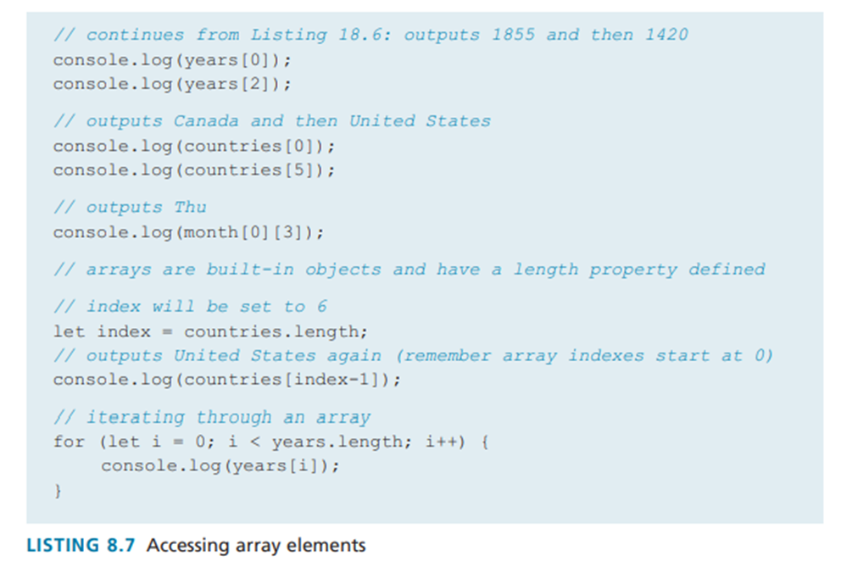
ARRAYS

Slide 66
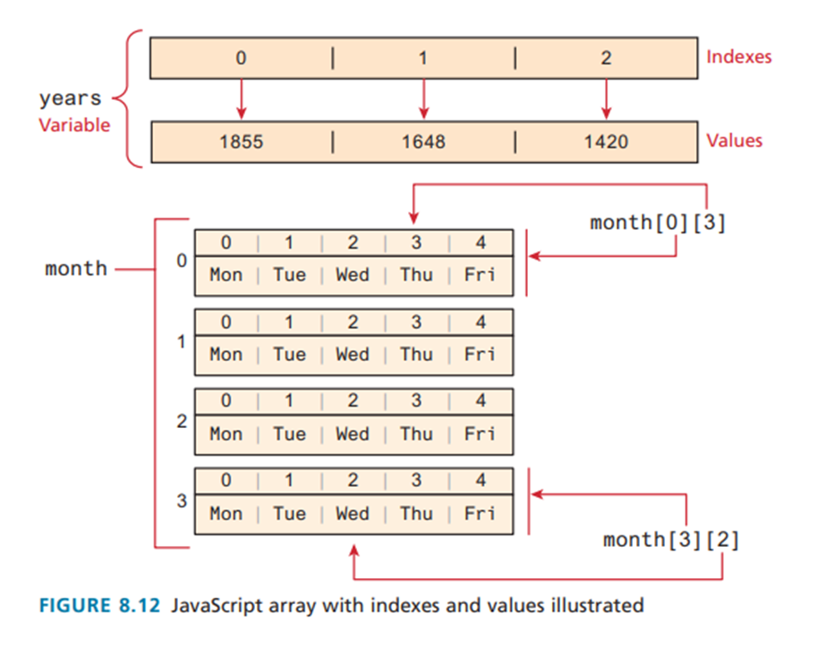
ARRAYS

Slide 67
arrays
spread syntax provides a new way to create an array from one or more existing arrays.
---
const sports = ["Tennis","Hockey"];
const games = ["Monopoly","Chess"];
---
const pastimes = ["Painting", ...sports, ...games, "Cooking"];
---
["Painting","Tennis","Hockey","Monopoly","Chess","Cooking"];

Slide 68
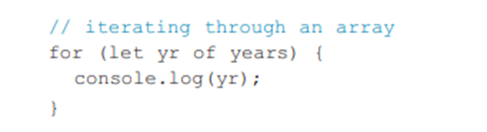
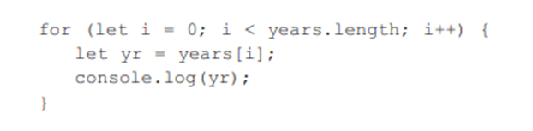
arrays
ES6 introduced an alternate way to iterate through an array, known as the for...of loop

Slide 69
arrays
Another new language feature introduced with ES6 is array destructuring, which provides a simplified syntax for extracting multiple scalar values from an array

Slide 70
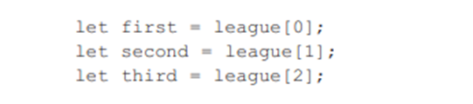



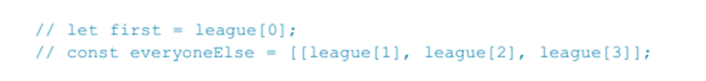
ARRAYS

Slide 71
objects

Slide 72
objects
In JavaScript, objects are a collection of named values (properties).
JavaScript instantiation: object literal notation
const objName = {
property1: value1,
…
}

Slide 73
objects
To reference the object properties, use
dot notation
objName.property1
square bracket notation
objName[“property1”]

Slide 74
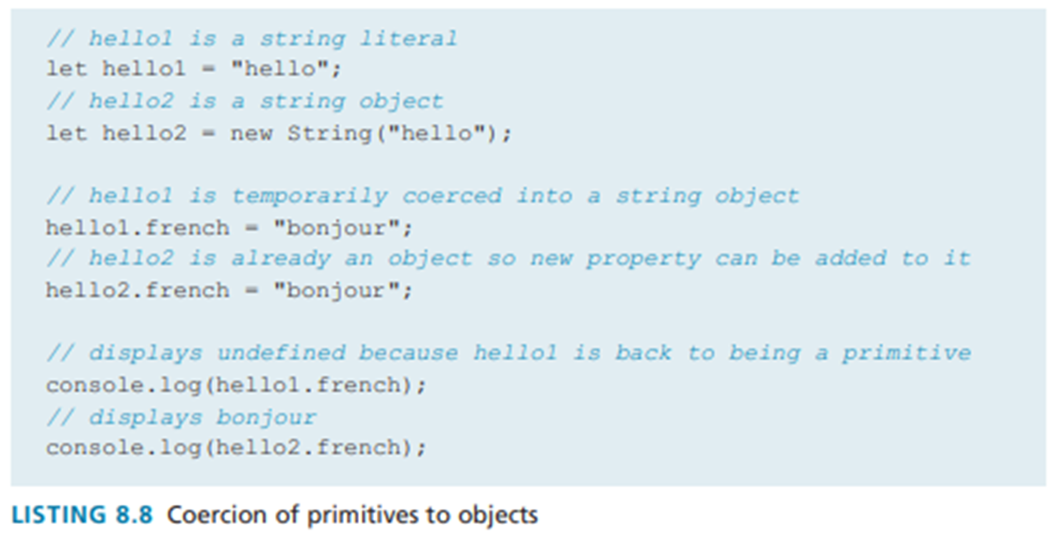
objects

Slide 75
objects
Creating object using object constructor
const objName = {}
or
const objName = new Object();
objName.property1 = value1;

Slide 76
objects
Object destructuring using spread syntax
const book = {
id: 1,
title: “A Song of Ice and Fire”,
publisher: {
name: “Bantam Books”,
location: “USA”
}
};

Slide 77
objects
let id = book.id;
let location = book.publisher.location;
let {id, title} = book;
let {name, location} = book.publisher
let {id, title, publisher: {name, location} = book;

Slide 78
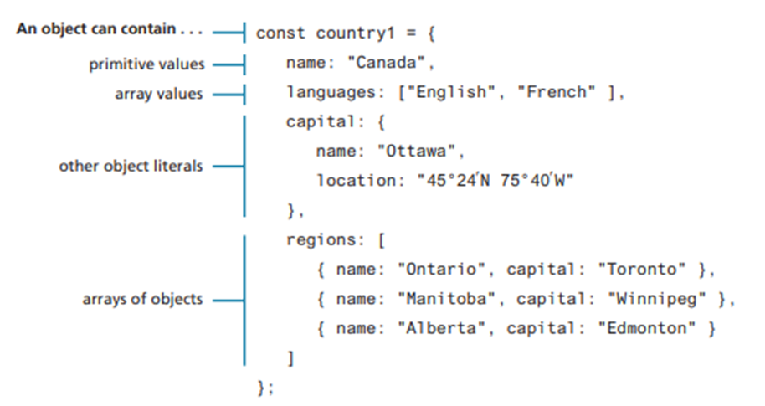
objects

Slide 79
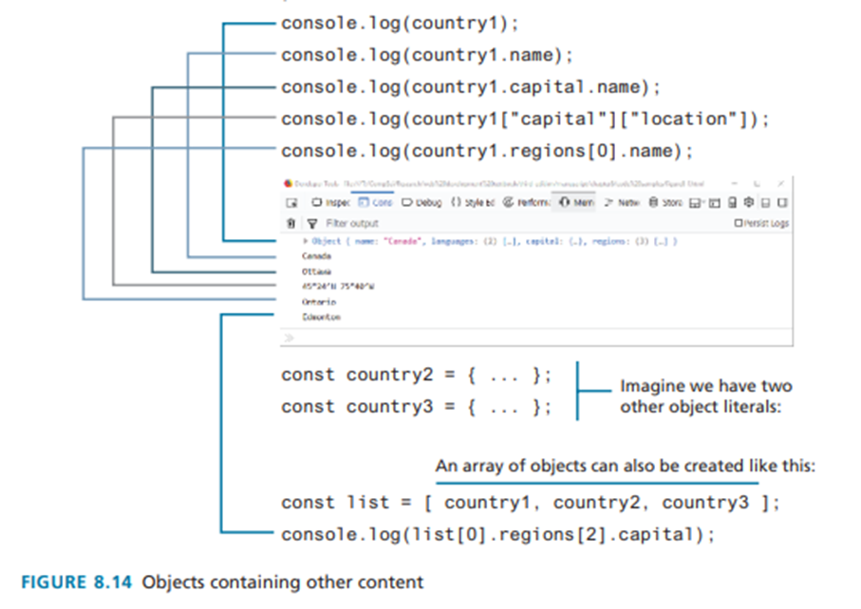
objects

Slide 80
objects
You can also make use of the spread syntax to copy contents from one array into another
const foo = { id:2, ...book.location, iso:"CA" };
const foo = {
id: 2,
name: “Bantam Books”,
location: “USA”,
iso: “CA”
};

Slide 81
objects
It should be noted that this is a shallow copy, in that primitive values are copied, but for object references, only the references are copied

Slide 82
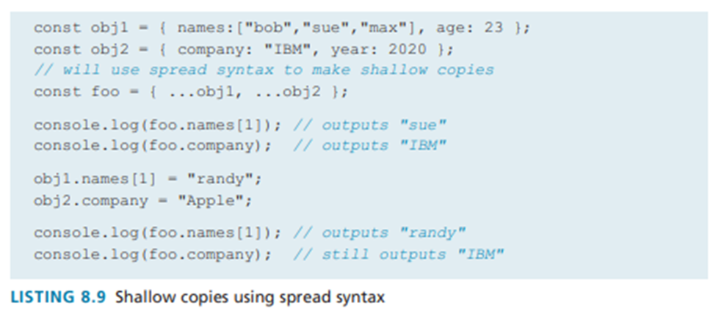
objects

Slide 83
objects
There is a variant of object literal notation called JavaScript Object Notation or JSON which is used as a language-independent data interchange format analogous in use to XML.
The main difference between JSON and object literal notation is that property names are enclosed in quotes

Slide 84
objects
const text = ‘{
"name1" : "value1",
"name2" : "value2",
"name3" : "value3"
}’;
const anObj = JSON.parse(text);

Slide 85
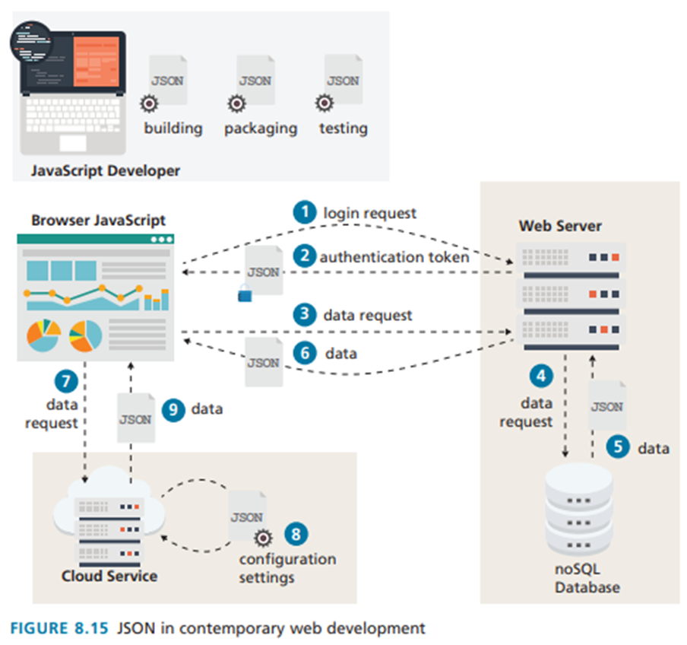
objects

Slide 86
objects
You can include the external JSON file using the <script> tag
<!-- in your HTML file -->
<script src="js/photos.json"></script>
<script src="js/ex14.js"></script>

Slide 87
objects
Then in your Javascript code (in js/ex14.js), you can convert the JSON string into an actual array using JSON.parse()
const books = JSON.parse(book);
// you can now make use of the data array
console.log(books[0].id);
for (let aBook of books) {
console.log(aBook.title);
}

Slide 88
functions

Slide 89
functions
Functions are the building blocks for modular code in JavaScript. They are defined by using the reserved word function and then the function name and (optional)
parameters
function definition/declaration
function subtotal(price,quantity) {
return price * quantity;
}

Slide 90
functions
function invocation
let result = subtotal(10,2);

Slide 91
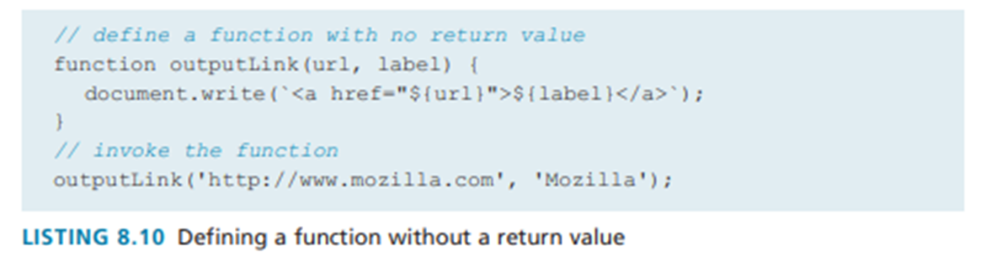
functions

Slide 92
functions
Just as with arrays and objects, it is possible to create functions using the constructor of the Function object.
// defines a function
const sub = new Function('price,quantity', 'return price*quantity’);
// invokes the function
let result = sub(10,2);

Slide 93
functions
function definition using function expression
// defines a function using a function expression
const sub = function subtotal(price,quantity) {
return price * quantity;
};
// invokes the function
let result = sub(10,2);

Slide 94
functions
anonymous function – function expression without function name
// defines a function using an anonymous function expression
const calculateSubtotal = function (price,quantity) {
return price * quantity;
};
// invokes the function
let result = calculateSubtotal(10,2);

Slide 95
functions
anonymous function – function expression without function name
// define another function
const warn = function(msg) { alert(msg); };
// now invoke that function
warn("This doesn't return anything");

Slide 96
functions
default parameters
function foo(a=10,b=0) { return a+b; }
rest parameters
function concatenate(...args) {
let s = "";
for (let a of args)
s += a + " ";
return s;
}

Slide 97
function hoisting
Function hoisting is a behavior in JavaScript where function declarations are moved to the top of their containing scope (their enclosing script or function) during the compilation phase before any code is executed.

Slide 98
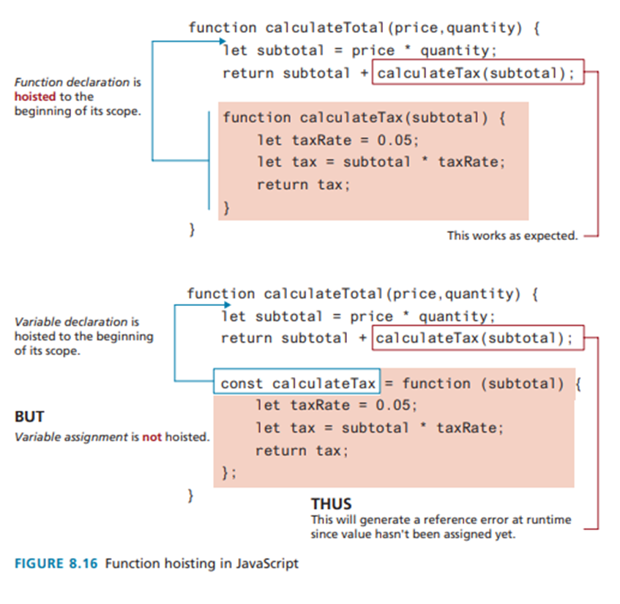
function hoisting

Slide 99
CALLBACK FUNCTION
A callback function is a function passed as an argument into another function, which is then executed inside that outer function to complete an action.

Slide 100
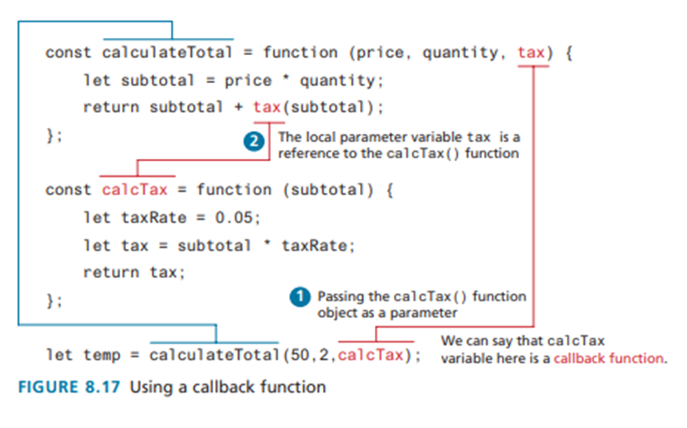
callback function

Slide 101
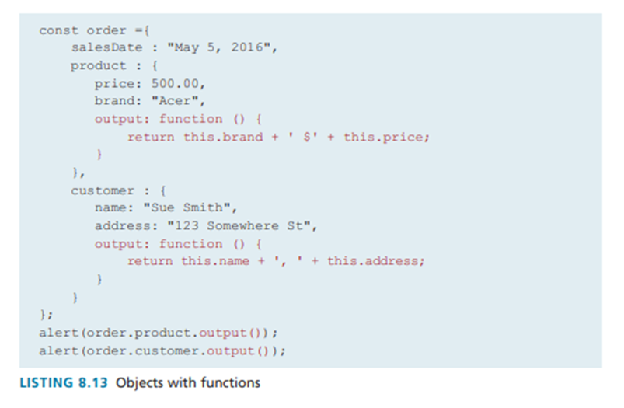
functions

Slide 102
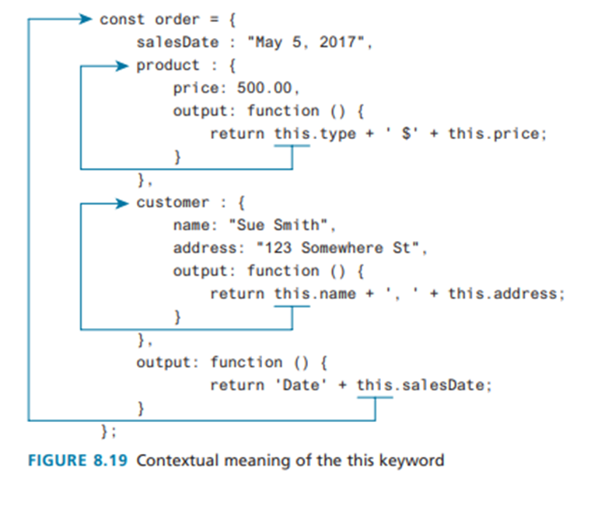
functions

Slide 103
functions
The main problem with the object literal approach lies in situations in which we want numerous instances with the same properties and methods.
One common solution to this problem is to use function constructors, which looks similar to the approach used to create instances of objects in a class-based language

Slide 104
functions
The key difference between using a function constructor and using a regular function resides in the use of the new keyword before the function name

Slide 105
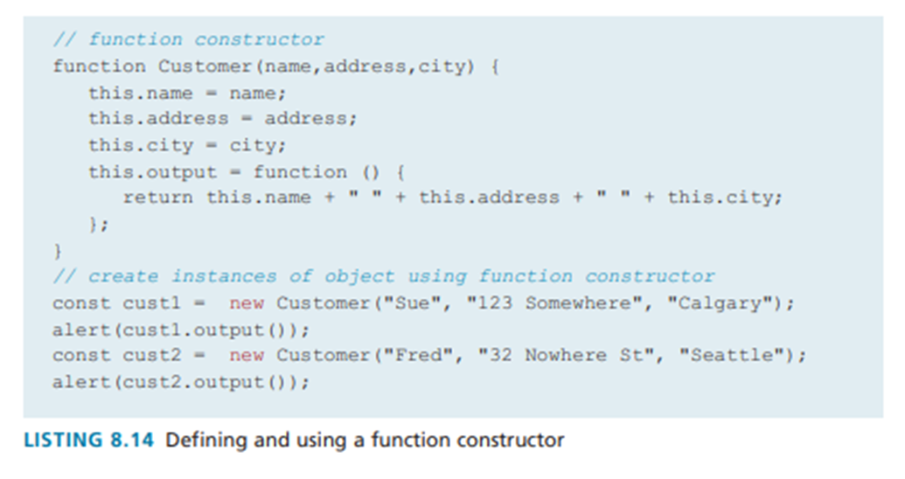
functions

Slide 106
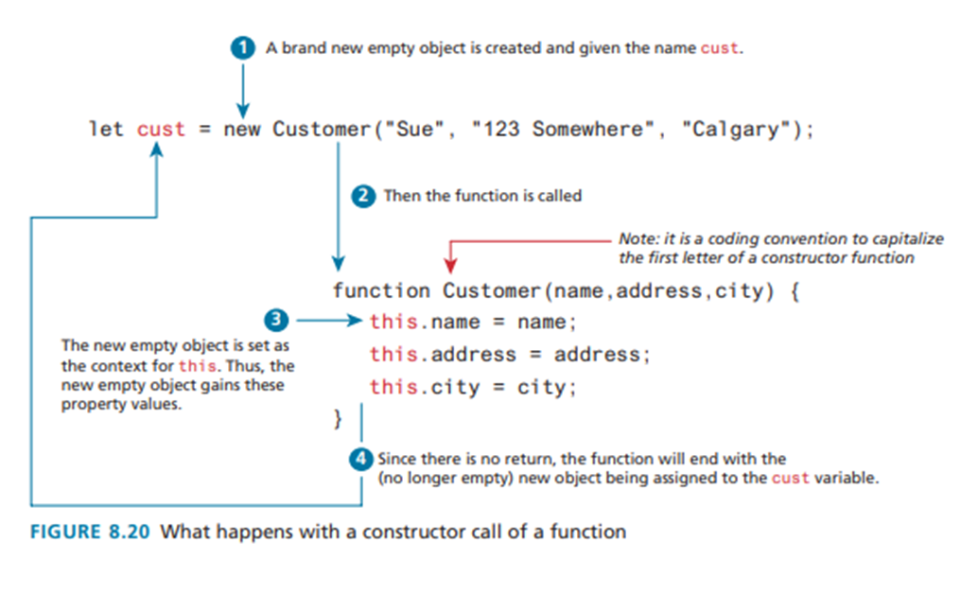
functions

Slide 107
functions
Arrow Syntax
ES6 added a new syntax for declaring functions known as arrow syntax (or simply arrow functions). Arrow syntax provide a more concise syntax for the definition of anonymous functions.
They also provide a solution to a potential scope problem encountered with the this keyword in callback functions.

Slide 108
functions
Arrow Syntax
const taxRate = function () { return 0.05; };
// arrow version
const taxRate = () => 0.05;

Slide 109
functions
const subtotal = function (price, quantity) {
let subtotal = price * quantity;
return subtotal + (subtotal * 0.05);
}
// arrow version
const subtotal = (price, quantity) => {
let subtotal = price * quantity;
return subtotal + (subtotal * 0.05);
}

Slide 110
functions
function calculateTip(subtotal) {
return subtotal * 0.15;
}
// arrow version
const calculateTip = subtotal => subtotal * 0.15;

Slide 111
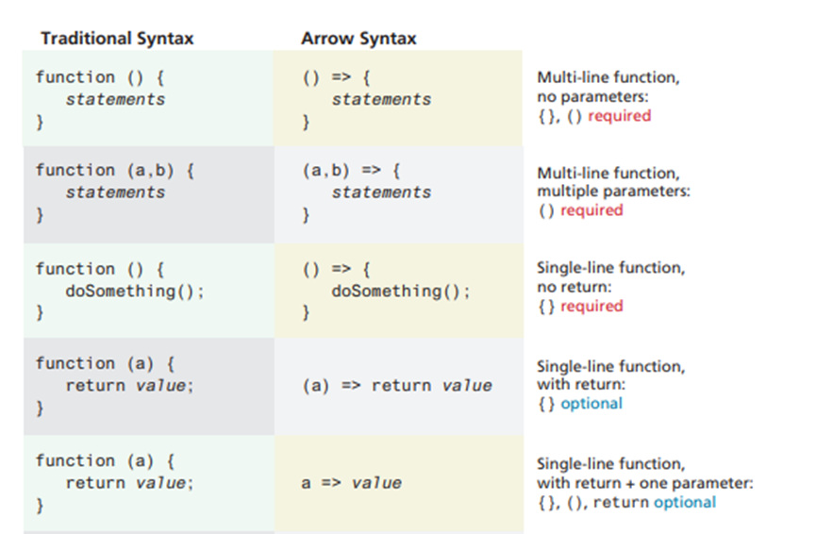
functions

Slide 112
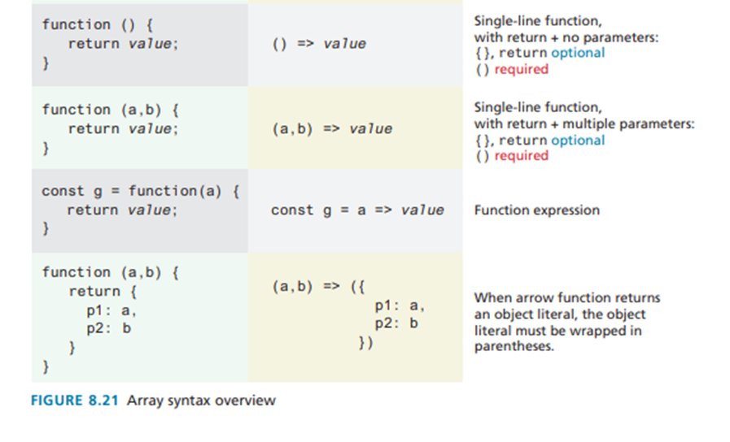
functions

Slide 113
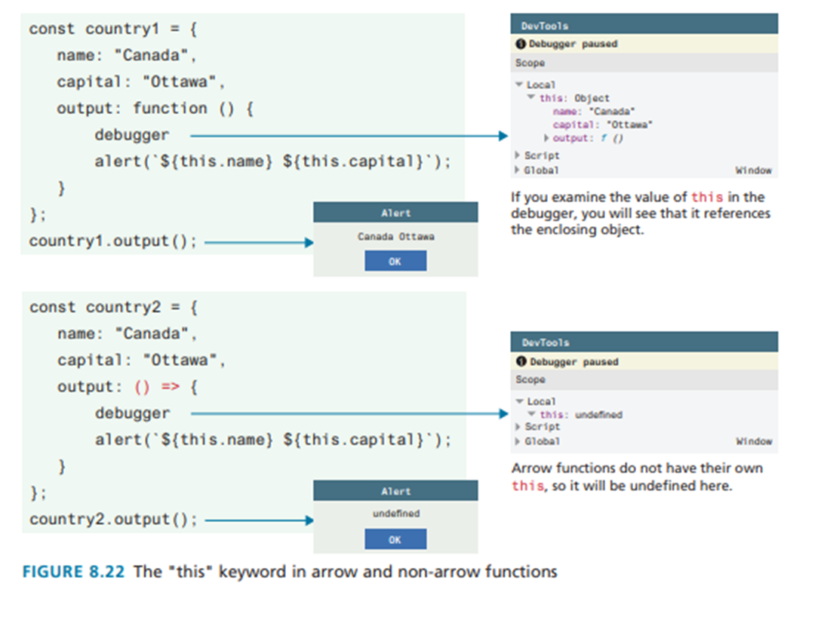
functions

Slide 114
scopes and closures

Slide 115
SCOPE AND CLOSURES
Scope generally refers to the context in which code is being executed.
JavaScript has four scopes: function scope (also called local scope), block scope, module scope, and global scope

Slide 116
SCOPE AND CLOSURES
Since ES6, JavaScript has had block-level scope. That is, in JavaScript, variables defined within an if {} block or a for {} loop block using the let or const keywords are only available within the block in which they are defined.
But if declared with var (or with no keywords) within a block, then it will be available outside the block.

Slide 117
SCOPE AND CLOSURES
If an identifier has global scope, it is available everywhere.
Scope in JavaScript is sometimes referred to as lexical scope because the scope is defined by the placement of identifiers at design (and then compile) time, not at
run-time.

Slide 118
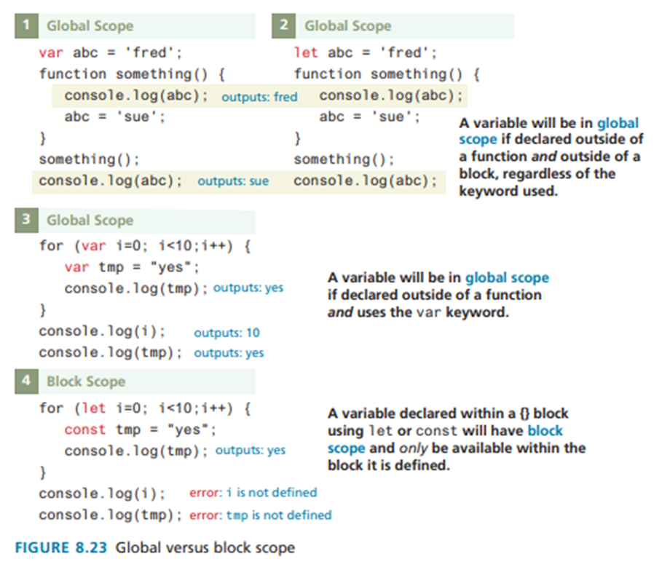
function scope

Slide 119
SCOPE AND CLOSURES
A closure is actually an object consisting of the scope environment in which the function is created; that is, a closure is a function that has an implicitly permanent link between itself and its scope chain.

Slide 120
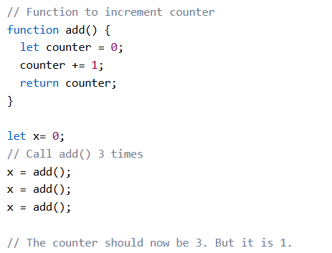
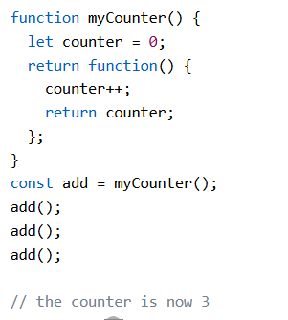
function closure

Slide 121



Thank you

