Slide 1


using javascript

Slide 2


dom

Slide 3


document object model
According to the W3C, the DOM is a
platform- and language-neutral interface that will allow programs and scripts to dynamically access and update the content, structure and style of documents.

Slide 4

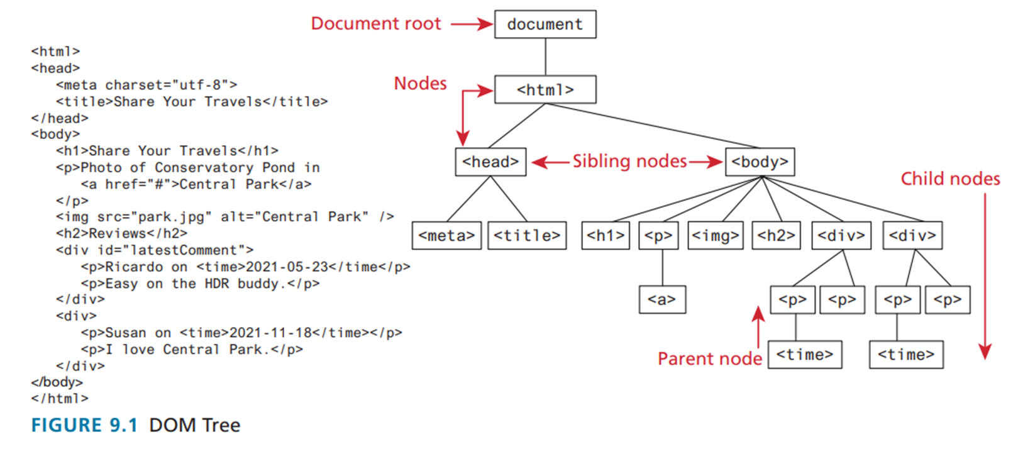
dom tree

Slide 5
dom
In the DOM, each element within the HTML document is called a node
The DOM also defines a specialized object called a NodeList that represents a collection of nodes
The DOM document object is the root JavaScript object representing the entire HTML document.

Slide 6
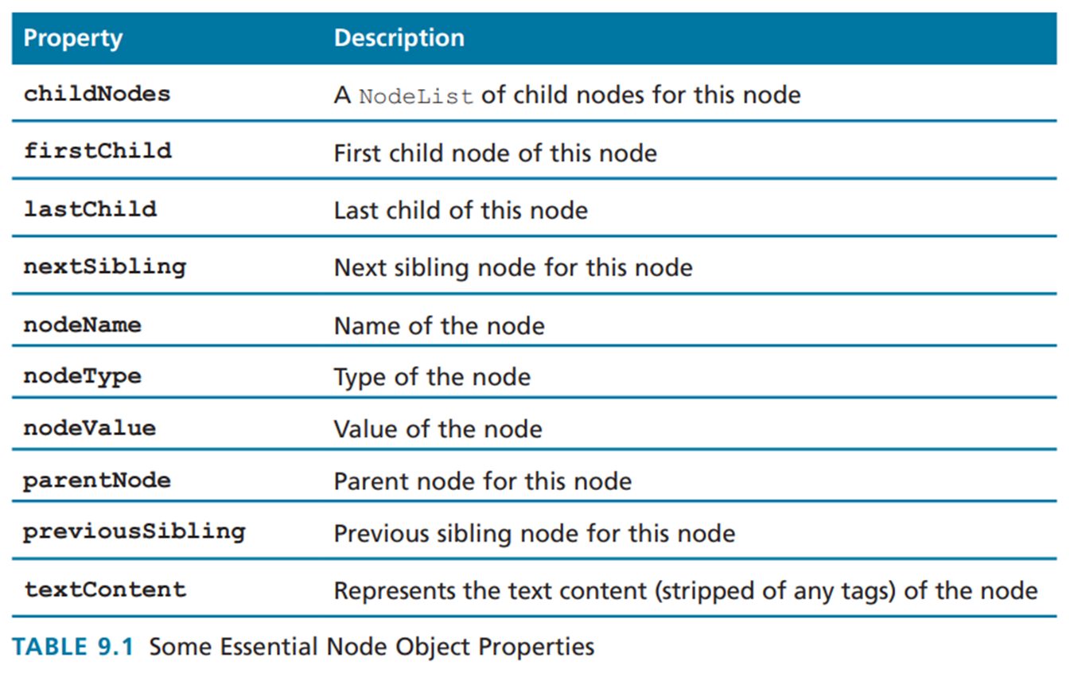
node objects

Slide 7
dom
Accessing properties:
//using dot notation
let a = document.URL;
//using square bracket notation
let b = document["inputEncoding"];

Slide 8
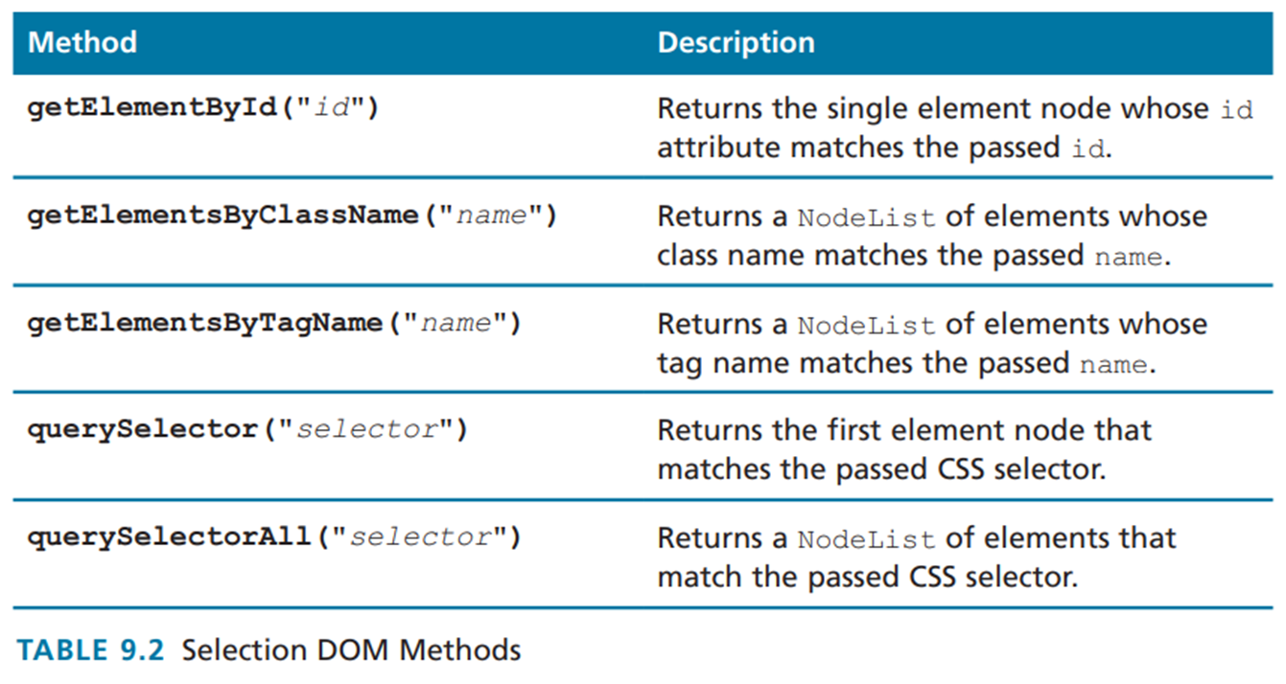
dom selection methods

Slide 9
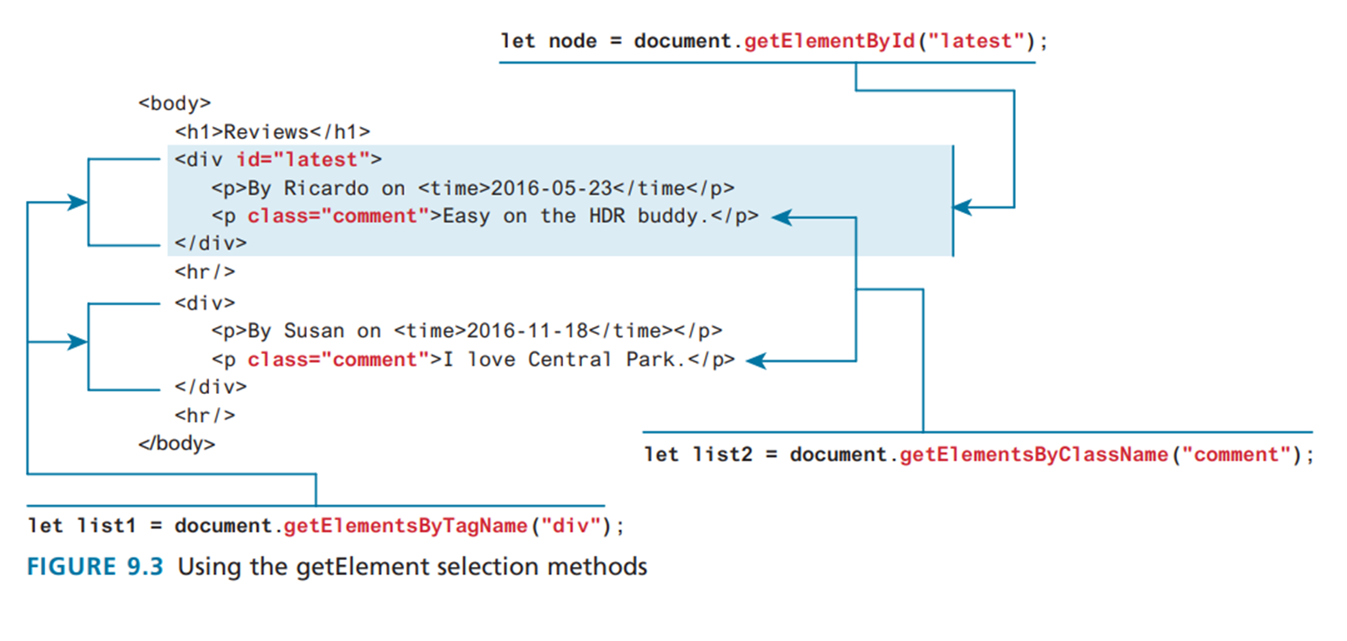
dom selection methods

Slide 10
DOM
Selection methods
The newer querySelector() and querySelectorAll() methods allow you to query for DOM elements much the same way you specify CSS styles and are now universally supported in all modern desktop and mobile browsers

Slide 11
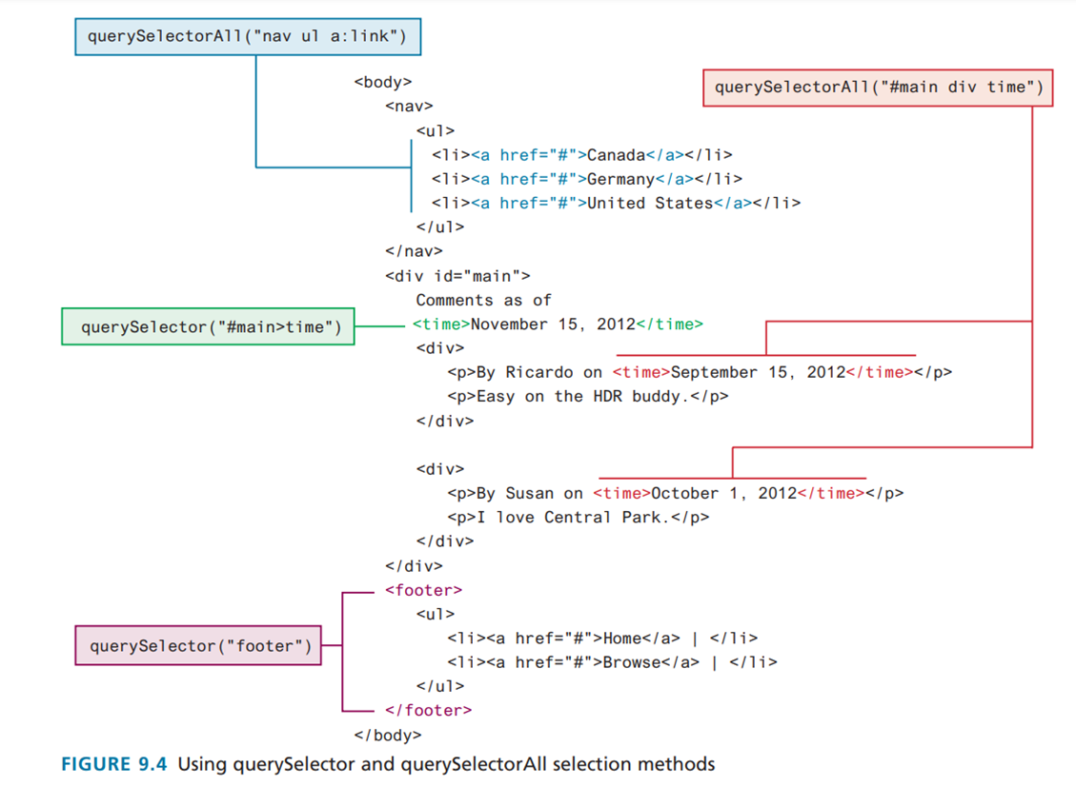
dom selection methods

Slide 12
DOM
The type of object returned by the methods getElementById() and querySelector() is an Element Node object.
This represents an HTML element in the hierarchy, contained between the opening <> and closing </> tags for this element.

Slide 13
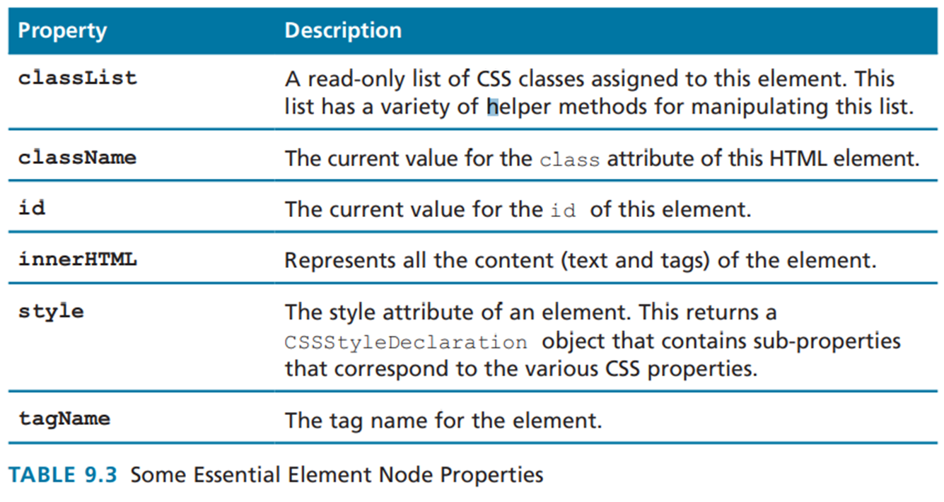
dom selection methods

Slide 14
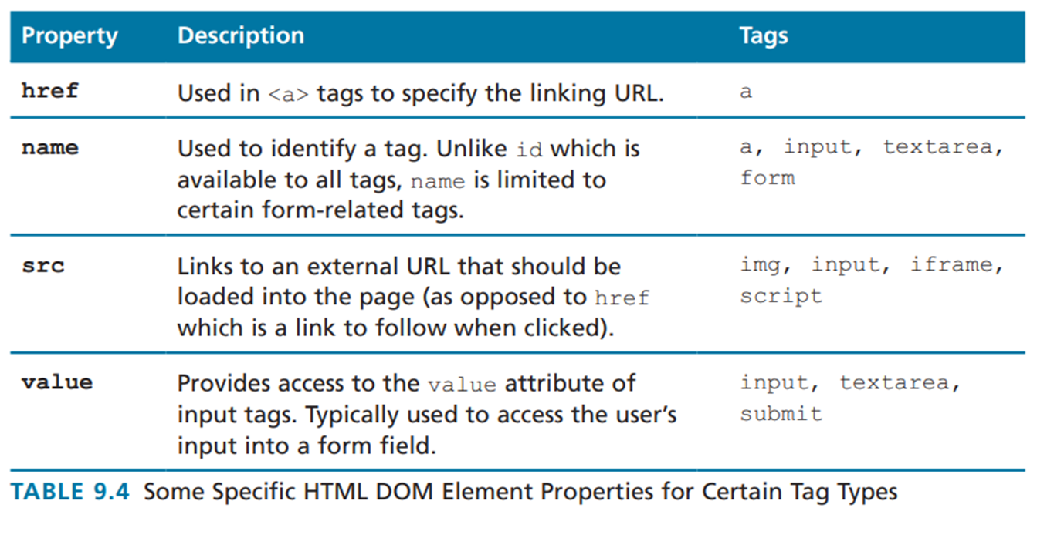
dom selection methods

Slide 15
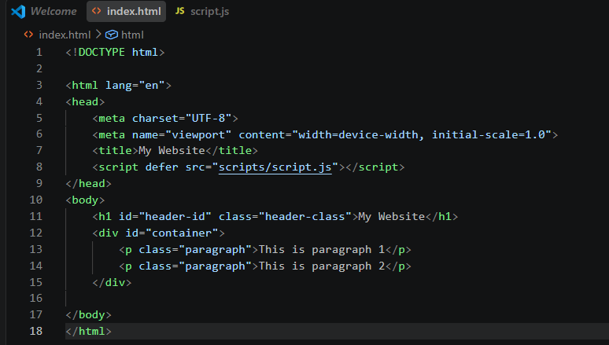
dom selection methods

Slide 16
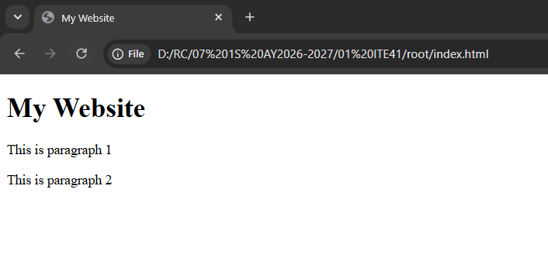
dom selection methods

Slide 17
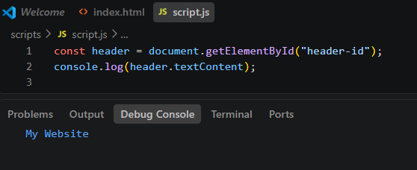
dom selection methods

Slide 18
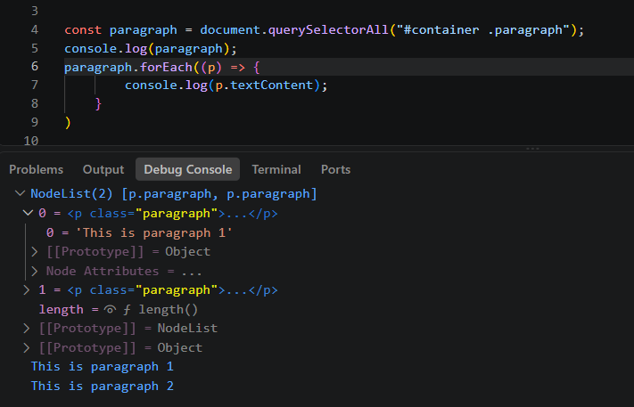
dom selection methods

Slide 19
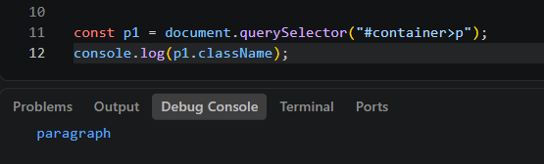
dom selection methods

Slide 20
modifying the dom
Changing and Element’s style
const node = document.getElementById("someId");
node.style.backgroundColor = "#FFFF00";
node.style.borderWidth = "3px";
A common use of the classList property is to toggle the use of a class. For instance, we might want an element to not be visible until some user action triggers its visibility, which can be done simply using the toggle() function.
node.classList.toggle("hide");

Slide 21
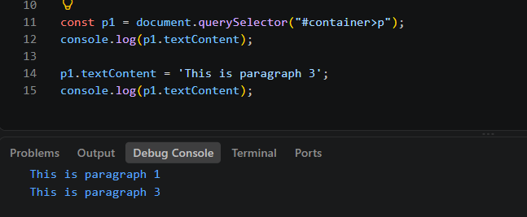
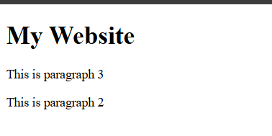
modifying the dom

Slide 22
modifying the dom
You can programmatically access the content of an element node through its innerHTML or textContent property
Using innerHTML is discouraged because it is potentially vulnerable to Cross-Site Scripting (XSS) attacks, in which user generated input containing malicious JavaScript is output using innerHTML

Slide 23
modifying the dom
In practice, when you need to change the inner text of an element, it is preferable to use the textContent property instead of innerHTML since any markup is stripped from it

Slide 24
modifying the dom

Slide 25
modifying the dom
DOM Manipulation Methods
Each node in the DOM has a variety of “family relations” properties and methods for navigating between elements and for adding or removing elements from the document hierarchy.

Slide 26
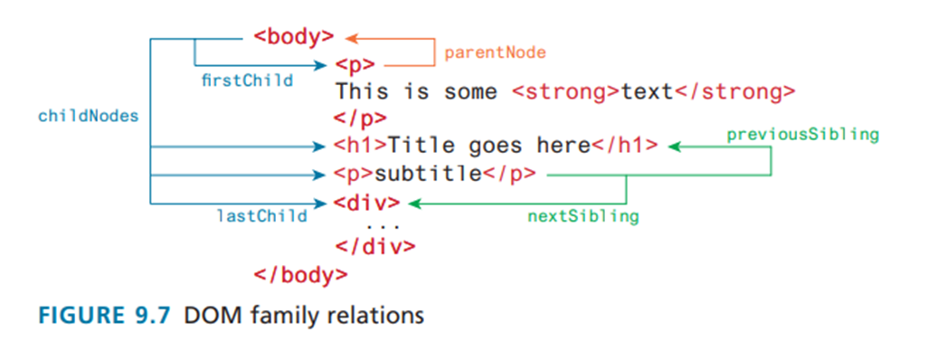
modifying the dom

Slide 27
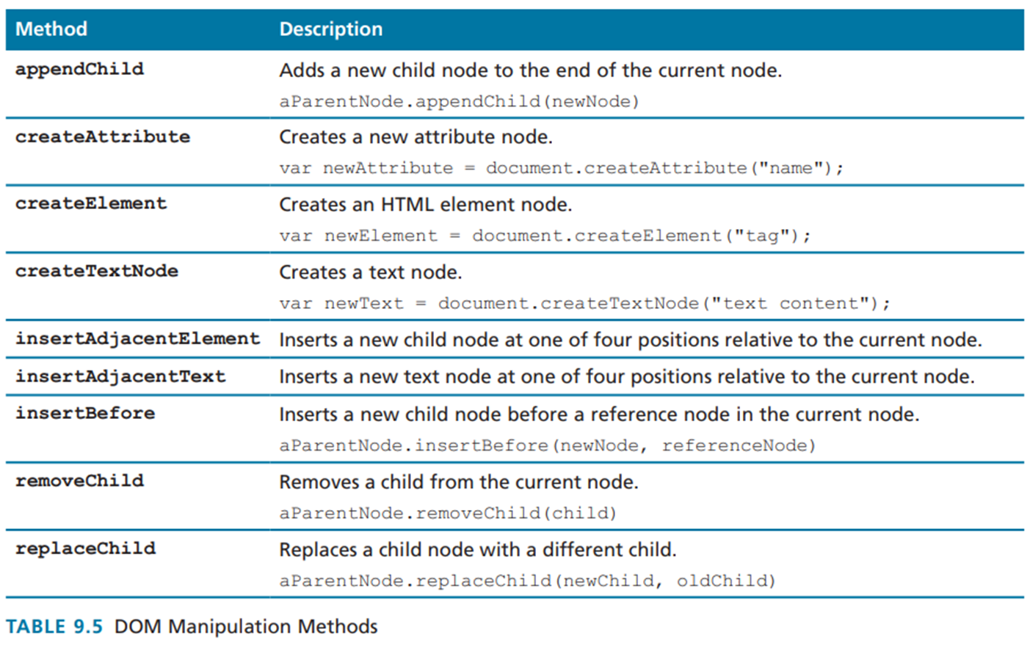
modifying the dom

Slide 28
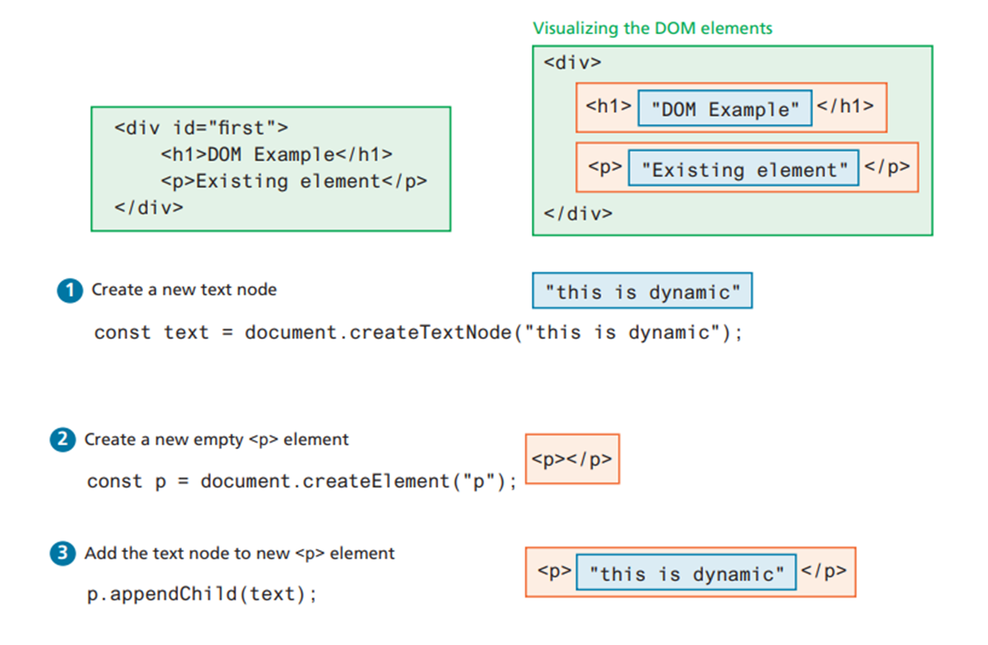
modifying the dom

Slide 29
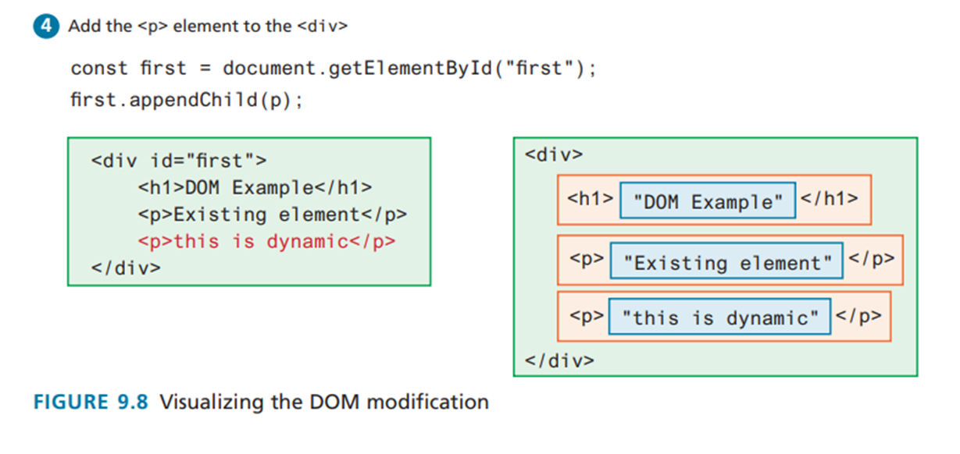
modifying the dom

Slide 30
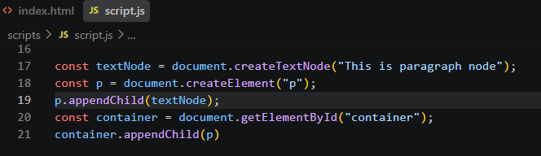
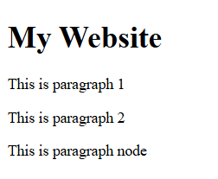
modifying the dom

Slide 31
modifying the dom
DOM Timing
You cannot access or modify the DOM until it has been loaded.
The DOM programming is written after the markup that is to be manipulated.
This should ensure that the elements exist in the DOM before the code executes.

Slide 32
events

Slide 33
javascript events
In JavaScript, an event is an action or occurrence that happens in the browser, which the browser can detect and respond to. These occurrences are usually triggered either by the user (like clicking a button) or by the browser itself (like a webpage finishing its loading process).

Slide 34
javascript events
Defining an event handler is simply creating a callback function
Registering an event handler requires passing a callback function to the addEventListener() method of a single node object.
The event is triggered by some user action
The handler executes the function

Slide 35
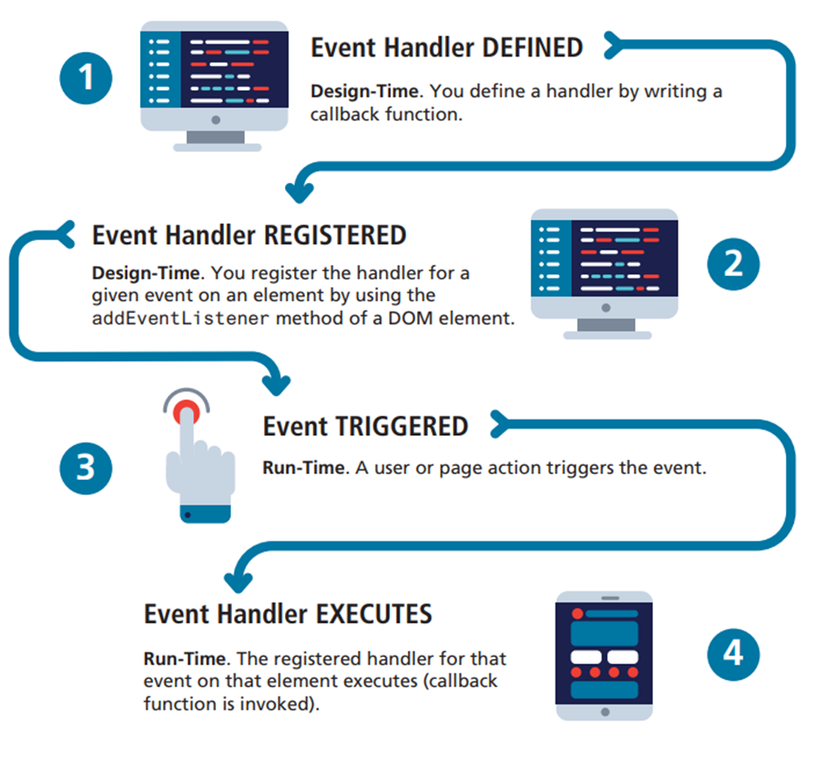
javascript events

Slide 36
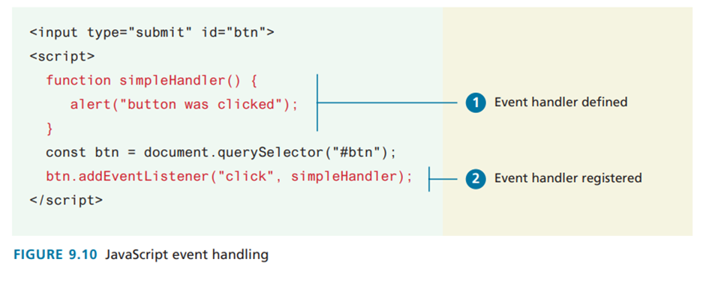
javascript events

Slide 37
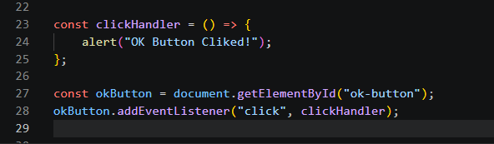
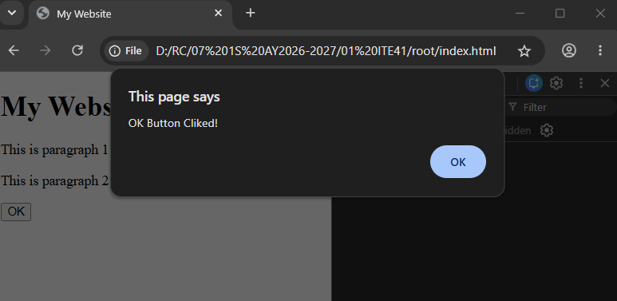
javascript events

Slide 38
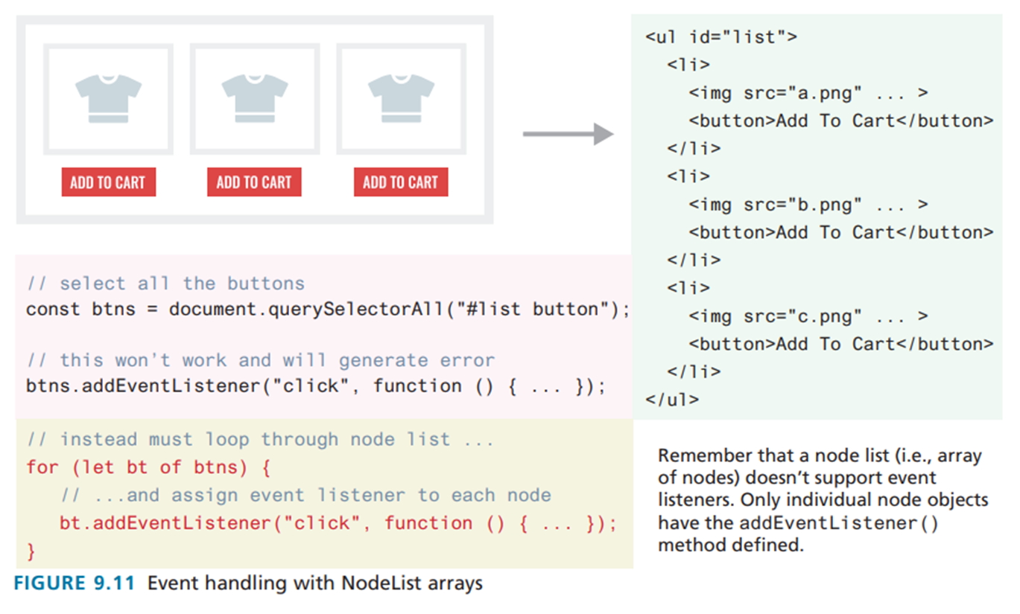
javascript events

Slide 39
javascript events
Page Loading and the DOM
A problem can occur if your JavaScript tries to programmatically reference a DOM element that has not yet been loaded.
That is, if your code attempts to set up a listener on a not-yet-loaded element then an error will be triggered.

Slide 40
javascript events
Page Loading and the DOM
window.load. Fires when the entire page is loaded. This includes images and stylesheets, so on a slow connection or a page with a lot of images, the load event can take a long time to fire.
document.DOMContentLoaded. Fires when the HTML document has been completely downloaded and parsed.

Slide 41
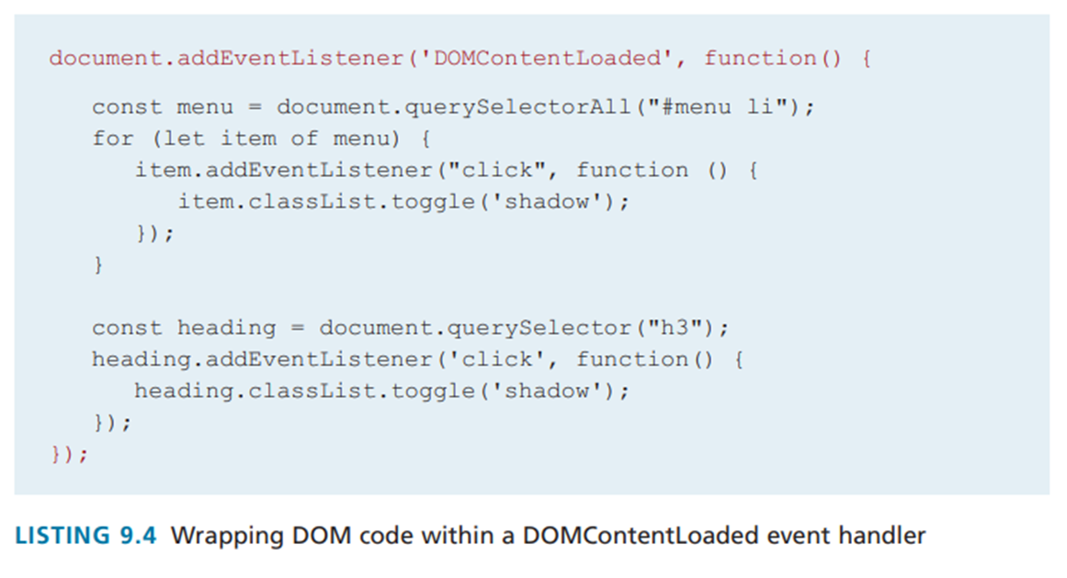
javascript events

Slide 42
javascript events
Event Object
When an event is triggered, the browser will construct an event object that contains information about the event. Your handler won’t always need this information, but it sometimes will be absolutely essential.

Slide 43
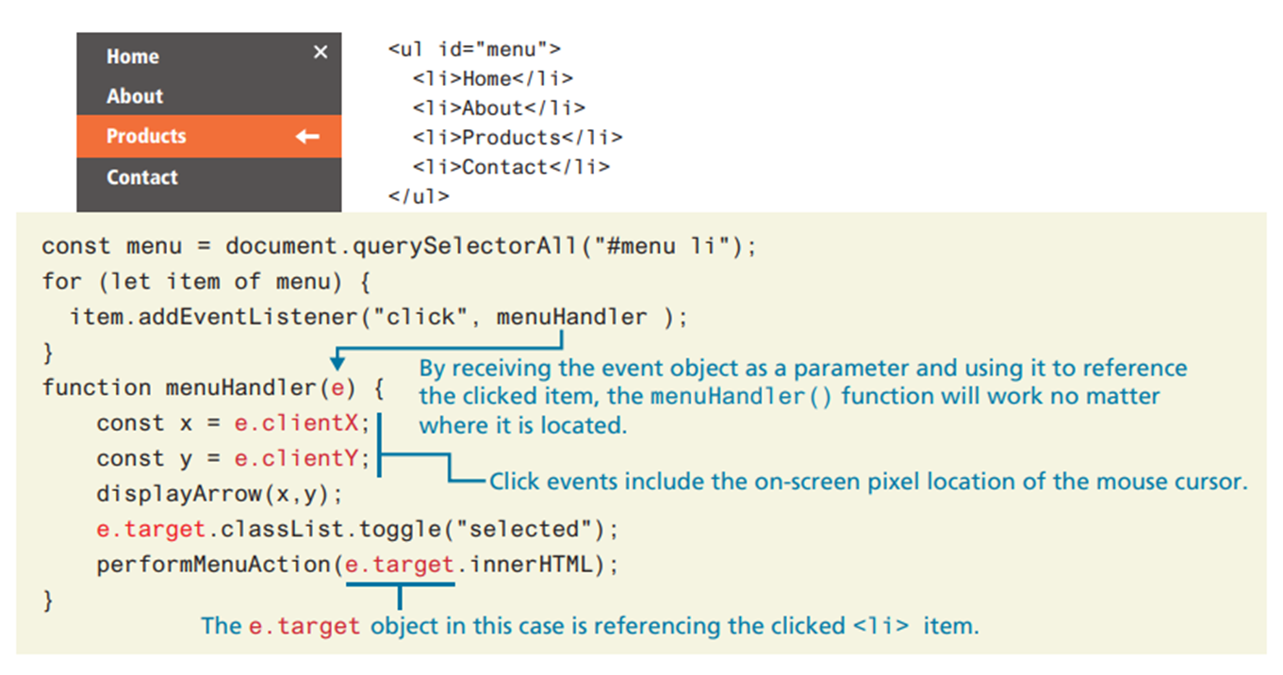
javascript events

Slide 44
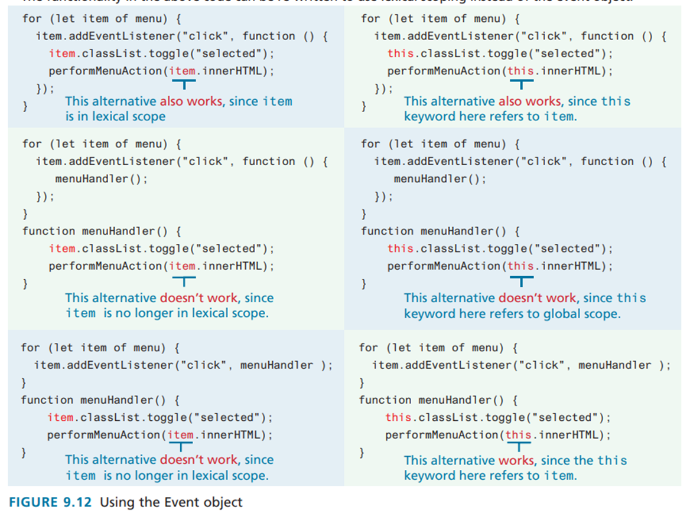
javascript events

Slide 45
javascript events
Event Propagation
Event propagation is when an event fires on an element that has ancestor elements, the event propagates to those ancestors. There are two distinct approaches
or phases of propagation: there is a capture phase and a bubbling phase.

Slide 46
javascript events
Event Propagation
In the event capturing phase, the browser checks the outermost ancestor (the <html> element) to see if that element has an event handler registered for the triggered event, and if so, it is executed.
It then proceeds to the next ancestor and performs the same steps; this continues until it reaches the element that triggered the event (that is, the event target).

Slide 47
javascript events
Event Propagation
In the event bubbling phase, the opposite occurs. The browser checks if the element that triggered the event has an event handler registered for that event, and
if so, it is executed. It then proceeds outwards until it reaches the outermost ancestor

Slide 48
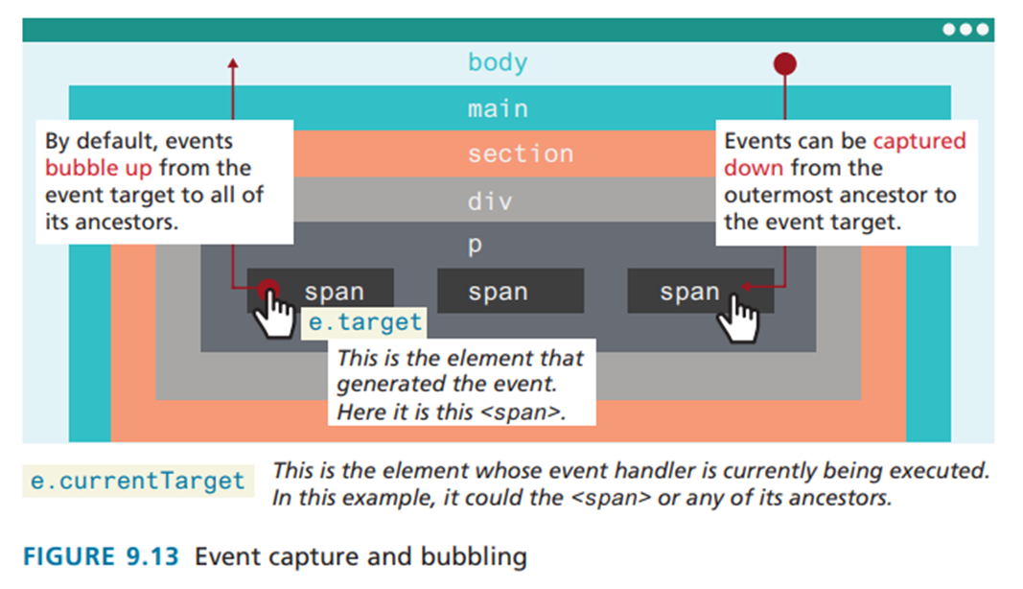
javascript events

Slide 49
javascript events
Occasionally, the bubbling of events can cause problems. You might want to do something special when an inner element is clicked, and do something else when an outer element is clicked.

Slide 50
javascript events
The problem here is event propagation. When the user clicks on the increment count button, the click handler for the increment will trigger first. Unfortunately, because of event bubbling, it will then trigger the click event for the
, which will remove the item from the cart as if the user had clicked on the remove button. The event will then bubble up to the next ancestor (the element and call its click handler, which will minimize the cart altogether.

Slide 51
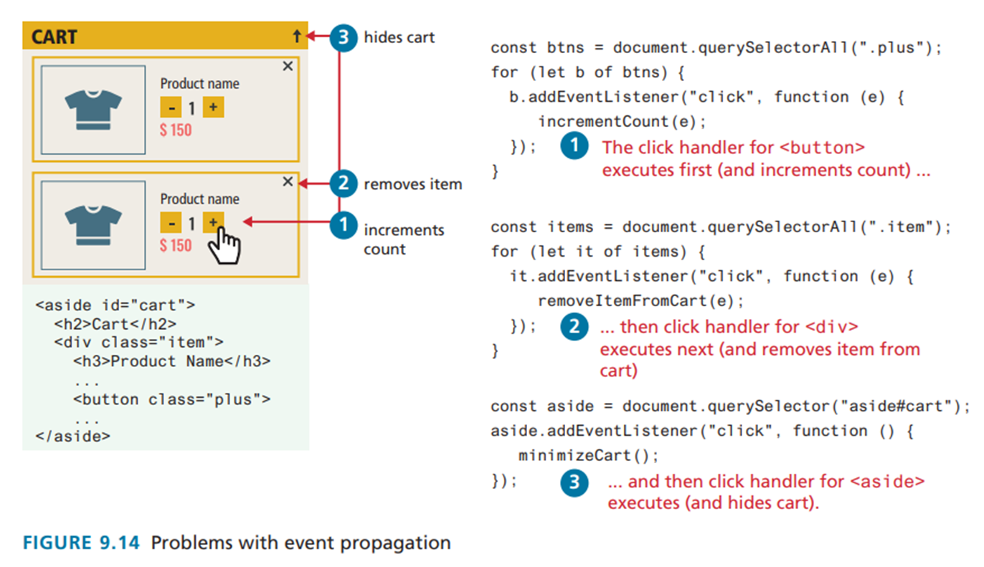
javascript events

Slide 52
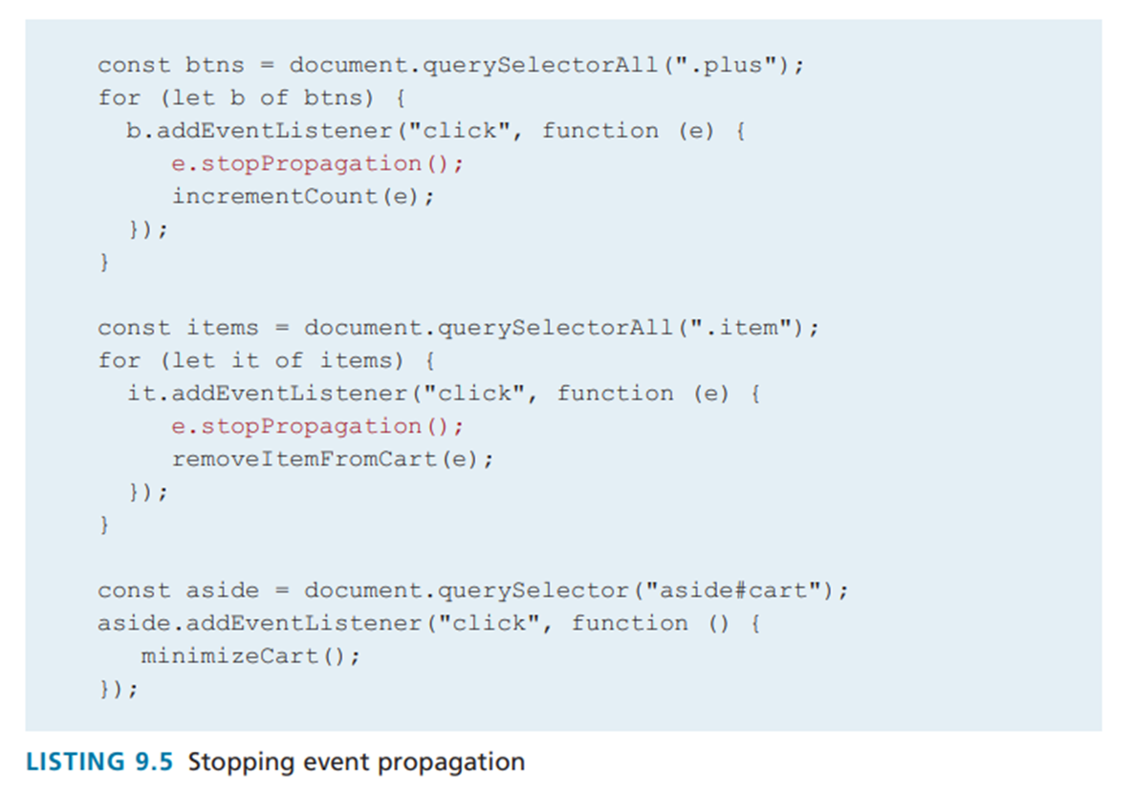
javascript events

Slide 53
javascript events
Event Delegation
Event delegation is a technique commonly used to avoid assigning numerous duplicate event listeners to a list
of child events.

Slide 54
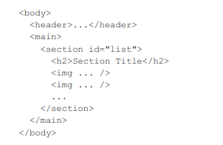
javascript events
Suppose we have numerous image thumbnails within a parent element

Slide 55

javascript events
Now what if you wanted to do something special when the user clicks the mouse on an (for instance, change the styling of the image, or display its caption on top of the image).

Slide 56
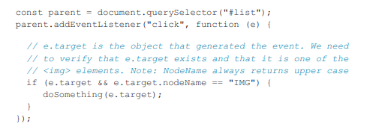
javascript events
While this code is straightforward, it would be exceedingly memory inefficient if there were many images on the page

Slide 57

javascript events
The JavaScript dataset property provides read and write access to custom data attributes (data-*) defined on HTML elements, bridging HTML markup and JavaScript logic cleanly.
In HTML, custom attributes start with data-:

Slide 58
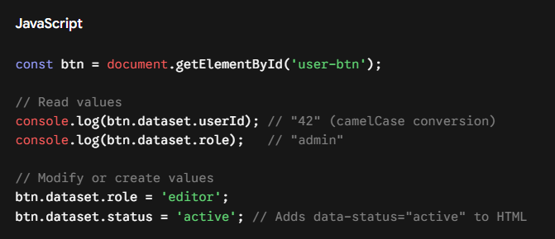
javascript events
In JavaScript, element.dataset accesses those attributes as an object map:

Slide 59
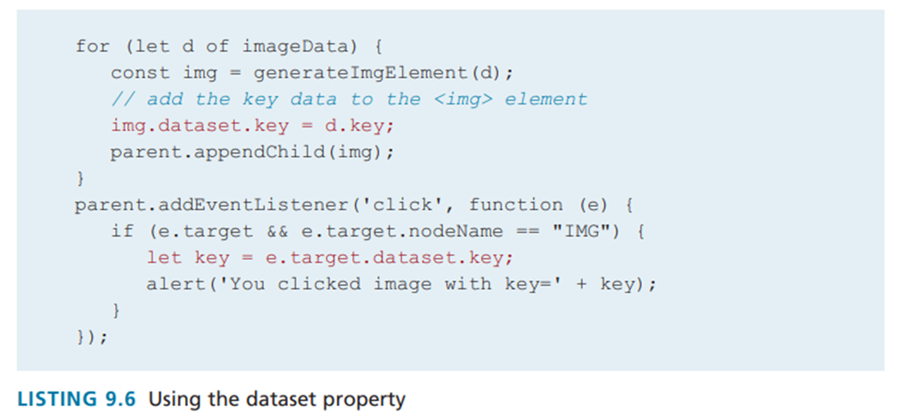
javascript events

Slide 60
event types

Slide 61
javascript event types
Mouse events are defined to capture a range of interactions driven by the mouse. These can be further categorized as mouse click and mouse move events

Slide 62
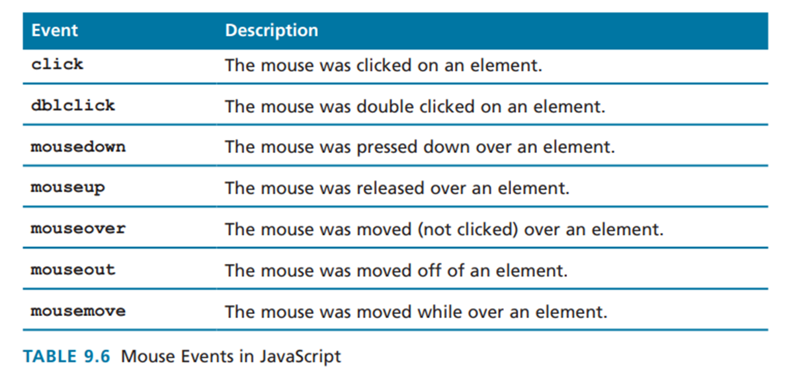
mouse events

Slide 63
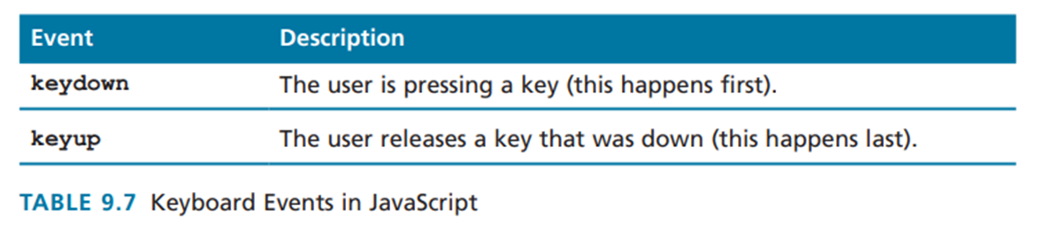
javascript event types
Keyboard events are most useful within input fields

Slide 64
javascript event types
Forms are the main means by which user input is collected and transmitted to the Server. Events triggered by forms are form events.

Slide 65
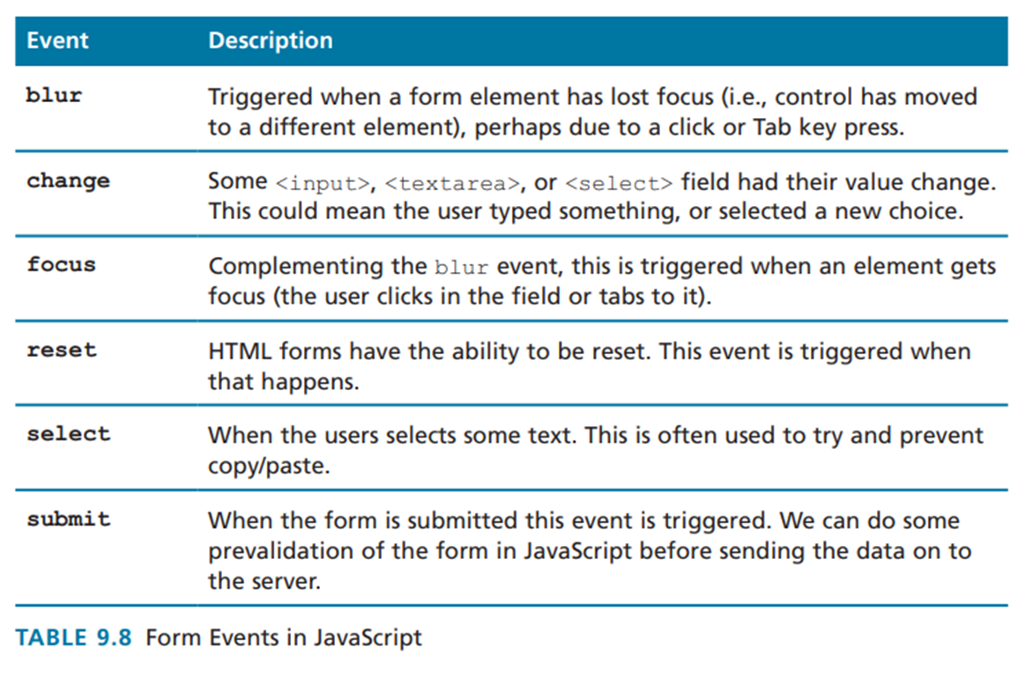
form events

Slide 66
javascript event types
Media events are those connected to the <audio> and <video> elements

Slide 67
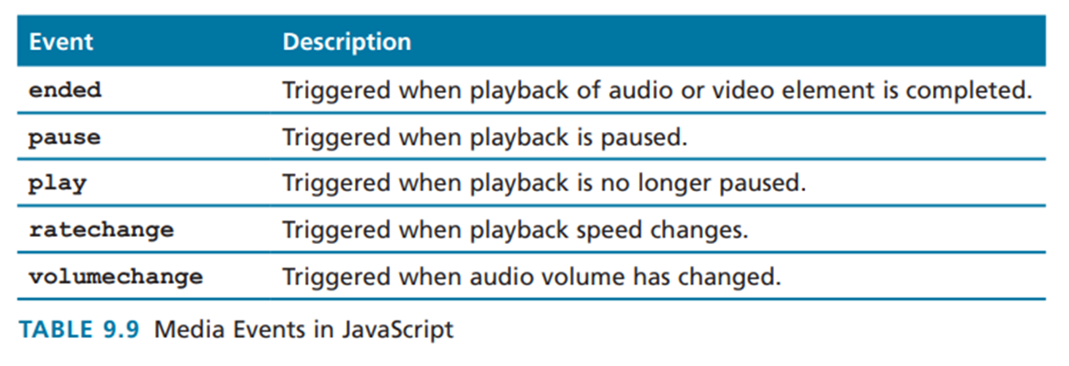
media events

Slide 68
javascript event types
Frame events are the events related to the browser frame that contains your web page.

Slide 69
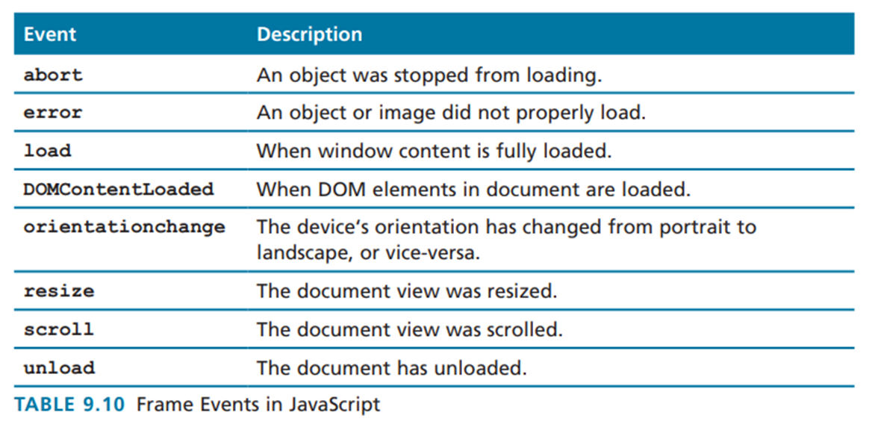
frame events

Slide 70
forms in javascript

Slide 71
forms in javascript
When working with forms in JavaScript, we are typically interested in three types of events: movement between elements, data being changed within a form element, and the final submission of the form

Slide 72
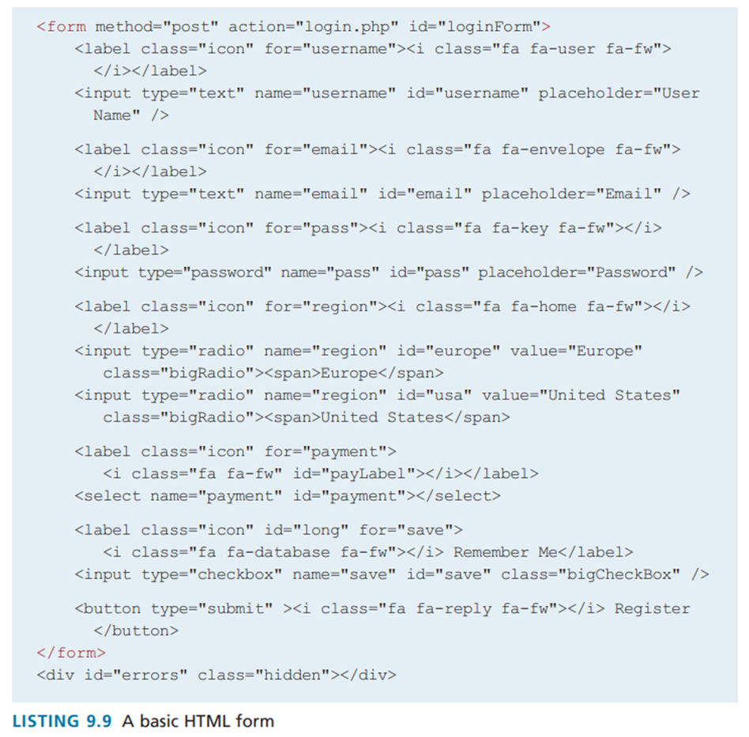
forms in javascript

Slide 73
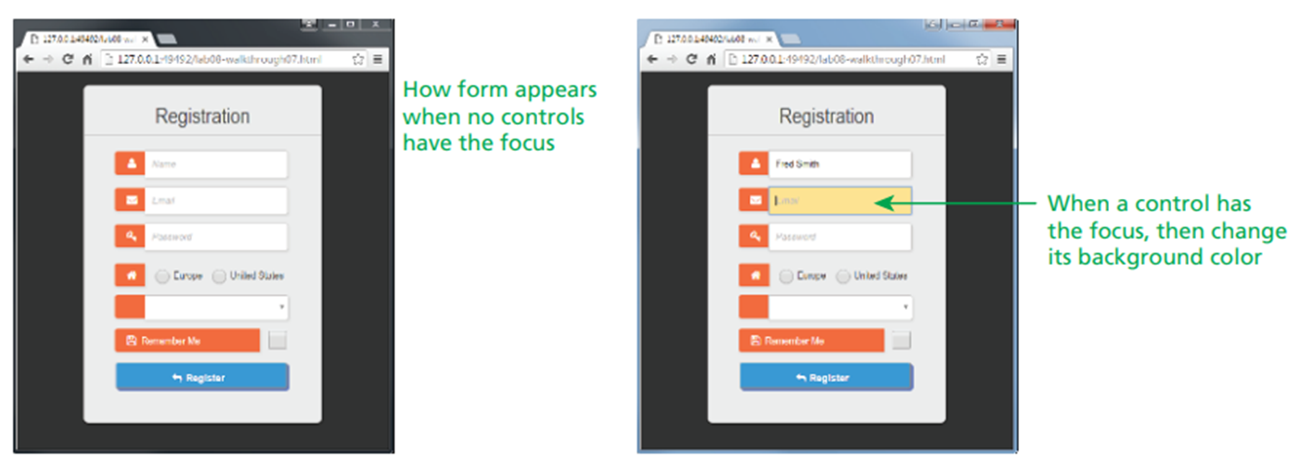
forms in javascript

Slide 74
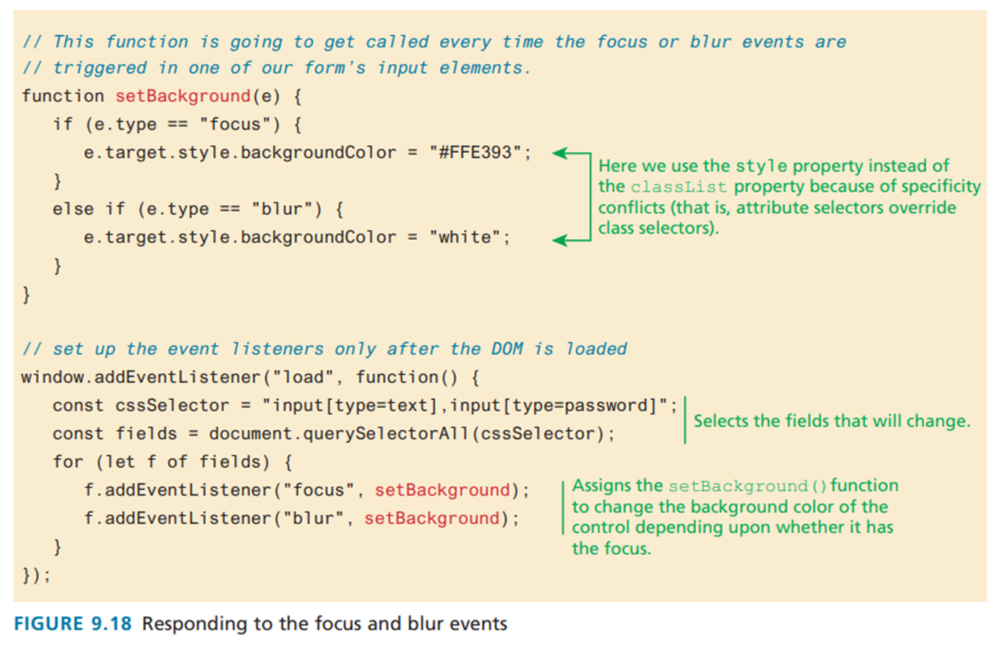
forms in javascript

Slide 75
forms in javascript
Responding to Form Movement Events
The blur and focus events trigger whenever a form control loses the focus (e.g., the user can no longer change its content or trigger the control) or gains the focus (the user can change its content or trigger the control). One typical use of these events is to dynamically change the appearance of the control that has the focus.

Slide 76
forms in javascript
Validating a Submitted Form
Form validation continues to be one of the most common applications of JavaScript. Checking user inputs to ensure that they follow expected rules must happen on the server side for security reasons (in case JavaScript was circumvented); checking those same inputs on the client side using JavaScript will reduce server load and increase the perceived speed and responsiveness of the form.

Slide 77
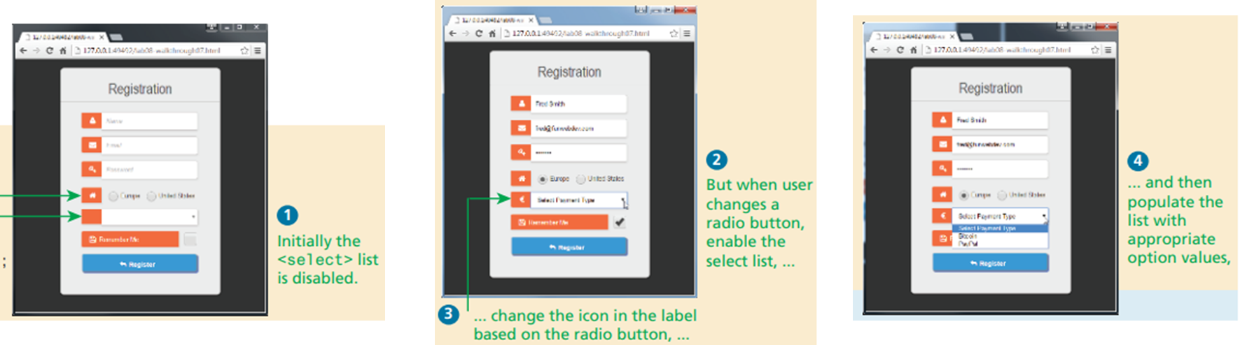
forms in javascript

Slide 78
forms in javascript
Empty Field Validation
A common application of a client-side validation is to make sure the user entered something into a field (or selected a value).

Slide 79
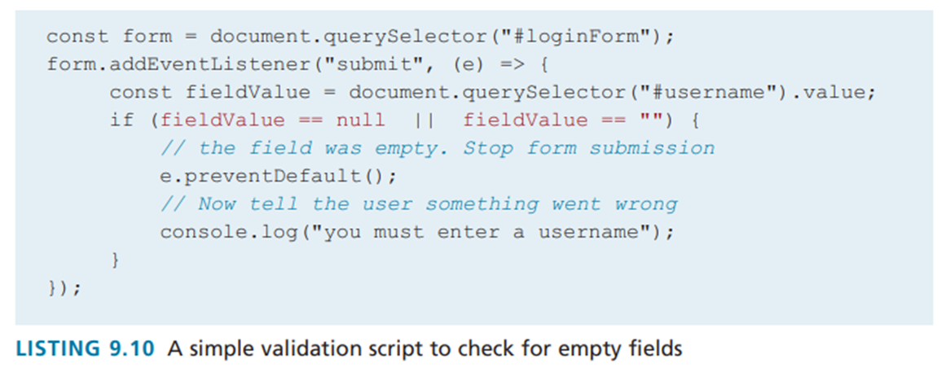
forms in javascript

Slide 80
forms in javascript
Empty Field Validation
To ensure that a checkbox or button is ticked or selected, you will have to examine its checked property

Slide 81
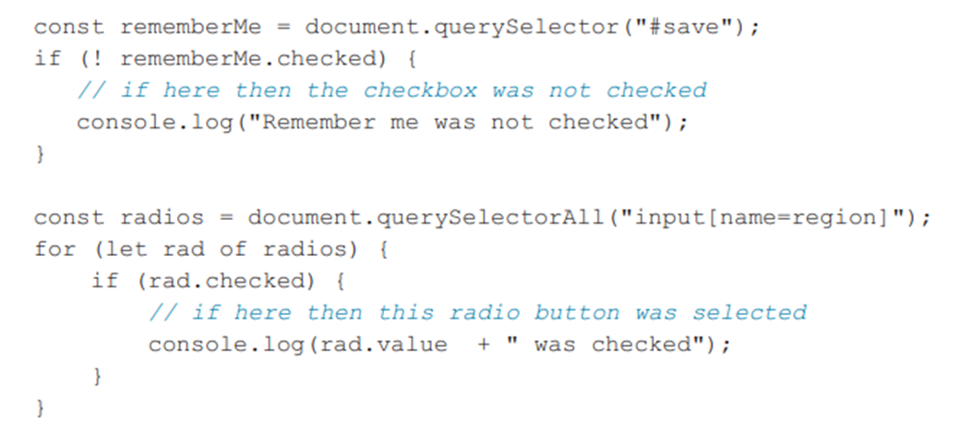
forms in javascript

Slide 82
forms in javascript
Empty Field Validation
For <select> lists, there are different ways to check if an item in the list has been selected. If the list is in the default state (i.e., it contains no <option> elements),
then its selectedIndex property will be -1. However, if there are <option> elements and one hasn't yet been selected by the user, then the selectedIndex property will have a value of 0

Slide 83
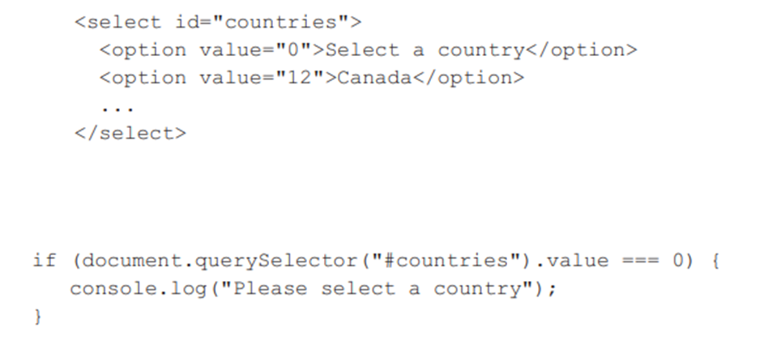
forms in javascript

Slide 84
forms in javascript
Number Validation
Using parseInt(), isNAN(), and isFinite(), you can write your own number validation function

Slide 85
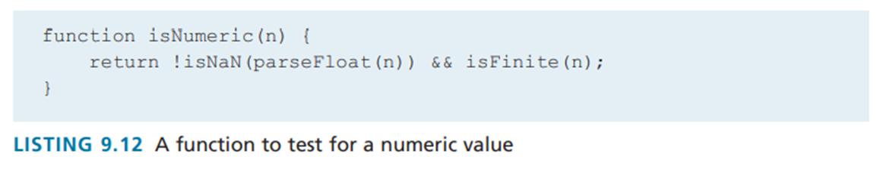
forms in javascript

Slide 86
forms in javascript
Submitting Forms
Submitting a form using JavaScript requires having a node variable for the form element

Slide 87
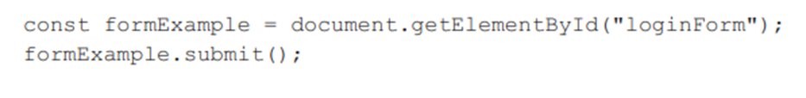
forms in javascript

Slide 88
regex

Slide 89
regular expressions
A regular expression is a set of special characters that define a pattern. They are intended for the matching and manipulation of text.
In web development they are commonly used to test whether a user’s input matches a predictable sequence of characters, such as those in a phone number, postal or zip code, or email address

Slide 90
regular expressions
Regular expressions are a concise way to eliminate the conditional logic that would be necessary to ensure that input data follows a specific format.
A regular expression consists of two types of characters: literals and metacharacters. A literal is just a character you wish to match in the target (i.e., the text that you are searching within). A metacharacter is a special symbol that acts as a command to the regular expression parser

Slide 91
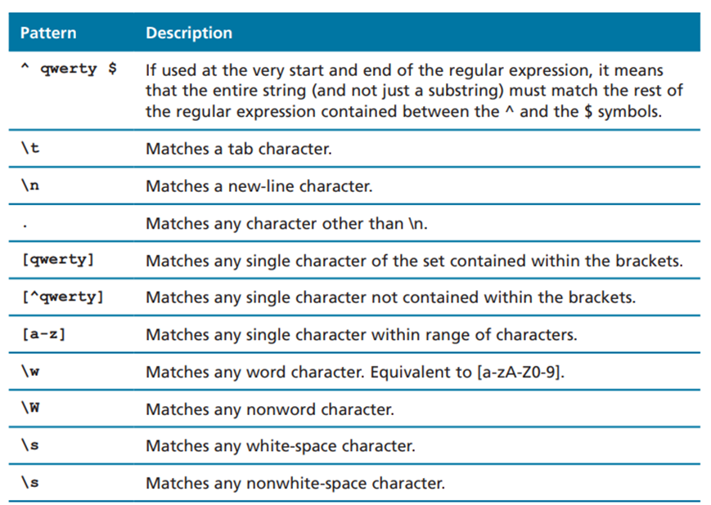
regex

Slide 92


regex

Slide 93
regular expressions
let pattern = /ran/;
let content = 'Sue ran to the store';
if (pattern.test(content))
console.log("Match found");

Slide 94

regex

Slide 95

regex

Slide 96



Thank you

