Slide 1
RSVP: Ready to Meet Up?
Camille Bustalinio

Slide 2
Objective:
Where are the Data Science Meetups?
How’s the Data Science Meetup interest in San Francisco?
When, Where, Who?

Slide 3
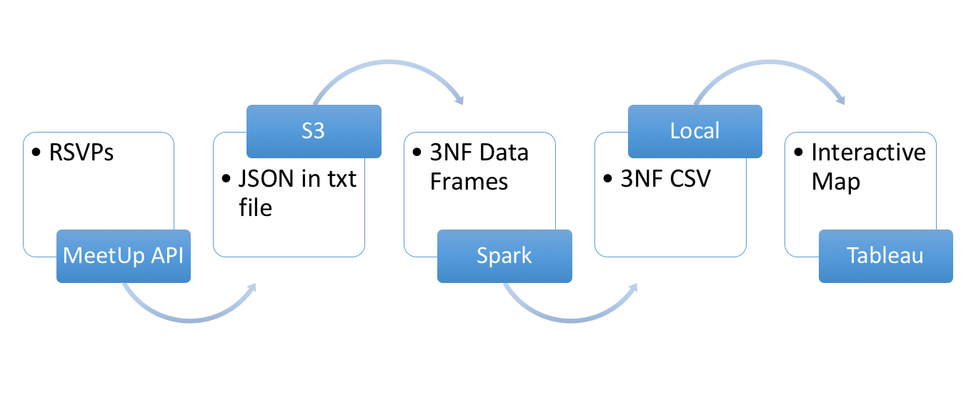
Pipeline
Kinesis

Slide 4
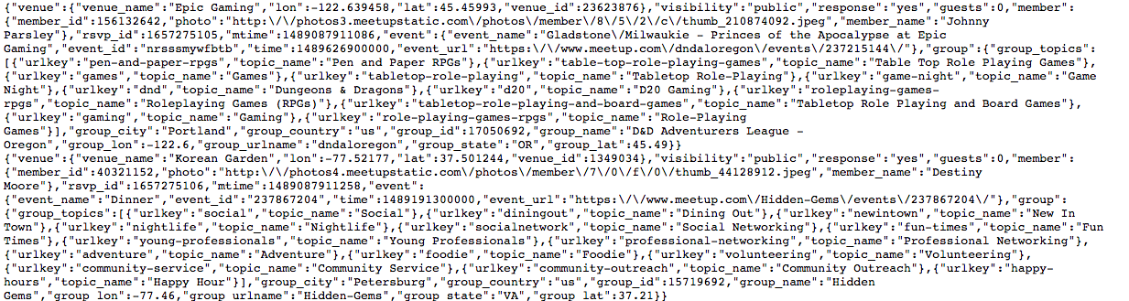
Data In: Meetup RSVP
http://stream.meetup.com/2/rsvps

Slide 5
Front End: Tableau
https://public.tableau.com/profile/camille.bustalinio#!/vizhome/DataScienceMeetUpsinSanFrancisco/DataScienceEventsperCity
Advantage:
Interactive visualization
Ability to download actual data points
Querying through Normal Tables

Slide 6
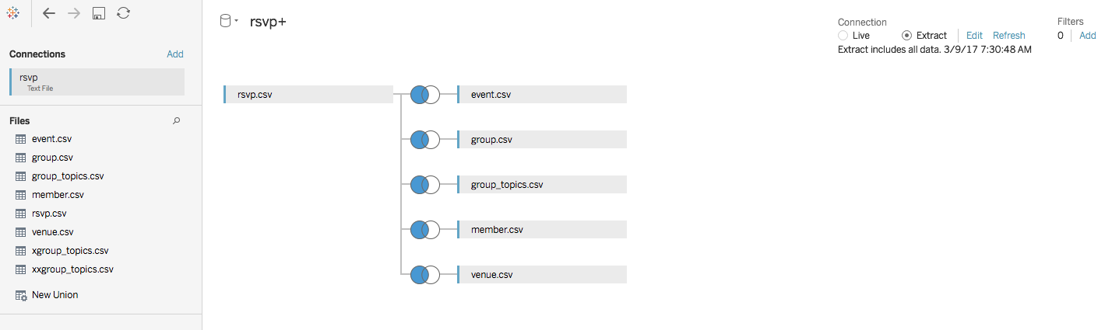

Slide 7
Challenges
EC2 disconnect, missing data during downtime
Extracting Group Topics
List, not dictionary
Used 2 RDDS
No RSVP Timestamp
Tableau Connection
Amazon EMR & Spark SQL possible but couldn’t
Back up: Connect CSV files
Static, needs to rerun to update data
15M data rows limit

