Slide 1
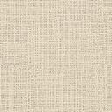
Detail level &
Visual style
Reveal Hidden Element
Hide analyze model
Lock 3D view
Reveal Contraints
Render
Current View Scale
Sun path & Shadow
Crop View & Crop Region
Temporary Hide/
Isolate
Highlight Displacement Sets
Temporary view Properties

