Slide 1
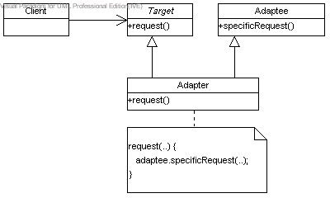
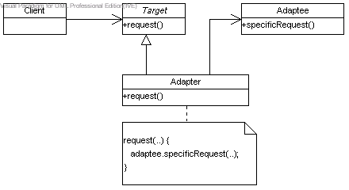
Class Adapter
Object Adapter

Slide 2
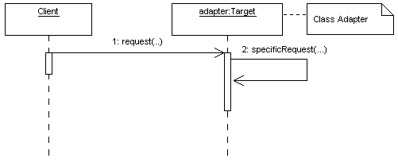
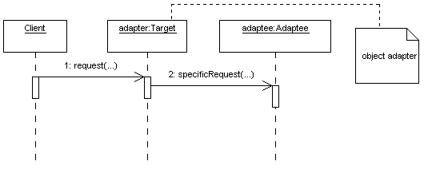
Class Adapter
Object Adapter

Slide 3
Calling Class Adapter
Main() {
Target adapter = new Adapter(…);
adapter.request()
}

Slide 4
Calling Object Adapter
Main() {
Adaptee adaptee = new Adaptee(…)
Target adapter = new Adapter(adaptee);
adapter.request()
}

