Slide 1
Introduction to JavaScript Programming

Slide 2
Outlines
Data Types
Type Conversion and Casting
Variables
Arrays
Expression
Operators
Control Flow
Selection Statements
Repetition Statements
Function

Slide 3
Data Types
In JavaScript, it combine those primitive data type into 3 general types of data:
Number
Used to store any type of number data, including integer (e.g. 10) and decimal (e.g. 12.34)
Used for calculation
price = 18.5;
String
Used to store any text information
Inside single quote (‘) or double quote (“)
var cname = “HD in CSA”;
var msg = ‘“No food!” said the guaid.’;
Boolean
Used to store true or false
foundFlag = true;

Slide 4
Type Conversion and Casting
Converting to a String
toString() method
Boolean – outputs the string “true” or “false”
var foundFlag = false;
alert(foundFlag.toString()); // outputs “false”
Number – outputs the numeric value in an appropriate string
var num1 = 20;
var num2 = 30.0;
alert(num1.toString()); // outputs “20”
alert(num2.toString()); // outputs “30”

Slide 5
Type Conversion and Casting
Converting to a Number
parseInt() method
Converts a value into an integer
var num1 = parseInt(“1234xx”); // returns 1234
var num2 = parseInt(“0xA”); // returns 10
var num3 = parseInt(“36.5”); // returns 36
parseFloat() method
Converts a value into a floating-point number
var num1 = parseFloat(“1234xx”); // returns 1234
var num2 = parseFloat(“36.5”); // returns 36.5
var num3 = parseFloat(“ABC10”); // returns NaN

Slide 6
Type Conversion and Casting
Casting to Boolean
Returns true when the value is:
A string with at least one character
A number other than 0
An object
Returns false when the value is:
An empty string
The number 0
Undefined
Null
Example
var b1 = Boolean(""); //false -- empty string
var b2 = Boolean("JavaScript"); //true -- non-empty string
var b3 = Boolean(100); //true -- non-zero number
var b4 = Boolean(null); //false -- null
var b5 = Boolean(0); //false -- zero

Slide 7
Type Conversion and Casting
Casting to Number
Casting to String
Usage | Result
Number(false) | 0
Number(true) | 1
Number(“1234xx”) | NaN
Number(“0xA”) | 10
Number(36.5) | 36.5
Usage | Result
String(false) | false
String(true) | true
String(1234) | 1234
String(null) | null

Slide 8
Variables
Each variable has a name
Sequence of characters that consist of
Letters, digits, underscores _, and dollar sign $
Must start with letter, _ or $
Case sensitive
CANNOT be a reserved word
true, false, null, if, for, …
Declare with the var
var x; // have no value
var cname = “HD in CSA”; // assign values when declare

Slide 9
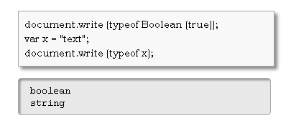
Variables
Get the data type of a variable
Use typeof

Slide 10
Arrays
A special variable that is used to store a list of values
Usually made out of a contiguous block of memory that is divided into a number of slots
Each slot holds a value
All slots are in the same data type
Slots are numbered sequentially starting at ZERO
Declaration
var courses = new Array();
Initialization
courses[0] = “HD in CSA”;
courses[1] = “HD in SE”;
Courses[2] = “HD in CDCA”;
Or (condensed array)
var courses = new Array(“HD in CSA”, “HD in SE”,
“HD in CDCA”);
Or (literal array)
var courses = [“HD in CSA”, “HD in SE”, “HD in CDCA”];

Slide 11
Expressions
Combination of literals, operators, variables, and parentheses used to calculate a value
Rule for correct JavaScript expressions are about the same as for algebra
E.g.
1 +2
a + b * (3 – c) / 5

Slide 12
Operators
Arithmetic Operators
Precedence
()
* / or %
+ or -
Operator | Description | Example
+ | Addition | x = y + 2
- | Subtraction | x = y – 2
* | Multiplication | x = y * 2
/ | Division | x = y / 2
% | Modulus | x = y % 2
++ | Increment | x = ++y x = y++
-- | Decrement | x = --y x = y--

Slide 13
<?xml version = "1.0"?>
<!DOCTYPE html PUBLIC "-//W3C//DTD XHTML 1.0 Strict//EN"
"http://www.w3.org/TR/xhtml1/DTD/xhtml1-strict.dtd">
<!-- Addition.html -->
<html xmlns = "http://www.w3.org/1999/xhtml">
<head>
<title>An Addition Program</title>
<script type = "text/javascript">
var firstNumber, // first string entered by user
secondNumber, // second string entered by user
number1, // first number to add
number2, // second number to add
sum; // sum of number1 and number2
// read in first number from user as a string
firstNumber =
window.prompt( "Enter first integer", "0" );
// read in second number from user as a string
secondNumber =
window.prompt( "Enter second integer", "0" );
// convert numbers from strings to integers
number1 = parseInt( firstNumber );
number2 = parseInt( secondNumber );
// add the numbers
sum = number1 + number2;
The window method prompt displays a prompt dialog in the browser with a message and a text field for input.
The first argument passed to method prompt is the message to be displayed.
The second argument is the default value for the text field.
Function parseInt converts its string argument to an integer.
The + operator adds the two numbers input by the user.

Slide 14
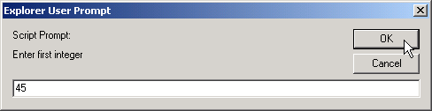
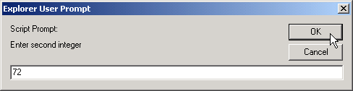
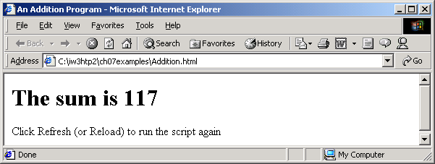
// display the results
document.write( "<h1>The sum is " + sum + "</h1>" );
</script>
</head>
<body>
<p>Click Refresh (or Reload) to run the script again</p>
</body>
</html>
Addition.html Program Output

Slide 15
Operators
Assignment Operators
Comparison Operators
Operator | Example
= | x = y
+= | x += y
-= | x -= y
*= | x *= y
/= | x /= y
%= | x %= y
Operator | Description | Example
== | Is equal to | x == 8
!= | Is not equal | x != 8
> | Is greater than | x > 8
< | Is less than | x < 8
>= | Is greater than or equal to | x >= 8
<= | Is less than or equal to | x <= 8

Slide 16
Operators
Logical Operators
Conditional Operators
Assigns a value to a variable based on some condition
variableName = (condition) ? value1: value2;
Operator | Description | Example
&& | And | (x<10 && y>1)
|| | Or | (x==5 || y==5)
! | Not | !(x==y)

Slide 17
Control Flow
Selection Statements
if
if-else
if…else if…else
switch-case
Repetition (Looping) Statements
for
for…in
while
do…while
break
continue

Slide 18
Control Flow
if
Execute some code only if a specified condition is true
if (condition) {
statement;
}
<script type="text/javascript">
var t = new Date().getHours();
if (t < 10) {
document.write("<b>Good morning</b>");
}
</script>

Slide 19
Control Flow
if-else
Execute some code if the condition is true and another code if the condition is false
if (condition) {
statement;
} else {
statement;
}
<script type="text/javascript">
var t = new Date().getHours();
if (t < 10) {
document.write("<b>Good morning</b>");
} else {
document.write("<b>Good day</b>");
}
</script>

Slide 20
Control Flow
if…else if…else
Select one of many blocks of code to be executed
if (condition) { statement;
} elseif (condition) { statement;
} else { statement;
}
<script type="text/javascript">
var t = new Date().getHours();
if (t<10) {
document.write("<b>Good morning</b>");
} else if (t>=10 && t<16) {
document.write("<b>Good day</b>");
} else {
document.write("<b>Hello World!</b>");
}
</script>

Slide 21
Control Flow
switch-case
Perform different action based on different condition
switch (n) { case label1: statement; break; case label2: statement;
break; default: statement; }
<script type="text/javascript">
var theDay=new Date().getDay();
switch (theDay) {
case 5:
document.write("<b>Finally Friday</b>");
break;
case 6:
document.write("<b>Super Saturday</b>");
break;
case 0:
document.write("<b>Sleepy Sunday</b>");
break;
default:
document.write("<b>I'm really looking forward to
this weekend!</b>");
}
</script>

Slide 22
Control Flow
for
Loops through a block of code a number of times
for (var=startvalue; var<=endvalue; var=var+increment) { code to be executed
}
<body>
<script type="text/javascript">
var i=0;
for (i=0;i<=5;i++) {
document.write("The number is " + i);
document.write("<br />");
}
</script>
</body>

Slide 23
Control Flow
for…in
Loops through the properties of an object
for (variable in object) { code to be executed
}
var person={fname:"John",lname:"Doe",age:25}; for (x in person) { document.write(person[x] + " "); }

Slide 24
Control Flow
while
Loops through a block of code while a specified condition is true
while (condition) { code to be executed
}
<body>
<script type="text/javascript">
i=0;
while (i<=5) {
document.write("The number is " + i);
document.write("<br />");
i++;
}
</script>
</body>

Slide 25
Control Flow
do…while
Loops through a block of code while a specified condition is true
do { code to be executed
} while (condition);
<body>
<script type="text/javascript">
i = 0;
do {
document.write("The number is " + i);
document.write("<br />");
i++;
} while (i <= 5);
</script>
</body>

Slide 26
Control Flow
break
break the loop and continue executing the code that follows after the loop
<body>
<script type="text/javascript">
var i=0;
for (i=0;i<=10;i++) {
if (i==3) {
break;
}
document.write("The number is " + i);
document.write("<br />");
}
</script>
</body>

Slide 27
Control Flow
continue
break the current loop and continue with the next value
<body>
<script type="text/javascript">
var i=0;
for (i=0;i<=10;i++) {
if (i==3) {
continue;
}
document.write("The number is " + i);
document.write("<br />");
}
</script>
</body>

Slide 28
Function
A block of code that will be executed when “someone” calls it
function functionname() { some code
}
<head>
<script type="text/javascript">
function displaymessage() {
alert("Hello World!");
}
</script>
</head>
<body>
<form><input type="button" value="Click me!"
onclick="displaymessage()" />
</form>
</body>

Slide 29
Function
Pass some arguments separated by comma when call a function
function functionname(arg1,arg2,...,argX) { some code
}
<head>
<script type="text/javascript">
function sumAnswer(num1, num2) {
ans = num1 + num2;
alert("Answer of " + num1 + " + " + num2 +
" is " + ans);
}
</script>
</head>
<body>
<form><input type="button" value="Click me!"
onclick="sumAnswer(10, 20)" />
</form>
</body>

Slide 30
Function
return statement
specify the value that is returned from the function
<head>
<script type="text/javascript">
function product(a, b) {
return a*b;
}
</script>
</head>
<body>
<script type="text/javascript">
document.write(product(2,3));
</script>
</body>

Slide 31
Function
Scope of variables
Global
Declared outside a function
All scripts and functions on the web page can access it
Deleted when close the web page
Local variables
A variable declared (using var) within a JavaScript function
Only be accessed within that function
Deleted as soon as the function is completed

