Slide 1

companies exiting China amid tightening security measures
Aida Koorang Beheshti
Strategic management
Dr.Safaeipour

Slide 2
Agenda
Introduction
Yahoo’s Exit & Industry Trends
Personal Information Protection Law (PIPL)
China’s Crackdown on Big Tech
Foreign Tech Faces Barriers in China
Apple’s Balancing Act in China
Conclusion

Slide 3
Introduction
Yahoo ceased operations in China on November 1, 2021
Services like TechCrunch and Engadget are no longer accessible
Follows the exit of other U.S. companies like Microsoft and Epic Games
Due to regulatory challenges and legal restrictions

Slide 4
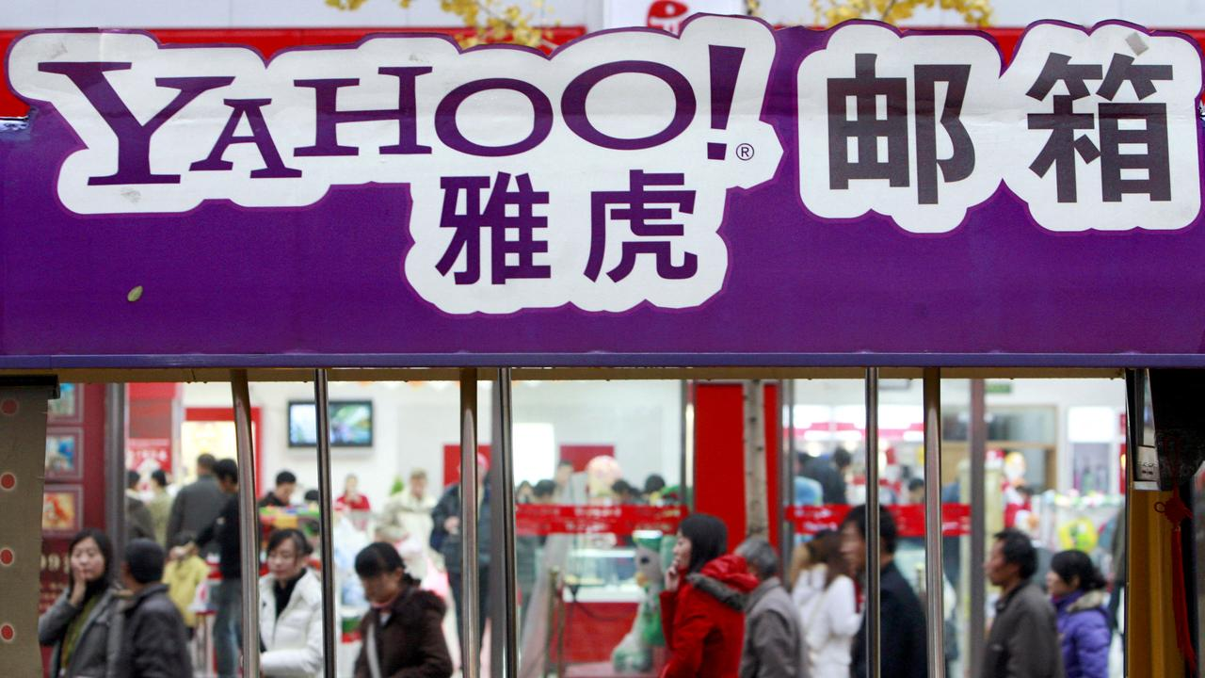
Yahoo’s Exit & Industry Trends
Yahoo criticized China’s restrictive digital policies
Microsoft removed LinkedIn from China
Epic Games withdrew Fortnite due to gaming regulations
Tencent impacted by gaming limits and content restrictions

Slide 5
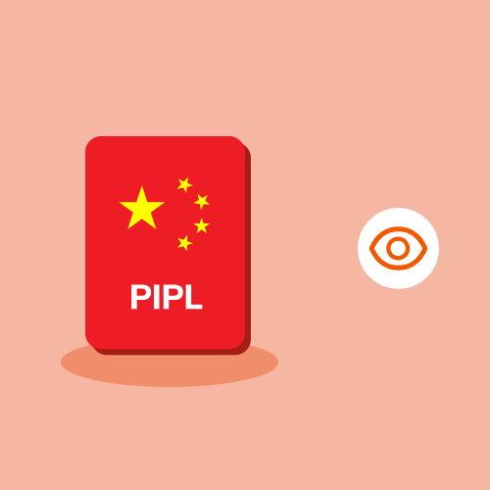
Personal Information Protection Law (PIPL)
China’s PIPL law came into effect on Nov 1, 2021
Similar to GDPR but with stricter controls
Requires data localization & security checks for foreign firms
Deeply connected to China’s censorship laws

Slide 6
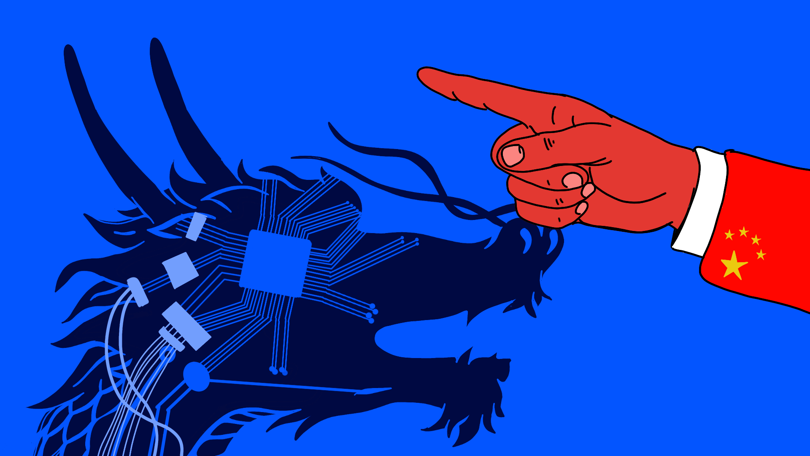
China’s Crackdown on Big Tech
Alibaba fined $2.8 billion for antitrust violations
Tencent facing tighter regulations on gaming & content
Restrictions on cryptocurrency, fan culture, and social platforms

Slide 7
Foreign Tech Faces Barriers in China
Foreign media and digital platforms increasingly restricted
TechCrunch conferences no longer held in China
Foreign films blocked from Chinese theaters
Startups shifting focus to India and other emerging markets

Slide 8
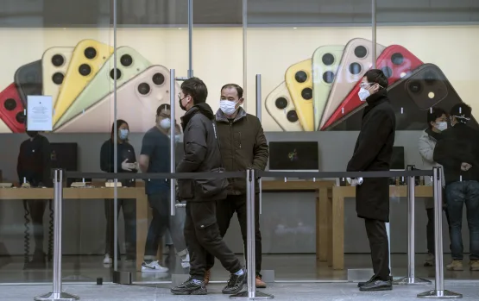
Apple’s Balancing Act in China
Apple depends on Chinese manufacturing
Has complied with Chinese laws on data localization & app removals
Faces pressure from U.S. & Chinese regulators
Can Apple continue operating in China?

Slide 9
Conclusion : A Broader Shift Away from China
Yahoo’s exit reflects a larger trend
Foreign firms facing rising compliance costs & risks
China is prioritizing state control over digital platforms
More U.S. companies may exit China in the future

Slide 10
Thank you
a.koorang@ec.iut.ac.ir

