Slide 1

Enhancing Network Security with Advanced Network Scanning Tools
SHUBH PATEL
PRARTHAN CHRISTIAN
KARTIKAY MISTRY
KRENIL RAJ
HIREN RAITHATHA
PAPER ID: 732

Slide 2

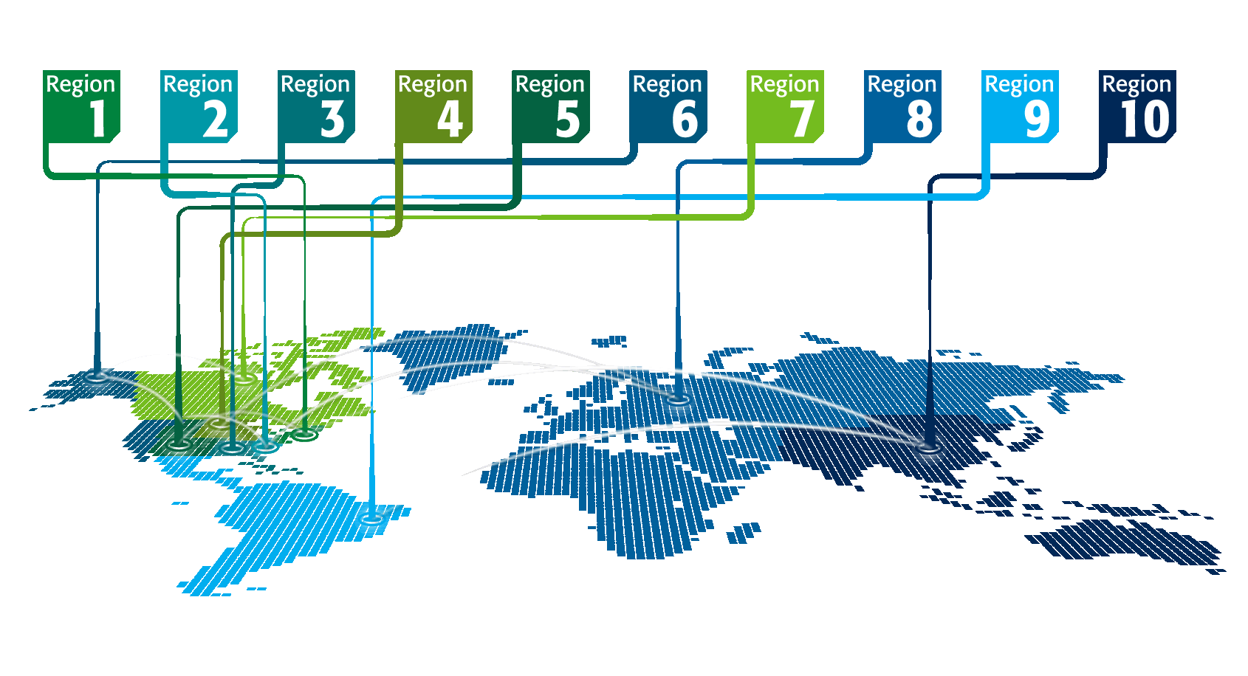
INDEX
Introduction
Motivation
Research Gap
Methodology
Future Work
Conclusion
Q & A
References

Slide 3






INTRODUCTION
Network scanning tools play a crucial role in organizational defense strategies, enabling the identification of vulnerabilities, anticipation of potential threats, and bolstering of resilience against cyberattacks.

Slide 4
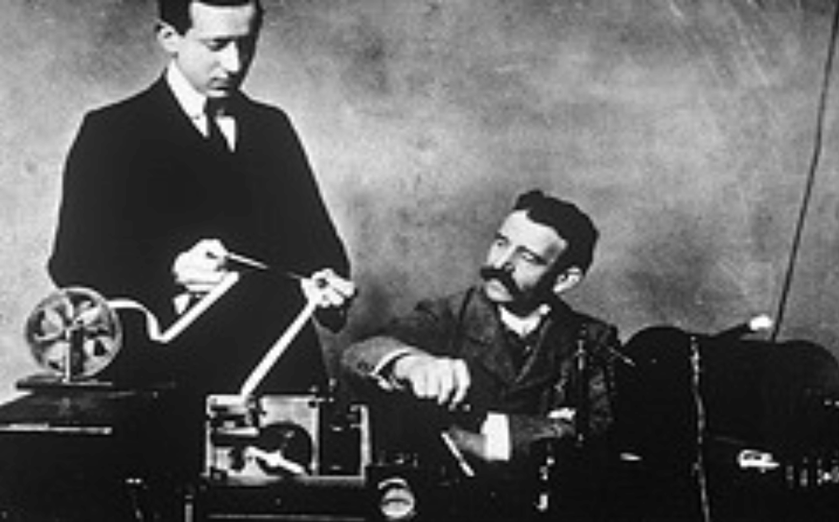






MOTIVATION
The motivation behind building network scanning tools stems from the imperative need to proactively identify and mitigate security vulnerabilities within network infrastructures. Cyber threats are constantly evolving, becoming more sophisticated and widespread, posing significant risks to organizations of all sizes and sectors.

Slide 5
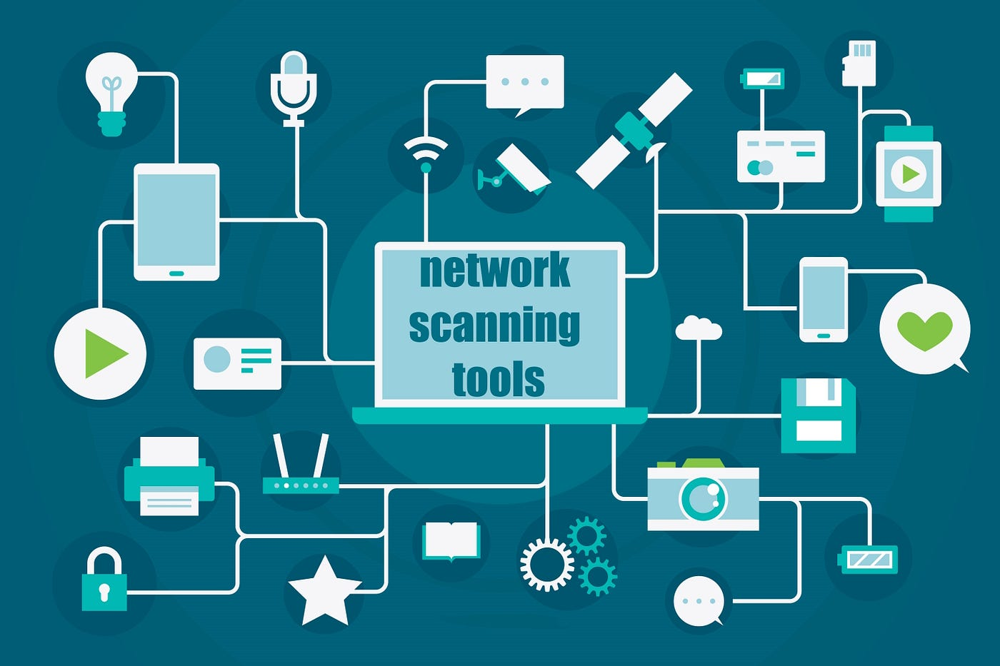
RESEARCH GAP
There's a research gap in network scanning tools concerning the need for advancements in detecting and countering sophisticated cyber threats like zero-day vulnerabilities, polymorphic malware, and evasive tactics. Moreover, there's potential for research to improve the scalability, usability, and compatibility of these tools, especially as network infrastructures become more intricate and dispersed.

Slide 6

METHODOLOGIES FOR LIVE HOST DETECTION
TCP SYN Ping
STCP INIT Ping
UDP Ping

Slide 7
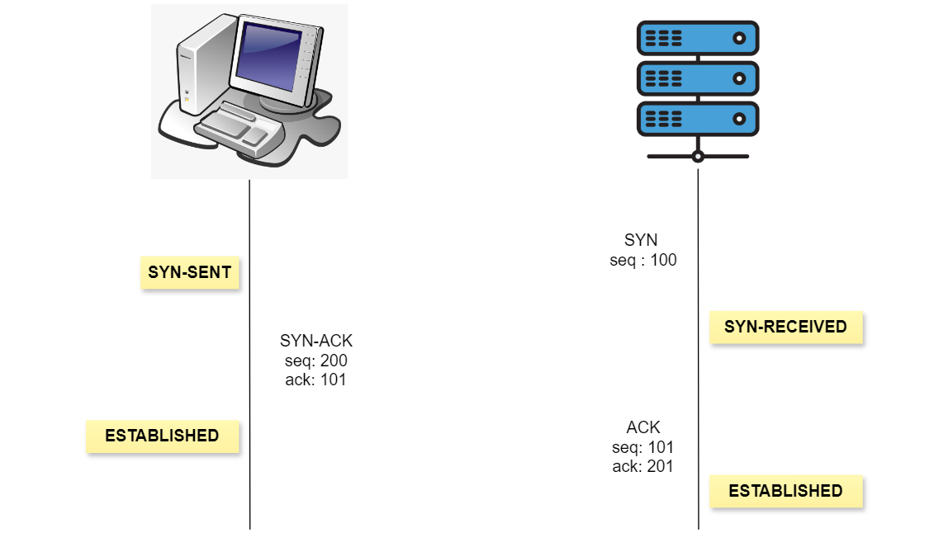
TCP SYN Ping
In port scanning, the scanner sends a SYN packet to the
target IP and port.
SYN packet initiates TCP connection establishment
Live target responds with SYN-ACK for connection.
No response or RST indicates target is down/filtered.
Fig :- 1 TCP SYN Ping

Slide 8
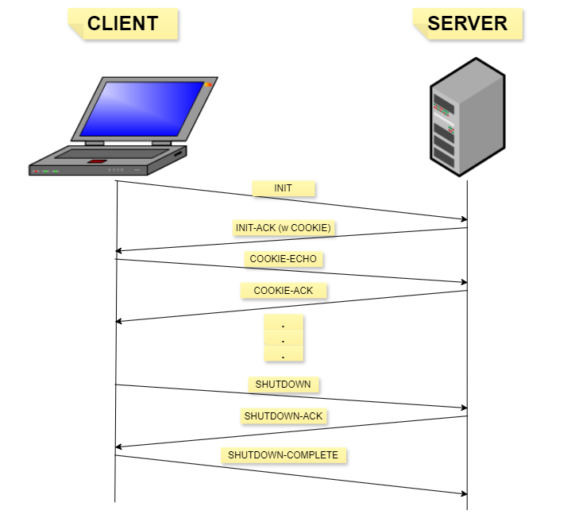
STCP INIT Ping
Scanner sends SCTP INIT chunk to target ports
INIT chunk attempts to establish SCTP connection.
Open port responds with INIT-ACK in SCTP handshake.
No response or RST indicates target is down/filtered
Fig :- 2 STCP INIT Ping

Slide 9
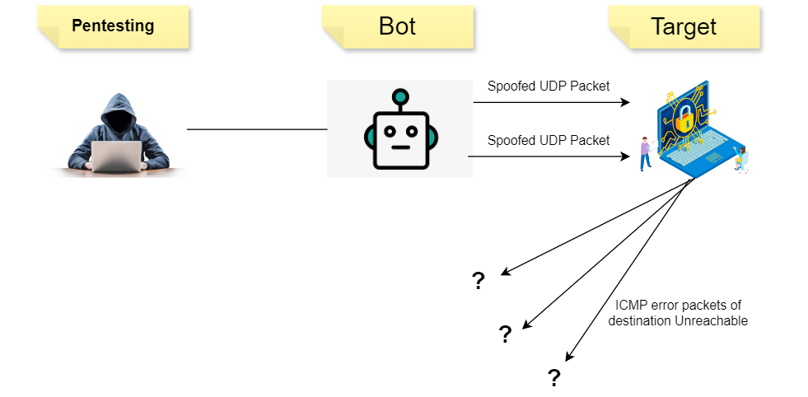
UDP Ping
Scanner sends SYN to target IP and port.
SYN initiates TCP connection request.
Live target responds with SYN-ACK for connection.
No response or RST indicates target down/filtered
Fig :- 3 UDP Ping

Slide 10

METHODOLOGIES FOR SERVICE SCANNING
SERVICE BANNER GRABBING

Slide 11
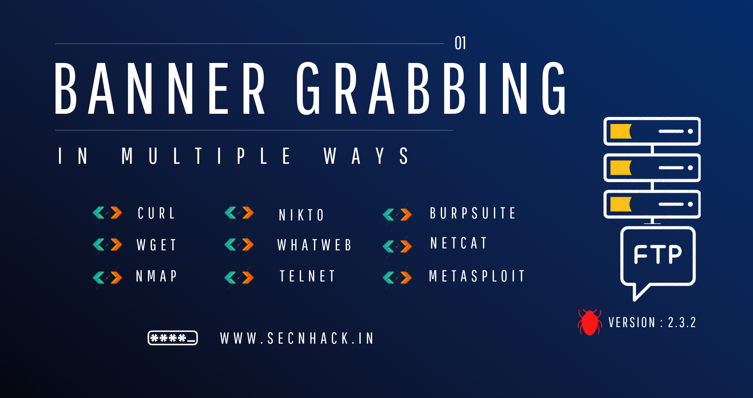
SERVICE BANNER GRABBING
TCP SYN scanning identifies open ports.
Connect to identified open port using appropriate protocol.
Send probes/commands to open service (e.g. HTTP GET).
Capture service response with banner/version info.
Extract service name/version from captured response.

Slide 12

OS DETECTION
Craft ICMP packets with varying size, flags, options.
Crafting and Sending Packets to Hosts
Response Capture & OS Fingerprinting: Analysing ICMP Behaviour
Challenges in Accuracy: Multiple Requests for OS Finalization

Slide 13
FUTURE WORK
Complexity: Implementing and configuring network scanning tools can be complex, requiring expertise and experience to optimize settings, interpret results accurately, and effectively manage the tool's functionalities.
Detection Limitations: Despite their capabilities, network scanning tools may not detect all types of threats, particularly sophisticated or stealthy attacks that evade traditional scanning techniques.

Slide 14
CONCLUSION
In conclusion, our proposed network scanning tool in C++ for Windows offers Live Host detection, Port Scanning, and Service Detection features. These additions promise comprehensive network reconnaissance capabilities, aiding cybersecurity professionals in identifying and mitigating potential threats effectively.

Slide 15
Q & A

Slide 16
REFERENCES
Gadge, Jayant and Anish Anand Patil. ”Port scan detection.” 2008 16th IEEE international Conference on networks. IEEE, 2008.
Fuchsberger, Andreas. ”Intrusion detection systems and intrusion prevention systems.” Information Security Technical Report 10.3 (2005): 134-139.
Singh, Gopal, Sachin Goyal, and Ratish Agarwal. ”Intrusion detection using network monitoring tools.” Available at SSRN 2426105 (2014).
Abu Bakar, R., Kijsirikul, B. (2023). Enhancing Network Visibility and Security with Advanced Port Scanning Techniques. Sensors, 23(17), 7541.
Xia, Wenfeng, et al. ”A survey on software-defined networking.” IEEE Communications Surveys Tutorials 17.1 (2014): 27-51.
Li, Ruoshi, Markus Sosnowski, and Patrick Sattler. ”An overview of OS fingerprinting tools on the internet.” Network 73 (2020): 73-77.

Slide 17









THANK YOU

