Slide 1



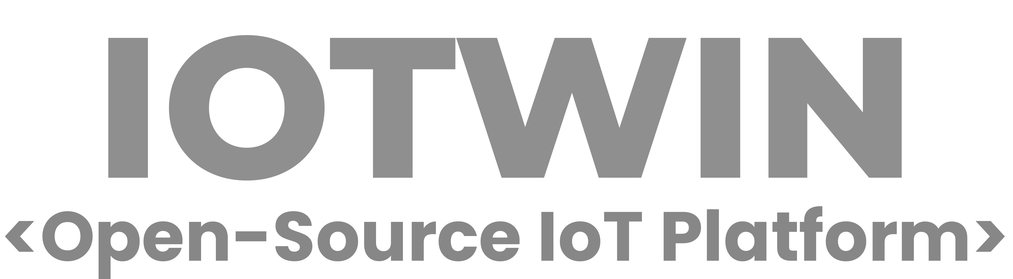








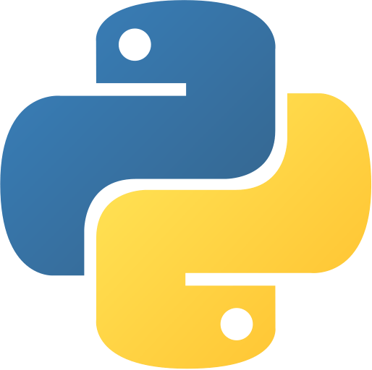





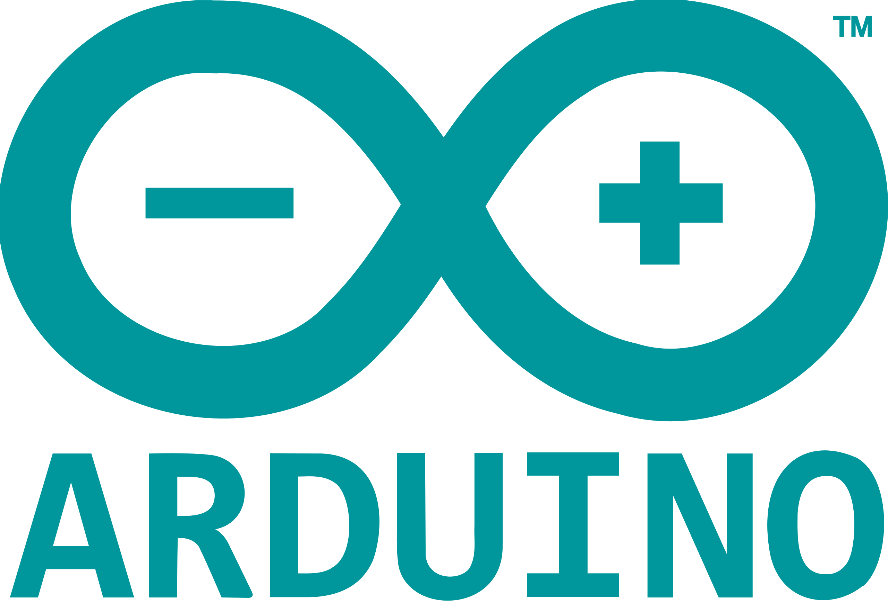


Slide 2
IoTwin is an open-source IoT platform for data collection, processing, and visualization.
Real-Time IoT Dashboard
Telemetry Data Collection
Multi-Tenancy Support
Asset & Device Management
Alert Management
Time Series Forecasting

Slide 3
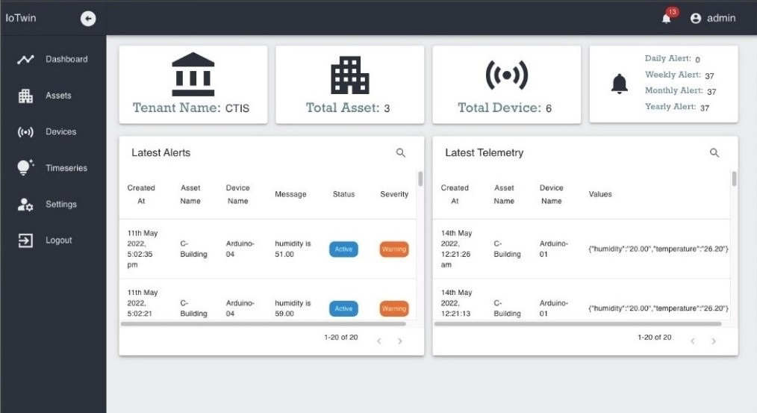
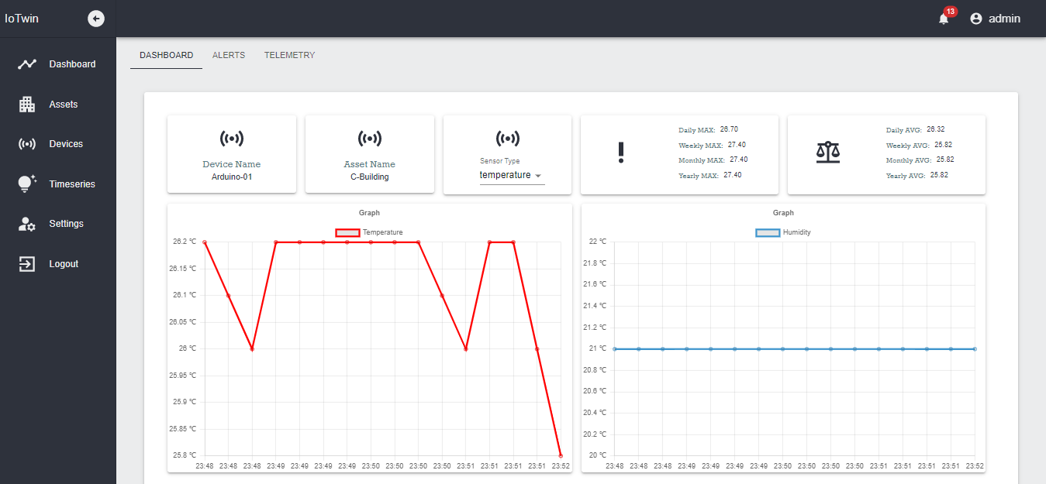
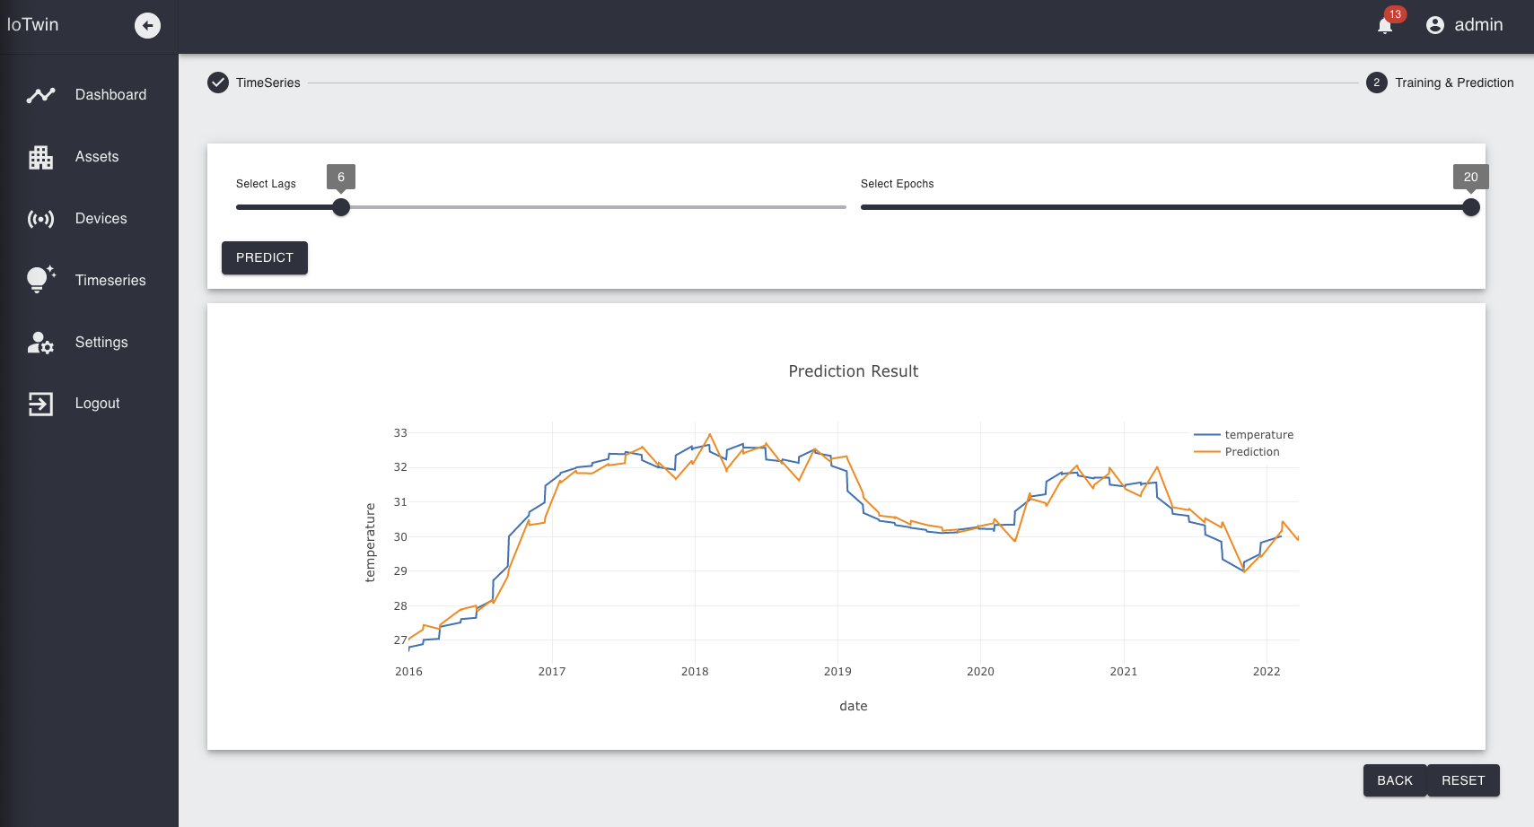
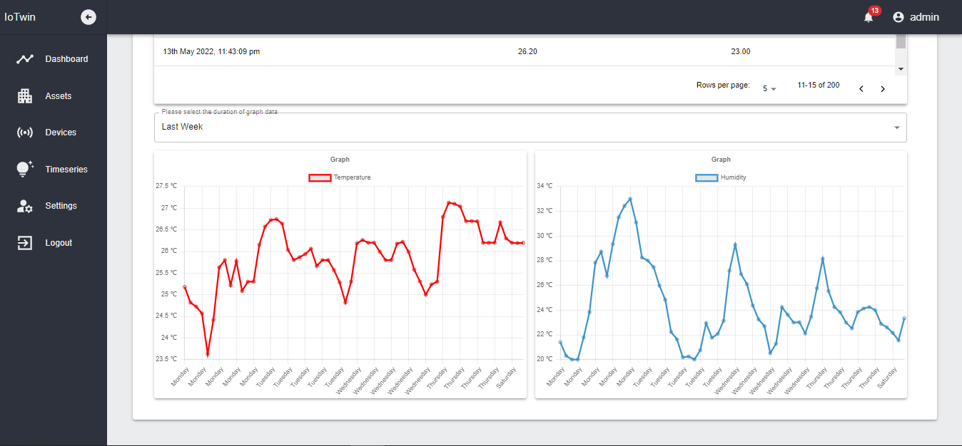
| Web App

Slide 4
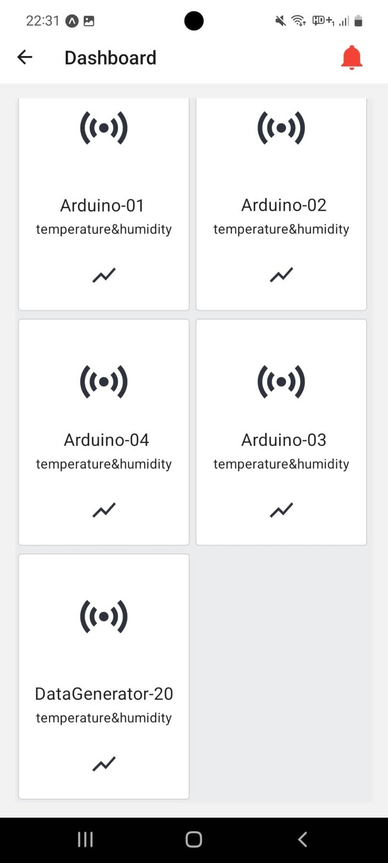
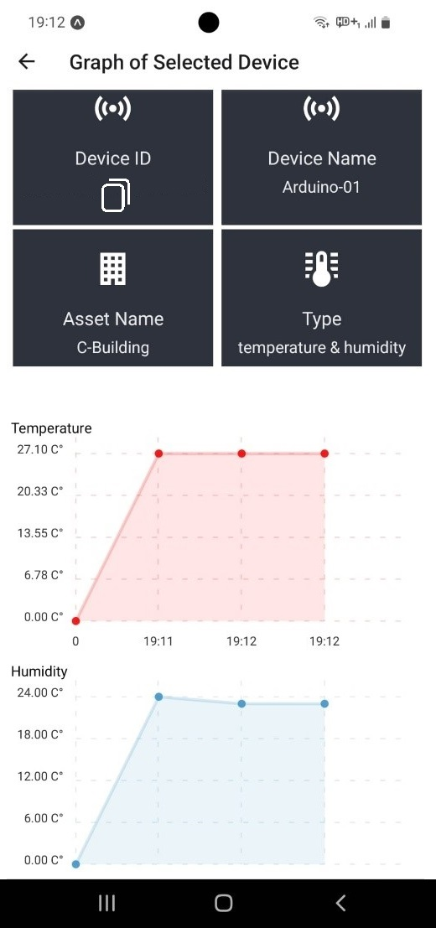
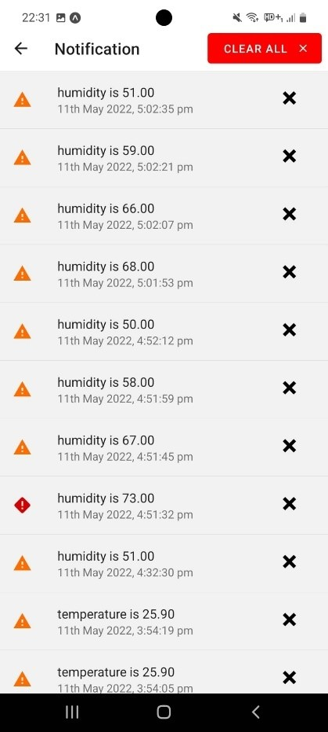
| Mobile App

Slide 5
Developers
Uğur Ata Dargün
Erdem Sert
Samet Ercan
Murat Alkan
Advisor
Füsun Yürüten

