Slide 1
R User Group
Building a community of R users in Connecticut state government
Launched June 2024

Slide 2
Table of contents
Resources
Getting started
Great references
Fun stuff
Demos
Census data
Cleaning address data
Appendix
Who we are
What is R?
Why use R?

Slide 3
2024 meeting schedule
Monthly meetings: second Tuesday of each month
July 9
August 13
September 10
October 8
November 12
December 10

Slide 4
R resources

Slide 5
R resources: Getting started
Installing R and R Studio
Download R
Download R Studio
R Packages (what’s an R package and how do I install one?)
Short primers from the owners of R Studio

Slide 6
R resources: Great references
A Gentle Introduction to Tidy Statistics in R – Introductory tutorial focusing on stats
R for Data Science – Free online textbook introducing R for data organization, analysis, manipulation, and visualization
Cheat sheets for popular R packages

Slide 7
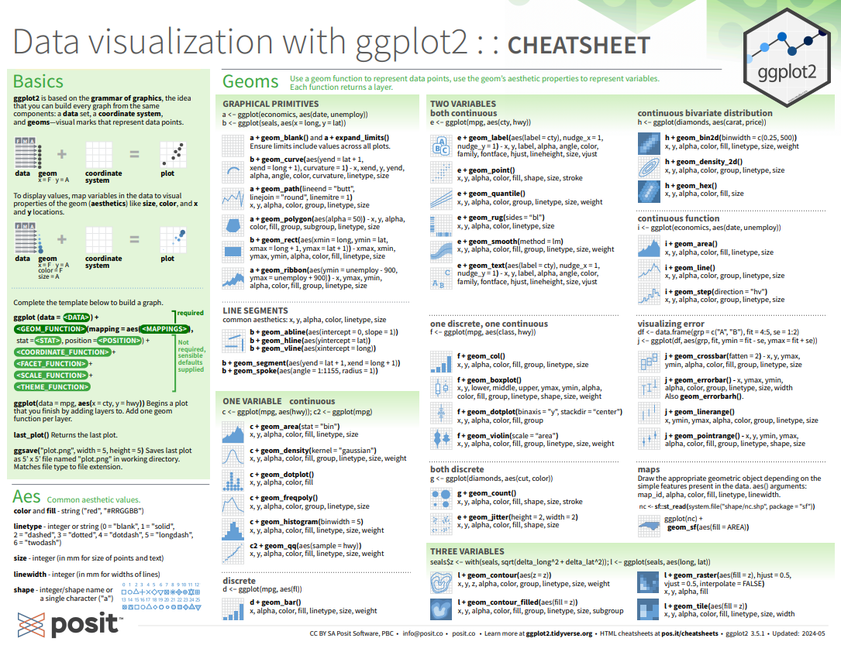

Slide 8
R resources: Fun stuff
R for cats – Fun tutorial about the basics of R programming… with cats!
Learning R – Episode of the PolicyViz podcast with Jonathan Schwabish from the Urban Institute where he talks about his approach to learning R

Slide 9
Demos

Slide 10
Census data
Demo topic: | Working with census data in R
Date: | July 9, 2024
Presenters: | Coral Wonderly
Packages used: | Tidycensus, Tidyverse, Insight
Script link: | Markdown Version: https://github.com/CTOpenData/r-user-group/blob/main/tidycensus.Rmd PDF Version: https://github.com/CTOpenData/r-user-group/blob/main/tidycensus.pdf

Slide 11
Cleaning address data
Demo topic: | Cleaning a column with unstandardized town name data
Date: | June 4, 2024
Presenters: | Sarah Hurley and Pauline Zaldonis
Packages used: | dplyr, readr, stringr
Script link: | https://github.com/CTOpenData/r-user-group/blob/main/address_data_cleaning.R

Slide 12
Appendix

Slide 13
Who we are

Slide 14

Notes:
Link to edit the form: https://forms.office.com/Pages/DesignPageV2.aspx?subpage=design&FormId=-nyLEd2juUiwJjH_abtzi5L_xJbiJ_5BoyF_jDckfpJUOUVLMzQ5UkhJMzM1NFlCQTlXWVVTV1JaMS4u

Slide 15
What is R?

Slide 16

What is R?
Programming language for statistical computing and data visualization
Open-source and free to use
Created by statisticians for statisticians

Slide 17
Key features of R
Statistical analysis: linear and nonlinear modeling, time-series analysis, classification, clustering
Data visualization: high-quality graphs and plots
Extensible with thousands of packages available
Comprehensive R Archive Network (CRAN) hosts user-contributed packages
Large and active user community
Extensive documentation and support available

Slide 18
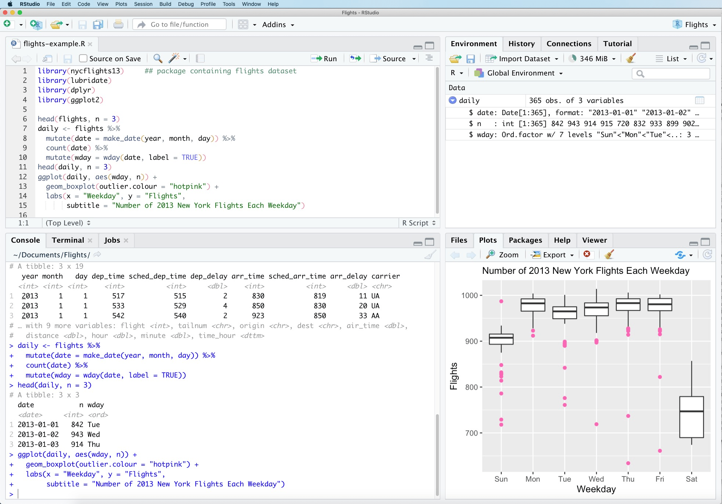
R Studio
R Studio is the integrated development environment (IDE) for working with R
User-friendly interface for writing and debugging R code
Enhances productivity and ease of use

Slide 19
Why use R?

Slide 20
Why use R?
Interoperability
Integrates with other programming languages and tools
Compatibility with Python, SQL, Hadoop, etc.
Facilitates seamless workflow in data science projects
Reproducible processes
Create processes that you can quickly repeat & reproduce results
Tools like R Markdown for creating dynamic documents
Combines code, output, and narrative text
Ensures reproducible research and reports

Slide 21
Discussion

Slide 22
Discussion questions
What R projects have you been working on?
What questions do you have?
What do you want to learn about R?
What would you be willing to demo at a future R meeting?

