Slide 1

Placental Bioinformatics Course
Dr Russell S. Hamilton
Email: rsh46@cam.ac.uk
Twitter: @drrshamilton
Dr Xiaohui Zhao
Email: xz289@cam.ac.uk
Dr Malwina Prater
Email: mn367@cam.ac.uk
Course Materials:
https://github.com/CTR-BFX/2019-PlacentalBiologyCourse
License: Attribution-Non Commercial-Share Alike CC BY-NC-SA ( https://creativecommons.org/licenses/by-nc-sa/ )
Attribution: You must give appropriate credit, provide a link to the license, and indicate if changes were made.
You may do so in any reasonable manner, but not in any way that suggests the licensor endorses you or your use.
NonCommercial: You may not use the material for commercial purposes.
ShareAlike: If you remix, transform, or build upon the material, you must distribute your contributions under the same license as the original.
Version 0.1: 20190619

Slide 2
Program
Lecture 1: What is RNA-Seq?
Introduction to RNA-Seq and sequencer options
From Sequencer to Quality Control and Aligning reads
Practical 1:
From FASTQ to BAM
Lecture 2: Gene Counts to hypothesis testing
Experimental Design
Gene quantification
Differential Gene Expression Analysis
Practical 2:
BAM to DEGs
Russell S. Hamilton (rsh46@cam.ac.uk), Xiaohui Zhao (xz289@cam.ac.uk) & Malwina Prater (mn367@cam.ac.uk) 2

Slide 3
Program
Lecture 2: Gene Counts to hypothesis testing
Experimental Design
Gene quantification
Differential Gene Expression Analysis
Russell S. Hamilton (rsh46@cam.ac.uk), Xiaohui Zhao (xz289@cam.ac.uk) & Malwina Prater (mn367@cam.ac.uk) 3

Slide 4
Reproducible Bioinformatics
Versioning
If you write code or scripts use a versioning system (a bit like track changes in Word)
Make it publicly available so people can comment and submit bug reports
e.g. http://www.github.com
Pipelines
Track program version numbers, consistent processing and reporting
Avoid manual input of data or settings
e.g. http://custerflow.io or SnakeMake
Data Repositories
Upload your published data to GEO, ENA, SRA etc
Russell S. Hamilton (rsh46@cam.ac.uk), Xiaohui Zhao (xz289@cam.ac.uk) & Malwina Prater (mn367@cam.ac.uk) 4

Slide 5
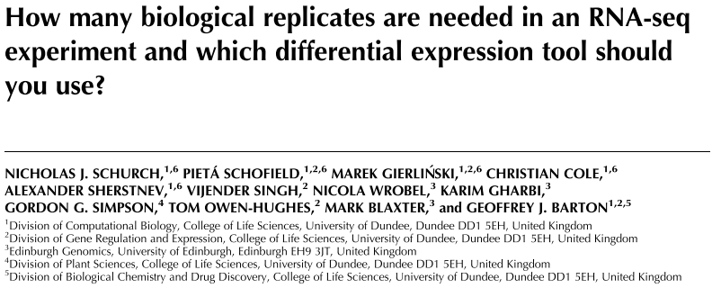
How Many Replicates?
Started with 48 replicates, removed replicated and investigated the power of statistical analysis
Conclusion/Recommendations:
At least six biological replicates should be used
Rising to at least 12 when it is important to identify SDE genes for all fold changes.
If fewer than 12 replicates are used:
edgeR and DESeq2 the leading tools for DGE
https://doi.org/10.1261/rna.053959.115
Russell S. Hamilton (rsh46@cam.ac.uk), Xiaohui Zhao (xz289@cam.ac.uk) & Malwina Prater (mn367@cam.ac.uk) 5

Slide 6
RNA-Seq Mapping Metrics: Counts Vs FPKM Vs TPM
Counts
The number of reads mapping to a transcript or gene
Longer transcripts will generally have more mapped reads
FPKM (Fragments Per Kilobase of transcript per Million mapped reads)
Normalises the counts for the length of the transcript
TPM (Transcripts Per Million)
Measurement of the proportion of transcripts in your pool of RNA
None of these are for comparing across samples
Sample normalisation required as performed by DESeq2 and Sleuth
Russell S. Hamilton (rsh46@cam.ac.uk), Xiaohui Zhao (xz289@cam.ac.uk) & Malwina Prater (mn367@cam.ac.uk) 6

Slide 7
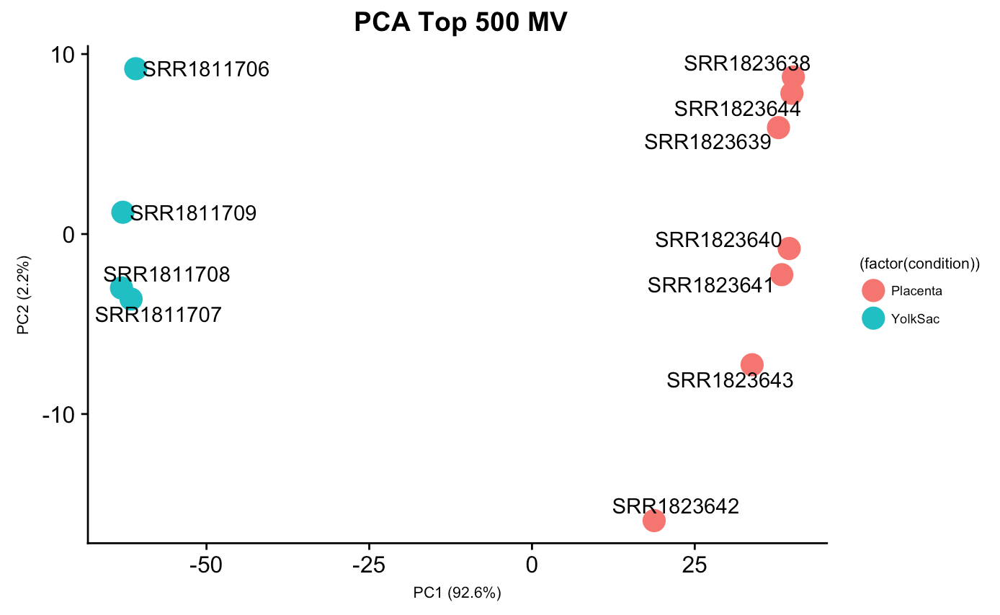
DESeq2: PCA
Similar to the Sleuth version, but you can customise number of genes to use, colour, labels etc much more easily using the DESeq2/ggplot custom version
Russell S. Hamilton (rsh46@cam.ac.uk), Xiaohui Zhao (xz289@cam.ac.uk) & Malwina Prater (mn367@cam.ac.uk) 7

Slide 8
Dr Russell S. Hamilton Email: rsh46@cam.ac.uk
Dr Malwina Prater Email: mn367@cam.ac.uk
Dr Xiaohui Zhao Email: xz289@cam.ac.uk
Course Materials:
https://github.com/CTR-BFX/2019-PlacentalBiologyCourse
License: Attribution-Non Commercial-Share Alike CC BY-NC-SA ( https://creativecommons.org/licenses/by-nc-sa/ )
Attribution: You must give appropriate credit, provide a link to the license, and indicate if changes were made.
You may do so in any reasonable manner, but not in any way that suggests the licensor endorses you or your use.
NonCommercial: You may not use the material for commercial purposes.
ShareAlike: If you remix, transform, or build upon the material, you must distribute your contributions under the same license as the original.

