Slide 1

Visualizing CFPB Financial Wellness Survey Data
January 8, 2020

Slide 2


The Consumer Financial Protection Bureau (CFPB) Financial Wellness Survey
Survey of more than 6,000 Americans from diverse backgrounds
A 100-point financial well-being score drawn from 10 questions
A large set of addition questions on:
Income and employment
Savings and safety nets
Past financial experiences
Financial behaviors, skills, and attitudes

Slide 3





CFPB (CSV) and FRED (API) data
Mongo DB
Flask Server
HTML– plotting with D3, Matplotlib, and Chart.js
Data manipulation with Excel and Python

Slide 4
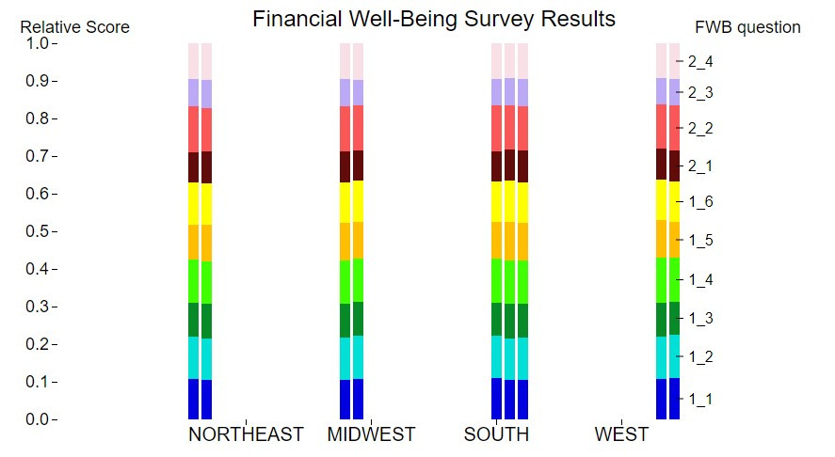

Slide 5
Why the fudge is this presentation separate to the work everyone else just presented?
Well, the data that the rest of the team analyzed is extremely thorough and contains an enormous amount of useful information on the financial wellness of consumers.
The limitations of that data set, however, are primarily that it is a snapshot in time and that it is from 2016.
Therefore we thought it would be useful to show a time series of some basic elements of financial wellness over time and through to more recent days.
For this analysis we pulled data from an API to the St Louis FRED, which contains fantastic information on many economic data points.
The main things that we considered are:
Median Household Incomes
Unemployment Rates
Consumer Delinquency Rates (for when consumers are >90 days past-due on loans)
The Ratio of Household Debt Service Payments to Median Incomes

Slide 6
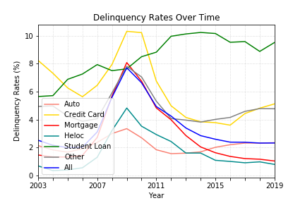
This chart shows delinquency rates across all types of consumer loans over time in the US. As you can see from the graph, the loan type that has the tightest relationship to Total Delinquency Rates (‘All’) is between delinquency rates on mortgages. This is because mortgages are typically by far the largest debt item on consumers’ balance sheets. What’s notable is how total delinquency rates are low today and have trended down since the Global Financial Crisis (‘GFC’), and all loan types exhibit delinquency rates that are as good as they’ve been for ~15 years, with the exception of Student Loans (which is also a growing portion of total personal debt outstanding…)
The null-hypothesis was that Mortgage Delinquency Rates are not a statistically significant variable in explaining Total consumer Delinquency Rates.
A p-value below 0.05 means that the 95% level of confidence measure has been achieved.
Here the p-value is far below zero, therefore we Reject the null hypothesis_3 and conclude that the Delinquency Rates on Mortgage loans have significant explanatory power regarding changes in total consumer delinquency rates.
Note this absurdly high r-squared & correlation values. The reason for this is obvious: mortgages are typically by far the largest loan that individuals have – and thus have by far the highest impact on Total Delinquency Rates.
Statistical Factor | Result
Correlation | 0.99
R-Squared | 0.99
Slope | 0.79
Intercept | 1.22
P-value | 3.14e-16
Standard Error | 0.02

Slide 7
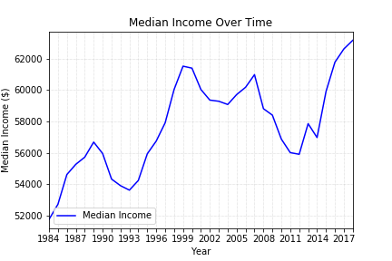
Real (i.e. inflation-adjusted) Median Household Incomes in the US have risen over the past forty years, and indeed have risen sharply since troughing in ~2011-2012. Notably during the 2011-2012 trough they were in-line with levels not seen since 15 years prior to that in ~1996, which is rather shocking to think about. Still, the overwhelming trend since this figure started being recorded by the FRED is positive. Median Household Income figures incorporate all households in the US – including households that earn no income.

Slide 8
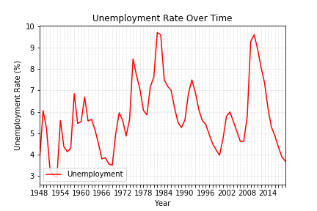
This chart goes back much further than other data sources that I’ve used in this analysis. As you can see, unemployment is currently near record-lows vs the past 80 years. It’s also a striking decrease since the near-record highs of the GFC. This graph shows the average unemployment rate during each calendar year (the data is actually measured monthly). The official unemployment rate for the month of November 2019 was 3.5%, which is extremely low and likely to put upwards pressure on wages. It’s worth noting that the methodology for calculating the Unemployment Rate excludes workers who are not actively seeking employment – i.e. it excludes discouraged workers, which is a weakness of the data source.

Slide 9
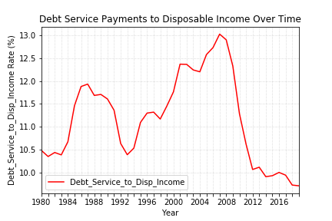
It’s remarkable how much this has come down post-GFC. Note how debt service payments as a percentage of disposable income was above 10% for the last forty years until several years after the GFC. The decline since the GFC has likely been due to declining interest rates as well as strong wage growth in an overall robust economy. This chart presents the strongest argument of all the charts I’ve shown that the US consumer’s balance sheet is very strong today – and that a consumer-confidence/ability-driven slowdown is unlikely to be the cause of an economic slowdown in the short-term (i.e. in the next 18 months or so). However note that, as I will explain more further on in the presentation, there are many other factors at work which can cause this to change rather rapidly. The DSR is divided into two parts. The Mortgage DSR is total quarterly required mortgage payments divided by total quarterly disposable personal income. The Consumer DSR is total quarterly scheduled consumer debt payments divided by total quarterly disposable personal income. The Mortgage DSR and the Consumer DSR sum to the DSR. Disposable Income is simply total income minus income taxes. Due to data limitations, the absolute level is not that important to pay attention to. But since the methodology of collecting this information is consistent over time, what is powerful & important is to observe the changes in the ratio over time.

Slide 10
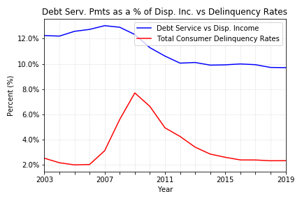
This chart shows Consumer Delinquency Rates over time in red, as well as Consumer Debt Service Payments as a percentage of Consumers’ Disposable Incomes. One thing that is more easily visible in the prior chart is that debt service payments as a percentage of disposable income were high for a long time leading into the GFC, likely due to far higher interest rates. Before running this analysis I thought that it would very likely show a statistically significant p-value, and thus I was surprised to see that not be the case – especially when looking at the chart. I believe that the reason for it is that is that the primary driver behind debt service as a percentage of disposable income is likely interest rates, which have come down substantially over the past 30 years, followed by median incomes. The high p-value could simply be reflecting the fact that the relationship is not caused by the debt service/disposable income metric, because that metric is in turn driven by other variables that do in fact exhibit explanatory power – as we have seen in looking at unemployment rates & median incomes…
Hypothesis_4: Debt Service vs Median Income rates are not a statistically significant variable in explaining total consumer delinquency rates
Accept the null hypothesis_4. Debt Service Payments to Median Disposable Household Income is not a statistically significant variable in explaining moves in total consumer delinquency rates and indeed there is not a strong relationship between the two at all over this time period.
Statistical Factor | Result
Correlation | 0.21
R-Squared | 0.05
Slope | 0.29
Intercept | 0.31
P-value | 0.41
Standard Error | 0.33

Slide 11
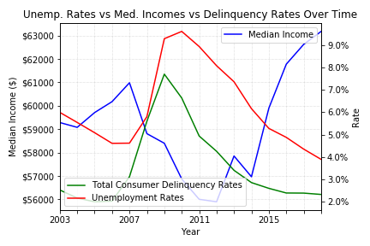
Here we can see Unemployment Rates, Consumer Delinquency Rates, and Median Household Income all plotted together on the same graph. The axis on the left hand side is for Median Income, in USD. The axis on the right hand side is for both Delinquency Rates and Unemployment Rates. The following statistical analysis relates to Median Incomes and Delinquency Rates:
Hypothesis_1: Median Income is not a statistically significant variable that impacts consumer delinquency rates
Reject the null Hypothesis_1.
There is a statistically significant relationship, but the relatively low R^2 indicates that Median Income is not, by itself, a strong predictor of future delinquency rates.
In the words of Jay-Z, ‘Mo-money mo- problems’.
Statistical Factor | Result
Correlation | -0.54
R-Squared | 0.29
Slope | -0.0
Intercept | 29.27
P-value | 0.03
Standard Error | 0.0

Slide 12
Here we can see Unemployment Rates, Consumer Delinquency Rates, and Median Household Income all plotted together on the same graph. The axis on the left hand side is for Median Income, in USD. The axis on the right hand side is for both Delinquency Rates and Unemployment Rates. The following statistical analysis relates to Unemployment Rate and Delinquency Rates:
Hypothesis_2: Unemployment Rate is not a statistically significant variable that impacts consumer delinquency rates
Reject the null hypothesis_2.
The Unemployment Rate also has reasonably strong explanatory power regarding changes in consumer delinquency rates.
Statistical Factor | Result
Correlation | 0.83
R-Squared | 0.69
Slope | 0.76
Intercept | -1.11
P-value | 4.00e-5
Standard Error | 0.13

Slide 13
Things missing from the analysis, as well as general limitations:
There’s no ‘magic formula’ – the economy is complex.! Things missing include:
Corporate debt & profits
Municipal debt to taxable income
Govt. debt to taxable income
Interest rates (especially relevant for looking at floating-rate mortgages…)
Inflation
Any data from outside the US
It would have been good to have had longer data series for delinquency rates…
Graphs don’t show overlaps with economic recessions
Limitations of the data include:
The data is national i.e. not broken down by State…
Doesn’t break out the data by income cohorts (however delinquency rates are a reasonable proxy for lower-income cohorts)
Only considered a small number of financial-wellness-related economic variables
Unemployment Rates don’t account for people who are not actively seeking a job i.e. it fails to capture disencouraged workers…
Finally, please remember that correlation does not imply causation.!

Slide 14
Sources Used:
Below is the API I used to access data from the St Louis FRED. Note that the St Louis Fed is not to be confused with THE Fed i.e. the Central Bank of the United States…
https://github.com/mortada/fredapi
https://mortada.net/python-api-for-fred.html
Note that ‘FRED’ stands for the Federal Reserve Economic Data and is a database maintained by the Research division of the Federal Reserve Bank of St Louis.
In addition, I also used data from the CFPB to get the data on the delinquency rates. That information was simply downloaded as an excel file since the website does not have a useable API at this time and this information was not available in detail from the FRED. The actual data is from a quarterly analysis run by the New York Fed Consumer Credit Panel/Equifax.

