Slide 1
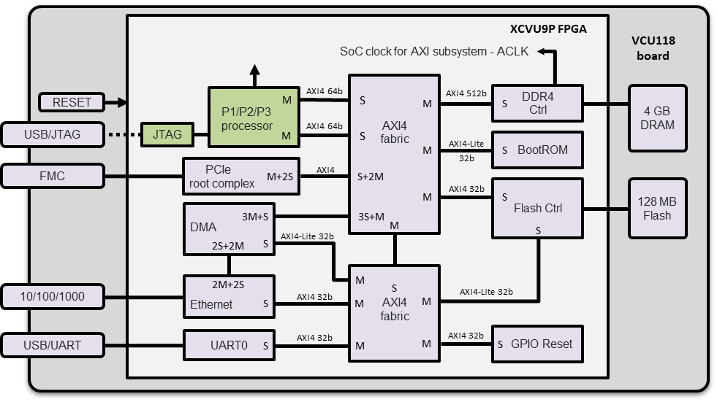
Updated to “P1/P2/P3” for in GFE_Rel5.0_System_Description.{docx,pdf} Figure 1
Used in GFE_Rel4.3_System_Description.{docx,pdf} Figure 1
XCVU9P FPGA
VCU118 board
TV
SoC clock for AXI subsystem - ACLK
M
AXI4 64b
AXI4
fabric
AXI4 512b
DDR4
Ctrl
4 GB
DRAM
RESET
P1/P2/P3
processor
S
M
S
USB/JTAG
JTAG
M
AXI4 64b
S
M
AXI4-Lite
32b
BootROM
S
S+2M
AXI4
PCIe
root complex
FMC
M+2S
AXI4 32b
Flash Ctrl
128 MB
Flash
M
S
DMA
3S+M
3M+S
M
S
2S+2M
S
AXI4-Lite 32b
AXI4
fabric
2M+2S
M
10/100/1000
Ethernet
AXI4 32b
S
M
AXI4-Lite 32b
M
M
M
S
UART0
AXI4 32b
M
AXI4 32b
GPIO Reset
USB/UART
M
M
S
S
1

Slide 2

Used in GFE_Rel4.3_System_Description.{docx,pdf} Figure 1
XCVU9P FPGA
VCU118 board
TV
SoC clock for AXI subsystem - ACLK
M
AXI4 64b
AXI4
fabric
AXI4 512b
DDR4
Ctrl
4 GB
DRAM
RESET
P1/P2
processor
S
M
S
USB/JTAG
JTAG
M
AXI4 64b
S
M
AXI4-Lite
32b
BootROM
S
S+2M
AXI4
PCIe
root complex
FMC
M+2S
AXI4 32b
Flash Ctrl
128 MB
Flash
M
S
DMA
3S+M
3M+S
M
S
2S+2M
S
AXI4-Lite 32b
AXI4
fabric
2M+2S
M
10/100/1000
Ethernet
AXI4 32b
S
M
AXI4-Lite 32b
M
M
M
S
UART0
AXI4 32b
M
AXI4 32b
GPIO Reset
USB/UART
M
M
S
S
2

Slide 3
Used in GFE_Rel4.3_System_Description.{docx,pdf} Figure 2
3

Slide 4
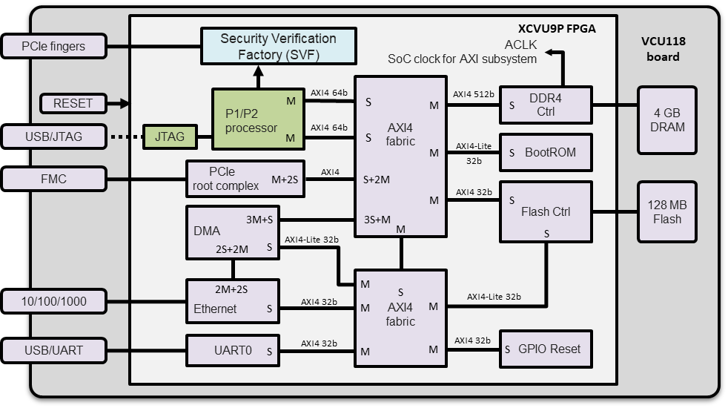
To be used in future SVF release UsedGFE_Rel4.*_System_Description.{docx,pdf}
Figure 1
Security Verification Factory (SVF)
XCVU9P FPGA
VCU118 board
PCIe fingers
ACLK
SoC clock for AXI subsystem
M
AXI4 64b
AXI4
fabric
AXI4 512b
DDR4
Ctrl
4 GB
DRAM
RESET
P1/P2
processor
S
M
S
USB/JTAG
JTAG
M
AXI4 64b
S
M
AXI4-Lite
32b
BootROM
S
S+2M
AXI4
PCIe
root complex
FMC
M+2S
AXI4 32b
Flash Ctrl
128 MB
Flash
M
S
DMA
3S+M
3M+S
M
S
2S+2M
S
AXI4-Lite 32b
AXI4
fabric
2M+2S
M
10/100/1000
Ethernet
AXI4 32b
S
M
AXI4-Lite 32b
M
M
M
S
UART0
AXI4 32b
M
AXI4 32b
GPIO Reset
USB/UART
M
M
S
S

Slide 5
Regenerate from vivado for future SVF release GFE_Rel4.*_System_Description.{docx,pdf}
Figure 2
5

Slide 6
To be used in future SVF release UsedGFE_Rel4.*_System_Description.{docx,pdf}
Figure 3
TV-trace
TV-trace_writer
Security Verification Factory (SVF)
XCVU9P FPGA
VCU118 board
PCIe fingers
PCIe fingers
ACLK
SoC clock for AXI subsystem
trace_data.dat
M
AXI4 64b
AXI4
fabric
AXI4 512b
DDR4
Ctrl
4 GB
DRAM
RESET
P1/P2
processor
S
M
S
TV-trace_checker
USB/JTAG
AXI4 64b
Cissr
gdb
USB/JTAG
JTAG
M
S
M
AXI4-Lite
32b
BootROM
S
S+2M
AXI4
PCIe
root complex
FMC
M+2S
AXI4 32b
Flash Ctrl
128 MB
Flash
trace_check.txt
M
S
DMA
3S+M
3M+S
M
S
2S+2M
S
AXI4-Lite 32b
Debian Buster host
AXI4
fabric
2M+2S
M
10/100/1000
Ethernet
AXI4 32b
S
M
AXI4-Lite 32b
M
M
M
S
UART0
AXI4 32b
M
AXI4 32b
GPIO Reset
console
USB/UART
USB/UART
M
M
S
S

Slide 7
Release 4.1
PCIe fingers
Security Verification Factory (SVF)
XCVU9P FPGA
VCU118 board
CLK
AXI4
fabric
P1/P2/P3
processor
AXI4
512b
DDR4
Ctrl
4 GB
DRAM
RESET
M
AXI4
64b
S
M
S
USB/JTAG
JTAG
M
S
M
AXI4-Lite
32b
BootROM
AXI4-Lite
32b
S
USB/UART
UART0
M
S
128 MB
Flash
M
AXI4-Lite
32b
Flash
Ctrl
10/100/1000
Ethernet
AXI4-Lite
32b
S
M
S
M
AXI4-Lite
32b
Soft Reset
(AXI GPIO0)
DMA
AXI4
32b
S
3S+M
3M+S
M
AXI4-Lite
32b
UART1
PMOD0
PMOD1
IIC0
AXI4-Lite
32b
M
S
S
Ch. 1
AXI4-Lite
32b
SPI1
PMOD1
PMOD0/1
GPIO1
AXI4-Lite
32b
M
M
S
LEDs
Ch. 2
S
7

Slide 8
Release 4.1
TV-trace
TV-trace_writer
PCIe fingers
PCIe fingers
Security Verification Factory (SVF)
XCVU9P FPGA
VCU118 board
trace_data.dat
CLK
AXI4
fabric
P1/P2/P3
processor
AXI4
512b
DDR4
Ctrl
4 GB
DRAM
RESET
M
AXI4
64b
S
M
S
TV-trace_checker
USB/JTAG
Cissr
gdb
USB/JTAG
JTAG
M
S
M
AXI4-Lite
32b
BootROM
AXI4-Lite
32b
S
console
USB/UART
USB/UART
UART0
M
S
128 MB
Flash
M
AXI4-Lite
32b
Flash
Ctrl
trace_check.txt
10/100/1000
Ethernet
AXI4-Lite
32b
S
M
S
M
AXI4-Lite
32b
Soft Reset
(AXI GPIO0)
Debian Buster host
DMA
AXI4
32b
S
3S+M
3M+S
M
AXI4-Lite
32b
UART1
PMOD0
PMOD1
IIC0
AXI4-Lite
32b
M
S
S
Ch. 1
AXI4-Lite
32b
SPI1
PMOD1
PMOD0/1
GPIO1
AXI4-Lite
32b
M
M
S
LEDs
Ch. 2
S

