Slide 1
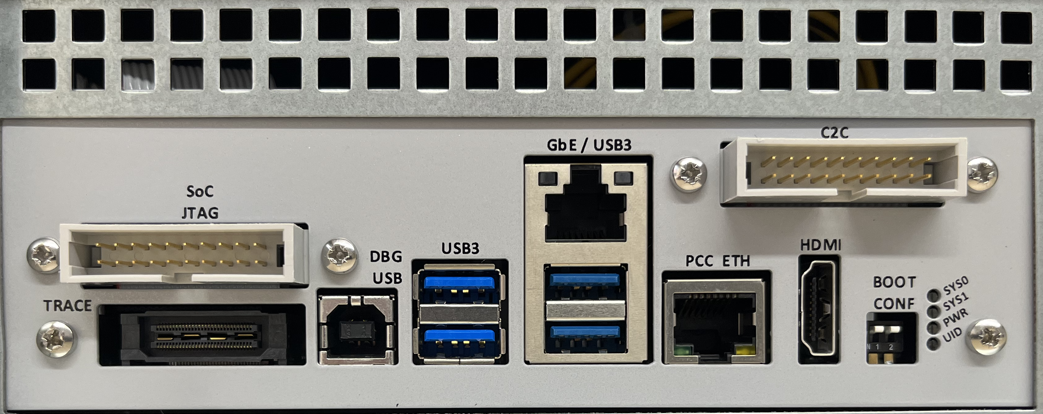
Morello GbE (Realtek 8168)
Morello HDMI console
USB-B:
Debug consoles (FTDI)
& firmware (umass)
Morello USB-A
Switches:
both up
Notes:
Export at 3386 pixels wide

