Slide 1
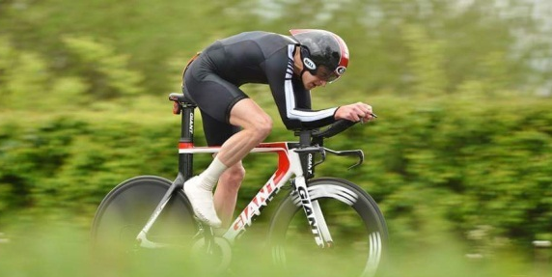
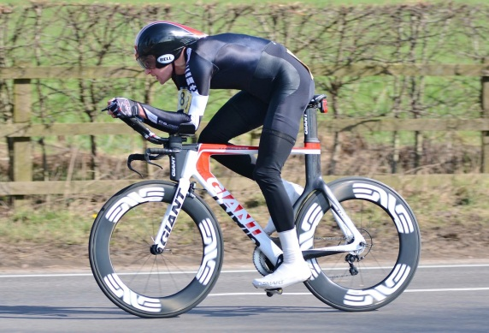
Charlie Taylor
Cyclist, twice National 100TT Champion, engineer, climber, hill walker, husband and father of two with a passion for all things outdoors
charlie.taylor30@gmail.com ctveloracing.com
@CTVeloRacing facebook.com/CTVeloRacing
Objectives
To form partnerships with brands that will help me achieve my 2016 goals. In return I can offer promotion on the British TT scene through; race wins, social media and my website. I can get you noticed!
2016 Goals
CTT 100 mile TT championships
CTT 50 mile TT championships
100 mile TT competition record
Selected Race Achievements
2015 CTT 100 mile TT Champion
2014 CTT 100 mile TT Champion
2nd fastest ever 100 mile TT 3:21:31
7 Open TT wins in 2015

