Slide 1
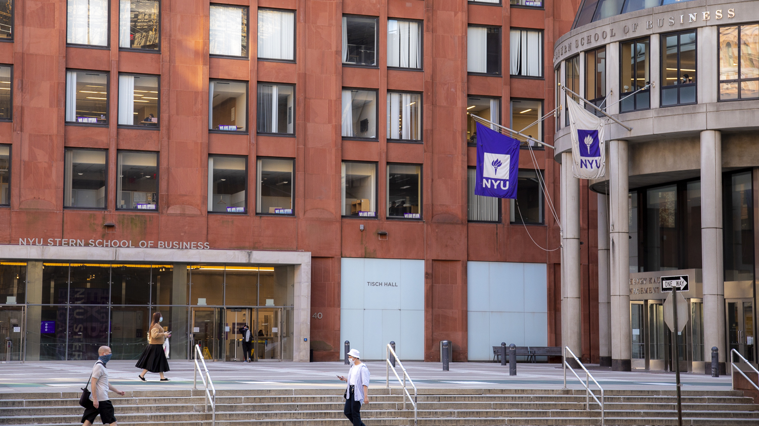
Topic 1 – Class Introduction
Data Science and AI for Business

Slide 2


What do you hope to get out of this course?
[AI Prompt : image of a successful data scientist]
required course for the Tech MBA program
become a better data scientist
be competitive for AI PM roles in Big Tech
bridge technical analysis with business strategy
gain foundational knowledge
effectively communicate with data science team members
understand the fundamentals of data science
be better equipped to be a data driven decision maker
understand the business side of AI companies

Slide 3
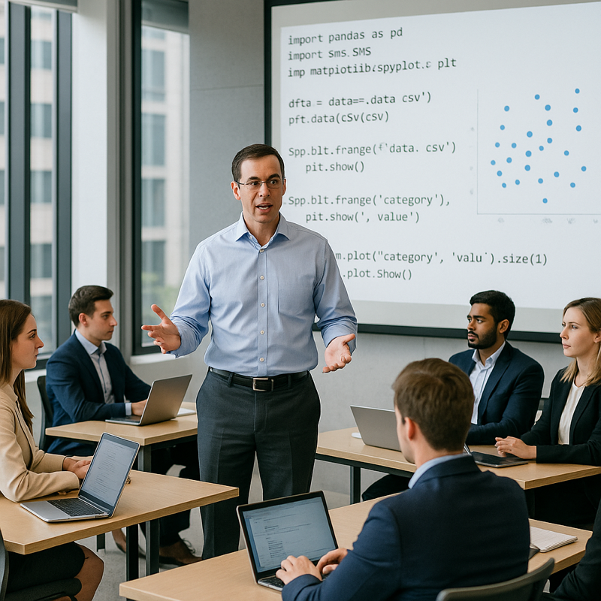
(My) Class Goals
Learn how to approach business problems data-analytically
Appreciate the full range of the data science process
Build (or expand) your knowledge of data science models and methods 🧰
Hands on experience with data science tools and algorithms on real problems (using Python and GenAI tools)
Understand application of methods to real business problems through use cases
[Professor teaching data science to business students]
Incoming expectations:
Basic statistical knowledge
Mean v median, spread
Variation, sampling
Concepts of hypothesis testing
Ability to read statistical graphs
Basic python (or other programming) knowledge
Notes:
Toolbox
Improve data literacy
Class is meant to be practical, focused on data literacy.
Not a programming class, not an AI class.
Class is not: engineering, math heavy, big data or databases.

Slide 4




About Me
The best part about being a [data scientist] is you get to play in everyone’s backyard.
- John Tukey, AT&T Bell Labs
Notes:
Tukey said “Statistician” but he was really the world’s first data scientist

Slide 5
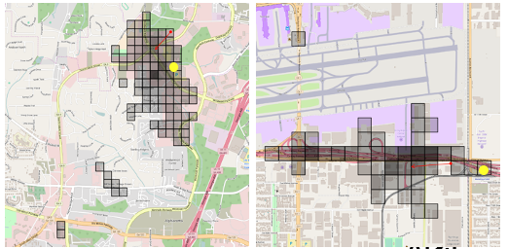
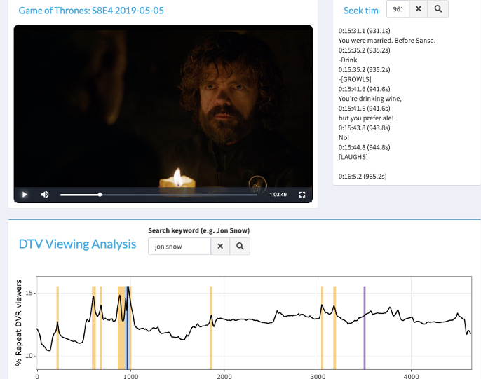
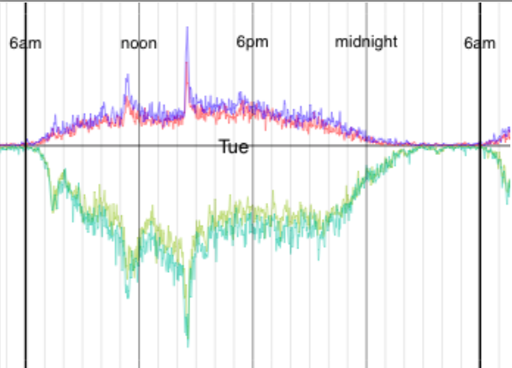
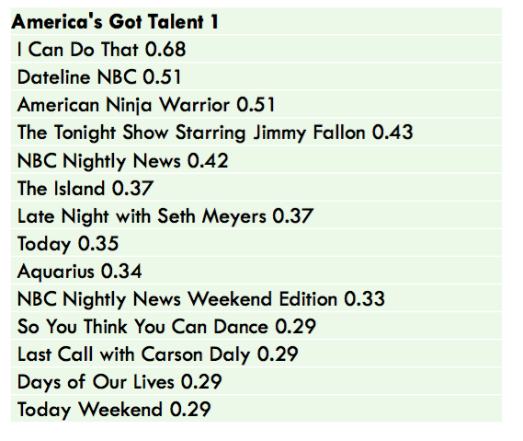
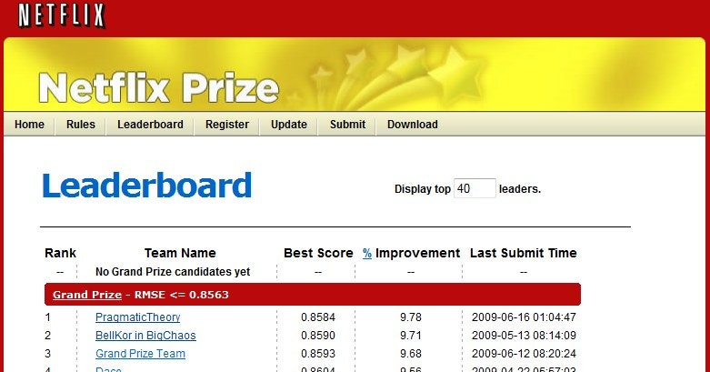
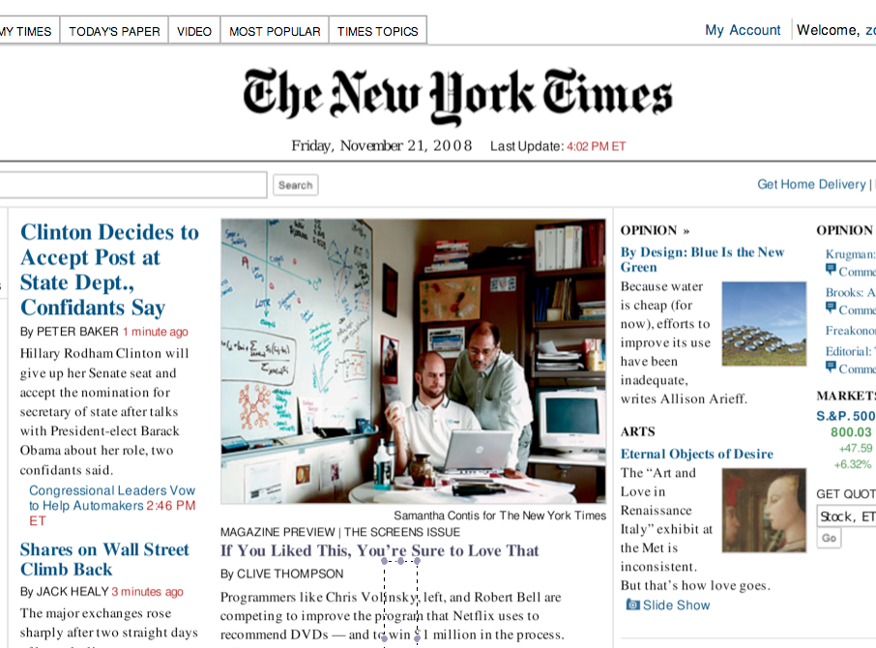
Data Science Projects
Network analytics
TV and Video Consumption
Content Recommender Systems
Notes:
As a DS got to work with people in many different fields.

Slide 6
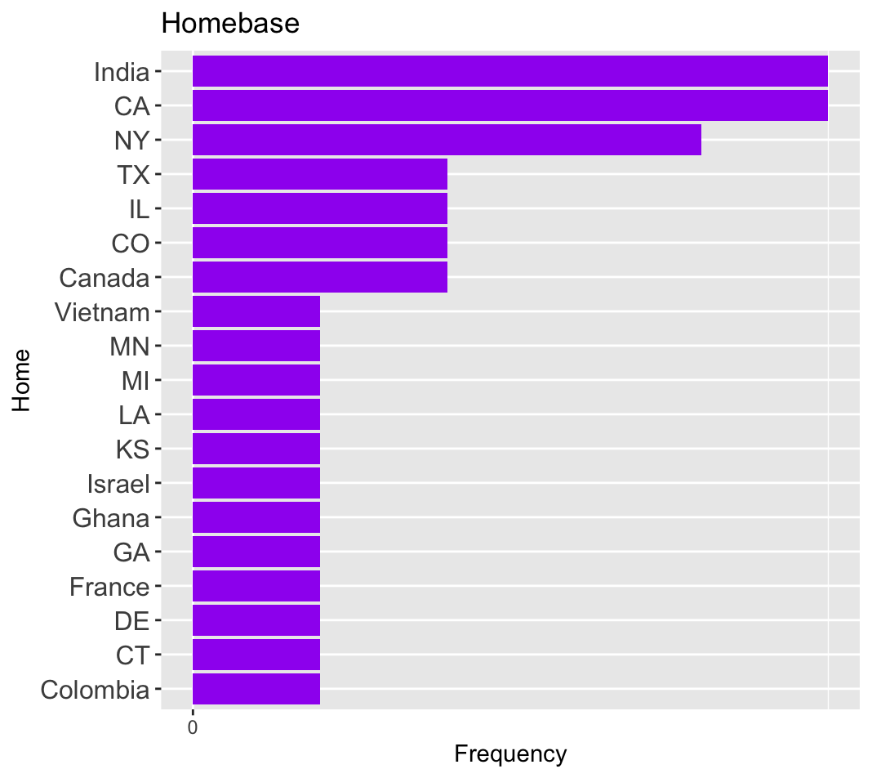

About you…
Where are we from?

Slide 7
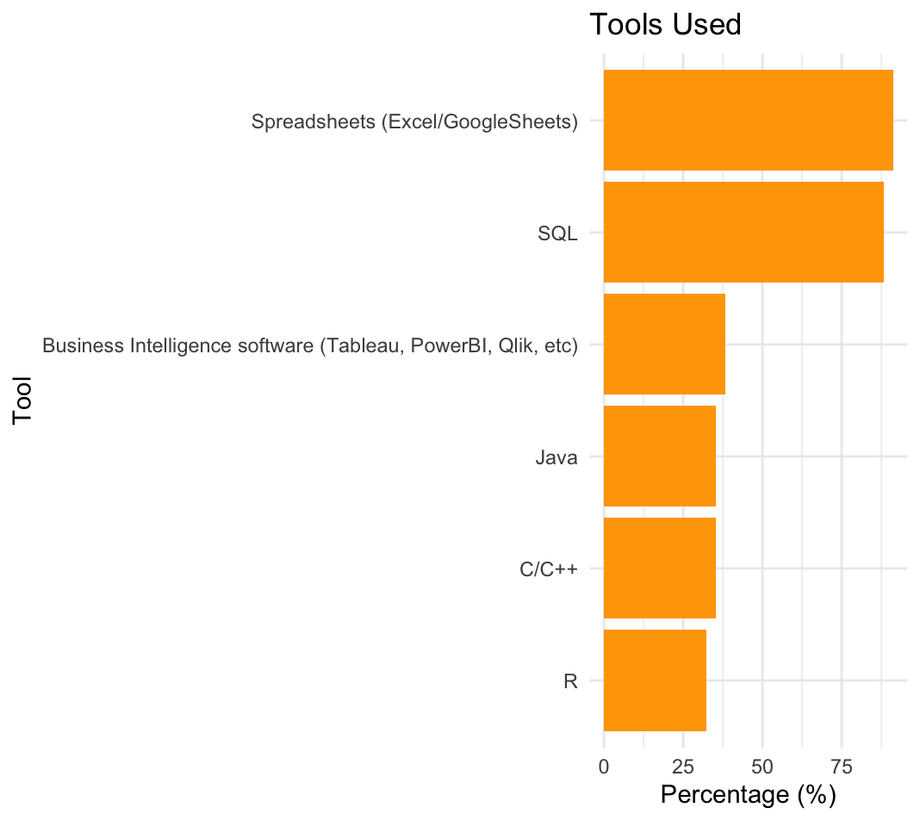
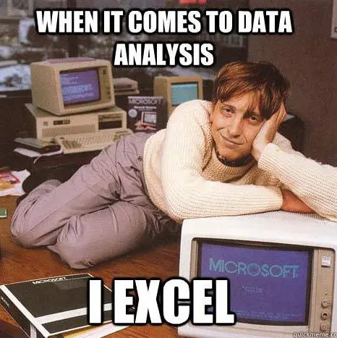
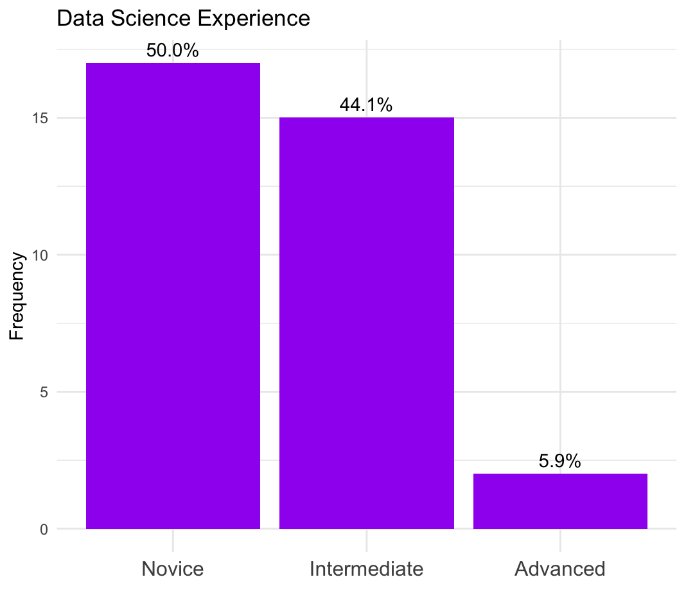
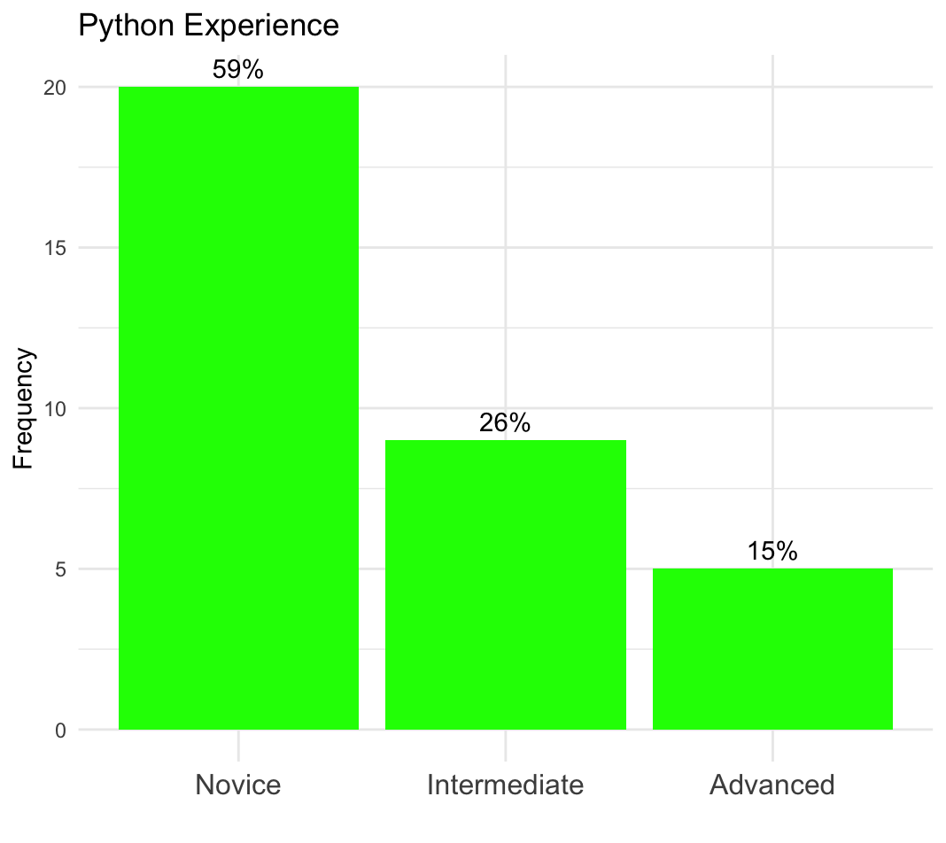
Tools and experience…

Slide 8
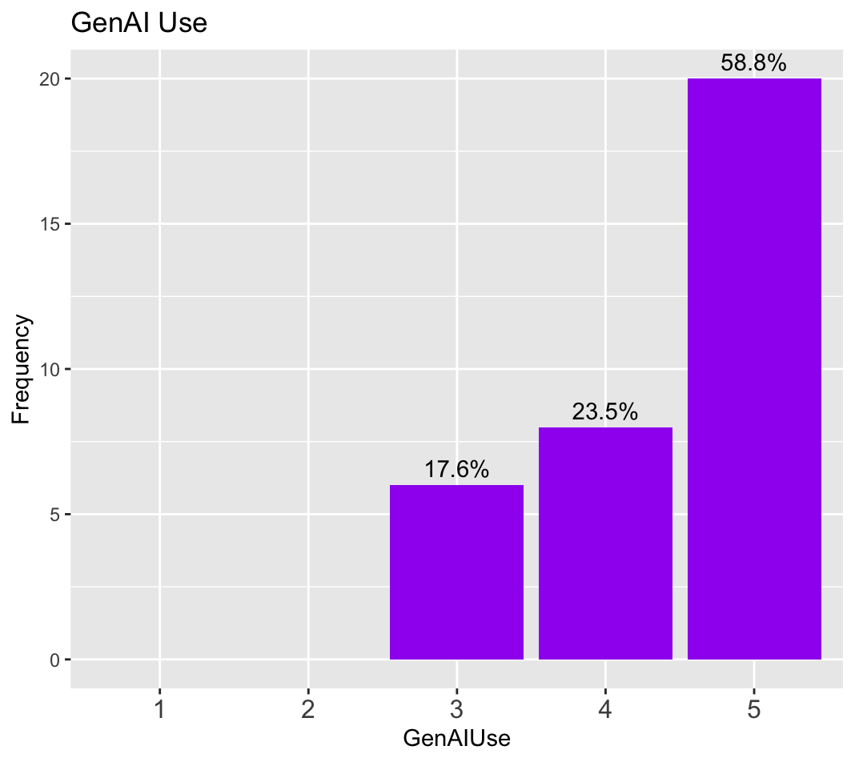
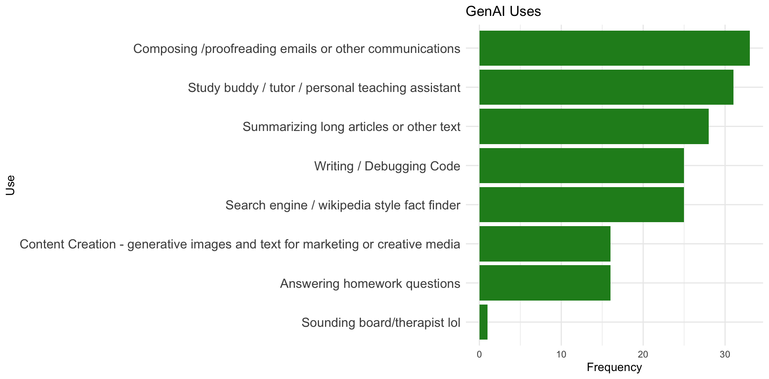
GenAI

Slide 9
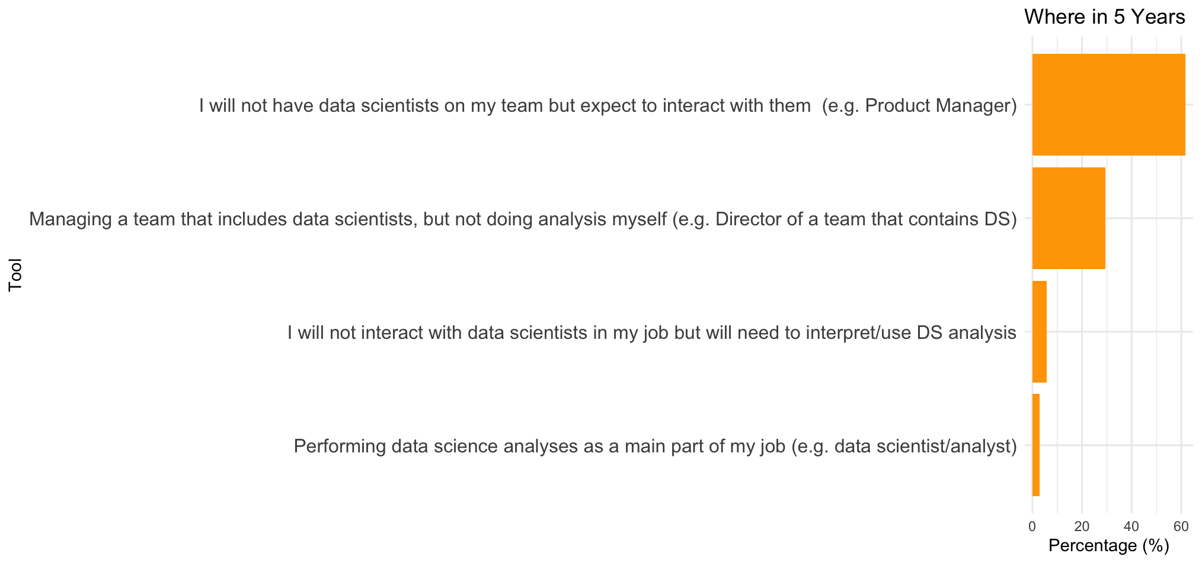
Five Years On..

Slide 10

Music and Food
Naya | 4
Pura Vida | 3
Brown Bag Sandwich Co | 3
Dig Inn | 3
Mamoun’s | 2
Springbone | 2
+ 12 others
Taylor Swift | 3
Bad Bunny | 2
Chappell Roan | 2
Coldplay | 2
Dominic Fike | 2
Ed Sheeran | 2
Grateful Dead | 2
Khruangbin | 2
Morgan Wallen | 2
Mt Joy | 2
Tame Impala | 2
+ 60 Others
Stumptown | 5
Matto | 4
Third Rail | 3
La Cabra | 2
HeyTea | 2
+ 17 More
All lists posted on Brightspace / Discussions

Slide 11
About this class…

Slide 12
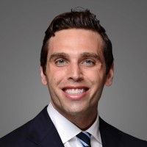
Meet your TA
Adam Peterson
Office Hours
TBD
Python/HW questions should start with TA
Course related or Project related questions can come to me
Helpful: Let us know if you are coming to office hours

Slide 13

Let’s talk about Python
Work through the introductory notebooks (HW0)
if you have trouble at this level lets discuss.
Due Friday! (graded only on completion)
Python IDE:
Colab will be what we use in class
For HW, projects you may use other IDEs (VScode, PyCharm, etc)
HW submitted on BS as .ipynb file
Pro Tip : Save all CoLab notebooks to your own Google Drive!!!

Slide 14
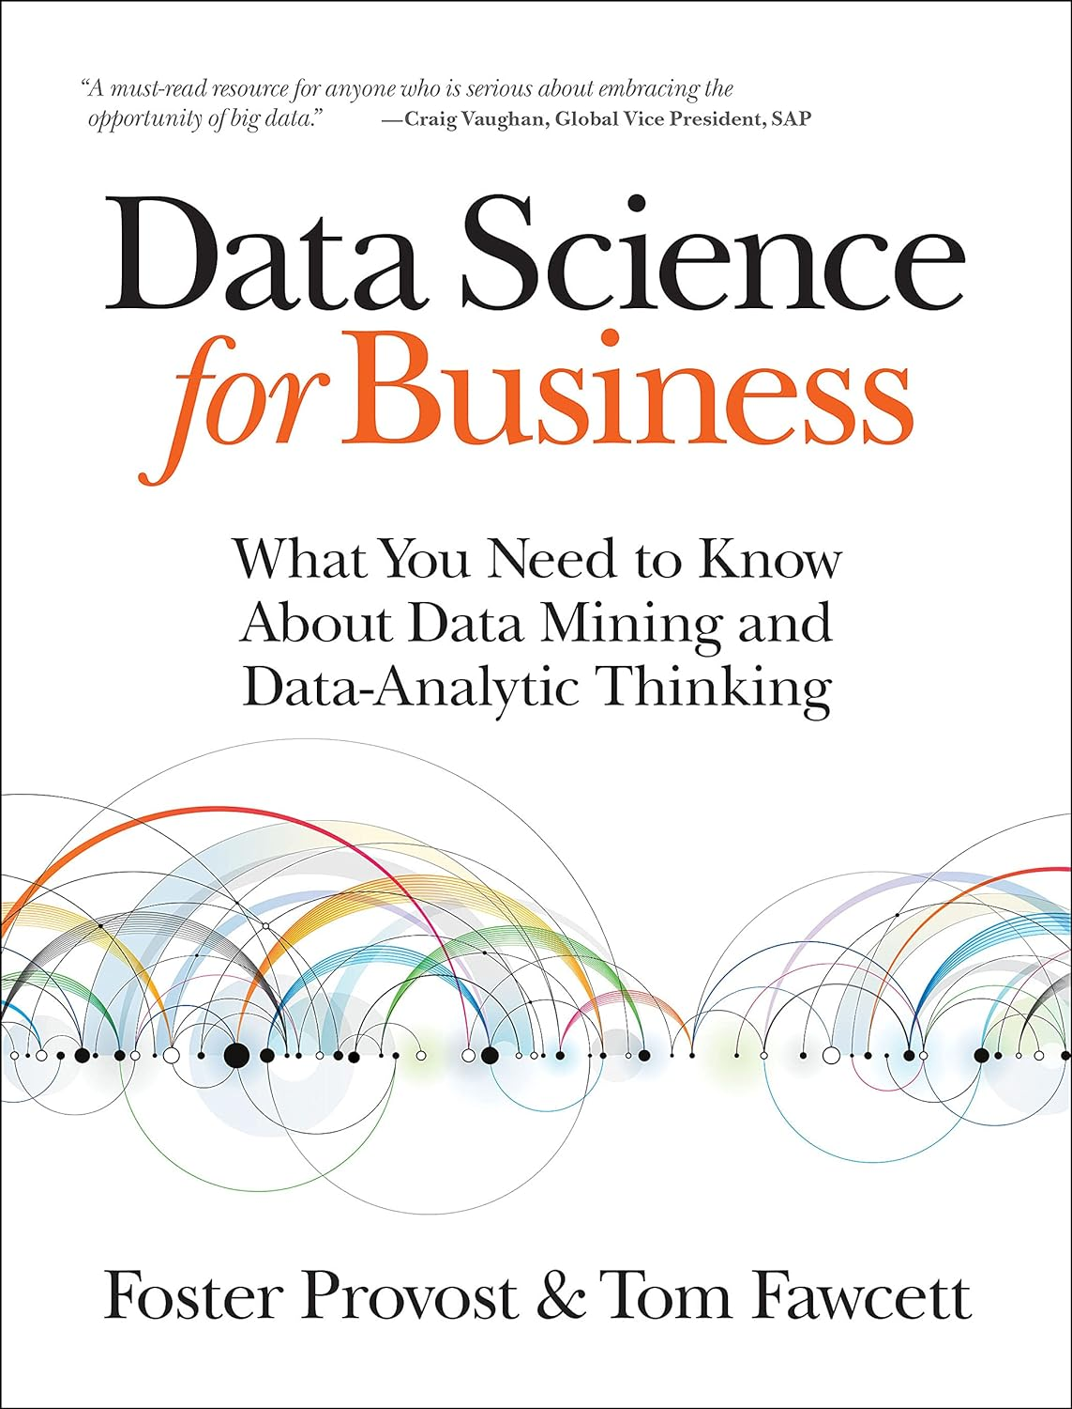
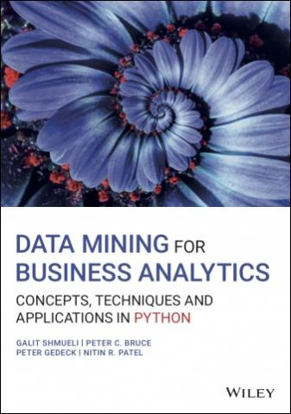
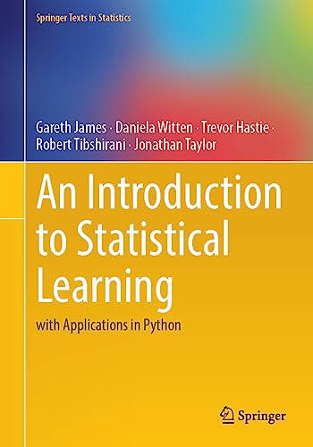
Textbooks
Required Text: Data Science for Business 2e [DSB]
Digital version available through bookstore - see Brightspace for details
Main text – data analytic thinking, business context
Optional Texts (all freely available – see syllabus):
Learning
Data Mining for Business Analytics (with applications in Python) [Shmueli]
Lots of good examples and code
An Introduction to Statistical Learning (with applications in Python) [ISLP]
More technical, deeper topics, python code

Slide 15

Grades
As per Stern Policy,
At most 35% of class will get A/A-
Quiz/Exams (2) 30%
2 in-class quizzes, non-cumulative
At start of class (30 min)
One page of notes allowed
No makeups!
Let me know of conflicts in advance
No final exam
Participation / Attendance : 5%
Show up, engage, participate!
Attendance will be taken
3 “freebies”
Brightspace discussions
Data Project 35%
Groups of 4
Select your own groups by next week or I will select for you
Multiple deliverables throughout the year
HW (4) 30%
Assigned and collected in Brightspace
Late HW:
25% reduction < 24 hr
50% reduction < 72 hr
HW are detailed
Start early!
Take advantage of TA office hours
Notes:
3

Slide 16
Class Data Project
Groups of 4 – selected by you or me
Goal: Find a data set that can address a business problem of interest. Use learnings from class to follow the data science process, analyze the data and evaluate the business impact.
Deliverables:
Week 2: Finalize teams of 4
Week 4: Initial Topic / Data Proposal
Mid-year: Status Report submitted
Last two weeks of class: In-class Presentations
Finals Week: Written reports (~20 pages) due
Notes:
Finding a good data set is worth the time and effort – start early!!!
Come with your group to at least one of my office hours to discuss ideas/progress
See detailed description on Brightspace, will discuss more next week
Groups of 4 to be finalized next week!

Slide 17
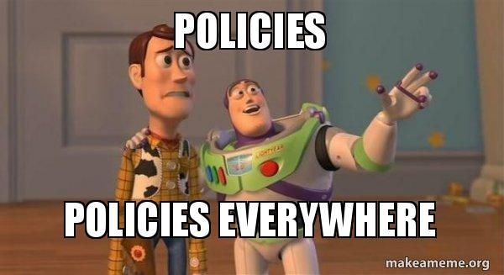
Policies
Religious Holidays
Accommodations
Academic Integrity
Stern Code of Conduct
Please check online syllabus for links and details

Slide 18
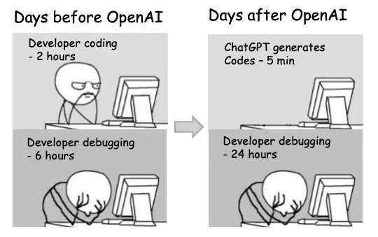
Generative AI Policy
Class Policy: Use of GenAI tools is freely allowed
Don’t use GenAI to simply provide the answer
Copy/paste strategy is a) obvious to grader and b) not a good way to learn
It can be wrong!
Do use GenAI for
Getting over stumbling blocks for coding
Debugging / error messages
Brainstorming ideas for directions
Explaining code
Why would I use method A over method B
Why might I be seeing these (strange)results?
A “study buddy”
GenAI is the best learning tool we have ever seen. Use it that way! Ask it questions, dig deeper
“use AI to train your brain”
Notes:
Plaigiarism point: can detect when it is used due to certain words “commendable, intricate, versatile, meticulous”
AI is a natural progression:
Phones we didn’t have to remember numbers
Internet we didn’t have to remember facts
Email storage we didn’t need to remember ocnversations
We just have to adjust
Don’t need to build the car, need to drive the car

Slide 19
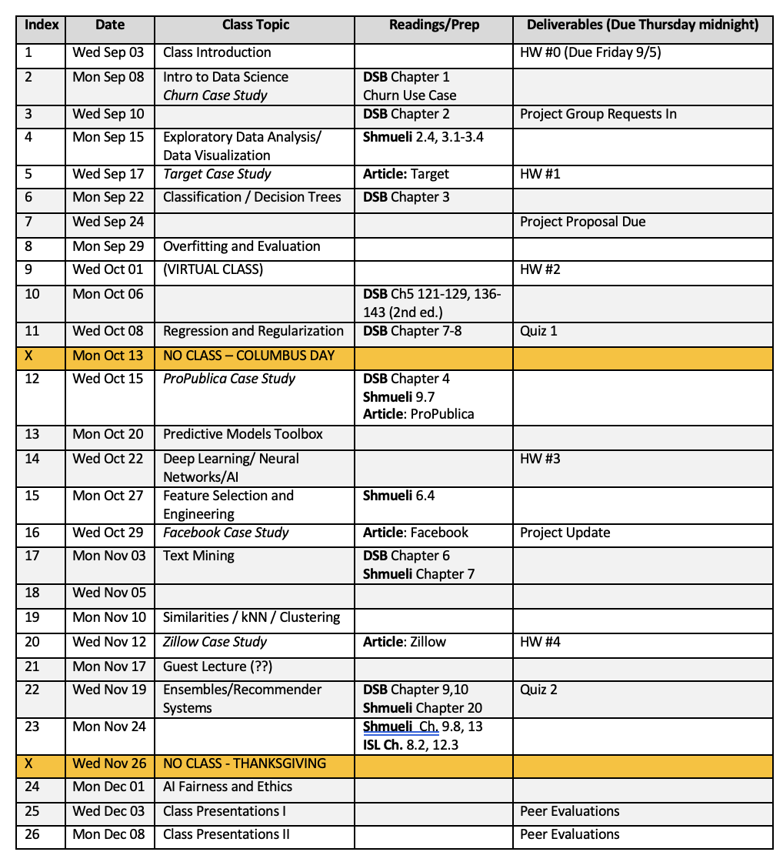
Class Calendar

Slide 20
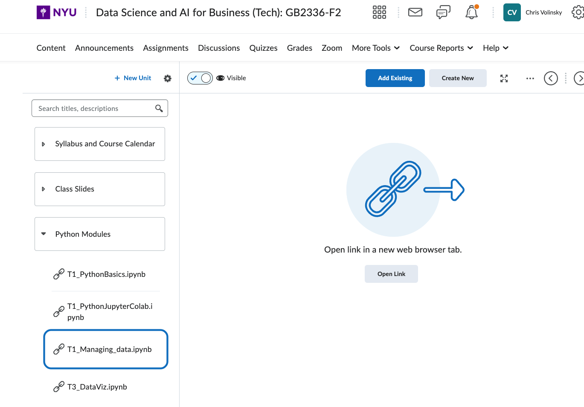
Input and Manage Data
T1_Managing_data.ipynb

