Slide 1
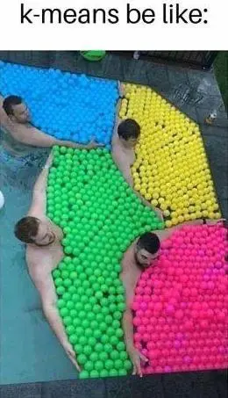
Topic 10 – Similarity, Nearest Neighbors, and Clustering
Data Science and AI for Business – Fall 2025

Slide 2
Similarity

Slide 3

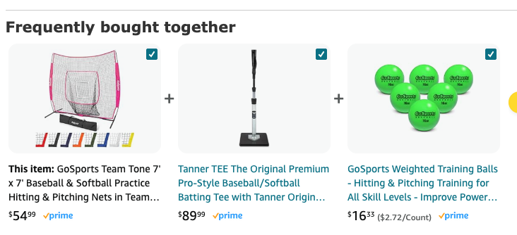
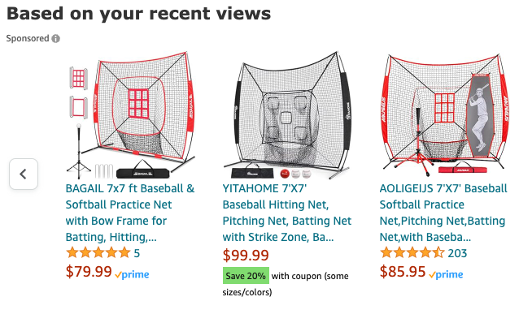
Similarity
The concept of similarity underlies many data science methods and solutions to business problems
Idea: If two things are similar in some ways, they often share other characteristics as well
Think about how similarity is used in retail:
Notes:
Products can be similar
Products can be bought together
People can be similar
How does similarity work in retail?

Slide 4





Similarity (and distance…)
We need a metric to define how similar any two customers are:
Customer | Age | Income | No. credit cards | Response
John | 35 | 35K | 3 | Yes
Charlene | 22 | 50K | 2 | No
Rayshawn | 63 | 200K | 1 | No
Ping | 59 | 170K | 1 | No
Nellie | 25 | 40K | 4 | Yes

Slide 5
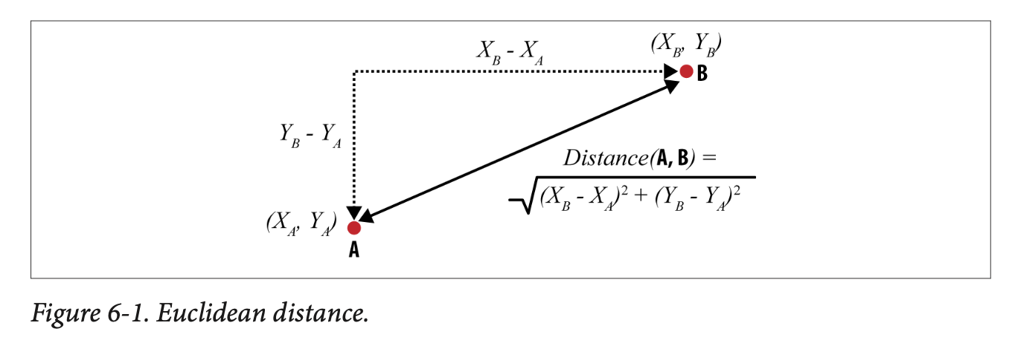
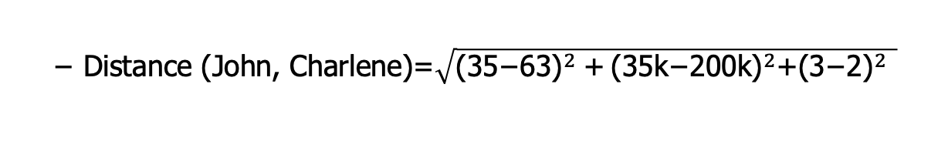
Similarity/distance
Customer | Age (X₁) | Income (X₂) | No. credit cards (X₃) | Response (Y)
John | 35 | 35K | 3 | Yes
Rayshawn | 63 | 200K | 1 | No
“Closeness” is defined in terms of the distance between two data items.
The most common numeric difference is Euclidean distance:
Distance (John, Charlene)=$\sqrt{{\text{(35−63)}}^{2} \text{+}{ \text{(35}\text{k}\text{−200}\text{k}\text{)}}^{2}\text{+}{\text{(3−2)}}^{2} }$
Do you see any issue with calculating distance this way?

Slide 6
Euclidean Distance
Customer | Age | Income | No. credit cards | Response
John | 35 | 35K | 3 | Yes
Rayshawn | 63 | 200K | 1 | No
Distance (John, Rayshawn)=sqrt [(35-63)² + (35,000-200,000)² + (3-1)²]
Distance between neighbors will be dominated by attributes with relatively large values
Goal: Each attribute should have the same “weight”
Solution: Normalize numeric variables – standard way to do this
Create z-scores by subtracting mean and dividing by standard dev
New feature will have mean = 0 and sd =1
from sklearn.preprocessing import StandardScaler
Notes:
And to take logs, for long-tail distributions (in our case, we divided by 1000)

Slide 7
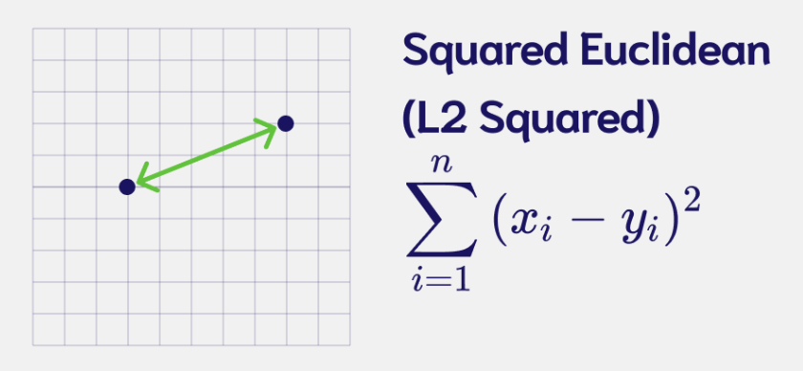
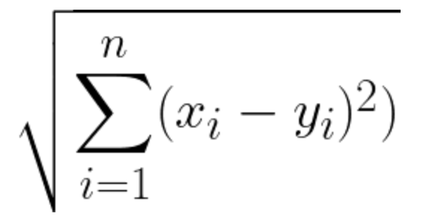
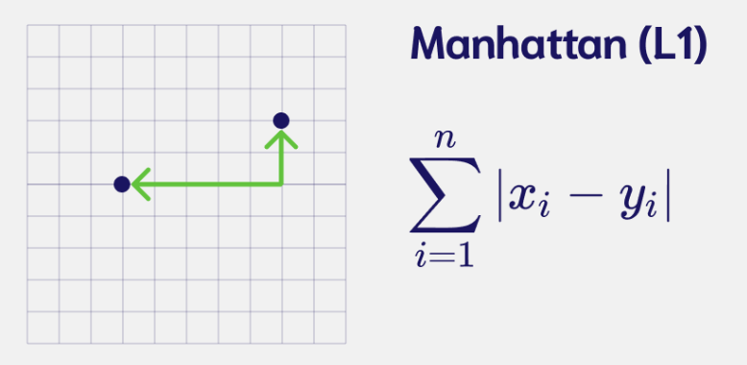
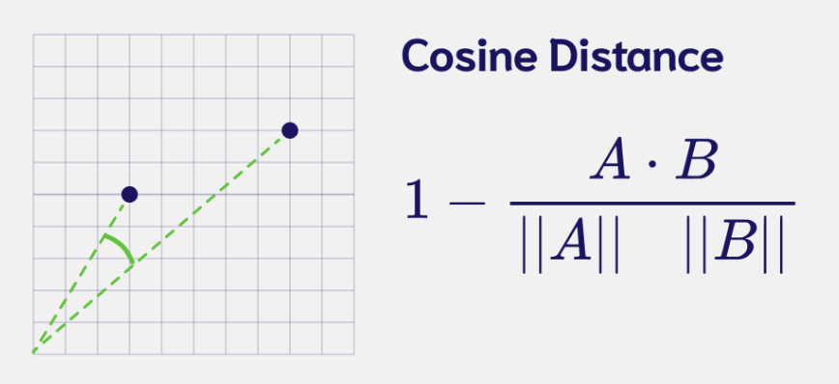
Different types of similarity/distances
Euclidean
Squared differences
Manhattan
Absolute differences
Less sensitive to outliers
Often used with many dimensions
Cosine
Often used in text analysis, sparse data
Direction more important than magnitude

Slide 8
Supervised: K-Nearest Neighbors (kNN)

Slide 9
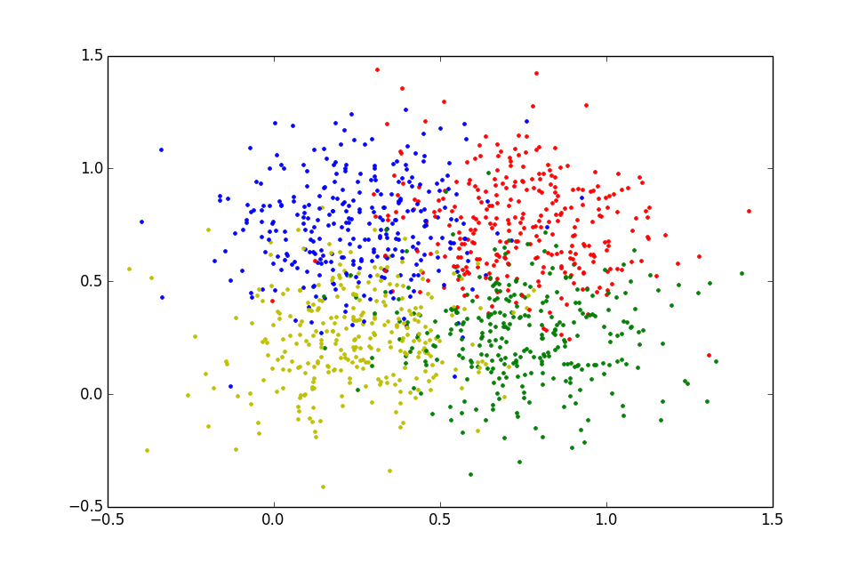
Nearest Neighbors: The idea
K-Nearest Neighbors (kNN) is a classification algorithm that ignores global structure and simply looks at similarities
I don’t know anything about this new customer…but if I can find their “neighbors” I might be able to infer something…

Slide 10

Using similarity for classification
Customer | Age | Income | No. credit cards | Response
John | 35 | 35K | 3 | Yes
Charlene | 22 | 50K | 2 | No
Rayshawn | 63 | 200K | 1 | No
Ping | 59 | 170K | 1 | No
Nellie | 25 | 40K | 4 | Yes
Jalen | 37 | 50K | 2 | ?
Notes:
Concptionslly the idea is easy…who is he most similar to and use that to make a predictions

Slide 11
Nearest Neighbors for Classification
To determine the class of a new example (Jalen):
Calculate the distance between Jalen and all examples in the training set
Select k examples closest to Jalen in the training set
Assign Jalen to the most common class* among its k nearest neighbors
yes
Similarity rank =2
Similarity rank =4
no
Similarity rank =1
yes
Prediction for Jalen = yes
Similarity rank =5
Similarity rank =3

Slide 12
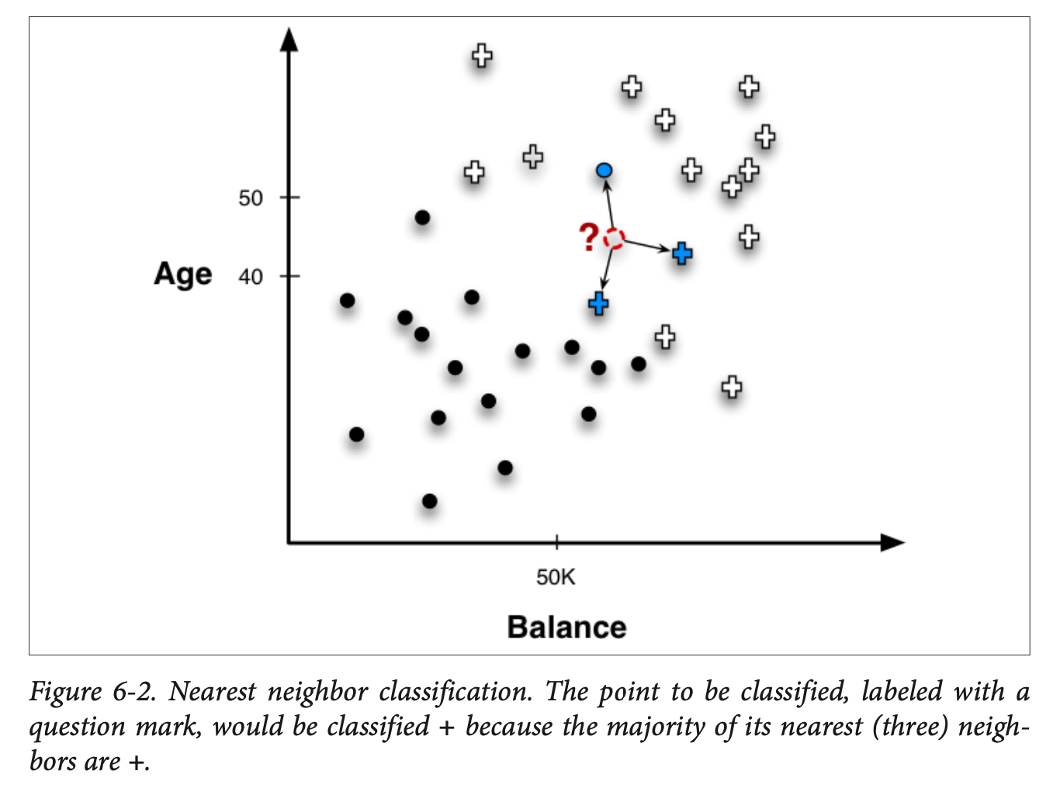
K-nearest neighbors
This is called “k-nearest-neighbors” or kNN classification
Note that your answer will depend on the k that you choose

Slide 13
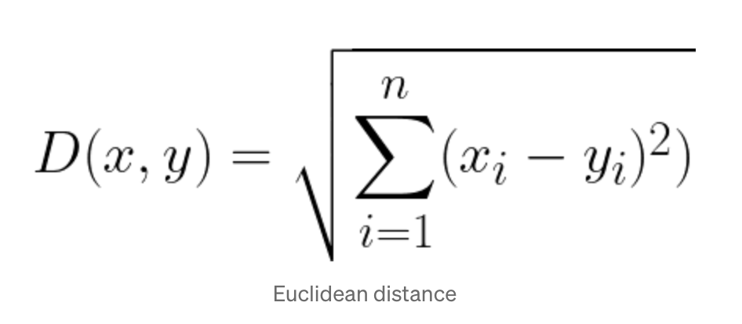
Example: K=1
Normalized data…
Customer | Age | Income (K) | No. cards
John | -0.30 | -0.81 | 0.61
Charlene | -0.98 | -0.62 | -0.15
Rayshawn | 1.16 | 1.27 | -0.92
Ping | 0.95 | 0.89 | -0.92
Nellie | -0.83 | -0.74 | 1.38
Jalen | -0.20 | -0.62 | -0.15
Response
Yes
No
No
No
Yes
?
Distance from Jalen
0.80
0.78
2.45
2.05
1.66
NO (1/1)

Slide 14
Example: K=3
Customer | Age | Income (K) | No. cards
John | -0.30 | -0.81 | 0.61
Charlene | -0.98 | -0.62 | -0.15
Rayshawn | 1.16 | 1.27 | -0.92
Ping | 0.95 | 0.89 | -0.92
Nellie | -0.83 | -0.74 | 1.38
Jalen | -0.20 | -0.62 | -0.15
Response
Yes
No
No
No
Yes
?
Distance from Jalen
0.80
0.78
2.45
2.05
1.66
Yes (2/3)

Slide 15
K-nearest neighbors
Strengths
Simple to implement and use
Interpretable – easy to explain
easy to add data
Weakness
Results are dependent on selection of k, distance function, and scaling
Probability estimates less useful (precise) than other methods
Considerations
What k is optimal?
What if k=N?
What if k=1?
Notes:
K = n you predict the majority class for everybody
K=1 you have a lot of variance…
Which one has the most complexity

Slide 16
Geometric interpretation
Age
X
How would you classify these X values?
40
X
X
100K
Income
Notes:
K=1 vs 3 might be different…

Slide 17
How does a 1-nearest-neighbor classifier partition the space?
Age
Question: Which is more complex, higher or lower k??
40
100K
Income

Slide 18
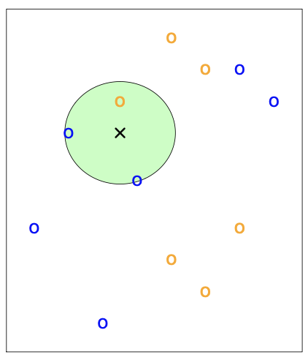
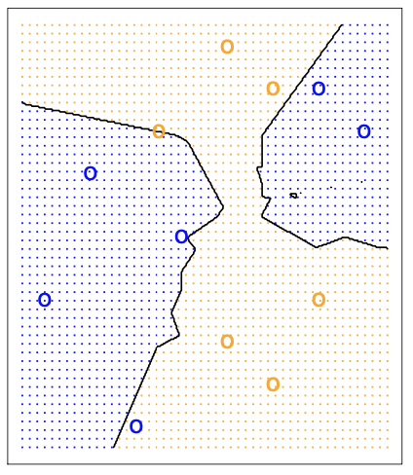
kNN – Decision Boundaries
k=3 nearest neighbors
Decision boundary for k=3

Slide 19
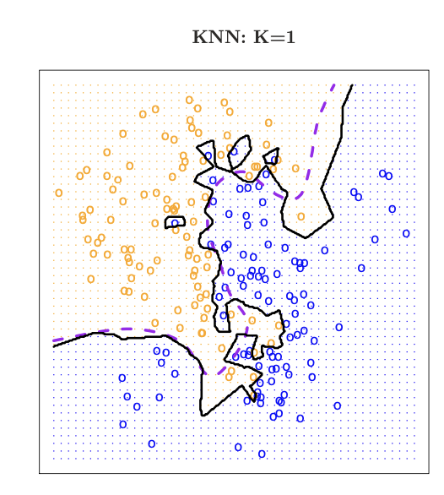
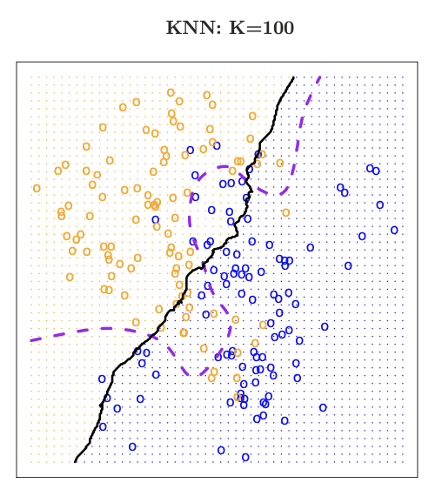
kNN and Complexity
Dashed line is the best answer based on knowing how the data was simulated
K is a complexity parameter
Small k has more complex decision boundary - tends to overfit the data
ISL Chap 2.2

Slide 20
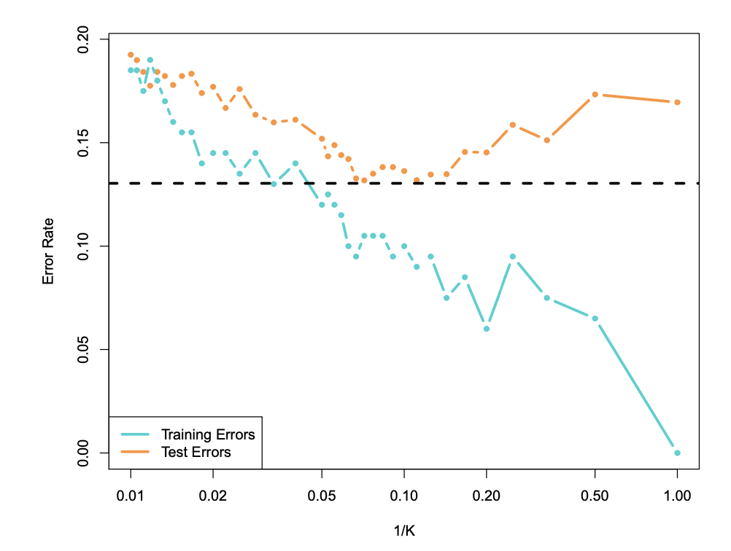
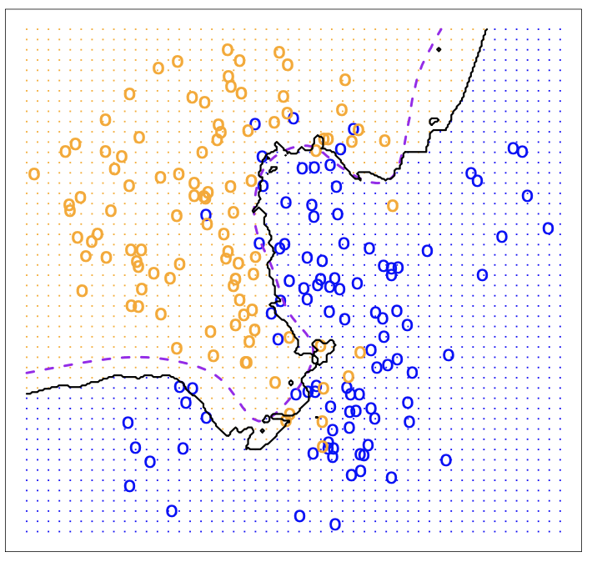
Optimizing k though cross-validation
k=10
Because high values of k correspond to low complexity, we use 1/k as the X-axis

Slide 21
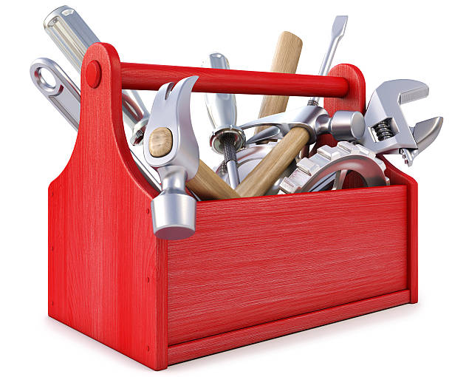
kNN as Regression model
kNN also works as a regression model
To get a prediction – use the average of the k nearest neighbors…
Finding the right k via cross-validation : use RMSE instead of error rate…
sklearn.kNeighborsClassifier(n_neighbors=k)
sklearn.kNeighborsRegressor(n_neighbors=k)

Slide 22
Unsupervised: Clustering

Slide 23
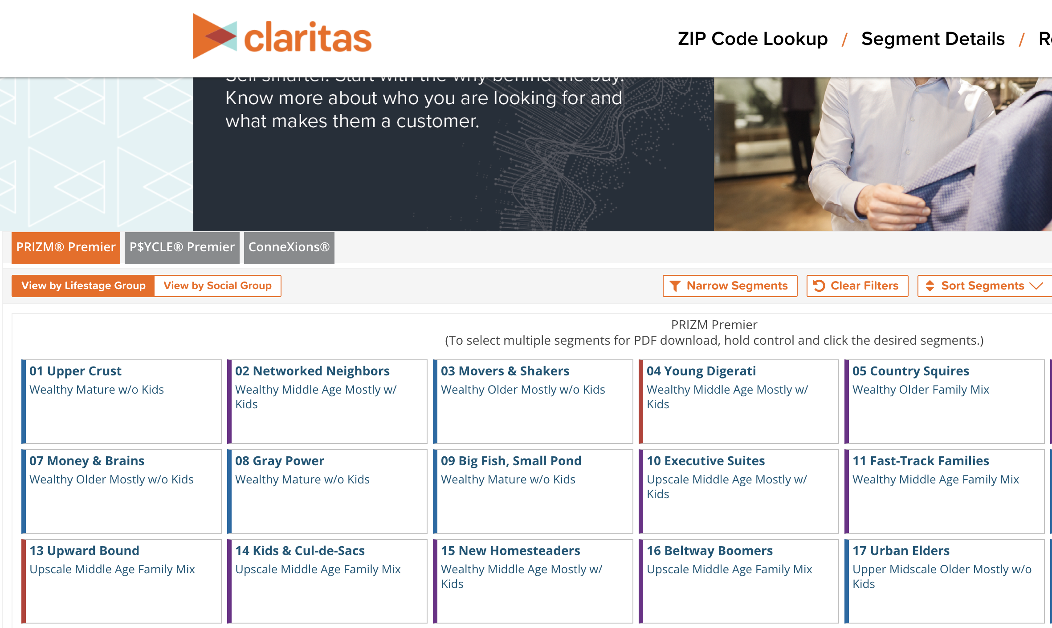
Clustering
Use data to automatically find interesting groupings of my data
Example: Claritas Customer Segmentation:
https://claritas360.claritas.com/mybestsegments
Notes:
By defining pre-set groups, no need to calculate all of the distances from everybody to everybody else.
Also, can combine with distances for a new customer.

Slide 24
Clustering
Question: How do I find (distinct) groupings of similar things?
“things” are objects with many features (multidimensional)
Key notions:
Define a similarity/distance metric between objects
Let the algorithm define clusters so the distance to things in a cluster are smaller than the distance between clusters
Two basic types of clustering:
Centroid based (a.k.a. Partitional)
Hierarchical
Notes:
Note: clustering assumes each point falls into

Slide 25
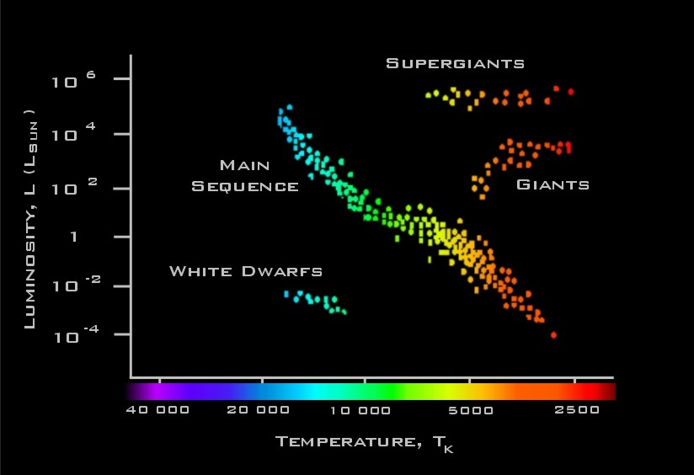
Clustering: Main idea
Ideally : create clusters of data items to achieve:
Maximum similarity between items within a cluster
Maximum dissimilarity between characteristics of different clusters
Intra-cluster distances are minimized
Inter-cluster distances are maximized

Slide 26
Clusters: k-means
One popular type of clustering is called “k-means clustering”
Again with the k!
k-means clustering:
Requires you to pick the number of clusters when you start – k!
Start with some guess as to the cluster centers
Iterate between
Classifying each point in one of the clusters
Recalculating cluster centers

Slide 27
K-Means
Predetermined
number of clusters
Start with seed centroids – random??
Seeds

Slide 28
Assign Instances to Clusters
Every point gets assigned to a cluster based on which centroid it is closest to

Slide 29
Find New Centroids
Calcuate the new centroids of the clusters

Slide 30
New Clusters
Repeat !!
Another example…

Slide 31
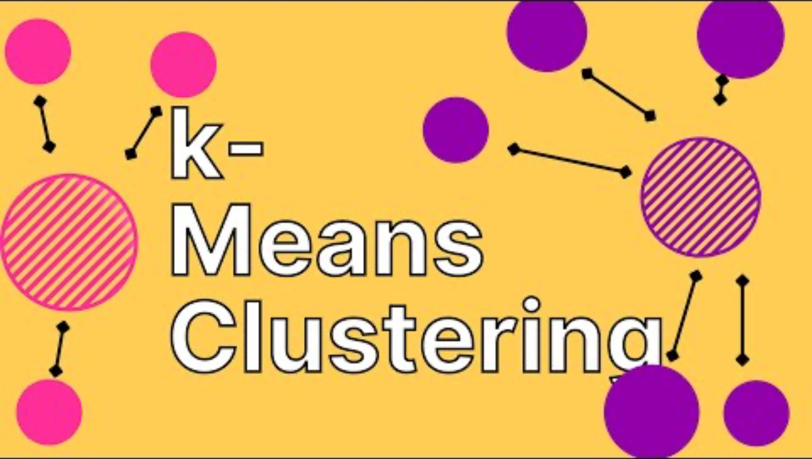
K-means
https://www.youtube.com/watch?v=DQTz7yVmz_g&t=103s (1:43)

Slide 32
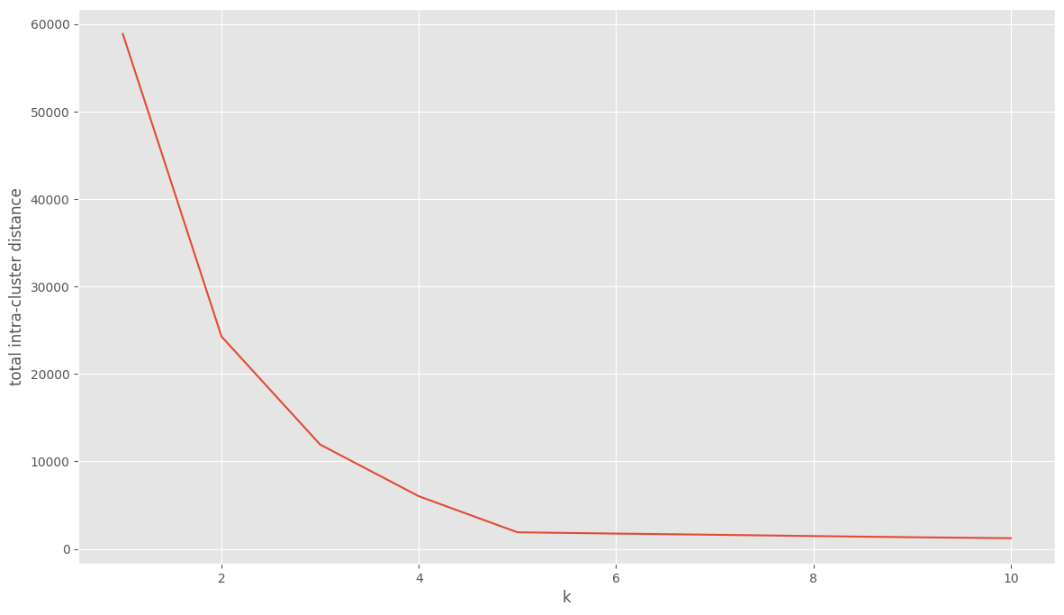
How to pick k?
When you start with a data set you have no idea how many clusters there are!
Why cant we just select k via cross-validation???
One method plots the decrease in intra-cluster variance as k increases – called the “elbow” method.
As k increases, inertia always decreases,
But…we can look for the point of diminishing returns, the “elbow”
Not an exact science!
Within cluster variance,
Or inertia
K=number of clusters
Notes:
No cross-validation because there is no metric for success!!!

Slide 33
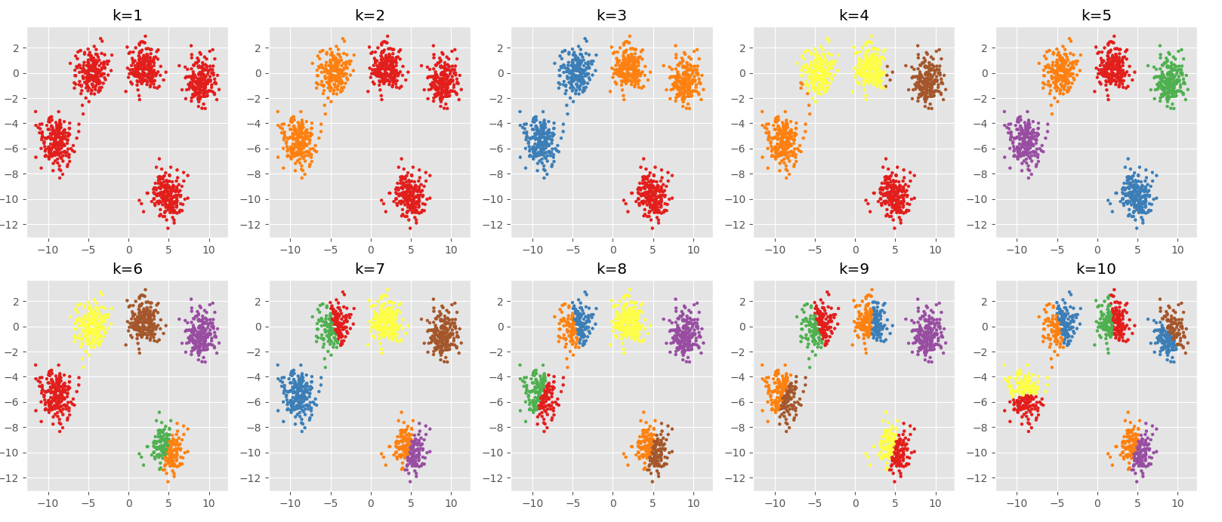
Best case scenario
Data consists of 5 clusters
Fit k-means with k=[1,10]
Real data will be messier…
”elbow” is where the curve starts to flatten, that is the optimal k
Intra-cluster variance
kmeans_Clustering.ipynb

Slide 34
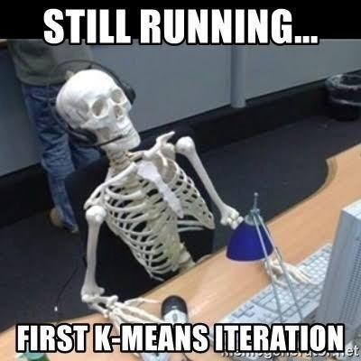
Discussion: k-means clustering
Data naturally does not cluster!!!!
But the algorithm will always find clusters….
Caveat emptor….
Sensitive to initial centers
n_init in sklearn implementation helps
Converges to a local optimum
Can run multiple times and get different results
Specifying the number of centers is subjective
”elbow method” imprecise
sklearn.cluster.KMeans
Notes:
S in pybbb

Slide 35
Unsupervised Learning – Hierarchical Clustering

Slide 36
Clustering: Hierarchical Clustering
Build a hierarchy of clusters from the bottom-up …
B
D
A
E
C
Start with n clusters, and progressively merge data until you have one cluster

Slide 37
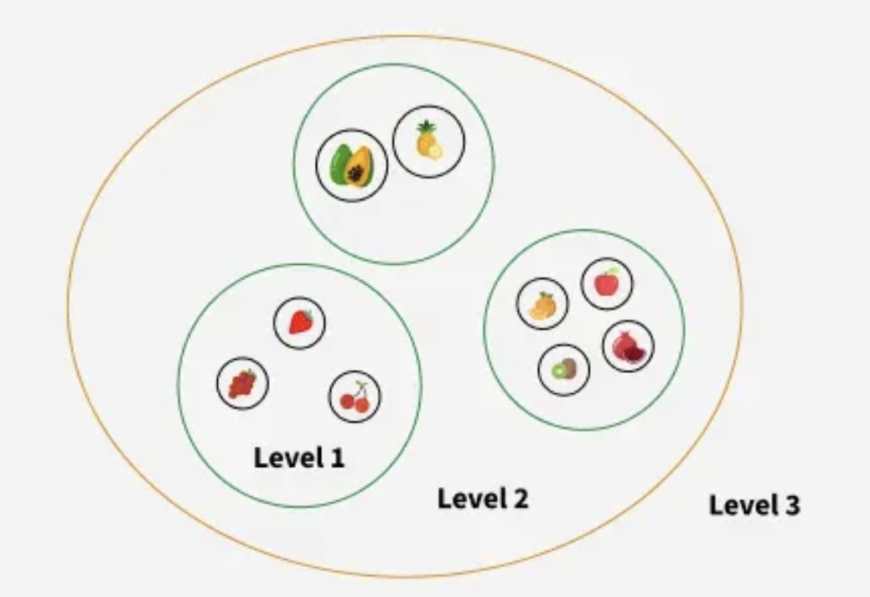
Clustering: Hierarchical Clustering
A different philosophy on how to find clusters:
Generic Algorithm:
Compute all pairwise similarities
Place each of n examples into a cluster of its own
Merge the two most similar clusters into one;
replace the two clusters by the new cluster
Repeat the above step until there are only k clusters left (note k could = 1).

Slide 38
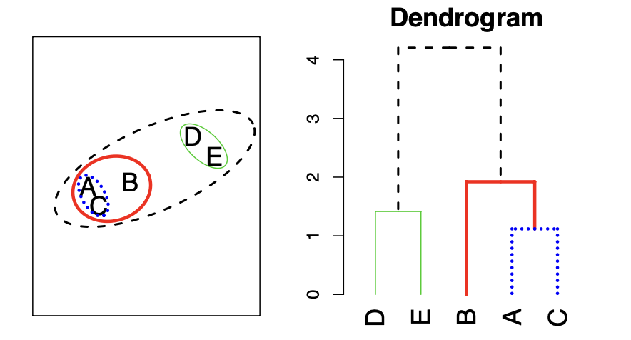
Dendrograms
Dendrograms are a visual representation of the hierarchical clustering process
Closest points get connected lower in the dendrogram

Slide 39
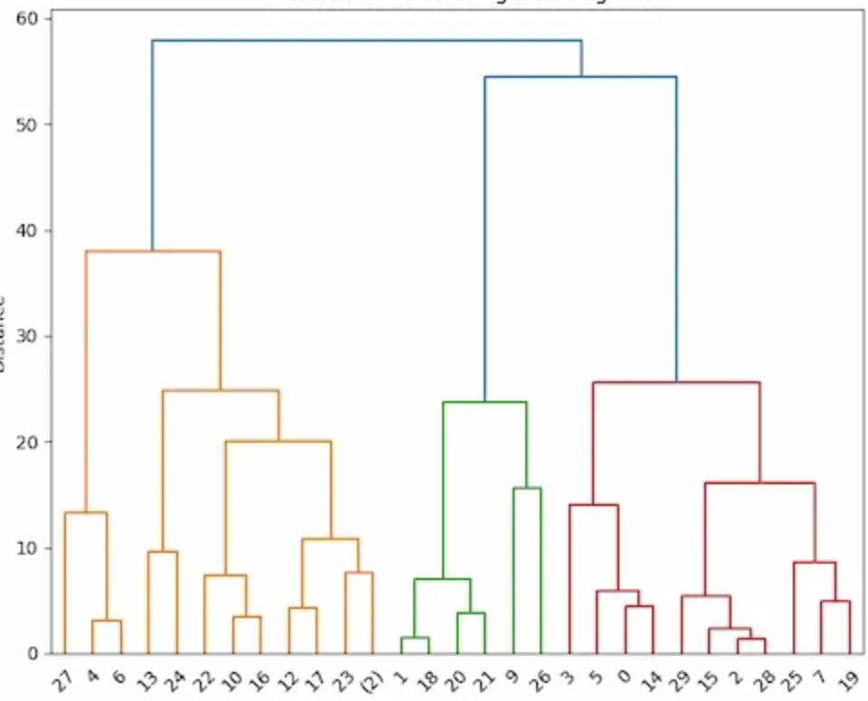
Dendrograms
Where you cut the dendrogram determines how many clusters you return:
This cut results in 3 clusters
This cut results in 8 clusters
You can partition your data into any number of clusters, from 1 to n

Slide 40
Make the Dendrogram!!
F
C
D
E
B
I
A
G
H

Slide 41
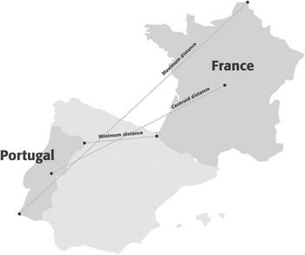
Hierarchical Clustering
Requires a metric for distance between clusters:
Maximum (complete linkage)
Distance between clusters is the maximum distance between two points
Minimum (single linkage)
Distance between clusters is the minimum distance between two points
Average
Distance is the average of all distances
Centroid
Distance is the distance between the centroids
Shmueli Ch 15

Slide 42
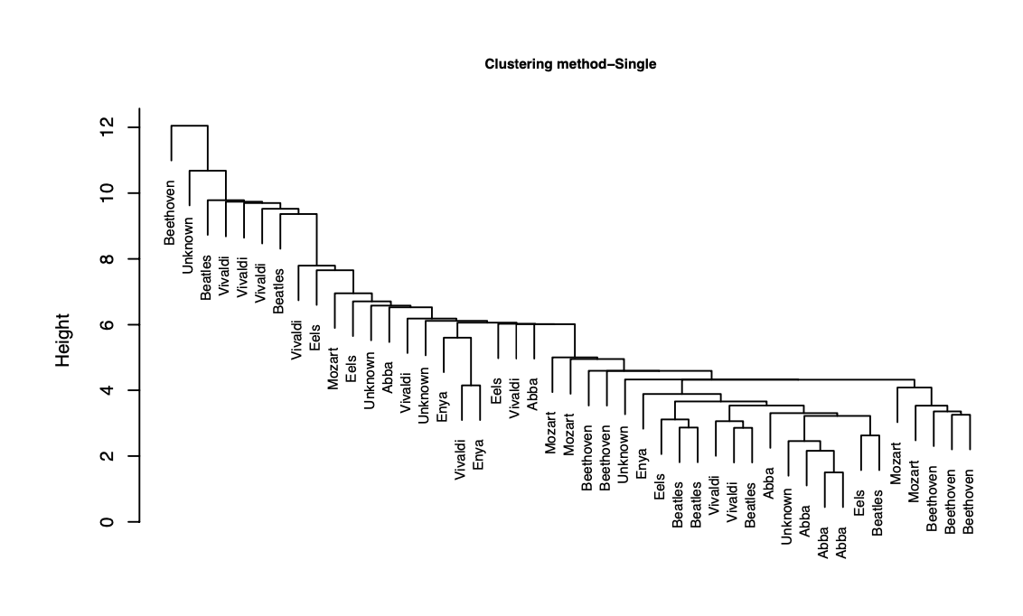
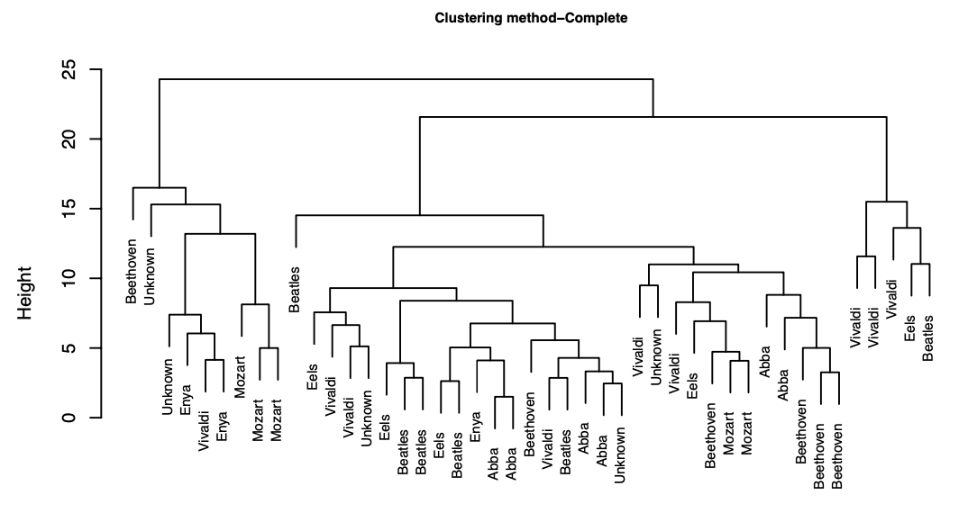
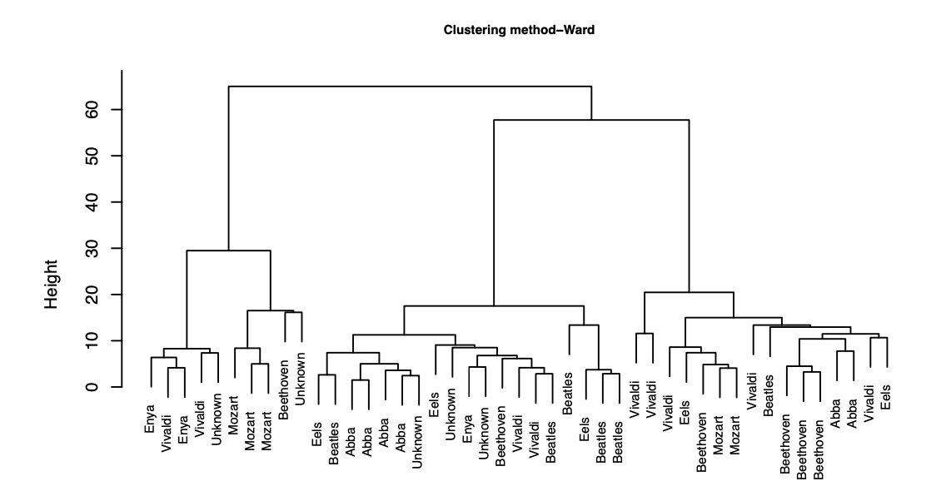
Hierarchical clustering – Music Example
Clustering can look very different under different linkages!
Single
Complete
Ward
Another approach:
Ward’s method: a way of doing Hierarchical clustering – merging is decided based on increase in within-cluster variance

Slide 43
Beware Clustering
Very hard to evaluate clustering output! Consider the following:
Cluster interpretability – did you find anything interpretable?
Cluster stability – do your clusters change with different inputs?
Cluster separation – does there really seem to be a difference between the clusters in a meaningful way?
Number of clusters – did you end up with enough to be meaningful in a business sense?
There are so many different levers to pull, and so little way to evaluate it!
It can be mis-used…algorithms will always reveal clusters, even if there is no real clustering in the data
Or just use as an exploratory measure to find interesting signal or to inspire other work.

Slide 44
Analysis Using Similarities
T9_Similarities.ipynb

Slide 45
Summary
Similarities
Many different ways to calculate similarities (and differences!) between data points
K-nearest neighbors
A useful method for classification that doesn’t involve fitting a model
Clustering
Unsupervised learning method to find groups in data
K-means
Iterative clustering algorithm that finds groups using distances and a given k
Hierarchical clustering
Clustering algorithm that builds a nested sequence of clusters, allowing one to choose any possible k

