Slide 1

Topic 2 – Intro to Data Science
Data Science and AI for Business

Slide 2

Use Case: TelCo Churn
Nadia is a Product Manager at MegaTelCo, one of the largest telecommunication firms. MegaTelCo is having a major problem with net customer churn in their wireless business, and senior leadership has called in Nadia to lead the solution team. You are the lead data scientist reporting into Nadia.
20% of cell-phone customers leave when their contracts expire
Marketing has designed a special retention offer that might be able to convince customers to stay.
What is the business goal?
What is the specific goal of the data science task/model?
What questions might you have for Nadia?
What will be the deliverable of the the data science exercise? What action will you take?
What data could you collect? On what population?
What are 5 specific features you could collect..
How will you measure success?
Notes:
What is churn? Why is it important?
One basis point = bp = .0001 x 70M = 7000 customers you save with one bp improvement of churn x $100 per month = 700k x 12 = 8.4M
Big Question / Small question
Offer: what is it, how much does it cost, can you give it to everybody, is there a downside to giving it to someone who didn’t need it?
One year, get one month free, 20% of next three months? What is their expectation ?
Output/Goal of model: predict who will take the offer? Why people leave? Who is likely to leave? What training set do you need to collect?
Goal: send marketing a list of who to make the offer to.
What is success? 30% take the offer. How do we know that these people wouldn’t have stayed anyway?
Will our action solve the big problem? Don’t know!!
What comes from the algorithm?
We also need decision logic.
What is the outcome? Who to send the plan to, or who will take the plan, or who will leave?
Or who will be impacted by the plan? These are all different things!
Final question…why not just make the offer to everybody?
MAJOR POINTS / WRAPUP:
Business goal and DS goal are different but need to be aligned
Different parts of the business might have different goals, output/action/evaluation success needs to be aligned to the business problem.
If you are not asking the right question, the DS will fail.
Anything ethical

Slide 3

What is Data Science?
The science of extracting useful information and knowledge from data
Data Scientist: Whatevs! We’ve got lots of data and cool algorithms – best prediction wins!!!!
Stats v. Data Science
Statistician: the only valid way to learn from data is to come up with a carefully constructed hypothesis and then collect data in a randomized controlled manner so we can correct for all possible confounding variables and assure ourselves of no bias!
Notes:
“Data science is just statistics with better marketing” - unknown
Pros and cons to these two takes:
Sometimes rigor is really important – medical testing, etc.
Depends on the situation.
Distribution focused
Data focused
Focused on models for understanding variable relationships
Focused on algorithms for prediction
Relatively small, clean data sets
Real-world, large, messy data
Used for scientific understanding
Used in business production systems
Starts with hypotheses
Can be exploratory
Obsessed with significance
¯\_(ツ)_/¯

Slide 4
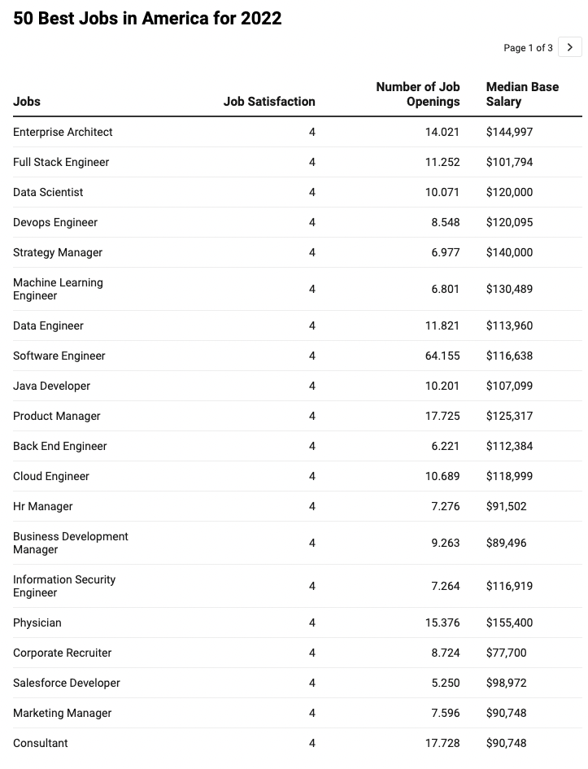
Why Data Science?
Best jobs in America:
Data Literacy will help you in almost any job
Opportunities all along the technical / management scale
Data Science has propelled some of the most successful companies
Source: Glassdoor
Notes:
What is safe in the world of AI?
Data Literacy = Data analytic thinking. Don’t just manage default, manage to maximize profit and personalize!
This is because companies that have been able to leverage data to learn about customers have succeeded.
Web-scale
Tell Signet example here

Slide 5
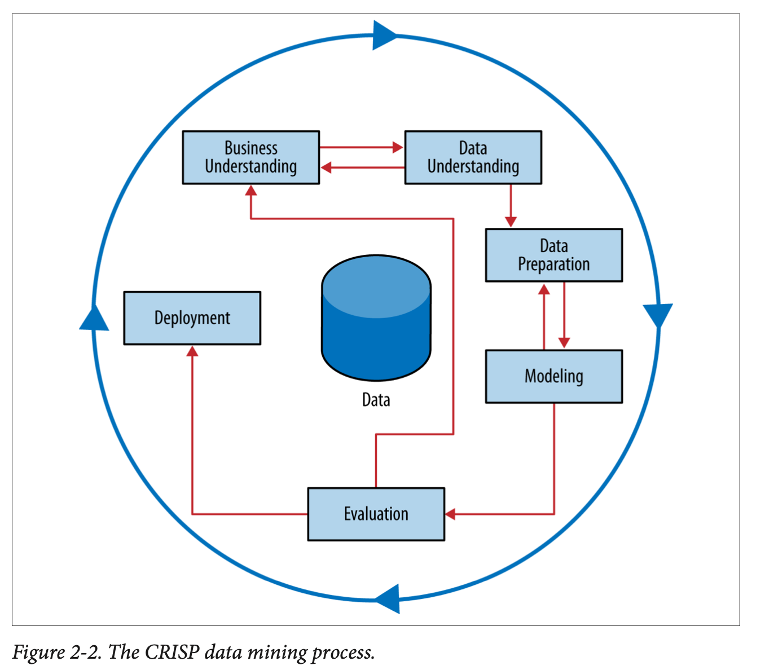
Data Science Process
CRISP-DM =
Cross-Industry Standard Process for Data Mining
Notes:
Work through this on board…
Why a process? Discuss analytics as a craft…this should not be viewed as a formula…more like an “artistic process” – tools, knowledge, experience, common sense.
When to be creative and when to trust the science.

Slide 6
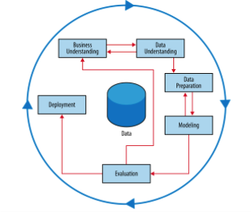


CRISP: Business Understanding
Data Science should be driven by a key business question
Avoid the “big data pipe dream”
Let’s tell our data scientists to use AI to raise revenue and cut costs!!
Break big questions into small questions that are answerable by data:
Smaller (specific, answerable) questions:
What are the properties of high performing stores?
Which population segments are buying less?
What strategies reduce customer service hold times?
Big questions:
How do we increase revenue?
How do we diversify customers?
Why is customer satisfaction down?
6
Notes:
6
Problem does not start with data, problem starts with a business need.
Sometimes you do start with a data set and do exploratory work…but that is only typically to do hypothesis generation, and then the questions get more defined
Clustering as an example – customer seg - why do we do it?

Slide 7
CRISP: Business Understanding
Put the problem into context…ask questions…be creative!
Be prepared to ask…
Who are the stakeholders?
Executive
What is the goal of the solution?
What data is available?
What constraints exist?
How do we evaluate?
What does success look like?
How will people act on the results?
Sales
Marketing
Technology
Operations
Notes:
Always be prepared to ask lots of questions from your data.
e.g. marketing team might want to know who is going to take the offer, but maybe you learn people dont stay after the next year?
Think about churn…there are different stakeholders with different goals! Who is your client, what is best for the company.
WHAT IS THE ACTION?
maybe if you analyze the WHY are people leaving this will generate different tasks for different roles
There are short term, local goals, and there are longer term needs of the businsess.
You can increase sales by offering 50% discount! Yay! What is wrong with that?
You can decrease churn by offering 3 months free.
people who call customer care every day...why?
Executive team – company strength and perception in marketplace
Sales – increase sales!
Marketing – effectiveness of campaign
Technology – people not leaving due to tech issues
Ops – are we losing customers because we cant onboard them quickly enough?.
DS team can be the connectors, and really drive value for the business.

Slide 8
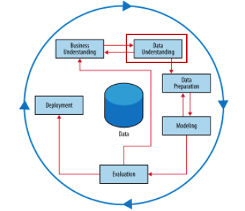

CRISP: Data Understanding
Know where your data comes from
Who / what system collected it
Know how to get the data
What systems, tools, etc
Understand the data
Spend time with EDA (exploratory data analysis)
Know the limits of your data
Need to spend time cleaning the data, caring for it, understanding it
Example:
Notes:
HBO Max example – looking at what are the qualities of customers who drop - churn
15k minutes of watching in a week…does this make sense?
There are about 11k , but maybe multiple devices…so we figured ok,
But device times out after a certain time…
What does the distribution look like?
Even flat with long tail vs
Distribution with a spike at 15k
Vs one big case at 15k

Slide 9
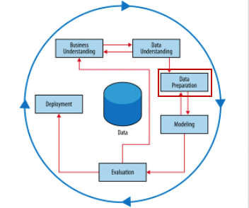

CRISP: Data Preparation
Data Preparation steps:
Exploratory Data Analysis (EDA)
Missing data analysis
Outlier detection and assessment
Feature engineering
Notes:
where most of your time is spent

Slide 10
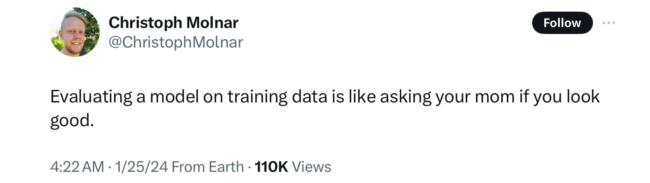
CRISP: Data Preparation
For predictive modelling, we always split data into training and test sets
Why??
Notes:
Do not want to “memorize” patterns from the training data…
People who live at 50 Olmstead road in Morristown nj like the yankees. That is not actionalble! It is overfitting, it is memorizing.
How does that manifest itself
you can always make the training data look good if you want it to.

Slide 11
Training and Test sets
Training set – randomly selected data (70-90%) – used to fit model, optimize parameters
Test set (“hold-out set”) – remaining data (10-30%)
Used to
calculate model’s performance metrics – on “unseen” data
estimate “generalization error” - Model’s error on the test data.
Original data
Training Data
(80%)
Test data
(20%)
Fit model
Evaluate model
Notes:
(dta

Slide 12
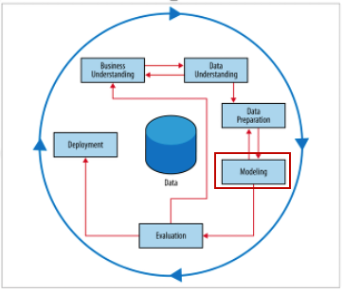
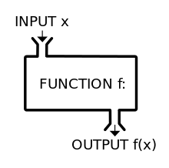
CRISP: Modelling
Applying machine learning or AI algorithms to make predictions
What data science / ML (algorithms) do you know?
Notes:
Talk about rectangles.
What most people think of when they think of DS…
Really just a function to take inputs and create outputs. A lot more goes in but that is basic.
Its a function to create a function!

Slide 13
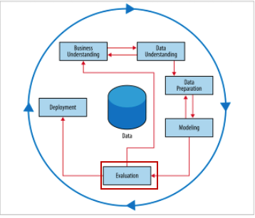
CRISP: Evaluation
We need a metric to determine the best model or the appropriate parameters to use
Examples?
Evaluation metric should be tied to the business problem
e.g. Recommender Systems
Trade-off between performance and interpretability
How do I interpret my metric
What does the RMSE mean?
Comparison to baseline, or dumb model
Notes:
Don’t blindly use the best metric!!

Slide 14

CRISP: Deployment
The critical aspect of every data science exercise in business:
What action will be taken?
Models don’t have any value until they get into production
Deployment decisions can affect the impact of the model
In addition to technical deployment issues:
How will you measure success?
Do you need stopping rules?
Deployment always has surprises!
Best practice if possible: deploy slowly with pilot studies, A/B testing
Careful monitoring and feedback loops
[machine learning engineers deploying a model]
Notes:
Low RMSE is not the goal!!
Think about a cosmetics company web site: do you want to update for everything the user does in real time? Or run it once in batch? What are the pros and cons?

Slide 15
Iterate …
Business Problem
Data
Action
Analysis
Notes:
So many focus on algorithm…but much much more
Must come back to Bus Und!!

Slide 16
CRISP – In Action
Think through our churn case, what decisions need to be made at each step?
Notes:
Think through the steps…big problem, small problem…does solving the small problem impact the big problem?
Data – what are the most important things that might impact churn?
WHAT data would you aslk for – on whom (e.g. only those that left at end of contract?) First Contract?
voluntary or involuntary?
How far back do you go?
Model – Control data?
what are you training your data on…
Evaluation: what is success? Evaluation before deployment?
What about after deployment? Early stopping?
What is baseline?
How do you "draw the line"?
How do you evaluate probabilities? You never observe them? How do you know if it is correct?
Is it just a threshold? what do you do if the customer is high risk but is already under contract? what if a customer is low risk but very valuable?

Slide 17
Types of Data Science Tasks
Supervised
Unsupervised
There is a specific, quantifiable target that we are interested in or trying to predict
There is no specific target to predict, we are just trying to understand the data
Predictive!
Descriptive!
Predict whether a customer will buy our product based on her browsing habits of our website
Segment customer base into customer types based on past behaviors
Most data science algorithms
(e.g. decision trees, Regression)
Data Visualization
Segmentation
Clustering
Notes:
Another way of saying the same thing
Note – can add re-inforcement mearning here. You update the model as you get input/

Slide 18
Supervised Learning - Types
Classification
Regression
Time series
Other…
Prediction variable is categorical (perhaps binary)
Prediction variable is numeric - continuous
Data are time-based: forecasting into future
Analyzing text or media…
Will the loan applicant default on their loan?
How much will this customer spend next year?
What will the DJIA close at next month?
What should my customer care chatbot say next?
Not cut and dried…tasks can fall between categories
Notes:
Multi factor could be like a customer segmentation model:
Hi value -
Lo value
Frequent purchaser
Don’t take this too seriously
sometimes you need to do both classification and regression...
or time series and regression
New product…will they buy the product, how much will they spend IF they buy the product.

Slide 19
Supervised Learning - Example
Loan Applicants – goal is to build a model to assess what factors result in loan default
Data:
Name | Industry | Age | Date | Balance | Default
Mike | Finance | 30 | 02/13/04 | 123,000 | Yes
Mary | Medical | 40 | 29/06/13 | 51,100 | Yes
Bill | Construction | 55 | 14/08/09 | 68,000 | No
Jim | Medical | 46 | 01/01/07 | 74,000 | No
Mark | Finance | 47 | 23/12/11 | 23,000 | Yes
Anne | Finance | 49 | 19/0512 | 100,000 | No
Supervised or unsupervised?
Classification or regression?
What action might we take??
Notes:
Action…don’t accept the loan!
Q: what is the action that they might take?
What is the outcome of the model?
What is the action of the model?
Put the model in the hands of the loan officer, who can make a judgement…

Slide 20
Supervised Learning - Example
Variables
Attributes
Features
Independent Variables
Predictors
Target
Dependent Variable
Identifier
Name | Industry | Age | Date | Balance | Default
Mike | Finance | 30 | 02/13/04 | 123,000 | Yes
Mary | Medical | 40 | 29/06/13 | 51,100 | Yes
Bill | Construction | 55 | 14/08/09 | 68,000 | No
Jim | Medical | 46 | 01/01/07 | 74,000 | No
Mark | Finance | 47 | 23/12/11 | 23,000 | Yes
Anne | Finance | 49 | 19/0512 | 100,000 | No
Rectangles!
Observations
Instances
Data Points
Examples
X
Y
Notes:
Importance of getting data into this rectangular format

Slide 21
Model
Takes features as inputs, gives a prediction as an output
Name | Industry | Age | Date | Balance | Default
Mike | Finance | 30 | 02/13/04 | 123,000 | Yes
Mary | Medical | 40 | 29/06/13 | 51,100 | Yes
Bill | Construction | 55 | 14/08/09 | 68,000 | No
Jim | Medical | 46 | 01/01/07 | 74,000 | No
Mark | Finance | 47 | 23/12/11 | 23,000 | Yes
Anne | Finance | 49 | 19/0512 | 100,000 | No
Algorithm:
Inputs features
Outputs prediction
Classification Model:
If Age > 45, predict No Default
Notes:
Ask “what is the performance of this model?
Other models – higher age means more likely to default.
Goal of the model : allows you to make predictions for cases you have not seen before (assuming the same data attributes
If. Name starts with M, you will default.
What is wrong with that? Not generalizable!!!

Slide 22
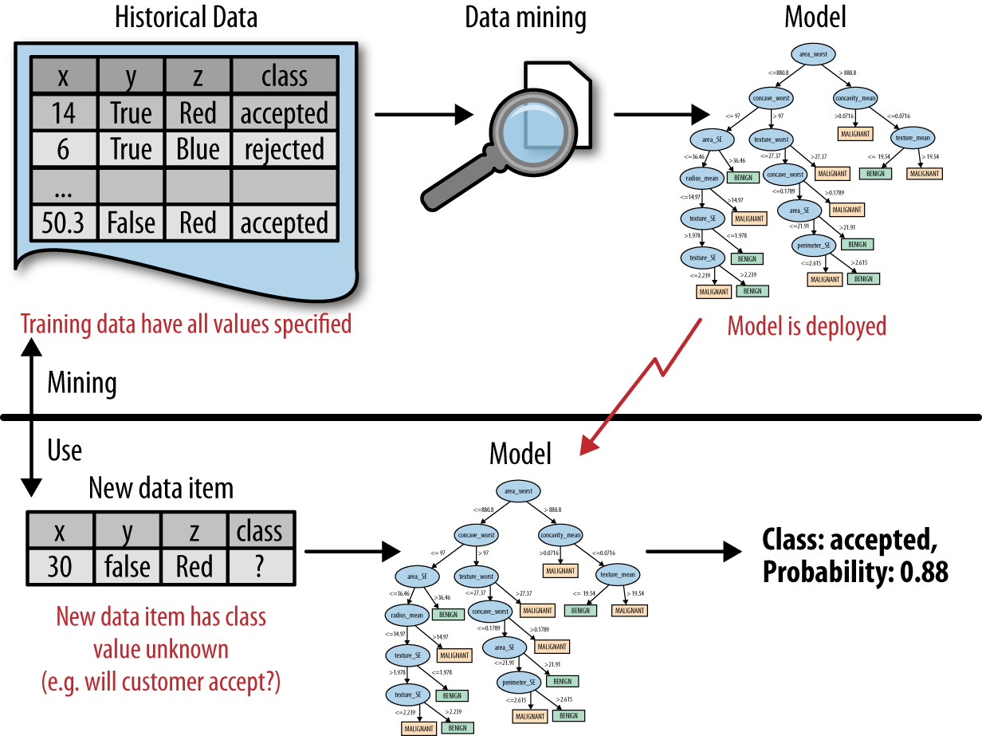
Predictive Analytics Flow
DSB Fig2-1
Modelling (Training) Phase
Prediction
Decision/Action
Use Phase
“Send offer”
Notes:
Put on board as data science vs use (deployment)
Data – science – selected mdlel
========================
New data – model – prediction – action (--outcome--feedback)
Modelling slide here???
ML is a pogram that writes programs

