Slide 1

Topic 3 – Exploratory Data Analysis
Data Science and AI for Business

Slide 2
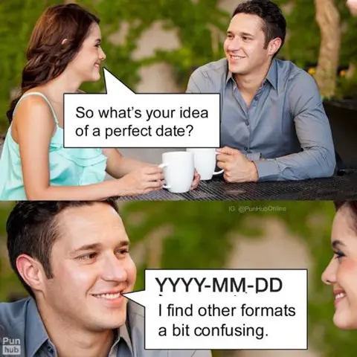

Slide 3
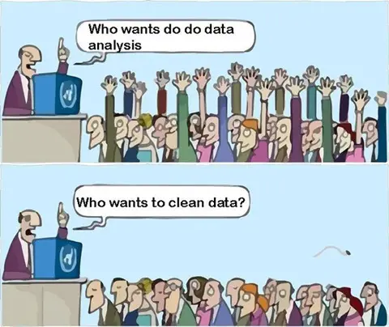
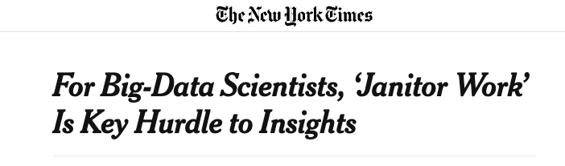
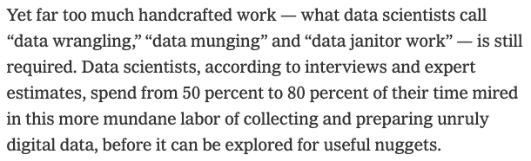
Data Science: Reality
Steve Lohr NYT 8/17/2014
Notes:
AI has promise but does not necessarily make this better!!

Slide 4
Where to Find Data
In business critical systems
Challenge: these systems are often not set up for collection of data, they are for running a business. Much cleaning needed.
Online
Challenge: Companies often do not give access to critical data, and if they do it is via a rate limited API
Can use parsers, scrapers, and other tools
Useful modules like Beautiful Soup* can scrape web sites
Using GenAI to get data (e.g. financial reports)
Curated data science websites
Challenges: Sanitized, much analyzed data
UCI repository
Lots of data science courses!
*https://pypi.org/project/beautifulsoup4/
Notes:
Talk here about finding data for their projects….dont try and take the easy road.

Slide 5

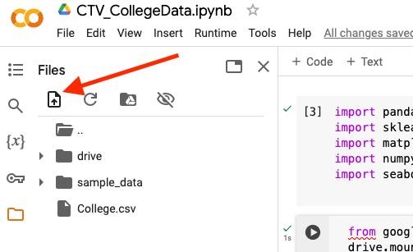
Reading data into Python
Ideally data we will access will come to us in a nice Excel or CSV format.
Reading in data via CSV requires the pandas module and read_csv()
Several ways to do this:
Mount your Google Drive and read from there
Upload file from computer to Colab session
See “T1_Managing_data”
In some cases may need to read in data from XML, SQL or JSON scripts
Come see me/TA if you need help with this
T3_Getting_Data_Through_APIs.ipynb
Notes:
We are not covering json or sql in class.

Slide 6

Exploring data through EDA
Exploratory Data analysis – prior to any modelling
Study (and understand) every feature!!
Know your feature types and distributions
Explore Outliers
Consider Transformations
Evaluate Missing Data
Visualize Key Features

Slide 7
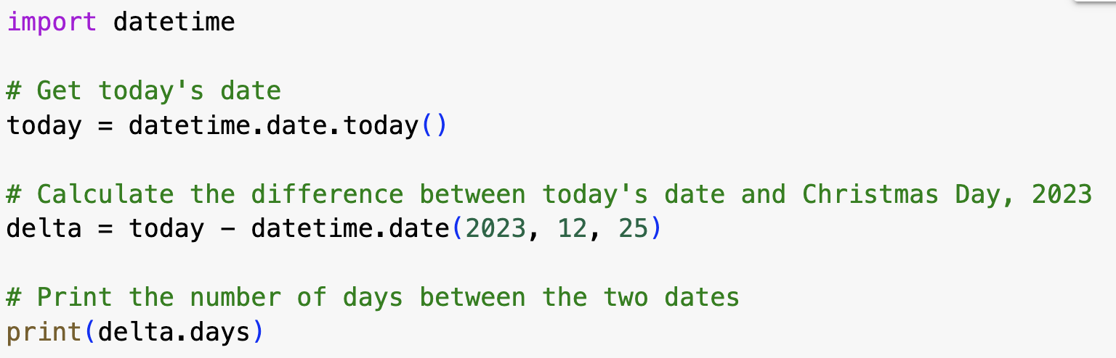
Feature Types
Numeric: anything where calculations are meaningful
Does addition / subtraction make sense
Categorical: cannot do meaningful calculations
Don’t be fooled: Categories might have numeric labels!
Are your categories ordered?
Ordinal: Income (A: 0-50k; B: 50k-100k; C: 100k-500k; D: > 500k)
Nominal: EyeColor (A:Blue; B=Brown; C=Green; D=Other)
Binary (special case of categorical):
Two possible values, in particular 0/1
Datestamps
Beware of format!
Make sure software imports dates properly (e.g. import datetime in python)
Numeric calculations should be possible
Notes:
May need to create variables
Income – adding 10k makes sense, doubling makes sense
Test grade? : SAT – adding numbers makes sense, I guess.
e.g., average balance may not be in any database, but would have to be computed during the data prep stage.
What happens if you add “unknown” to an ordinal?

Slide 8
Things can get messy
Its not always obvious what is categorical – so don’t trust the software!
Social Security numbers
Credit scores
Zip codes
Ordinals can be coded as numbers
e.g. (1=no HS; 2=HS grad; 3=post HS)
Make sure that your software recognizes the right data type:
Make numbers look like numbers
Make categoricals NOT look like numbers

Slide 9
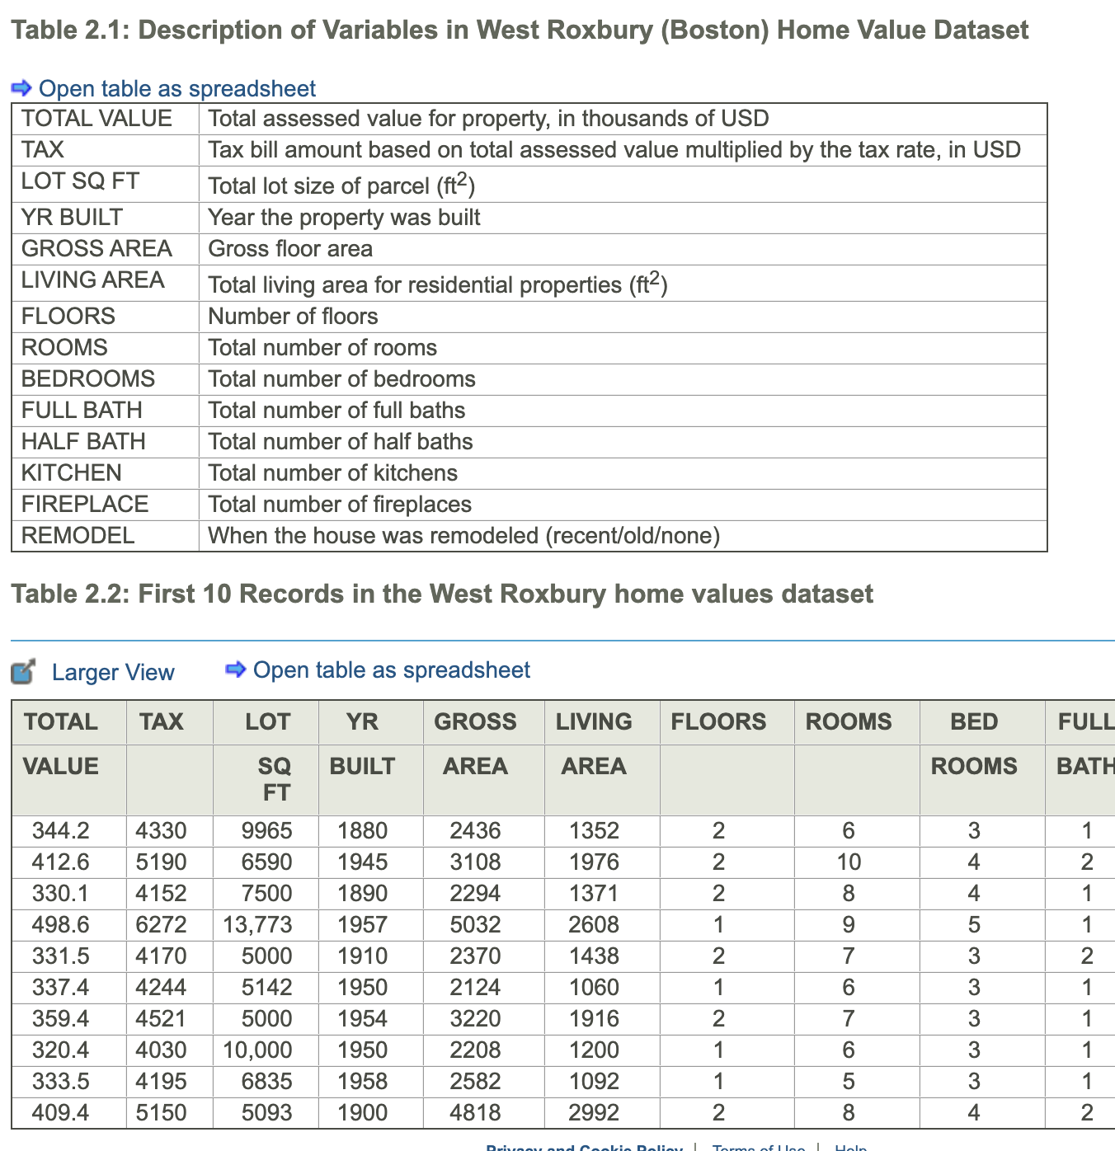
Exploring data in python
ISLP Ch2.3
Shmueli Ch2.4
Looking at data in Python:
Ideally data can be input as a .csv file
Make sure no commas!
Python tools for initial manipulation of data
Renaming variables (.rename)
Summaries of variables (.info and .describe)
Exploring data (.head, .tail)
Viewing slices of data (.loc and .iloc)
Categorical variables (.value_counts)
Merging and splitting attributes (.concat, .split, other text tools)
Can use sampling if data is too large (.sample)

Slide 10
Encoding Categorical Variables (python)
Lets say we wanted to study impact of diet type on Cholesterol
Name | Diet | Cholesterol
Alberto | Vegetarian | 135
Becky | Vegan | 112
Callie | Omnivore | 198
Daneyah | Pescatarian | 201
Erica | Omnivore | 155
… | … | …
Four types:
Vegan (Vn)
Vegetarian (Vg)
Pescatarian (P)
Omnivore (O)
You should re-code this variable as k binary (0,1) indicator variables (also called dummy variables or one-hot encoding).
Note: only (k-1) dummies are needed to encode the information
For some methods (regression!) you must encode with (k-1) dummies to avoid an error:
pandas.get_dummies (drop_first=TRUE) sklearn.preprocessing.OneHotEncoder (drop=‘first’)
Notes:
Note: This changes how you interpret the coefficients…
Redundant features may lead to

Slide 11
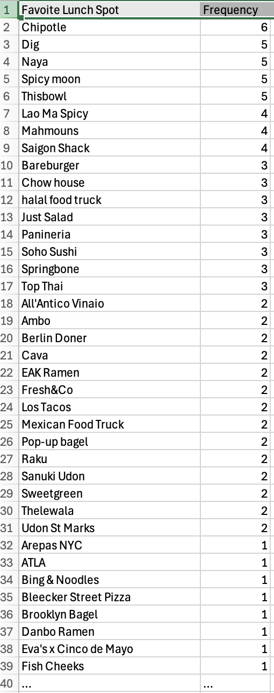
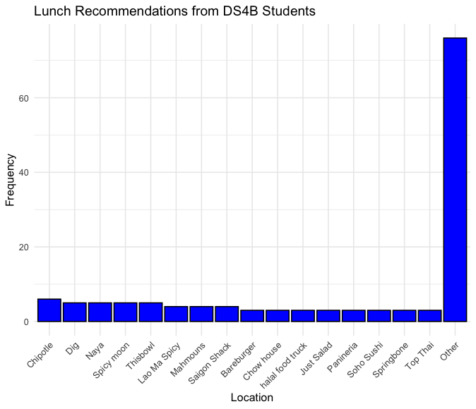
Categorical Variables
Another issue with categorical variables: there can be too many levels – this can make modeling complicated and messy
May want to cluster, or transform to top levels + “other”
+ 40 more
Notes:
For interpreteability

Slide 12
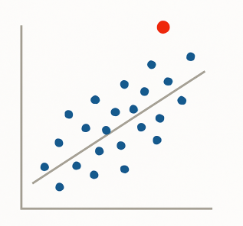
Outliers
Outliers are observations that are far from the mean, and fall outside the range of most of the data
Can be found via summary tables, visualization or simple sorting
Look at each feature!!
Outliers typically are attributable to one of the following causes
The measurement is observed, recorded, or entered into the computer incorrectly. (Blood pressure = -50)
The measurement comes from a different population. (Age = 5)
The measurement is correct but represents a rare (chance) event. (Net worth = $3B)
Outliers should always be identified and inspected to see if they are “real” or some artifact of data collection
Notes:
Ask : how do you find outliers?
Blood pressure = -100
Temperature = 800
Net worth = 3B.
Go back to HBO example…hours…is there a smooth distribution with some high, or a spike or single value?
Even if real, you may want to delete it – to avoid overweight influence.

Slide 13
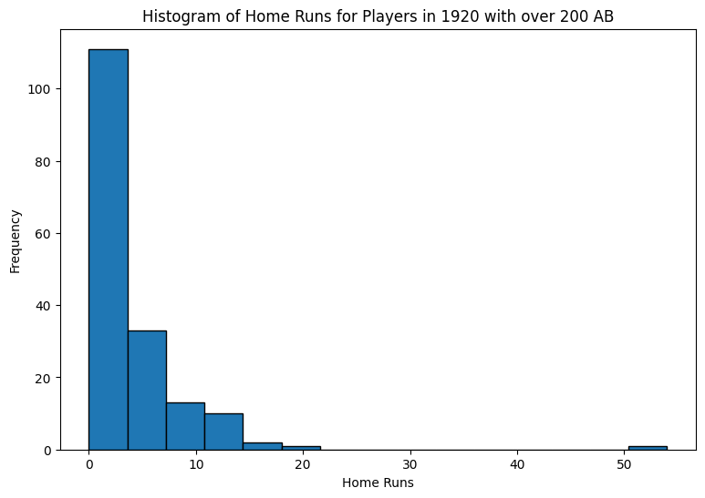
Outliers: Remove or no?
Outliers can have an outsize impact on analysis
You may choose to remove an outlier, even if it is legitimate, just to avoid influence on analysis
Or, choose a robust analysis technique
Regression is sensitive to outliers
Decision Trees are robust to outliers
Carefully assess data for legitimacy. If appears incorrect, remove it (or fix it!)
Blood Pressure = -50
Temperature = 180 degrees
Net worth = $3B
Notes:
Q1 – 1.5 IQR…

Slide 14
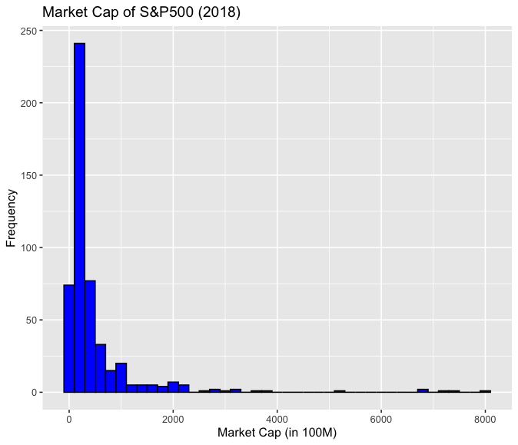
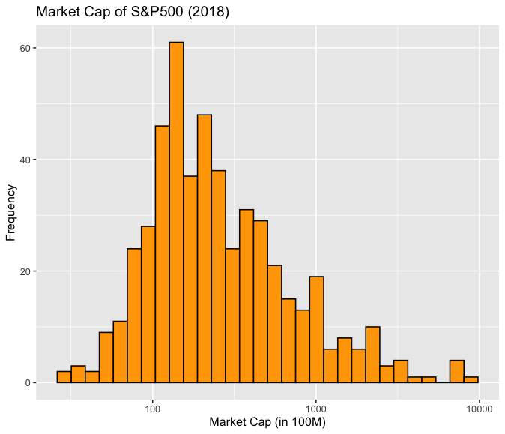
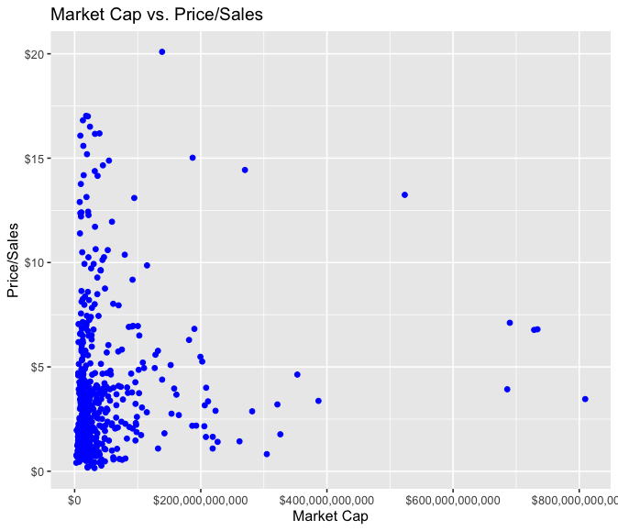
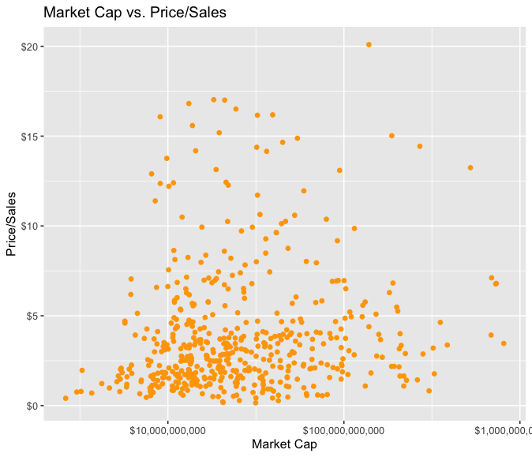
Skewed Data
Highly skewed data can be problematic in data science analysis
Income and other monetary values are often heavily skewed right.
Can obscure patterns
Makes EDA/Viz challenging
Consider Transformations:
Log-scale
Square root
Binning (deciles)
Beware of interpretation of transformed features

Slide 15

Missing Data
Missing Data: Data points that are not recorded or are absent in the dataset.
Can be represented by “.” “NA” “99” “-1” etc.
Python uses “NaN”
Reasons for missing data
data entry errors
non-responses in surveys
system errors, etc.
Missing Data Considerations
How much is there?
Is it ”missing at random”
Is missing-ness important by itself?
How does the model handle it?
Pandas functions:
isnull(), notnull(): To detect missing values.
Notes:
Medical test – the fact that you had the test might be important, or the fact that you refused the test.

Slide 16
Strategies for Missing Data
Deletion Methods:
Row Deletion: Remove entire row if any value is NA.
Column Deletion: Delete features with high % of NA
These are drastic! Should evaluate impact on analysis
Imputation Methods:
Mean/Median/Mode Imputation:
Replace NAs with mean, median, or mode of the feature.
Modeled Imputation:
Use algorithms like regression or k-nearest neighbors to predict and fill missing values.
Interpolation
Give data point the average of the two observations surrounding it (relevant for time series)
Create a new category for NA
Pandas functions
dropna(): To drop rows or columns with missing values.
fillna(): To fill missing values with a specific value or method (mean, median, etc.)
SciKitLearn:
SimpleImputer(): Basic imputation strategies
IterativeImputer(): Modelling based imputation
Important to evaluate: How much influence does your strategy have on the final conclusions?
Notes:
Needs careful consideration
Robustness

Slide 17
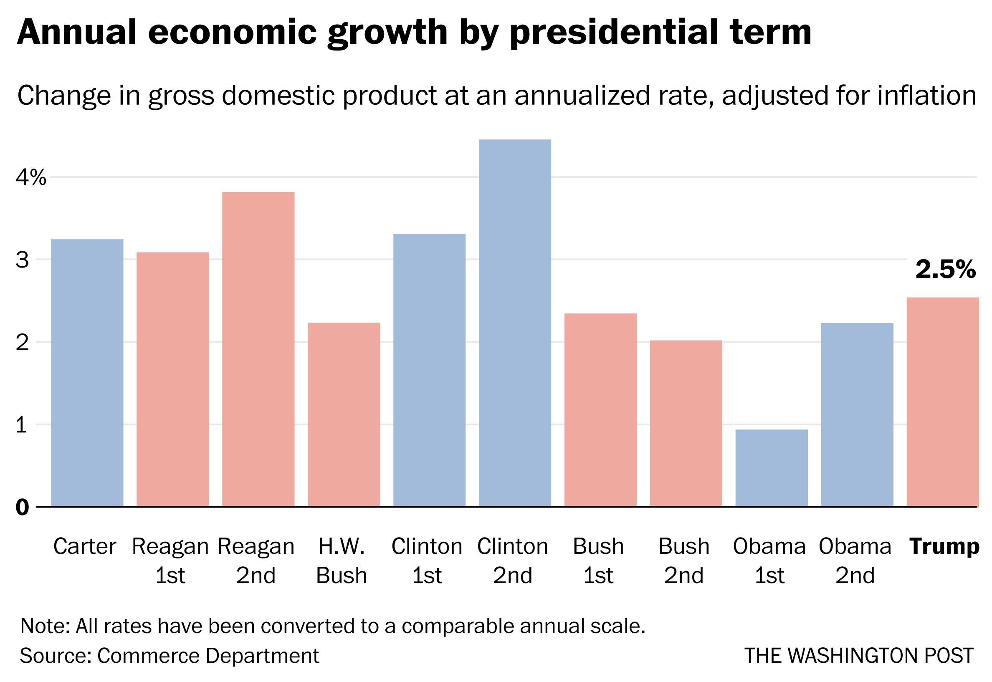
Data Visualization
Looking carefully at your data is an important part of the exploratory process:
to identify mistakes in collection/processing
to find violations of statistical assumptions
to observe patterns in the data
Sometimes a good, simple visualization is all the “analysis” you need!
Tools like Tableau and PowerBI are good for this

Slide 18
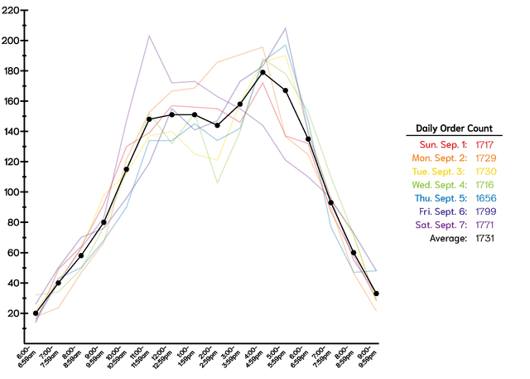
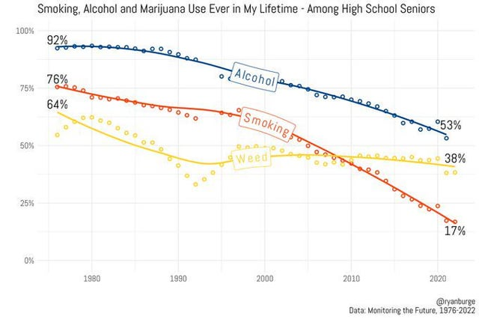
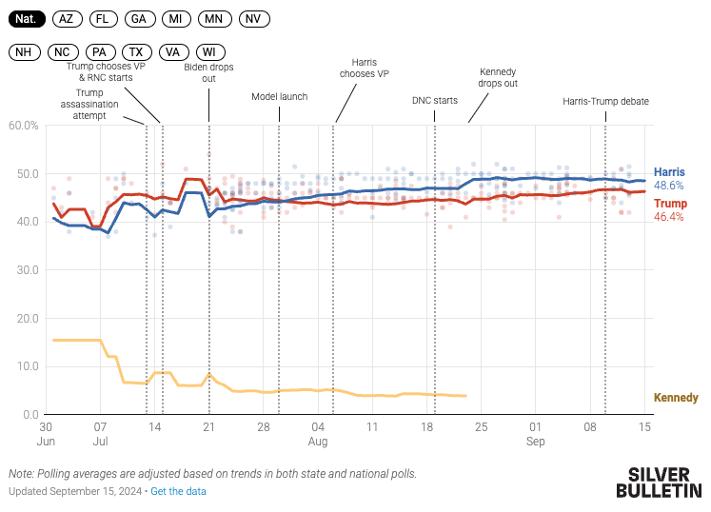
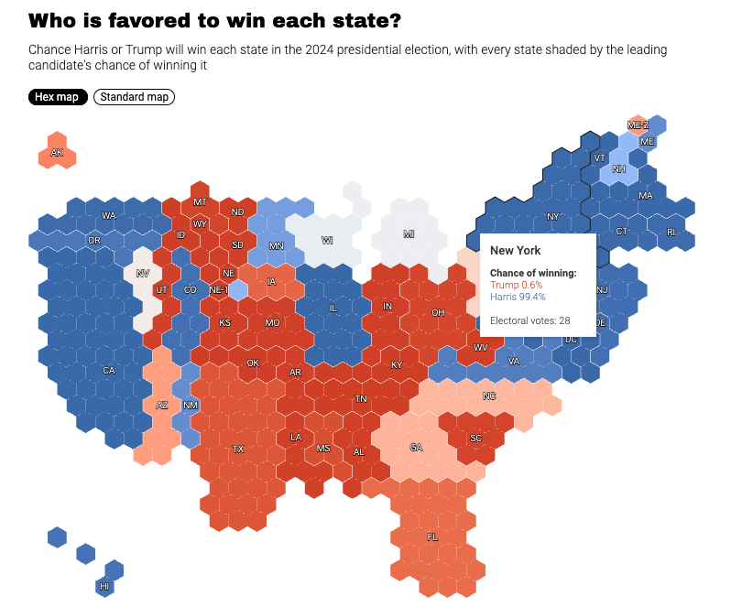
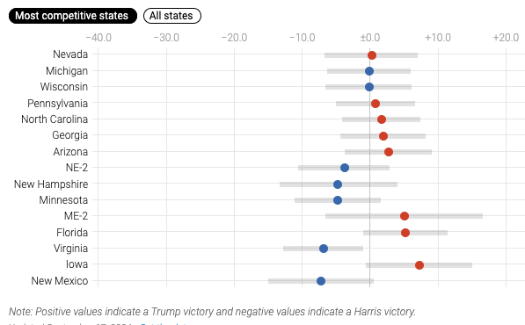
Effective visualizations say a lot with a little:
https://www.reddit.com/r/dataisbeautiful/

Slide 19
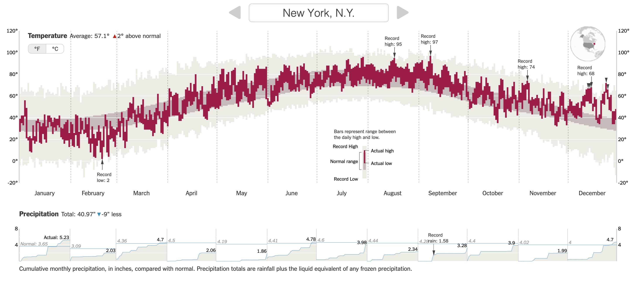
Effective visualizations say a lot with a little:

Slide 20
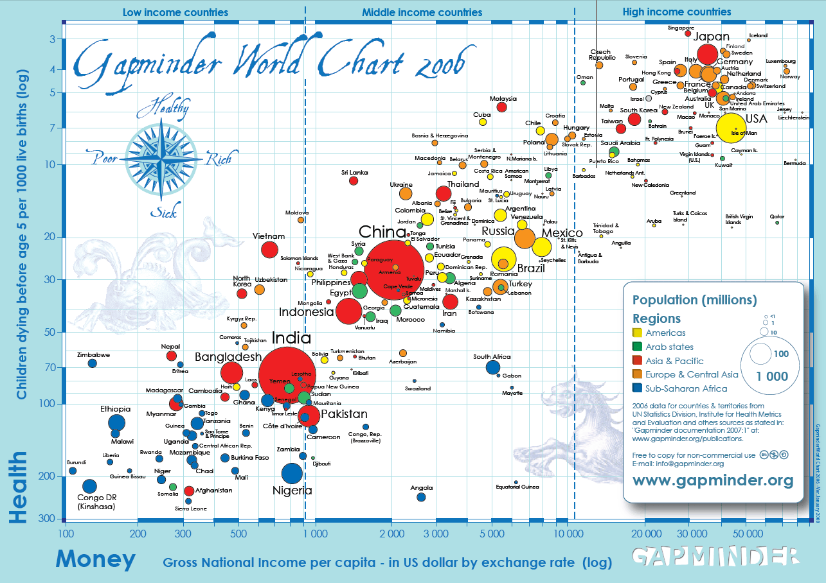

Data Viz: Good examples
The best data visualization talk you will ever see:
Hans Rosling
https://www.youtube.com/watch?v=usdJgEwMinM
Notes:
3:14 – 4:53 – fertility rate vs life expectancy
9:17 – 10:52 13:03 tracks of GDP vs exp. Survival

Slide 21
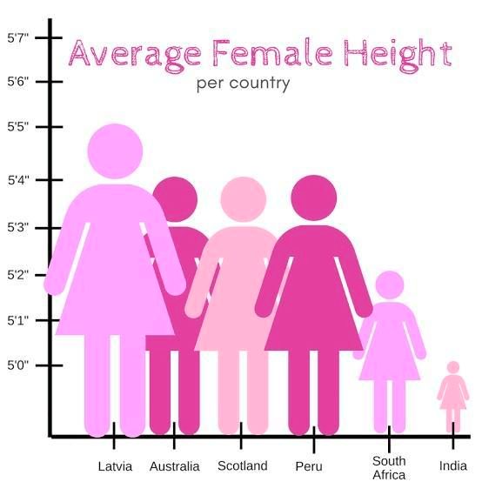
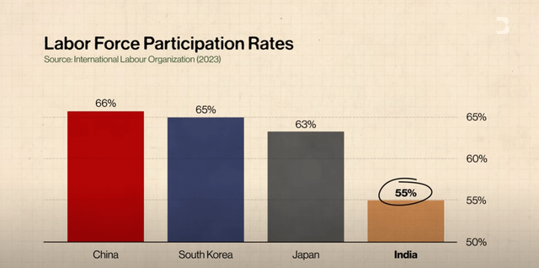
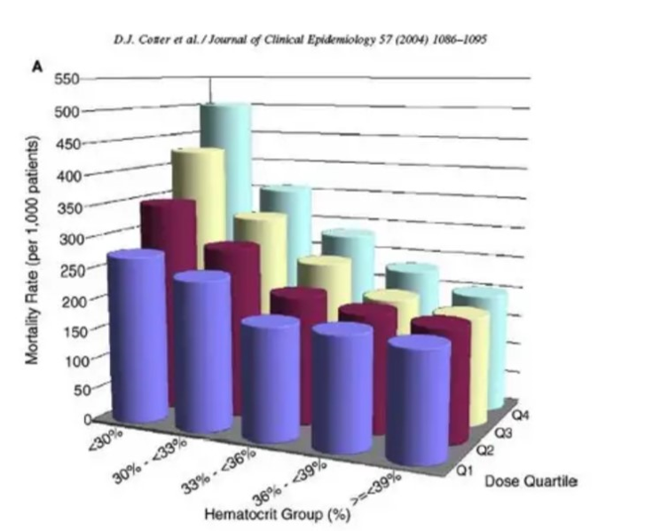
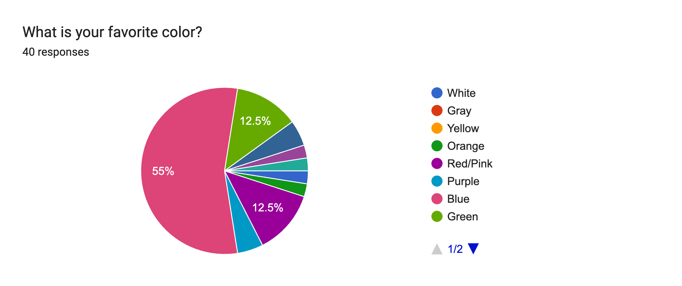
Data Viz: Bad Examples
Purposely bad
Bad design
https://www.reddit.com/r/dataisugly/

Slide 22
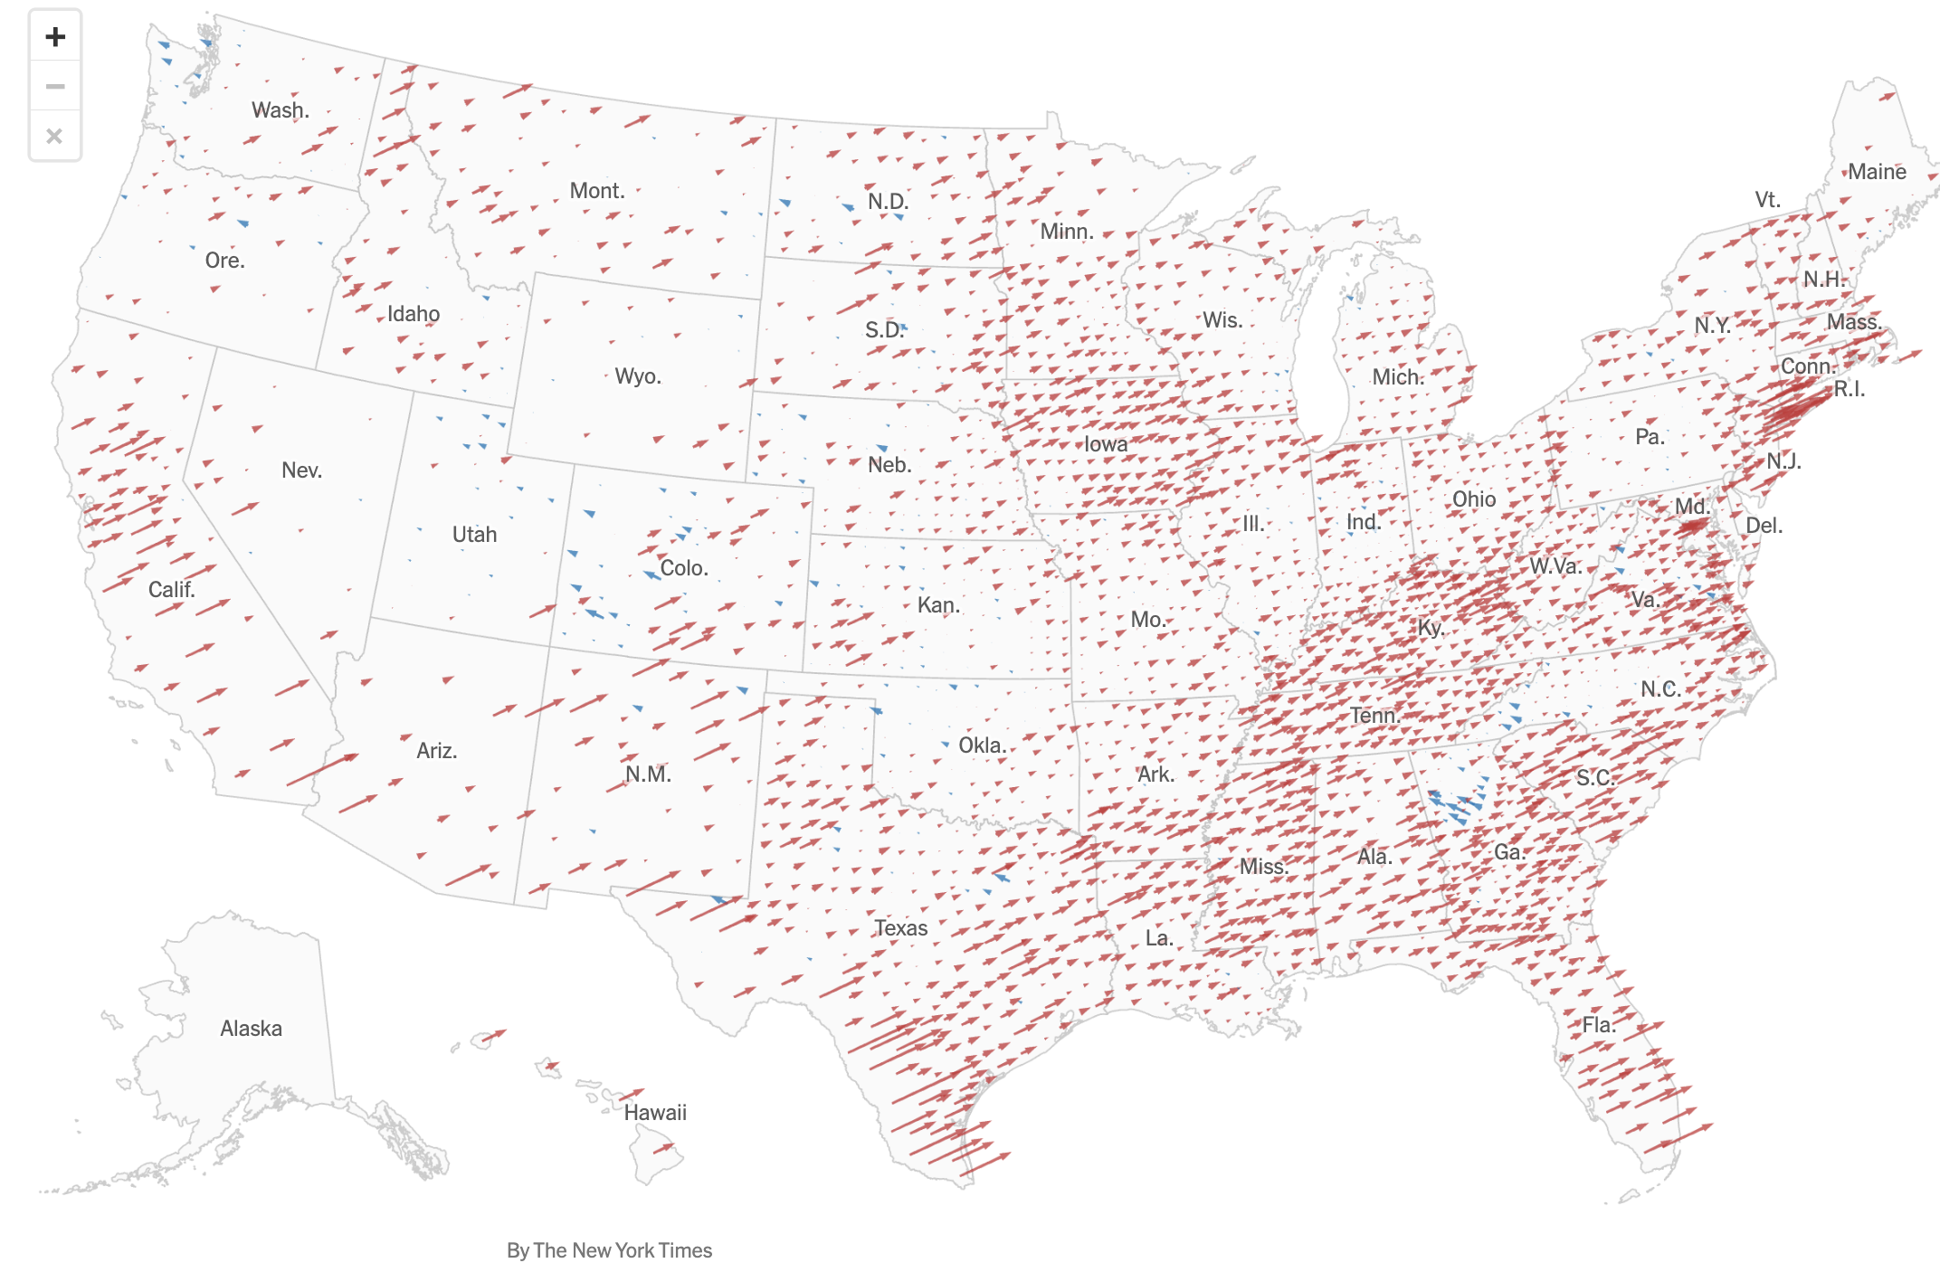
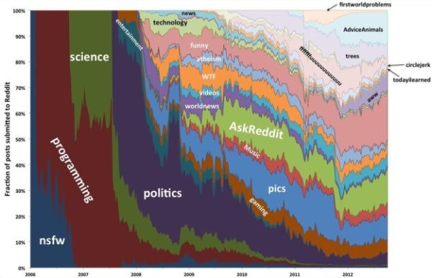
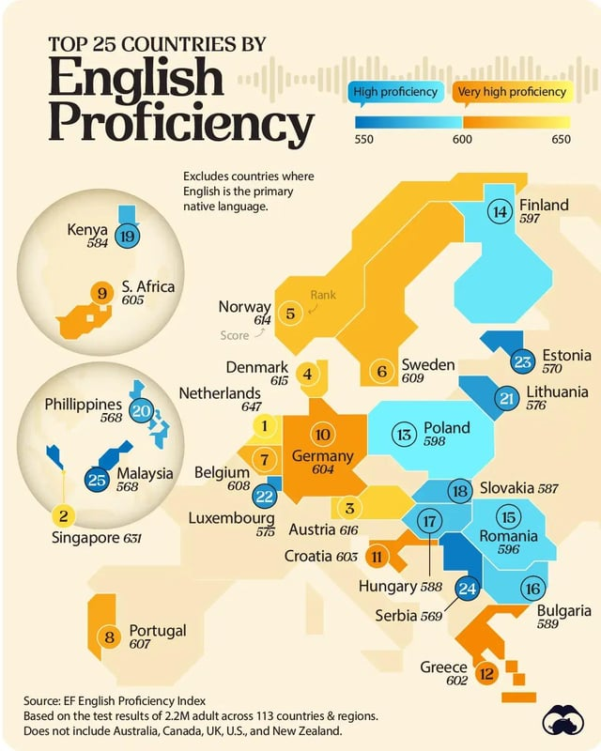
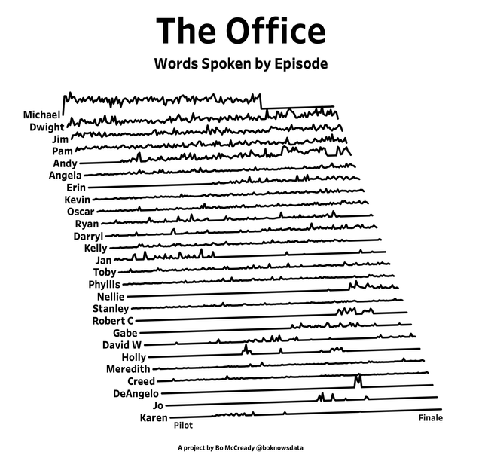
Visualization Challenge!
See Brightspace Discussion page and post your own example of one good and one bad visualization you find online

Slide 23
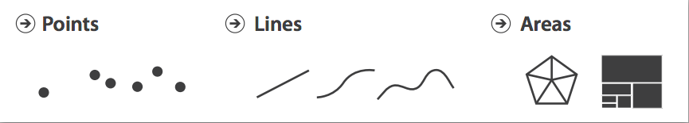
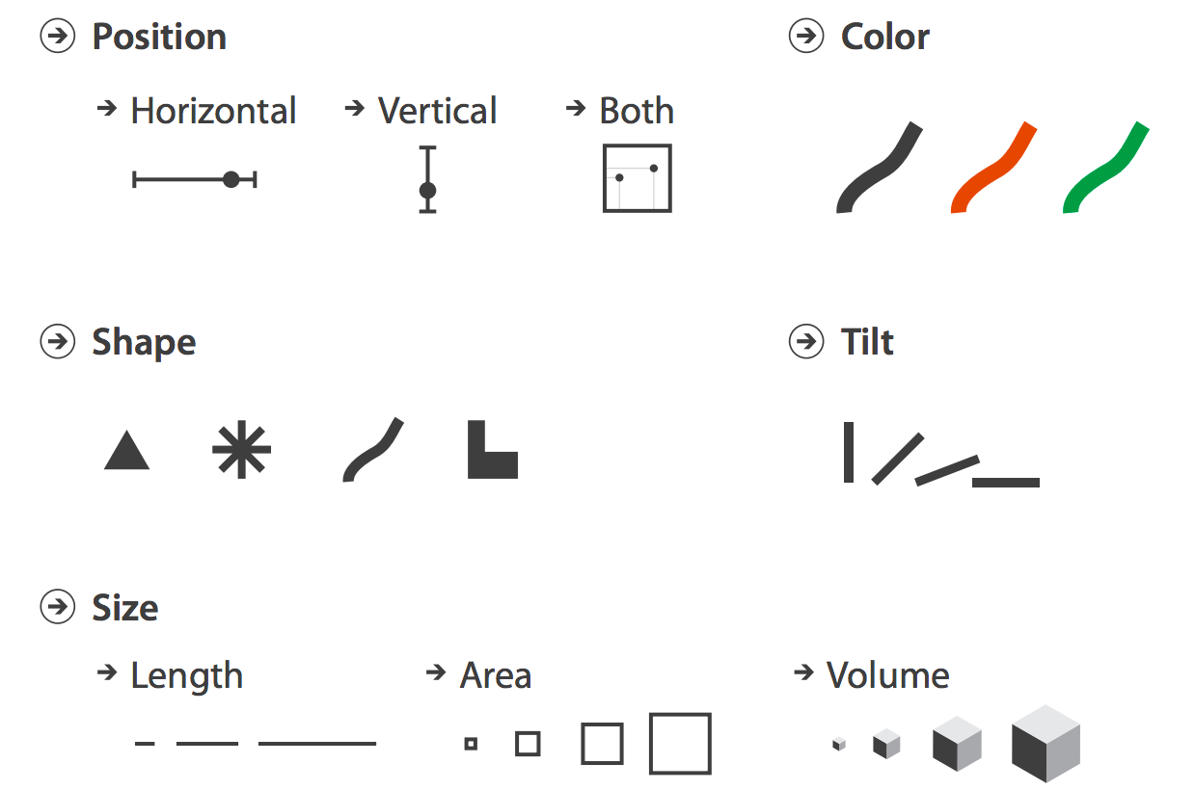
Data Visualization
Data Visualization is a challenging topic – very hard to do well
Many design decisions to make
Data Visualization theory covers things like
What do humans perceive well
How to use marks, color, etc.
Start simple! Basic building blocks of visualization:
Histograms
Boxplots
Scatterplots

Slide 24
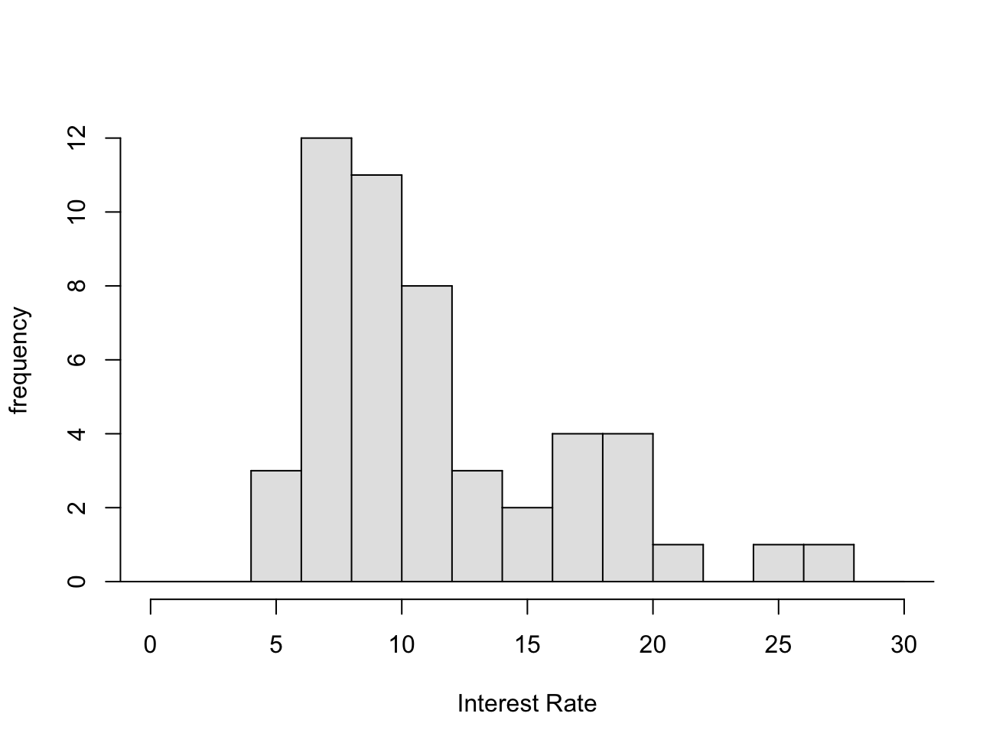
Visualizing Numeric Data: Histograms
Probably most used (and useful) way to present numeric data
Frequency chart of binned data
Histograms provide a view of the data and a quick view of:
Range
Distribution shape
Outliers
Trends
Lending Club Data
Notes:
Maybe go back to echo.csv data…

Slide 25
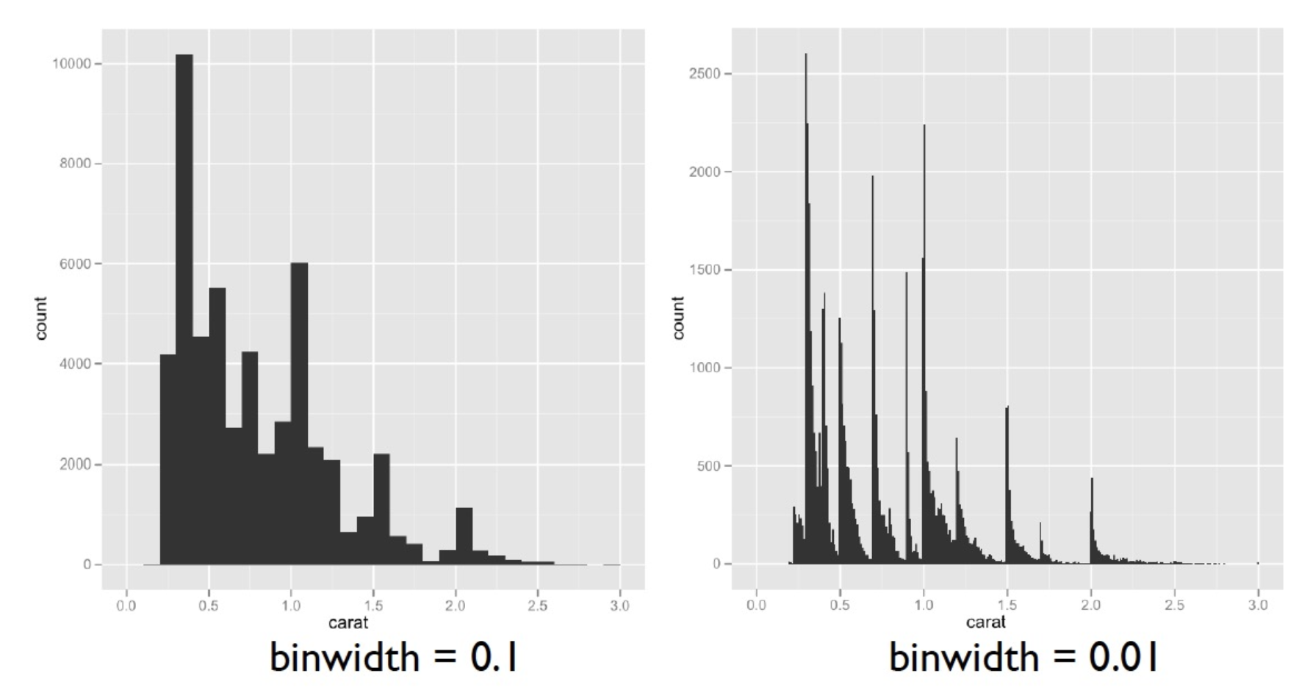
Histograms
Bin width can have a role in interpretation
Notes:
Perhaps show this in Orange?

Slide 26
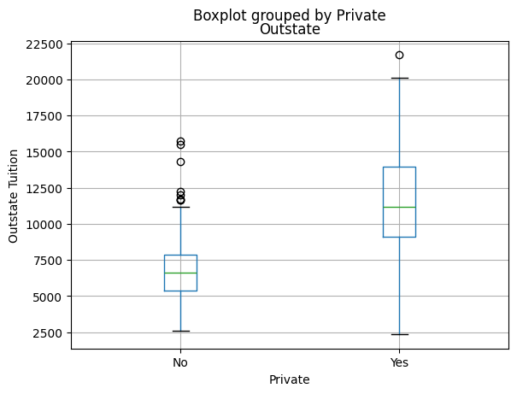
Numeric Data: Boxplots
A Boxplot gives a quick visual of the key points of the data distribution:
Note: Boxplots are a good choice to show difference of numeric feature across values of a categorical
Suspected “Outliers”
Upper range
75th percentile
median
“Middle half”
25th percentile
Lower range
Notes:
Remember not to be too harsh on outliers.

Slide 27
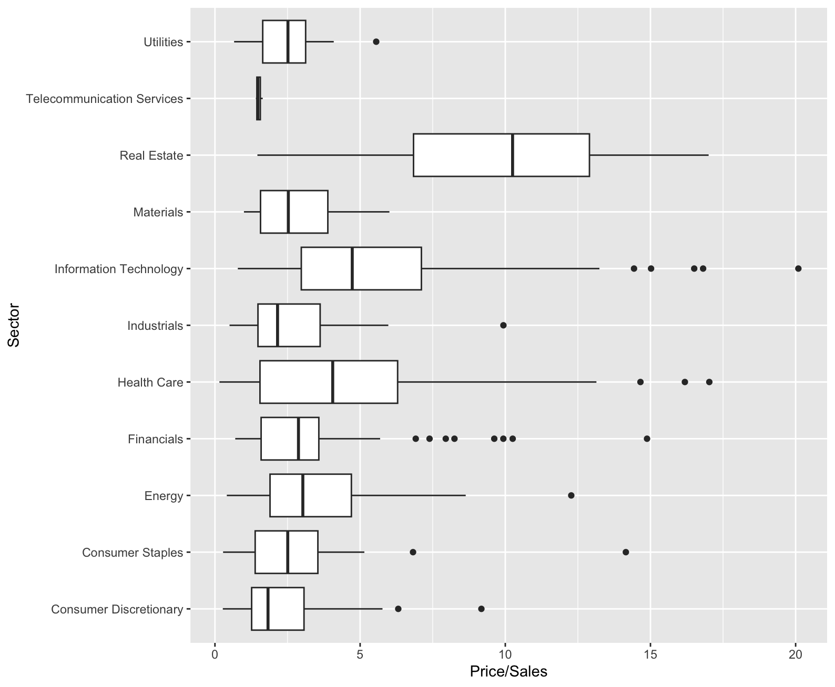
Combining Categorical and Numeric
Side by side boxplots allow you to compare numeric distributions across variables which are categorical
S&P 500 data
Price/Sales ratio
by Sector

Slide 28
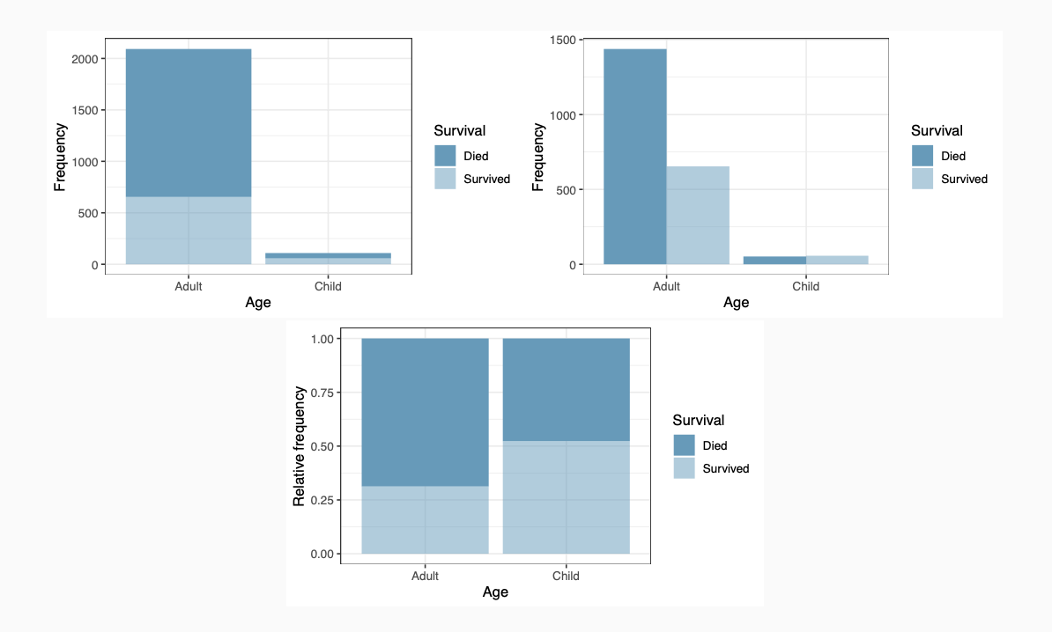
Multiple Variables: Categorical
Three different ways of presenting contingency tables
Titanic passenger data: age vs survival
Stacked bar
Side-by-side bar
Standardized bar

Slide 29
Multiple Variables: Categorical
Many design decisions go into data visualization
Takes careful thought as to the message you are trying to convey
Example Data : Customer Purchase data (n=200)
> cseg_df
| Index | CustomerID | Age Group | Product Category | Purchase Frequency |
|--------:|-------------:|:------------|:-------------------|:---------------------|
| 1 | 674852 | 26-35 | Home & Kitchen | Low |
| 2 | 900795 | 60+ | Electronics | High |
| 3 | 107026 | 46-60 | Electronics | Medium |
| 4 | 336542 | 36-45 | Sports & Outdoors | High |
| 5 | 871414 | 18-25 | Home & Kitchen | Low |
| 6 | 519718 | 18-25 | Clothing | High |
| 7 | 373993 | 18-25 | Electronics | Low |
| 8 | 819752 | 46-60 | Home & Kitchen | Low |
| 9 | 668056 | 36-45 | Electronics | High |
| 10 | 621755 | 46-60 | Books | Low |
Notes:
Ask questions:
What kind of data do we have here?
What do we want to visualize (counts!)
Which columns do we use?

Slide 30
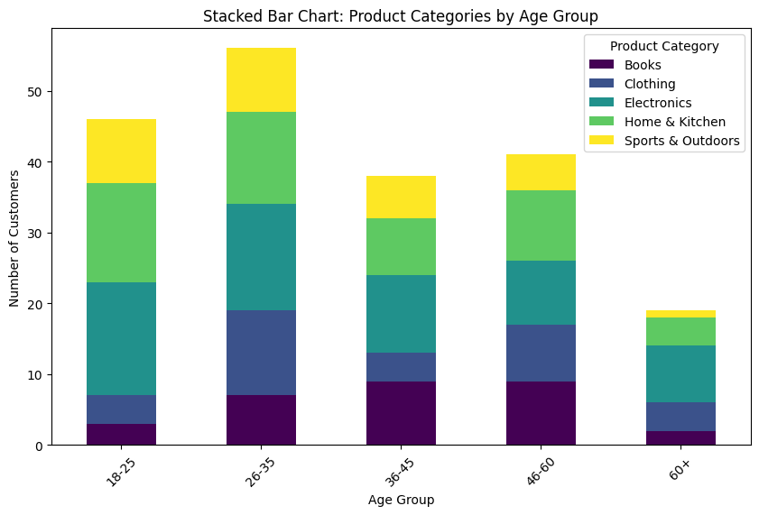
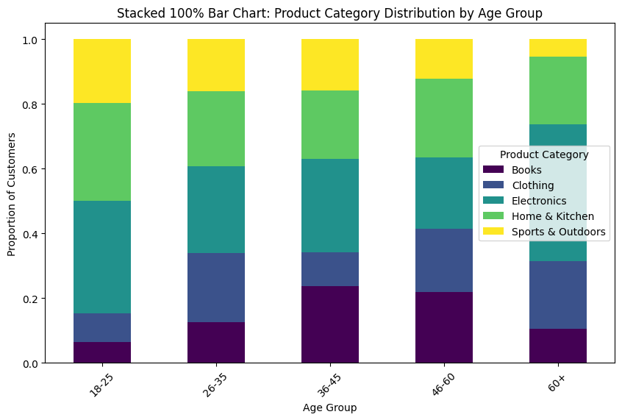
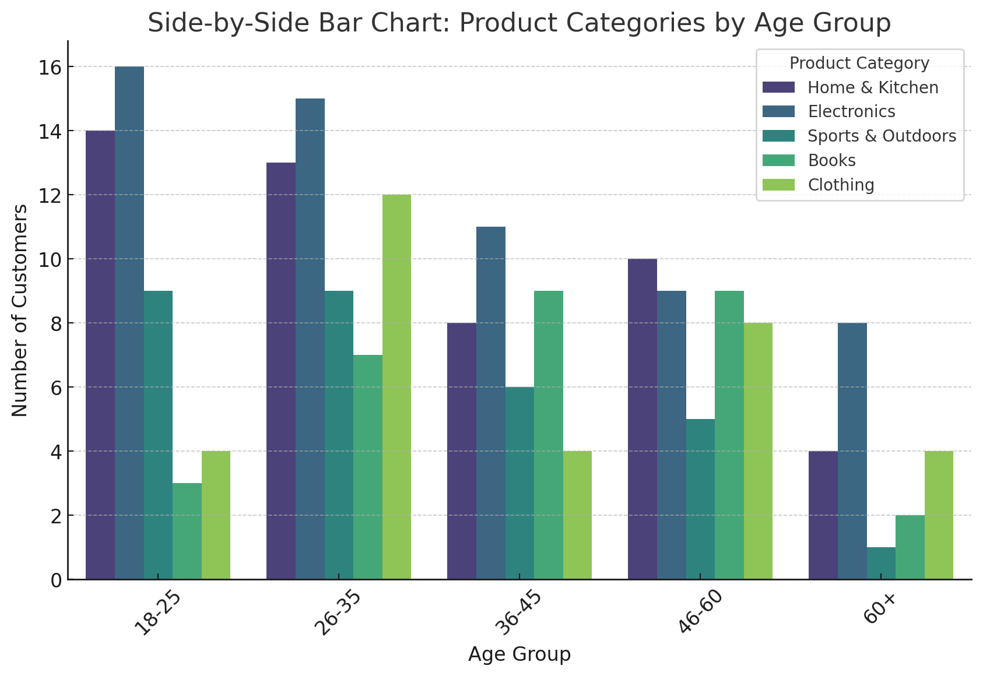
Notes:
Clear what the largest age group is
B) clear that sprots and outdoors is decreasing (as %) as age increases
Clear which is largest within an age group

Slide 31
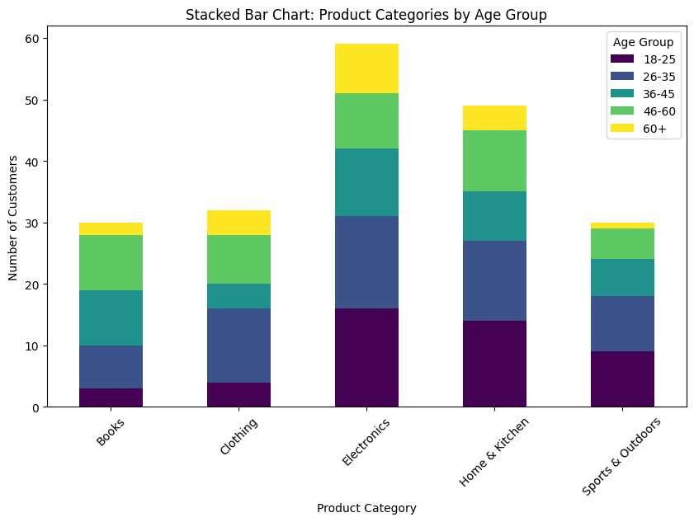
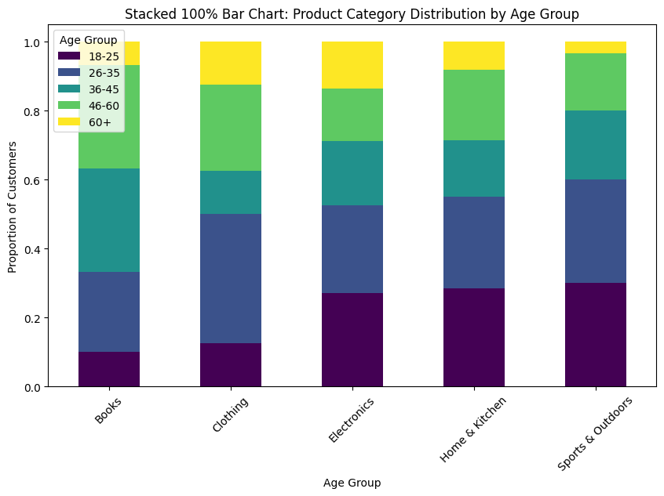
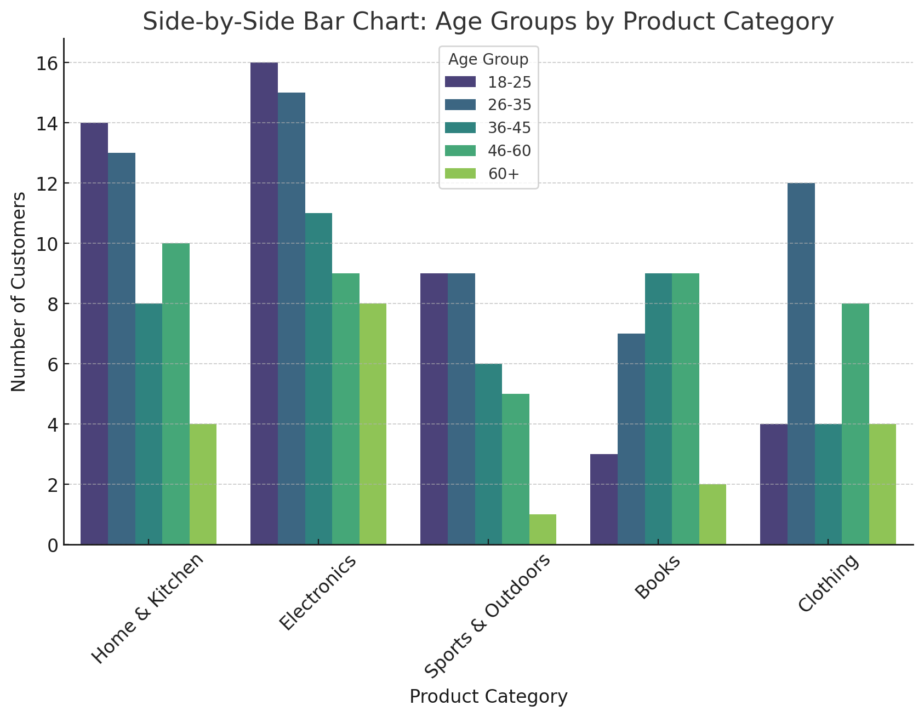
Notes:
Maybe not as good because there is not an actual ordering on the x?

Slide 32
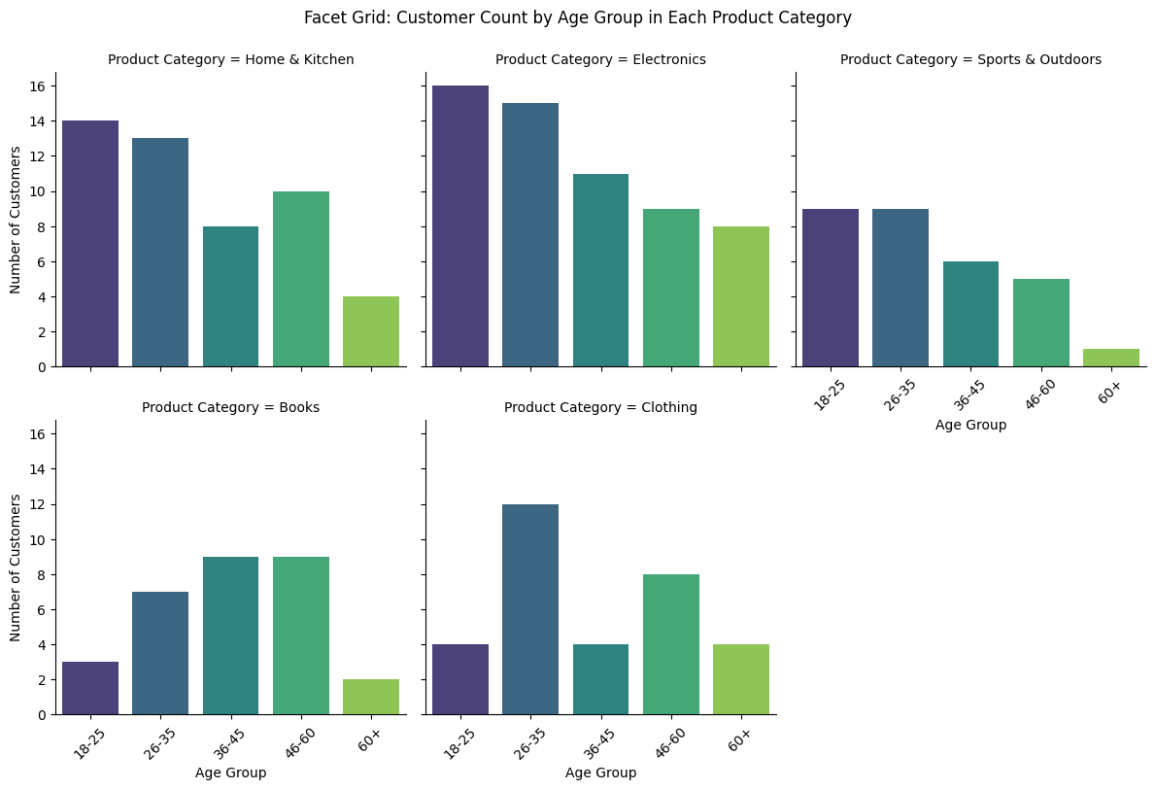

Slide 33
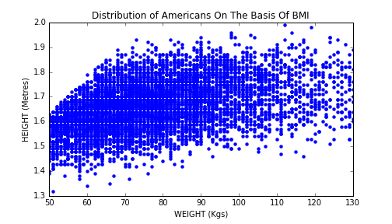
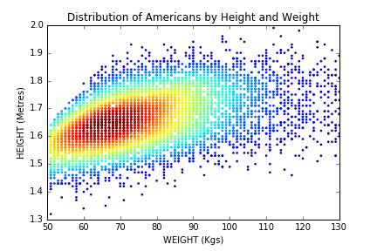
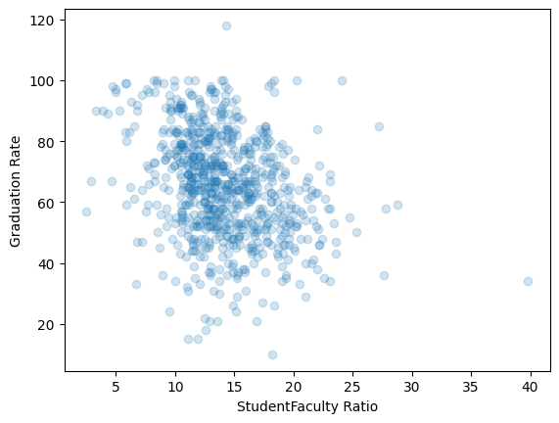
Scatterplot
Scatterplot is the standard tool to display relation between 2 variables
e.g. y-axis = response, x-axis = suspected indicator
Useful to answer:
Are x,y related?
Linear correlation
Strange patterns?
outliers present?
Use “alpha blending” (transparency) or heat maps for overplotting

Slide 34
Python Visualizations
T3_DataViz.ipynb

