Slide 1

Topic 4 – Decision Trees
Data Science and AI for Business

Slide 2

Class Data Project

Slide 3
Class Data Project
Project Instructions in Brightspace
Define your business problem
Who are you?
What can you answer with the data?
Is it interesting?
What is the predictive problem?
Should be very clear about what are the Xs and Ys (i.e. what are you predicting? What are the features?)
Start looking for data!
Link to suggestions on Brightspace
Online : (Kaggle, UCI Repository, Google)
Kaggle competitions are particularly useful
Beware of synthetic data sets, or data sets that have no info about their collection
Government agencies (NYC Open Data, etc)
May need an API – See API Notebook for examples
Personal connections (jobs, internships, etc)
Note: special consideration given to more challenging data sets!
Best strategy: find data about a topic that is interesting to you
Initial Proposal due in two weeks
See instructions in Brightspace
Submit via email
May submit TWO ideas

Slide 4
Fitting ML Models in Python

Slide 5
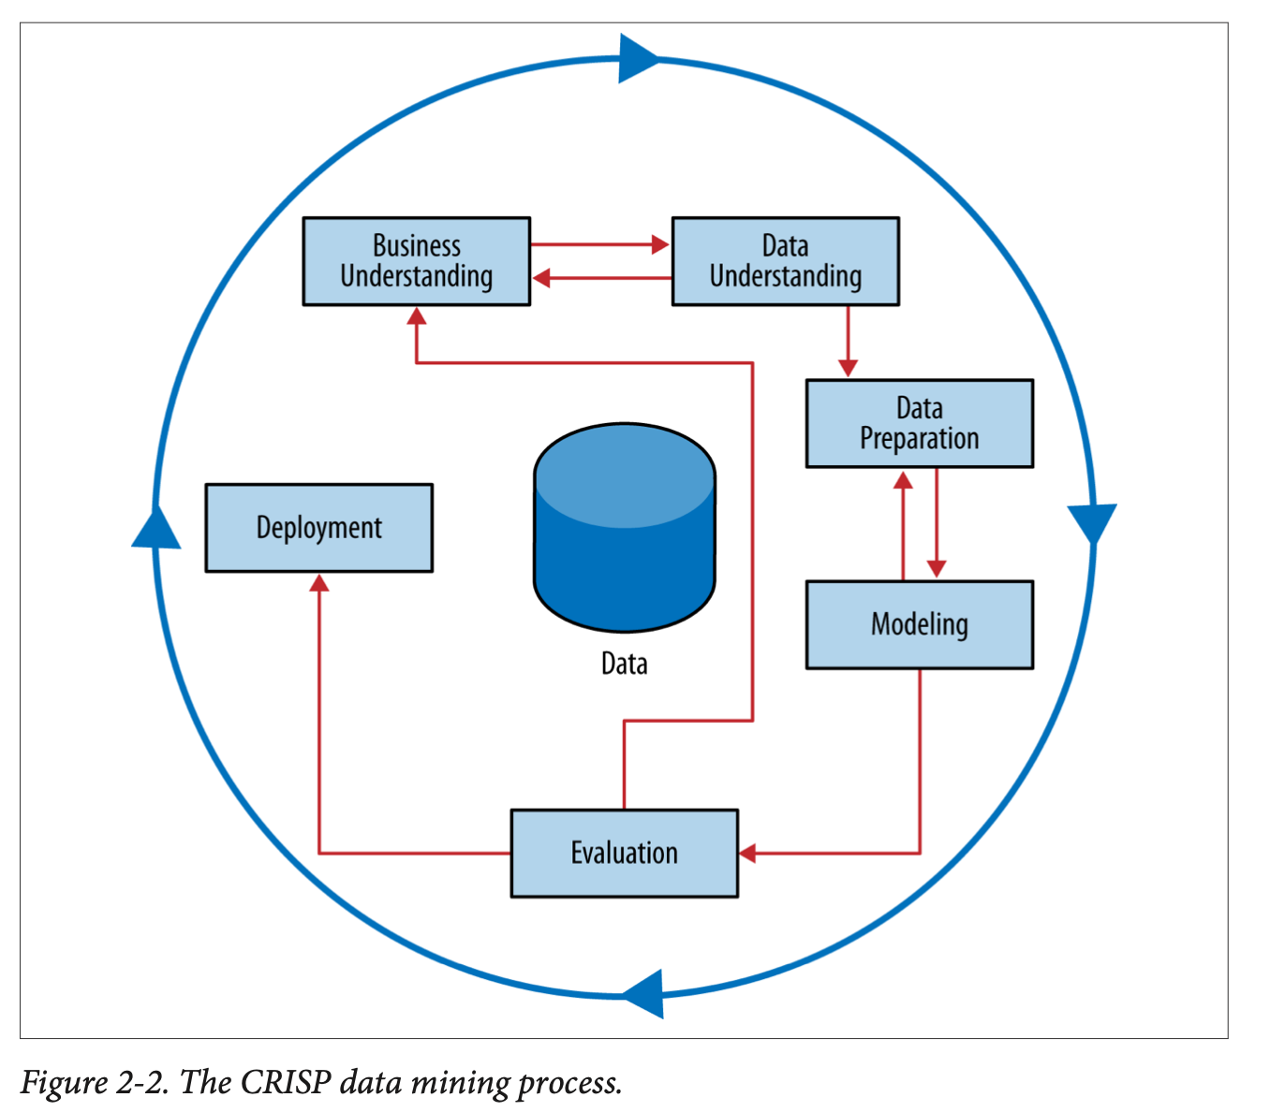
From Exploration to Model Fitting
Fitting data science models all follow the same basic structure in Python
Instantiate model
Set model parameters
Identify X (predictors) and Y (target)
Create training/test sets
Use .fit to apply model to data
Set other parameters
Use .predict to apply model to test set
Calculate model fit metrics
Compare predicted values to truth
Do this over and over again!
my_regression = LinearRegression()
X_train, X_test, y_train, y_test =
train_test_split(X, y, test_size=0.2)
my_regression.fit(X_train, y_train)
y_pred = my_regression.predict(X_test)
rmse = root_mean_squared_error(y_test,
y_pred)

Slide 6
Fitting Data Science Models
T4_Fitting_Data_Science_Models.ipynb

Slide 7
Decision Trees - Intro

Slide 8
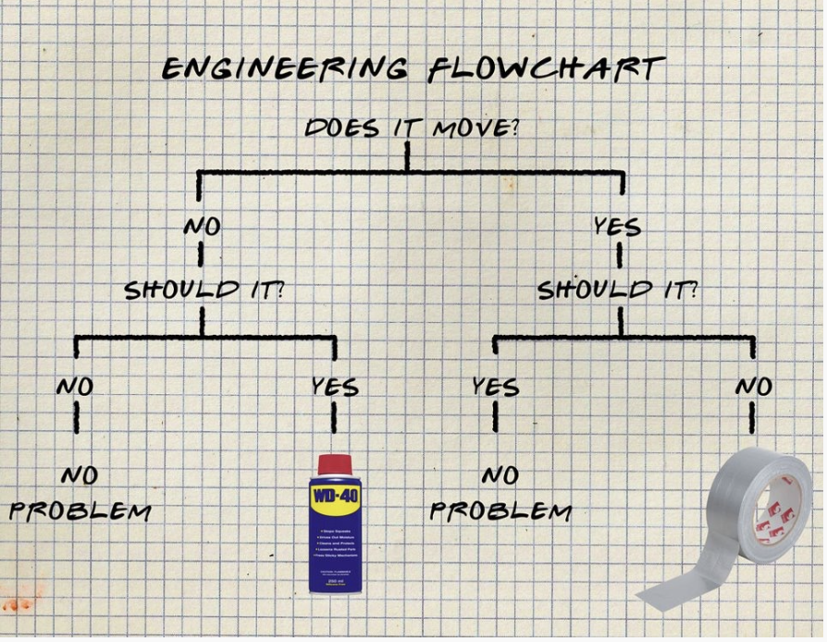
Why decision trees?
Notes:
DT are a supervised, predictive model
Easy to interpret
Data at the top, you make a bunch of decisions, and you get a prediction, and and action at the bottom.

Slide 9
Supervised Classification : Example
12 Bank Customers
N
N
Y
Y
Y
N
Y
N
N
Y
N
Y
Name | Head | HeadSize | BodyType | BodyShading | Buy?
Amy | Round | Regular | Oval | Light | N
Bani | Triangle | Regular | Oval | Dark | N
Crista | Round | Regular | Rectangle | Light | Y
Dev | Round | Regular | Rectangle | Light | Y
Eliza | Round | Regular | Rectangle | Light | Y
Fran | Triangle | Regular | Rectangle | Dark | N
Gianna | Round | Regular | Rectangle | Light | Y
Hector | Round | Large | Oval | Light | N
Irina | Round | Regular | Oval | Light | N
Jaquie | Round | Large | Rectangle | Light | Y
Kendra | Round | Large | Oval | Light | N
LaToya | Triangle | Regular | Oval | Light | Y
Target Variable of interest: Did they buy the product?
Features:
Head: Circle or Triangle
HeadSize: Large or Regular
Body Type: Oval or Rectangle
Body Shading: Light or Dark

Slide 10
Separating Classes
Name | Head | HeadSize | BodyType | BodyShading | Buy?
Amy | Round | Regular | Oval | Light | N
Bani | Triangle | Regular | Oval | Dark | N
Crista | Round | Regular | Rectangle | Light | Y
Dev | Round | Regular | Rectangle | Light | Y
Eliza | Round | Regular | Rectangle | Light | Y
Fran | Triangle | Regular | Rectangle | Dark | N
Gianna | Round | Regular | Rectangle | Light | Y
Hector | Round | Large | Oval | Light | N
Irina | Round | Regular | Oval | Light | N
Jaquie | Round | Large | Rectangle | Light | Y
Kendra | Round | Large | Oval | Light | N
LaToya | Triangle | Regular | Oval | Light | Y
Goal: find rules to separate those who buy from those who don’t
What attributes would you use?
What rules would you make?
How do you determine how good it is?
Notes:
Maybe introduce the concept of baseline…

Slide 11
Separating Classes
N
N
Y
Y
Y
N
Y
N
N
Y
N
Y
Let’s look just at body type:
N
N
N
Y
Y
Y
N
N
Y
N
Y
Y
Notes:
Does it separate well? What criteria do you use?

Slide 12
Separating Classes
N
N
Y
Y
Y
N
Y
N
N
Y
N
Y
What about BodyShading?
Y
N
N
Y
N
Y
N
N
N
Y
Y
Y
Notes:
Which is better? More pure, vs more coverage?

Slide 13
Separating Classes
Lets look deeper at one of the subsets from our first split
N
N
N
N
Y
N
Are there any rules that make sense here?
You can make a rule here that only applies to this subgroup
“recursive partitioning”

Slide 14
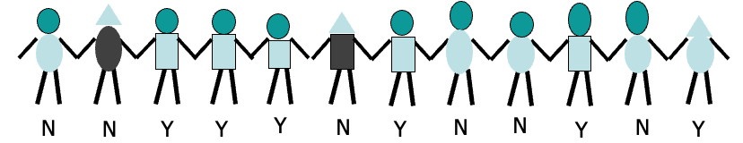
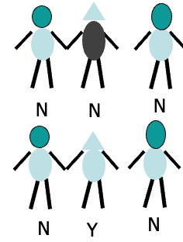
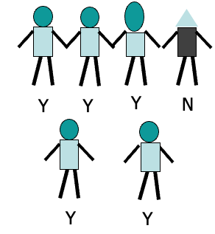
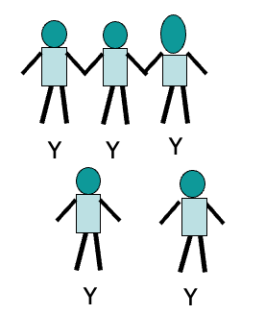
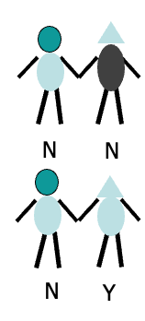
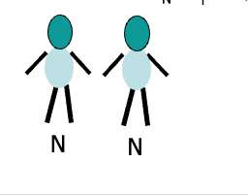
Put it all together
50%
body-shape=oval
body-shape=rectangle
16%
84%
Body-shading=dark
Body-shading=light
Head-size=large
Head-size=normal
100%
0%
0%
N
25%
Notes:
Can we go further?

Slide 15
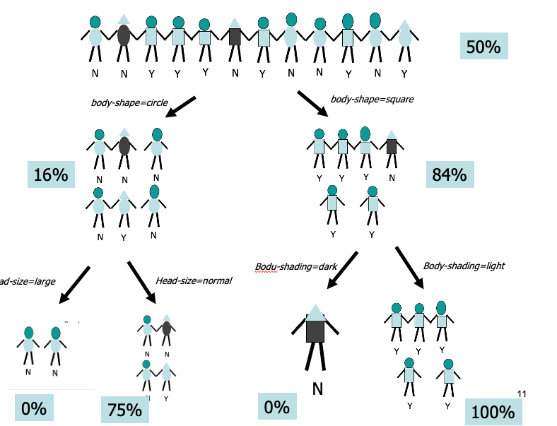
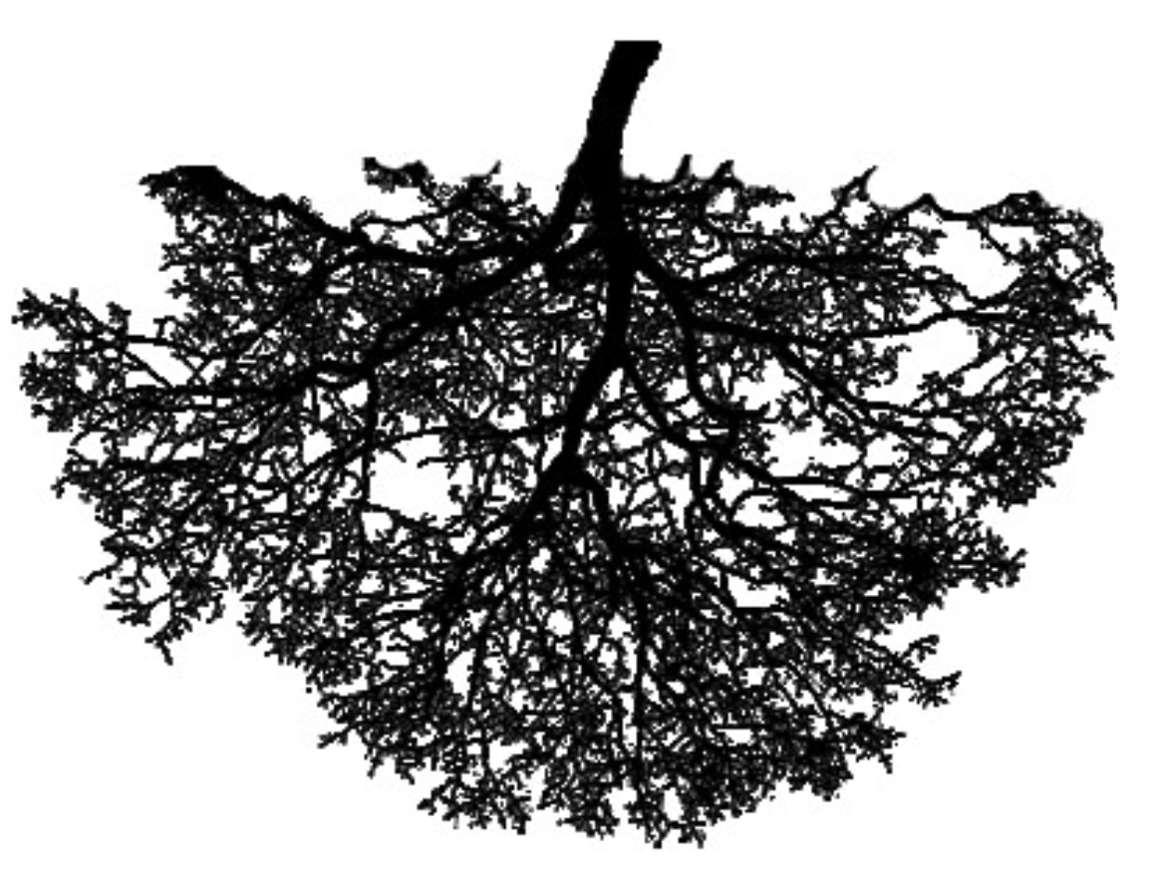
Decision / Classification Tree
This is known as a decision tree or classification tree
Start with all of the data
At each level you create a rule that creates “branches”
Each branch splits independent of previous splits
Bottom level are called the “leaves”
Each data point falls in one and only one leaf
Each leaf is defined by a set of rules that got us there
Each leaf gets labelled with the majority class for those that fell in the leaf
New data can now be classified
Every new instance goes to a single leaf
25%

Slide 16
Representing a tree
root
Yes (50%)
body-shape=circle
body-shape=rect
No
Yes
node
Body-shade
=dark
Body-shade
=light
Head-size=norm
Head-size=large
25%
No
No
No
Yes
leaf
What do we predict for this person?

Slide 17
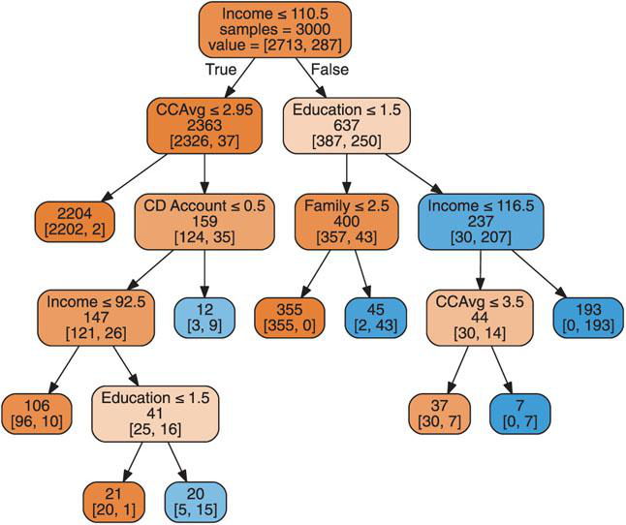
Loan example
Personal Loan acceptance data
Shmueli Chap 9.4
Probability of success comes from leaf node
What cohort has the lowest percentage acceptance?
What about this person:
0.001%
75%
0%
96%
100%
Income=110k
CCAvg = 2
CD Account = 1
Family = 3
Education = 2
9.4%
100%
19%
4.8%
75%
Notes:
You should be able to read and interpret a tree model…
CCAvg is average credit card spending

Slide 18
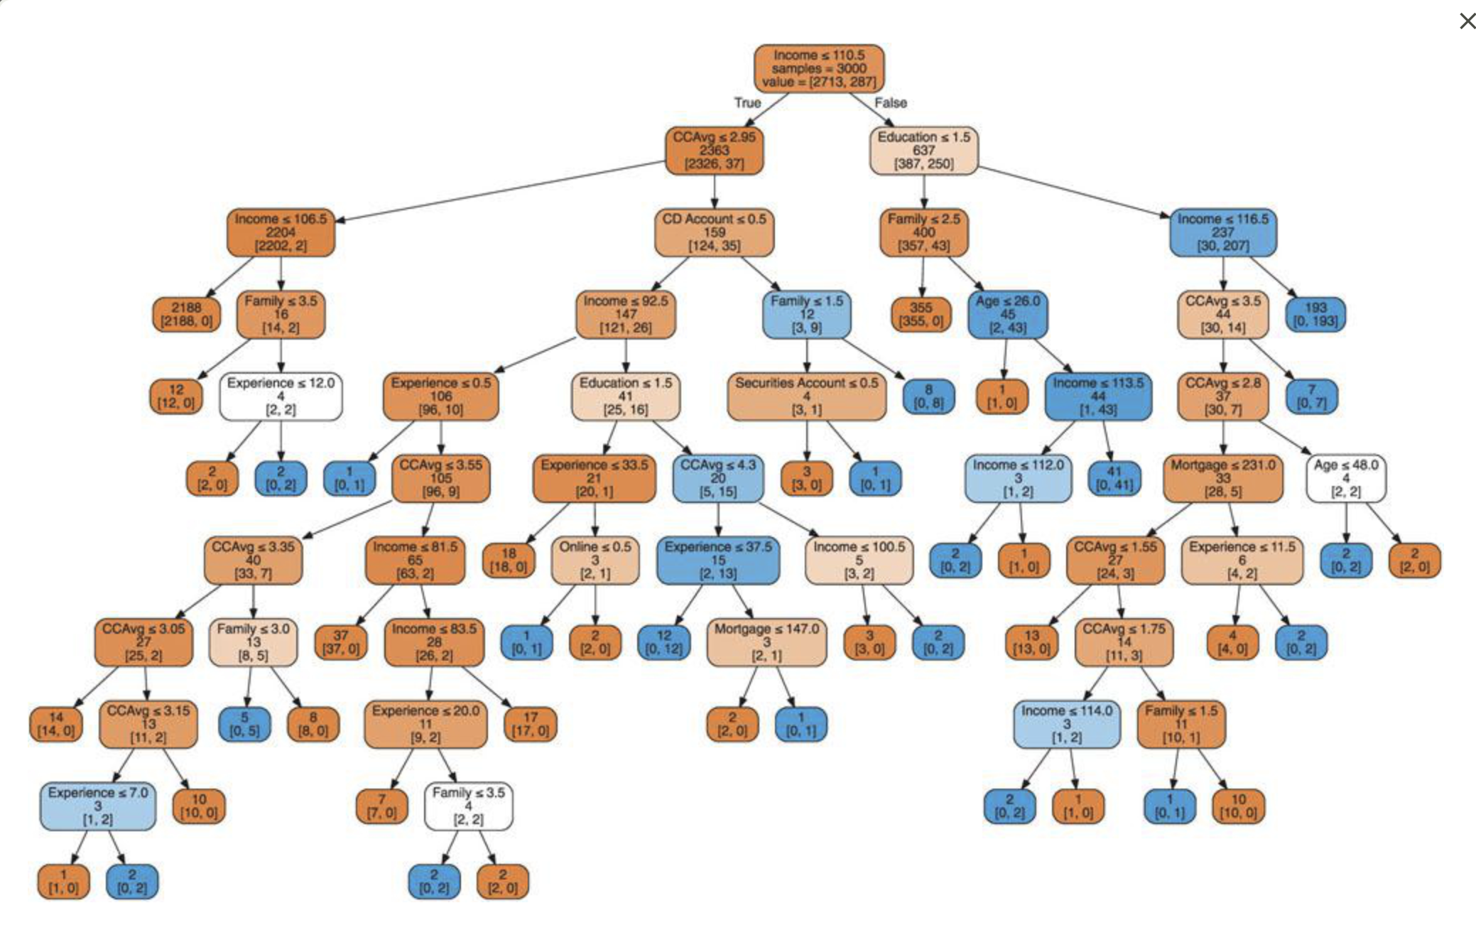
Decision Trees
The larger you build the tree, the more accurate it gets…
…on the training set 🫤
Control against overfitting by using a TEST SET to measure performance

Slide 19
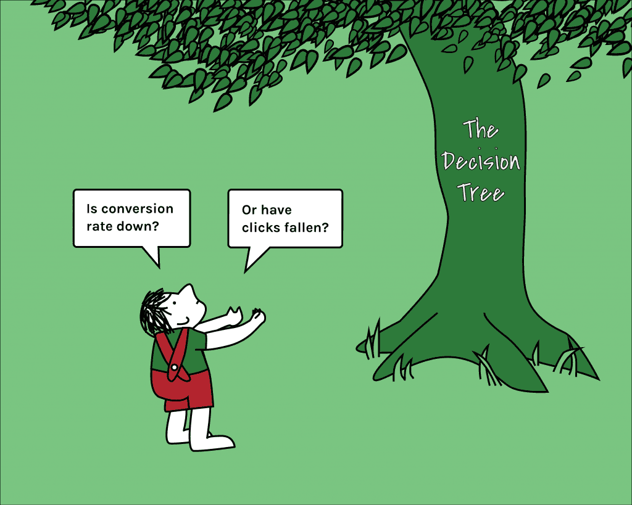
Trees - Summary
Easy to understand (when small)
Easy to communicate to executives / non-technical stakeholders
Reasonable performance for simple model
Efficient fitting algorithms
Provides estimate of feature importance
Doesn’t make any distributional assumptions (normality, etc)

Slide 20
How to Grow Decision Trees

Slide 21
Growing a Tree
Now we know how trees work, but still so many questions!
How do we know which variable to split on ?
How do we know where to split numeric attributes?
How many levels do we build the tree?
How do we evaluate performance?
Algorithms do the work, but we need to make some decisions along the way!

Slide 22
Growing a tree
What makes a good split?
Name | Head | BodyType | BodyShading | Buy?
Amy | Circle | Oval | Light | N
Bertha | Triangle | Oval | Dark | N
Crista | Round | Rectangle | Light | Y
Dante | Round | Rectangle | Light | Y
Eliza | Round | Rectangle | Light | Y
Fran | Triangle | Rectangle | Dark | N
Gianna | Round | Rectangle | Light | Y
Hector | Round | Oval | Light | N
Irina | Round | Oval | Light | N
Jaquie | Round | Rectangle | Light | Y
Kendra | Round | Oval | Light | N
LaToya | Triangle | Oval | Light | Y
a good split has:
pure branches
“coverage” of the data
Notes:
Have them try and answer this question….

Slide 23
Measuring Impurity through Entropy
The more homogeneous (consistent) a group is, the more pure it is
+ good risk – no default
bad risk - default
Very impure group
Less impure
Minimum impurity
Measure this with entropy:
Entropy = - p₁log₂(p₁) - p₂log₂(p₂)
Where p is the probability of a + in that group

Slide 24
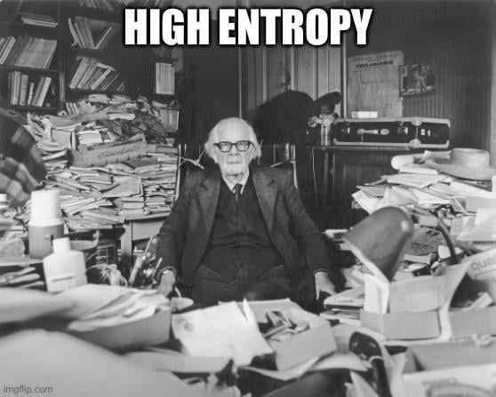
Entropy
+ good risk – no default
bad risk - default

Slide 25
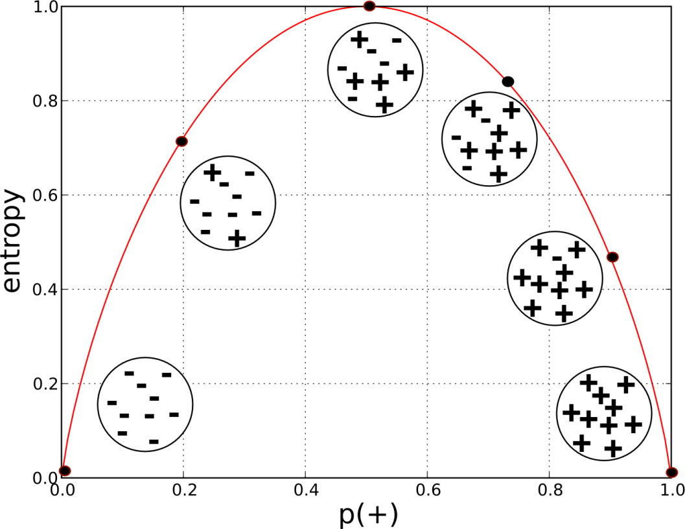
Entropy
Entropy is maximized at 1 when classes are equal
Entropy also extends to more than 2 classes

Slide 26
Entropy
Entire population (30 instances)
17 instances
Balance>=50K
Balance<50K
13 instances
+ good risk – no default
bad risk - default
Overall entropy of split is a weighted average of the two
Notes:
Started at .96

Slide 27
Evaluating Splits via Information Gain
Information Gain = Entropy (parent) – [Weighted Entropy (children)]
Gain = 0.38
Impurity(Pre-Split) =0.996
Average Impurity(Post-Split) = 0.615
Balance>=50K
Gain=0.996-0.615=0.38
Impurity = 0.787
Balance<50K
+ good risk – no default
bad risk - default
Impurity = 0.39

Slide 28
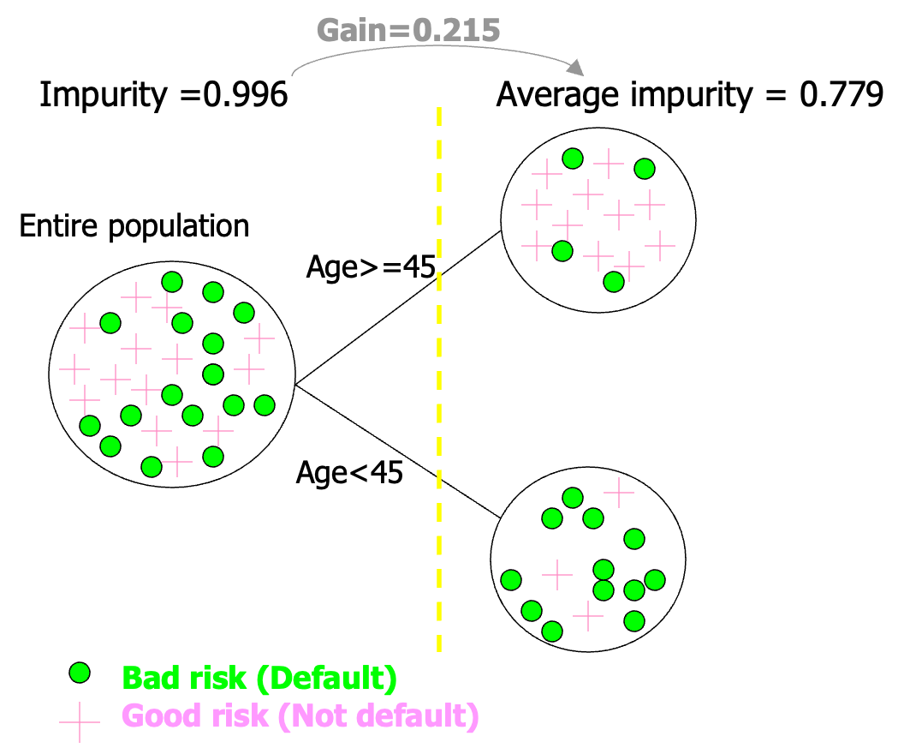
Finding the best split
What if we tried to split over age instead?
Not as good as the split for income!
First, need to find the best place to split the age variable (using information gain)
Then, compare the maximal info gain to other splits
Thankfully we have software to do this!

Slide 29

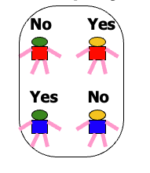
Building the tree…
At each split, we need to
Find the optimal split point for each numeric attribute
Find the optimal split for any categorical attribute
Compare the information gain of those splits for each attribute
Pick the best one and split
We stop growing when:
Perfect purity
Or no split can add information
But, we don’t want to build trees as deep as we can
Test / hold-out sets will guide us in optimal tree size

Slide 30
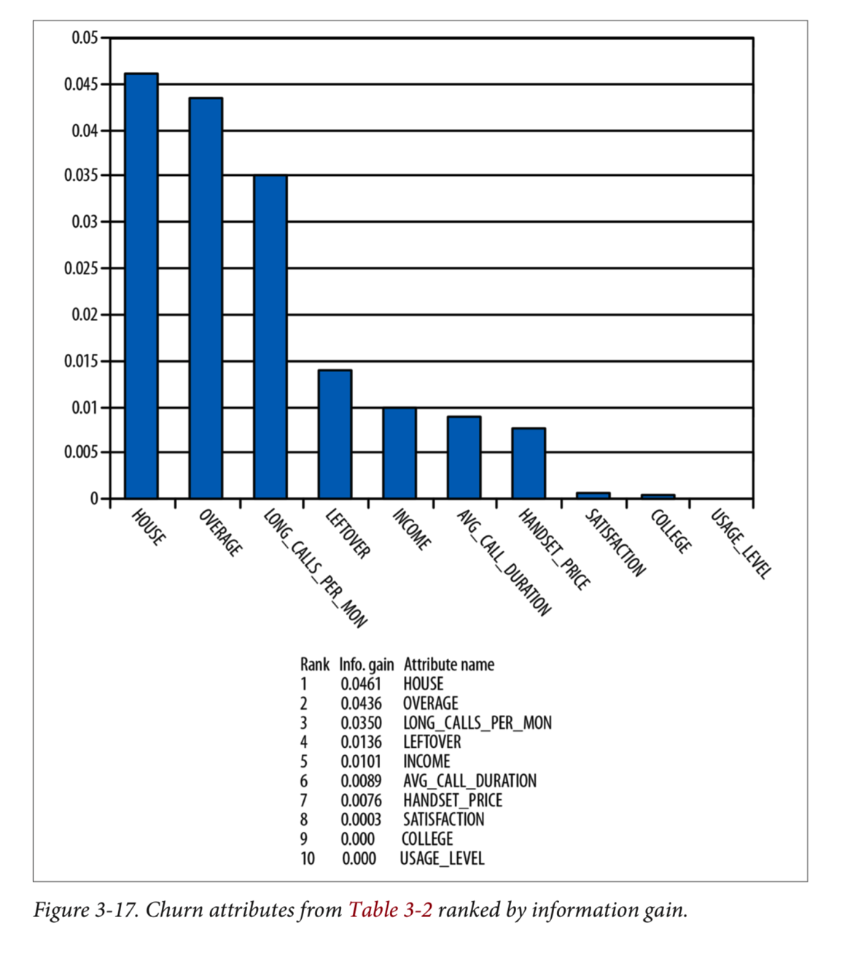
Information gain for feature importance
DSB Chap 3
Each split results in information gain
Decreasing entropy is increasing information
You can assign the info gain to the attribute used for that split
Summed information gain over the entire tree gives a measure of feature importance

Slide 31
Tree Evaluation
Most basic measure of performance is “accuracy” – strictly how many of your data points you got correct
What is the accuracy in this example? Is that good?
Goodness depends on the baserate!
Always best to report performance on a test set
Notes:
(2970+3000) = 99%
2713/3000 = 90.4%
Other metrics will be discussed.

Slide 32
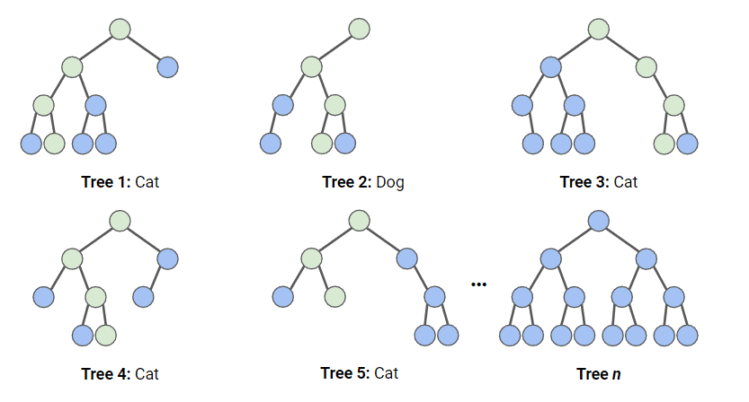
Teaser: Random Forests
Typically, multiple trees (or forests) will outperform a single well-built tree.
Random Forests is a ML method that fits many different trees to a prediction problem - using random samples of rows and columns – and averaging the predictions across trees.
Pro: improved predictive power
Con: loss of interpretability
More to come when we get to ensembles…
from sklearn.ensemble import RandomForestClassifier

Slide 33
Fitting and Interpreting Decision Trees
T4_Decision_Trees.ipynb

