Slide 1
Topic 6 – Regression and Regularization
Data Science for Business – Fall 2025

Slide 2

Linear Regression
Linear Regression is a mathematical optimization model to predict a numeric variable from one or multiple other features
Simple Linear Regression (SLR)
Only one explanatory variable (attributes)
Multiple Linear Regression (MLR)
Multiple explanatory variables (attributes)
Simple, mathematically rigorous, surprisingly effective
from sklearn.linear_model import LinearRegression
import statsmodels.formula.api as sm

Slide 3

Test your knowlege
Regression Knowledge Test:
Or Click Link

Slide 4

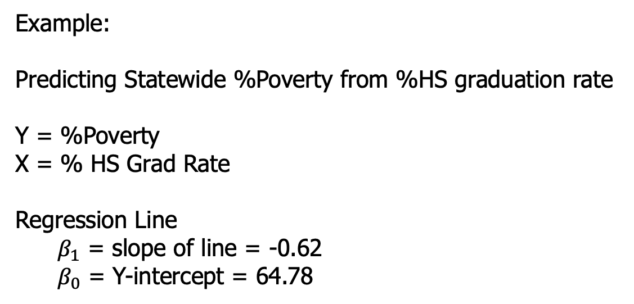

Defining the Regression Line
Any line is mathematically expressed as an equation with a slope and an intercept (you may have seen y=mx+b in algebra)
Example:
Predicting Statewide %Poverty from %HS graduation rate
Y = %Poverty
X = % HS Grad Rate
Regression Line
$β_{1}$ = slope of line = -0.62
$β_{0}$ = Y-intercept = 64.78
Regression Line Equation:
$Y=64.78 − 0.62$ X
negative slope= negative relationship =negative correlation
$Y=β_{0}+β_{1}$X

Slide 5
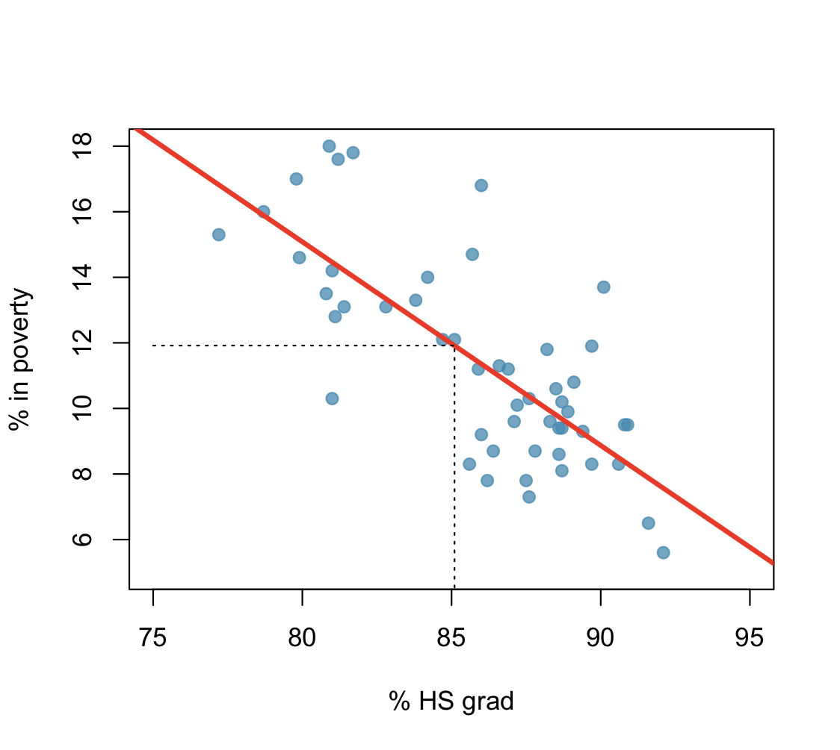

Regression line
The high school graduation rate in Georgia is 85.1%. What poverty level does the model predict for this state?
$Y=64.78 − 0.62$ X
Poverty = 64.78 – 0.62 x 85.1 = 12.02
Notes:
64.78 - 85.1x.62 = 12.02
Allows you to make a prediction for something you haven’t seen yet.

Slide 6
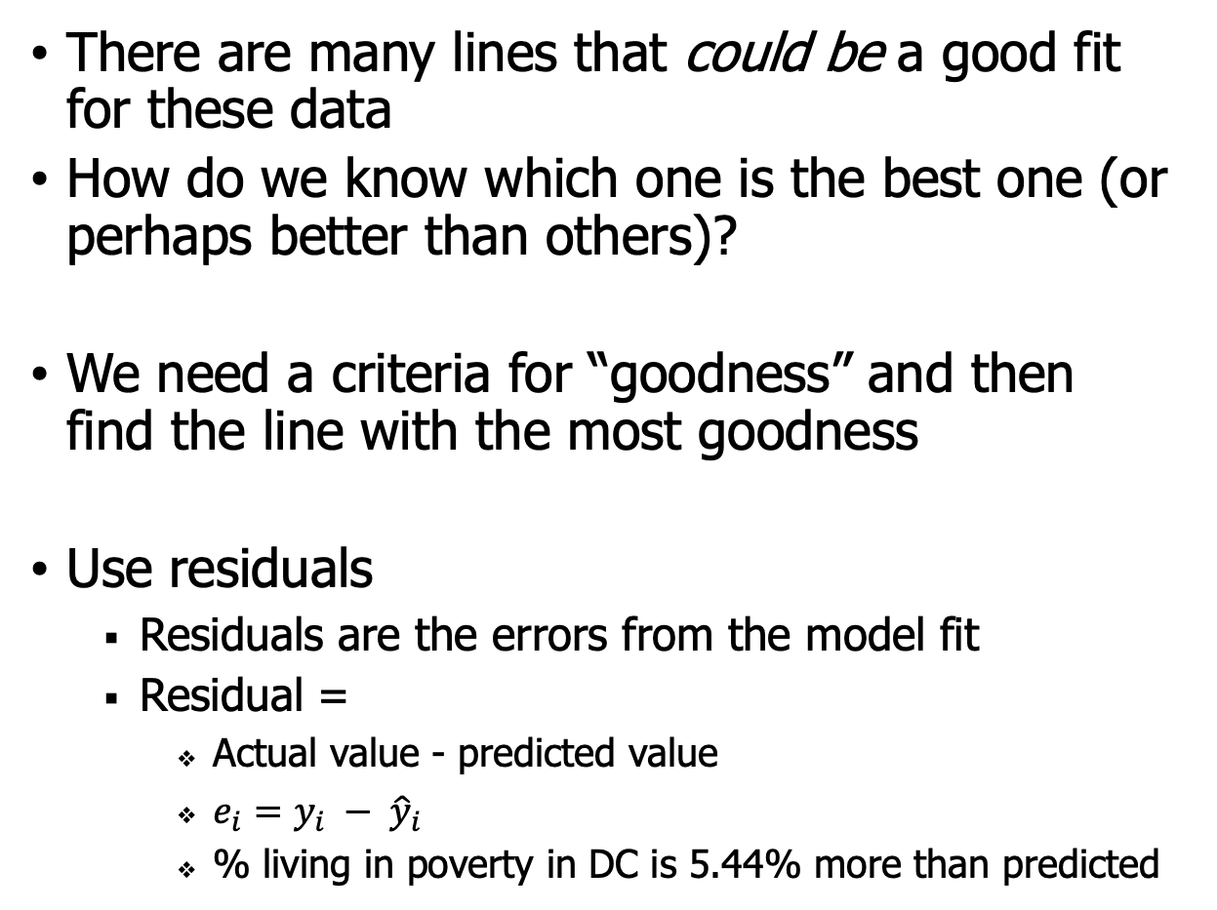
Finding the Right Regression Line
There are many lines that could be a good fit for these data
How do we know which one is the best one (or perhaps better than others)?
We need a criteria for “goodness” and then find the line with the most goodness
Use residuals
Residuals are the errors from the model fit
Residual =
Actual value - predicted value
$e_{i}=y_{i} − {\hat{y}}_{i}$
% living in poverty in DC is 5.44% more than predicted

Slide 7




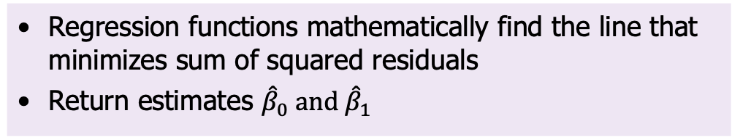
Least Squares Regression Line
The least squares regression line is the line that minimizes the sum of the squared residuals
Squares? This makes sure errors don’t cancel out
aka: mean squared error
Regression functions mathematically find the line that minimizes sum of squared residuals
Return estimates ${\hat{β}}_{0} and{ \hat{β}}_{1}$
$Y=64.78 − 0.62$ X
$${\hat{β}}_{0}$$
$${\hat{β}}_{1}$$

Slide 8
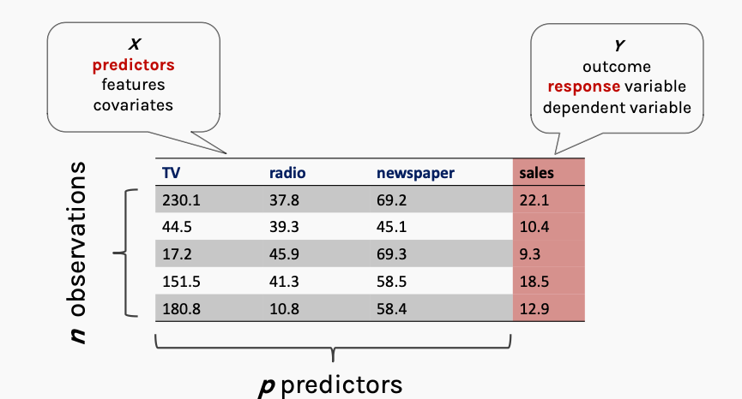
Multiple Regression: Example
Advertising vs. Sales for three different ad channels
X: thousands of $$
Y: thousands of units sold
Courtesy: Harvard IASC CS109A Protopapas

Slide 9
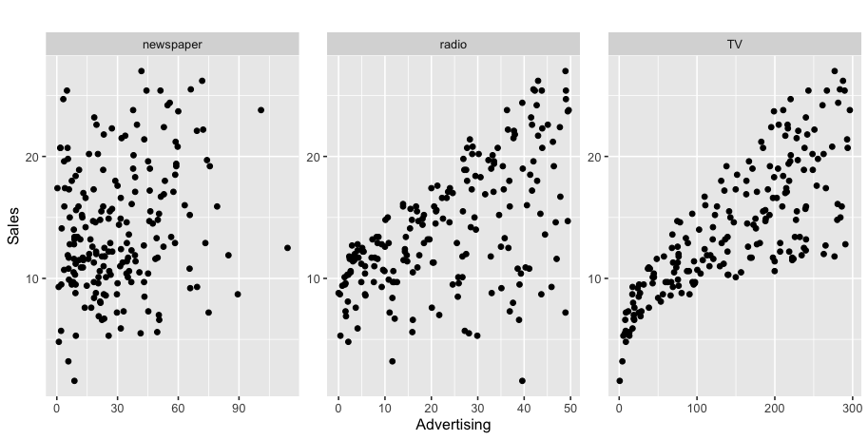
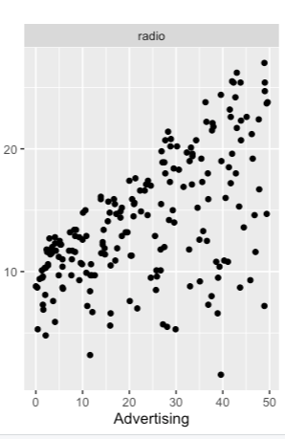
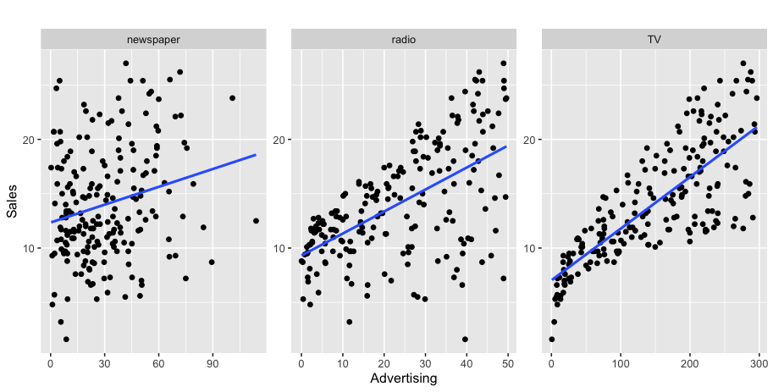
Regression Example – Advertising v Sales
k units sold
sales
$k
Is there a relationship between advertising and sales?
How strong is the relationship between different types of advertising and sales?
How accurately can we predict future sales?
Which media has the strongest connection to sales
Can do a simple regression for each one, or combine them into a multiple regression
Notes:
Advertising in different markets

Slide 10

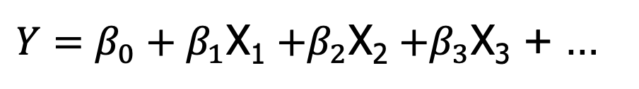



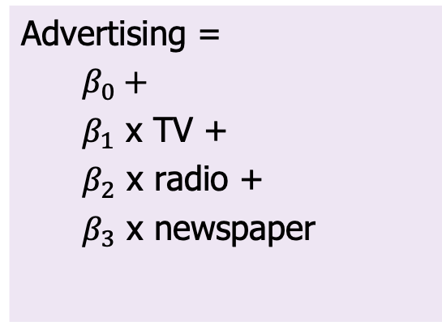
Multiple Regression Model
Regression line equation defines the relationship between the features and target:
$Y=β_{0}+β_{1}$X₁ $+β_{2}$X₂ $+β_{3}$X₃ + …
Advertising =
$β_{0}+$
$β_{1}$ x TV +
$β_{2}$ x radio +
$β_{3}$ x newspaper
Sales = 2.94 + 0.04 TV + 0.18 radio - 0.01 newspaper
$${\hat{β}}_{0}$$
$${\hat{β}}_{1}$$
$${\hat{β}}_{2}$$
$${\hat{β}}_{3}$$
Notes:
What is the prediction for a market that spends 10k on each
2.94 + 0.46+1.89 – 0.01 = 5.28 k units sold

Slide 11
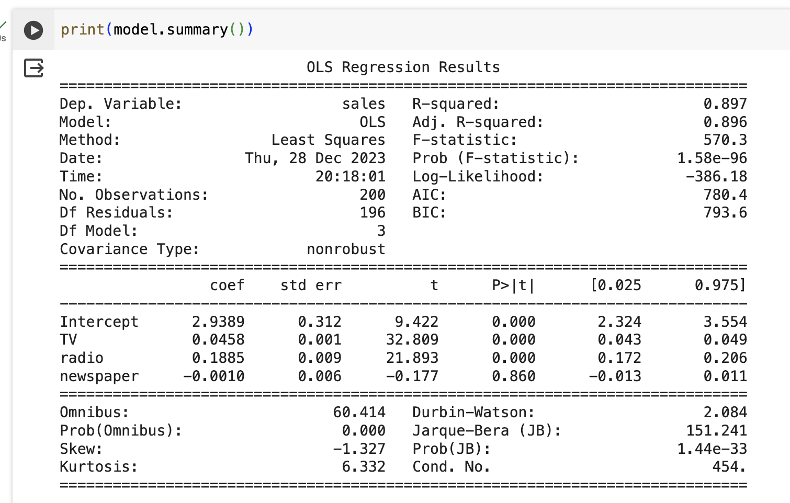
Regression output - python
Using statsmodels
How good is the model? You might be familiar with these but..
R² and Adjusted R² are measures on the training set 😮
The t-stat and the p-value tell us which features are most important
Can use train/test, RMSE, and ROC, just like other models
Notes:
What is the equation???
What is the prediction for a market that spends 10k on each
2.94 + 0.46+1.89 – 0.01 = 5.28 k units sold

Slide 12
Regression – Complexity Control
One simple way to balance complexity and performance in linear regression…
Simply remove the features that have significance p<0.05
Remove and refit

Slide 13
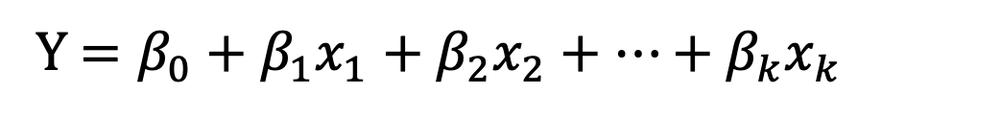
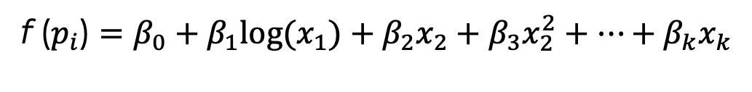
Extending Regression: Non-linear regression models
Linear regression is … linear in the features
Y $=β_{0}+β_{1}x_{1}+β_{2}x_{2}+⋯+β_{k}x_{k}$
But maybe you have seen through exploratory analysis that the relationship does not seem to be linear
One “trick” to do this, is to keep a linear model, but transform the predictor:
Logarithmic
Square or other polynomial
f ($p_{i}$) $=β_{0}+β_{1}{log(x}_{1})+β_{2}x_{2}+β_{3}x_{2}^{2}+⋯+β_{k}x_{k}$
Notes:
You can fit any model perfectly
Think about age vs performance…
Income vs. success…

Slide 14
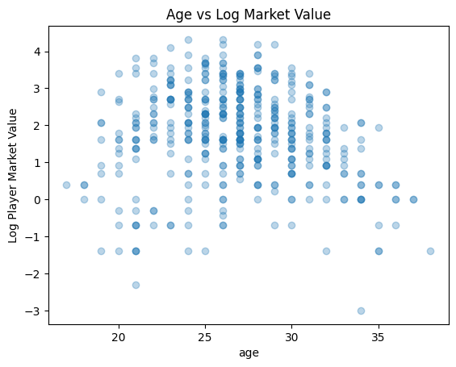
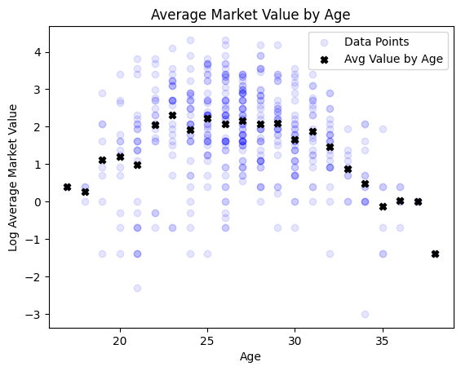
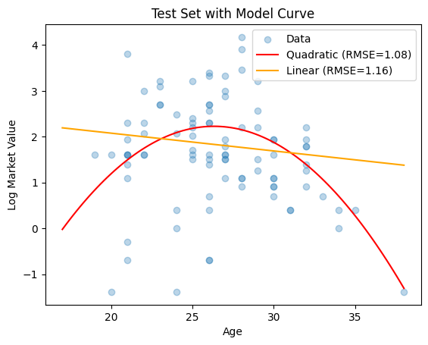
Add polynomials where needed
English Premier Soccer Data
Y = log(Market Value) vs. Age…
This adds complexity to the model and should be done carefully…

Slide 15
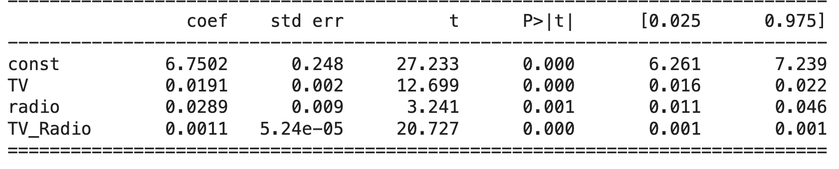
Interaction Terms
The Linear regression model assumes that all effects are independent and linear
The effect of one feature does not depend on the value of another
Not always true!
Interaction terms can account for these dependencies
ad["TV_Radio"] = ad["TV"] * ad["radio"]
Interaction term =>
More complexity! Adding interactions can really explode your feature space
Notes:
Maybe advertsing on radio helps make the TV advertising even more effective because of the awareness….
OR…maybe advertising on radio makes TV less effective.

Slide 16
Logistic Regression

Slide 17

Logistic Regression
Logistic Regression is a bit of a misnomer
It is a model for classification
It uses the same framework as linear regression, but in order to predict probabilities it uses a clever transformation of a (0,1) target
Used for binary prediction and estimating probabilities
from sklearn.linear_model import LogisticRegression

Slide 18
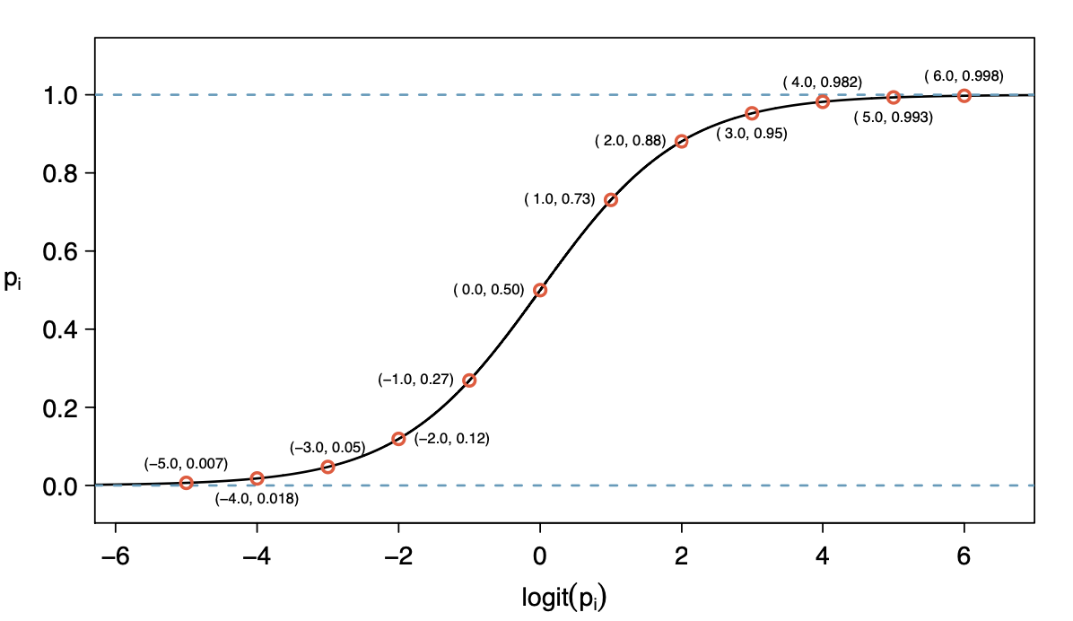

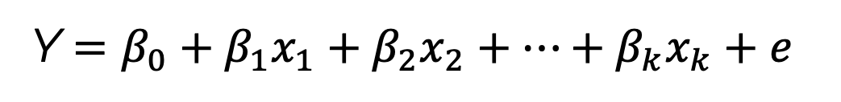
Logistic Regression
Logistic Regression directly predicts (a function of) the probability of a “success”:
Model:
Y $=β_{0}+β_{1}x_{1}+β_{2}x_{2}+⋯+β_{k}x_{k}+e$
Y= $logit\left(p_{i}\right)=log⁡( \frac{p_{i}}{1−p_{i}})$
Note: β_{i} not interpreted as a slope, now it it log-odds
Logistic Regression is a common baseline model for classification
Notes:
Its hard to fit a model that just “stops” at 0 or 1, so logistic regression was a mathematical trick invented to allow the model to estimate a number that can take on any value, but map it to a probability.
Beta_i is NOT interpreted as a change in Y for every unit change in X. Technically beta refers to the “log-odds” of the feature, which is the ration of the log(prob(Y=1)/prob(Y=0))
Logistic regression is a workhorse in data science…not the best model but has easy intepretations…
@SSAC – super bowl squared

Slide 19
Complexity and Overfitting in Regression

Slide 20
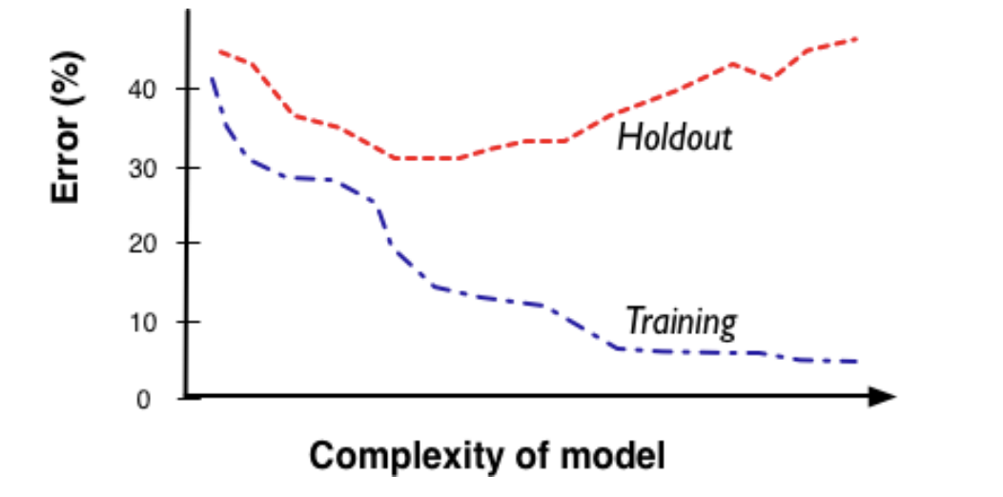
Complexity
Remember the complexity balance
More complexity allows us more freedom and flexibility to fit the messy realities
BUT higher complexity runs the risk of overfitting data

Slide 21


Complexity in Regression
For regression models, complexity comes in multiple forms – often called the “dimensionality” of the model
Number of attributes
More attributes means more complex relationships
Categorical variables can explode dimensionality (remember one-hot encoding)
Functional form of the regression
Degree of polynomial
Interaction between features
In general we want to follow “Occam’s Razor”
Keep the model as simple as possible while maintaining predictive performance
Adding attributes might make our model better!
But now we’ve added complexity and might be overfitting

Slide 22
Complexity in Regression
There are real-world scenarios where we may want to explore hundreds, thousands, even MILLIONS of attributes
Recommender Systems
Web-based marketing models
Financial models with time based attributes

Slide 23
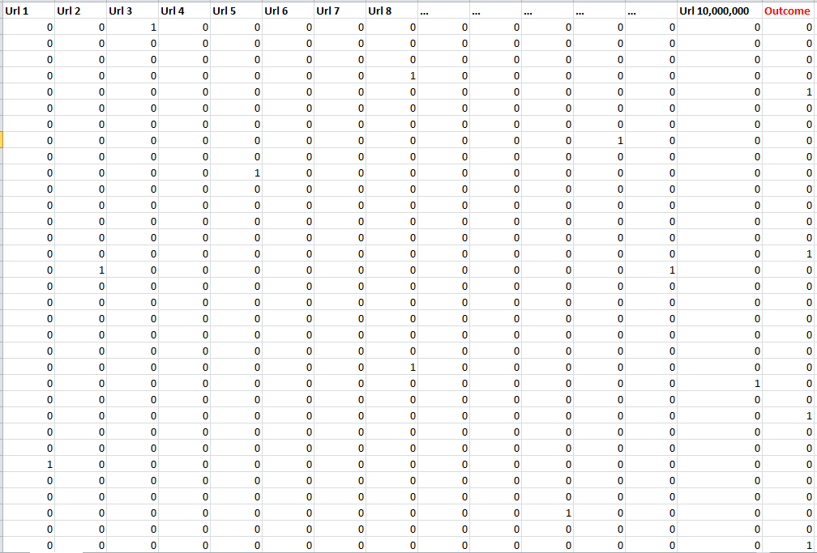
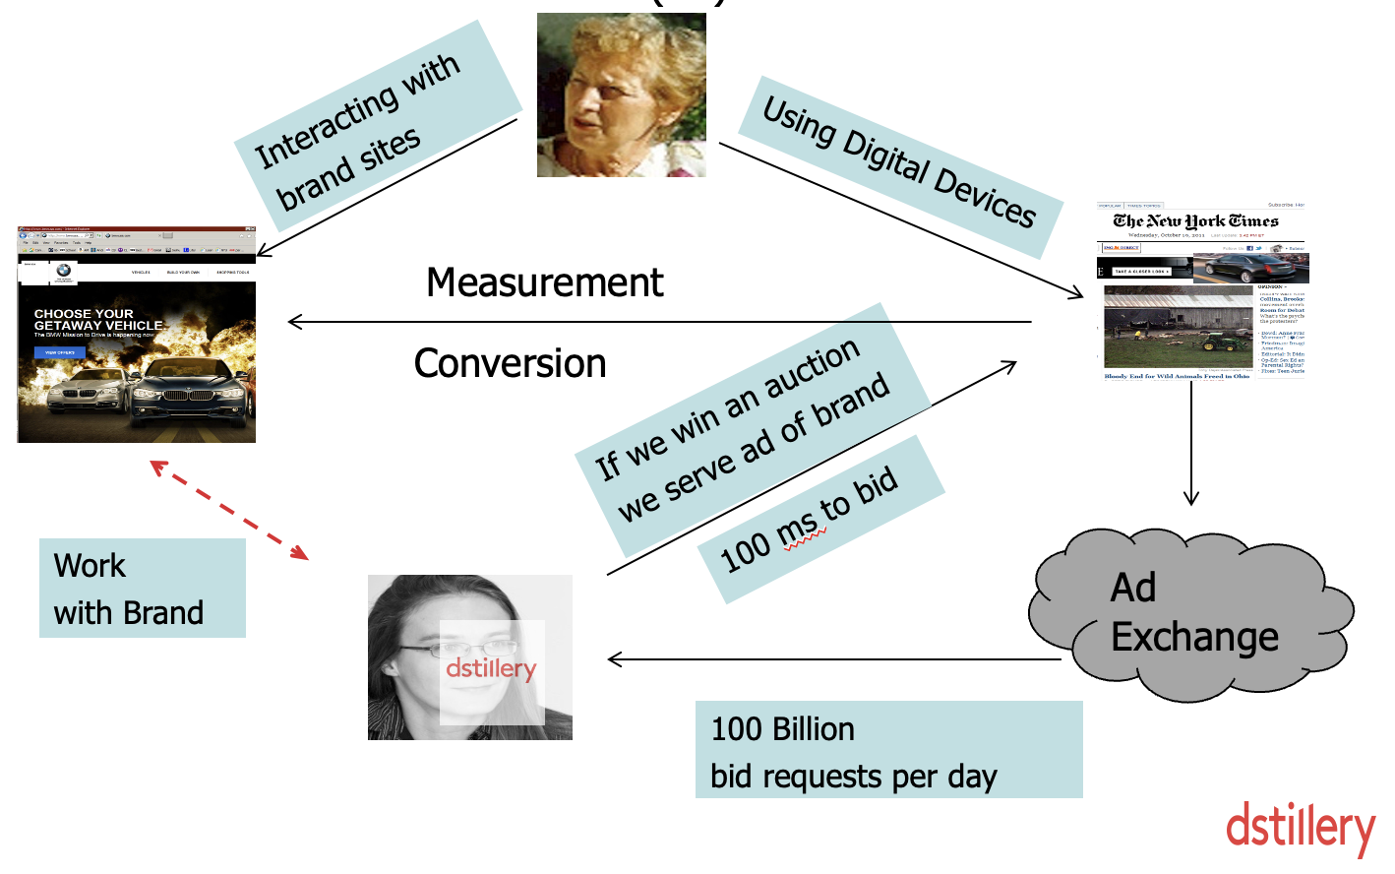

Advertising Example
10 Million Columns
<0.1% Positives
Notes:
Predicting who is going to click on an ad…

Slide 24
Complexity in Regression
Two ways to reduce complexity when you have a HUGE number of features
Reduce the number of attributes
Variable Selection, clustering, principal components
2) Use a penalty in the objective function
regularization : One weird trick to address complexity

Slide 25

Feature Selection/Reduction

Slide 26
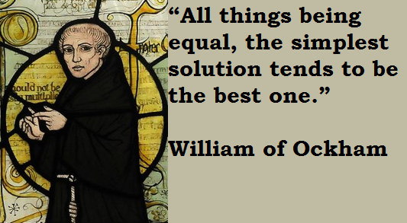
Removing Unimportant Attributes
It is helpful to remove unimportant features from your modelling.
Why?
Model Accuracy
Overfitting
Efficiency – for fitting and use modes
Interpretability
Occam’s Razor
In some examples you might be handed (or can engineer) thousands, or even millions of attributes!

Slide 27
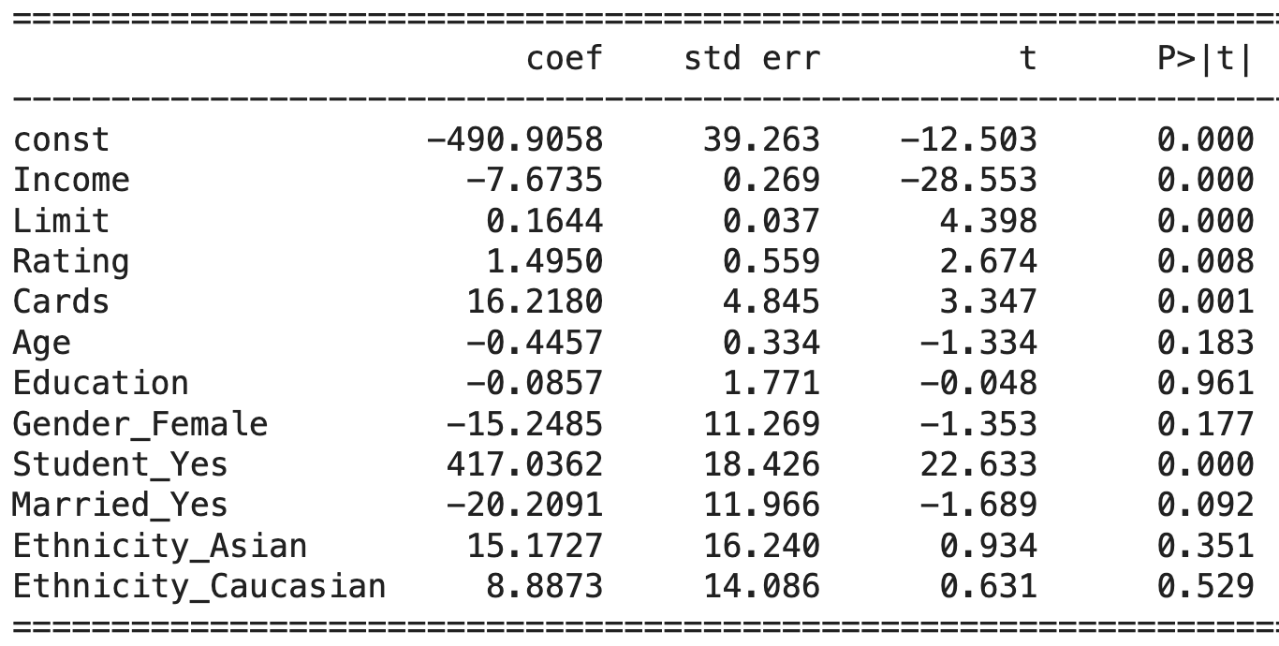
Iterative Feature Selection by Subtraction
Steps:
Fit a regression model with all features
Identify and remove “noise features” (p-value > 0.05)
Re-fit model and assess value
Credit Data
Backward elimination :
Stepwise, at each step
eliminate one variable at a time
Re-fit model and assess RMSE
Stop when model performance degrades
Iterative removal is a bit more “careful” than block removal
Notes:
Doesn’t use an arbitrary p>0.05 level

Slide 28

Dimension Reduction – Principal Components
Principal Components Analysis (PCA)
One other possibility for dimension reduction when you have a lot of features
Mathematically:
A projection of numerical values from a high dimensional space into a smaller dimensional space while retaining the maximal amount of information in the data
ISL: Ch 6.3.1

Slide 29
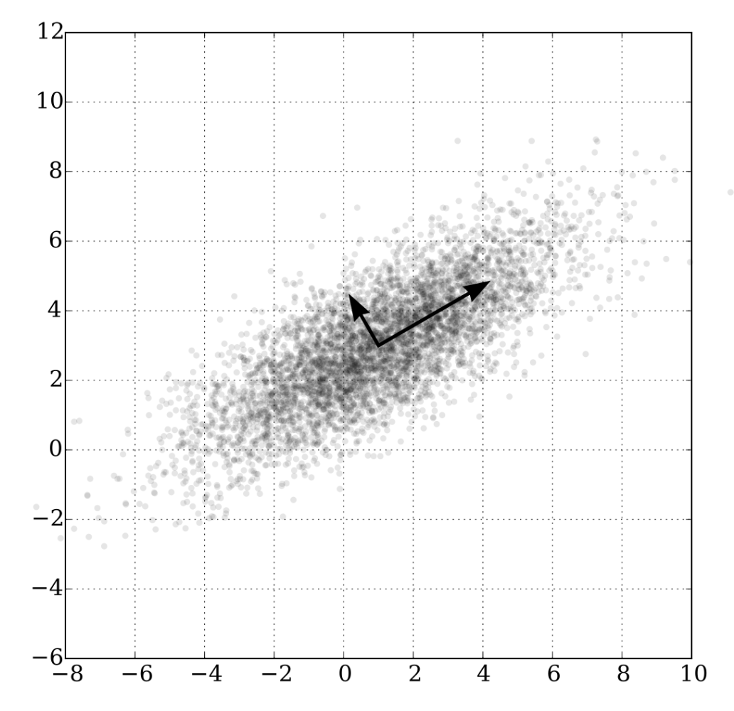
Principal Components Analysis
PCA is a method to create a new set of features from the original ones:
There are many less of them
They are a linear combinations of the original features
They capture the maximum amount of variance in the observed data.
Reduces redundancy and correlations in features
Advertising example: many features are low information or redundant
Notes:
You may have a bunch of features which are correlated or are getting at the same thing.
Advertising

Slide 30
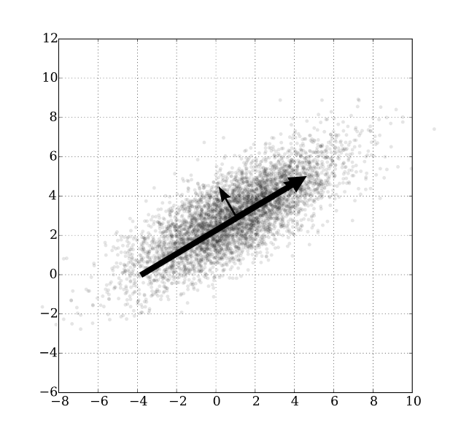
Principal Components
ISL: Ch 6.3.1
Expand this to many dimensions
You can take a high-dim data set and reduce it to something much smaller and not lose much information
Each PCA feature is a linear combination of ALL of the original features
Beware : variables should be standardized (mean=0, sd=1) for PCA
Principal Components Regression
Fit regression on PC instead of original data
Method for complexity control
PC are ordered by importance (or “information)
Take original data and reduce to the top principal components
How many? Can use Cross-validation to figure it out!

Slide 31
PCA – pros and cons
PCA is great for:
Reducing dimensionality in very high dimensional settings (e.g. image Compression)
Speeding up the training of a model (by reducing size) without significantly decreasing the predictive ability.
Reducing multicollinearity where it exists, improving computational stability
When you have many features with low (but positive) value (e.g. text)
PCA is not so good in certain situations because:
Interpretation of coefficients in PCA is lost. Each PCA feature is a linear combination of ALL of the original features
Requirement to normalize original features further reduces interpretability.
Feature importance is important

Slide 32
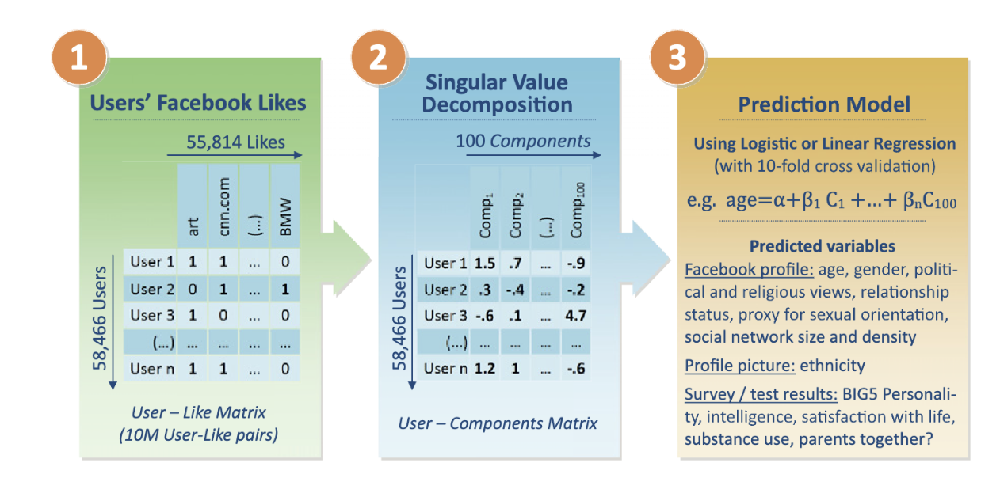
PCA in action
PNAS Facebook Paper – read for next class
Note : Singular Value Decomposition = Principal Components

Slide 33
Regularization

Slide 34

Regularized Regression
Regularization is another way of controlling complexity
Regularization means “penalizing” features with large coefficients. This encourages simplicity, and reduces overfitting

Slide 35
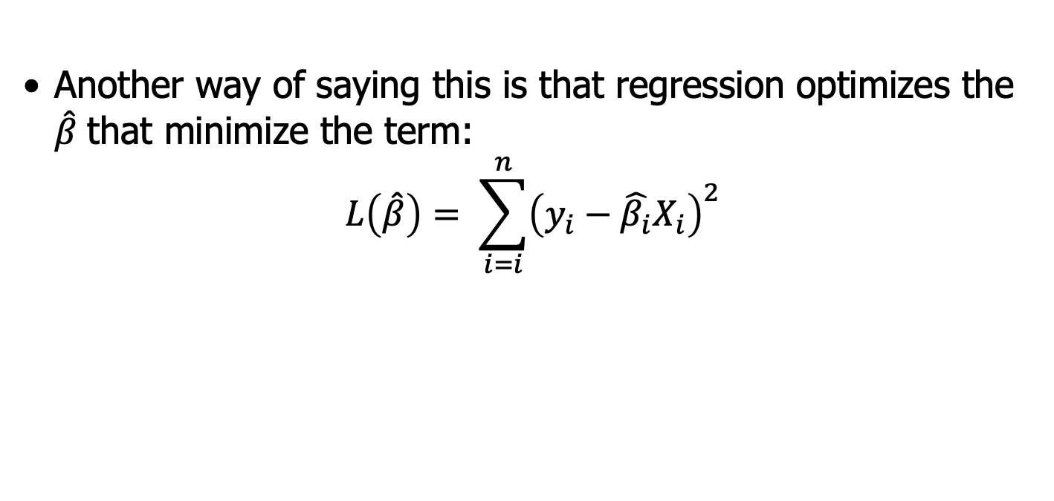

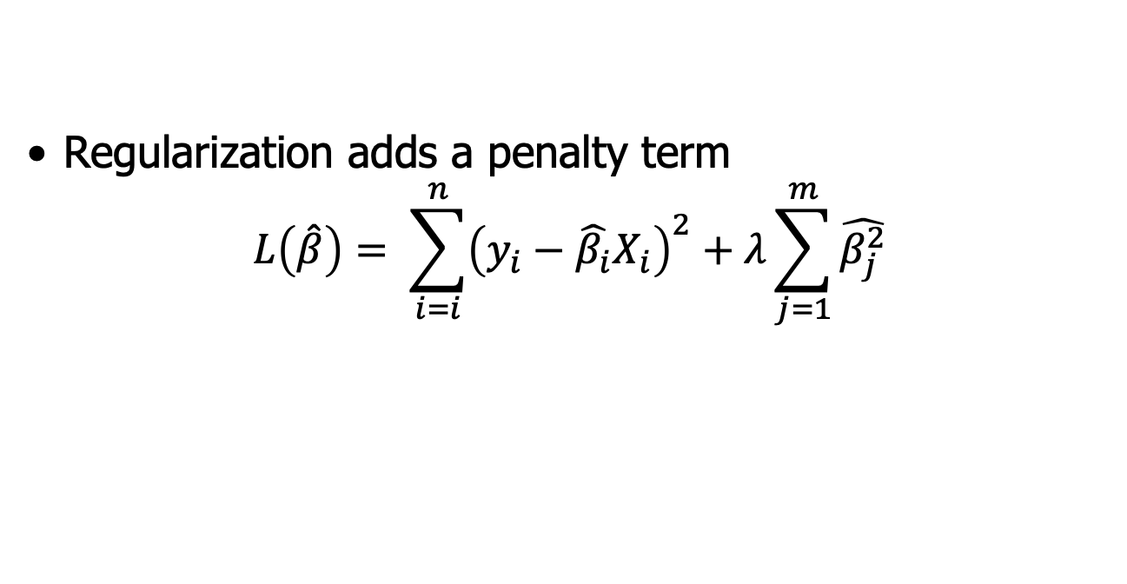
Regularized Regression
Recall how we find the best regression line
The least squares regression line is the line that minimizes the sum of the squared residuals
Another way of saying this is that regression optimizes the $\hat{β}$ that minimize the term:
$$L\left(\hat{β}\right)= \sum_{i=i}^{n}{{\left(y_{i}−\hat{β_{i}}X_{i}\right)}^{2}}$$
Discourages extreme or overfit values in model parameters
Regularization adds a penalty term
$$L\left(\hat{β}\right)= \sum_{i=i}^{n}{{\left(y_{i}−\hat{β_{i}}X_{i}\right)}^{2}+λ\sum_{j=1}^{m}{\hat{β_{j}^{2}}}}$$
$λ$controls how much we discourage

Slide 36
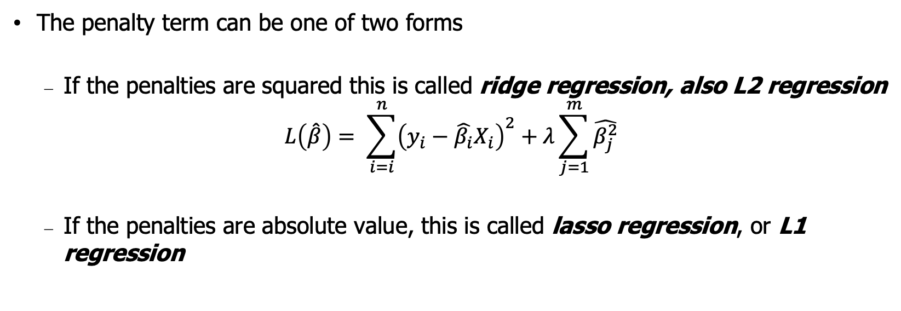
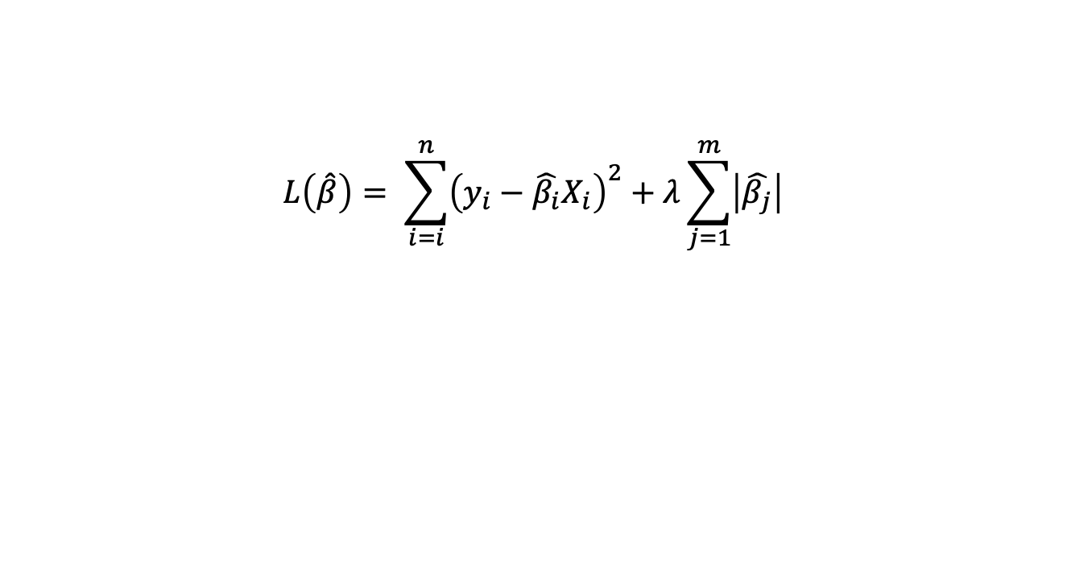
Regularized Regression
The penalty term can be one of two forms
If the penalties are squared this is called ridge regression, also L2 regression
$$L\left(\hat{β}\right)= \sum_{i=i}^{n}{{\left(y_{i}−\hat{β_{i}}X_{i}\right)}^{2}+λ\sum_{j=1}^{m}{\hat{β_{j}^{2}}}}$$
If the penalties are absolute value, this is called lasso regression, or L1 regression
“ridge penalty”
$$L\left(\hat{β}\right)= \sum_{i=i}^{n}{{\left(y_{i}−\hat{β_{i}}X_{i}\right)}^{2}+λ\sum_{j=1}^{m}{\left|\hat{β_{j}}\right|}}$$
“lasso penalty”
The typical result of the penalty is to “shrink” the β parameters towards zero
This shrinking of the coefficient value corrects for overfitting
Can be done – efficiently! - for up to millions of features!
Regularization is also often referred to as shrinkage

Slide 37

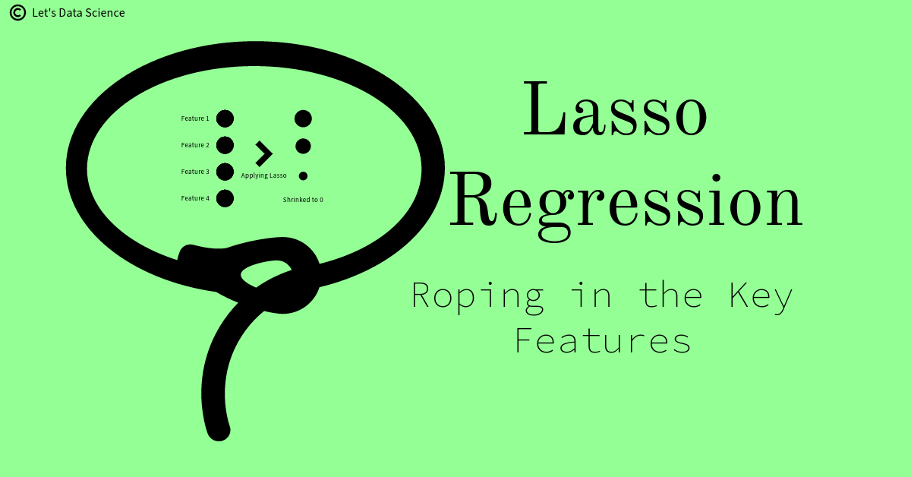
Key points about Regularized Regression
Regularized regression can be used when you have many features (millions!)
Two types of regularization:
Ridge: uses squared penalty (L2)
Lasso: uses absolute penalty (L1)
Single parameter lambda (λ) determines the amount of regularization
λ = 0 means no regularization
Larger λ is stronger penalty
λ can be determined by test set or cross-validation
The more a coef is shrunk towards zero, the less important it is
Lasso has a special property: it shrinks unneeded coefficients all the way to zero
Effectively, this is variable selection
Lasso is very popular and tends to be quite effective while creating a much simpler model.
More details: ISL Chapter 6.2

Slide 38
Regularized Regression in Python
Linear Regression:
from sklearn.linear_model import Lasso
from sklearn.linear_model import Ridge
lasso_model = Lasso(alpha=0.1) # note Python uses alpha instead of lambda 😡
Logistic Regression
logistic_model= LogisticRegression(C=1)
“C” is the complexity parameter and = 1/lambda 😡
Large C means no regularization (C=10000)
Small C means more regularlization
Often : C = [0.01 , 0.1, 1, 10, 100]
For lasso use penalty=‘l1’
logistic_model = LogisticRegression(C=.1, penalty=‘l1’)

Slide 39

Regularization Uses
Regularization has many uses in data science
Shrinks parameter values to avoid overfitting
Removes noise features by setting parameter value to 0 (lasso)
Can help deal with heavily correlated features (multicollinearity)
Can enable fitting massive amounts of features (high dimensionality)
Can fit models where you have more parameters than observations (p>n)
Notes:
Stabilizes the matrix
ML engineers love it

Slide 40
Regularization Notebook
T6_Regression_Regularization.ipynb

