Slide 1
Topic 7 – Machine Learning Toolbox
Data Science for Business – Fall 2025

Slide 2

Regression

Slide 3
More ML Models …

Slide 4
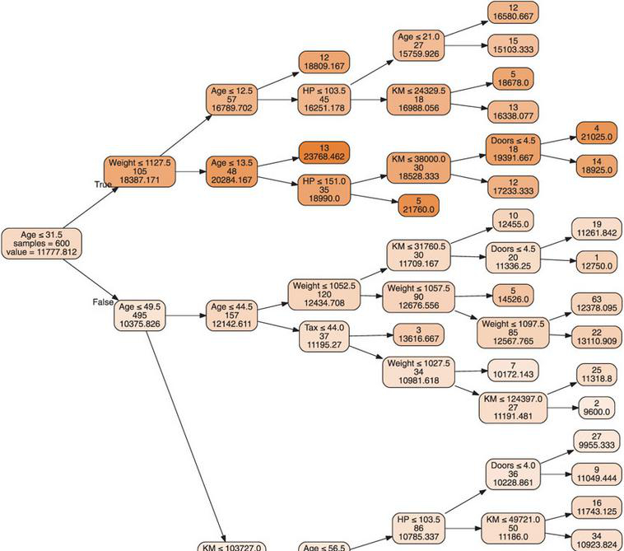
Regression: Regression Trees
🧰
Tree models can also be used with a numeric outcome, called Regression Trees
Purity is measured by the variance in the nodes
Prediction accuracy is measured by (root) mean squared error
Fitting process is similar to Classification Trees
Example: Predicting the price of used Toyota Corollas
From sklearn.tree import DecisionTreeRegressor
4
Shmueli: Chapter 9.6

Slide 5
Linear Discriminant

Slide 6
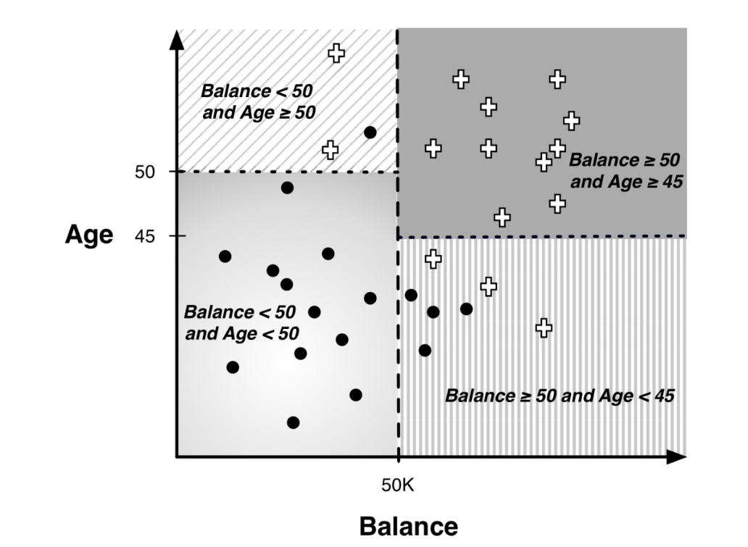
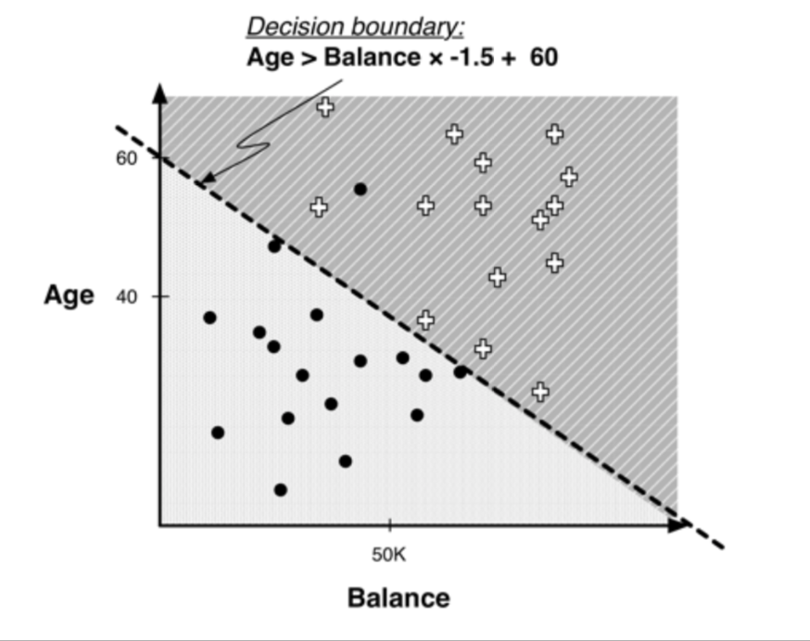

Classification: Linear Discriminants
🧰
Decision Tree
Linear Discriminant model
vs
“best” line is found via mathematical optimization
Linear discriminant:
Linear discriminants:
Competing model to logistic regression
Both are linear in the features
Good when
You believe the relationship might be linear
Feature distributions are “well-behaved” (normal)
+ if 1.0×𝐴𝑔𝑒 −1.5×𝐵𝑎𝑙𝑎𝑛𝑐𝑒+ 60 > 0
Class(x) =
$∘$ if 1.0×𝐴𝑔𝑒 −1.5×𝐵𝑎𝑙𝑎𝑛𝑐𝑒+ 60 $≤$0
from sklearn.discriminant_analysis import LinearDiscriminantAnalysis

Slide 7
Support Vector Machines

Slide 8
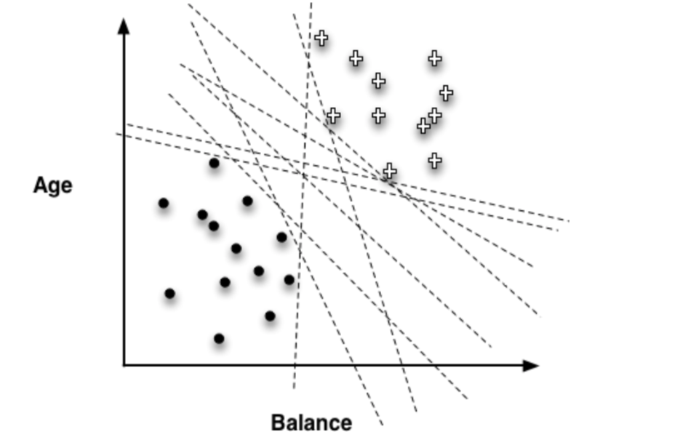
Classification: Support Vector Machines (SVM)
🧰
Support Vector Machines are another type of mathematical model that finds linear boundaries between classes
They have become popular in recent years due to excellent performance in classification problems.
Assume your data is separable…
Margin: The minimum distance from the separating line to a single point
The optimal SVM is the separator that maximizes the margin
Which line is best?
Notes:
The optimal SVM is the boundary that maximizes the margin

Slide 9
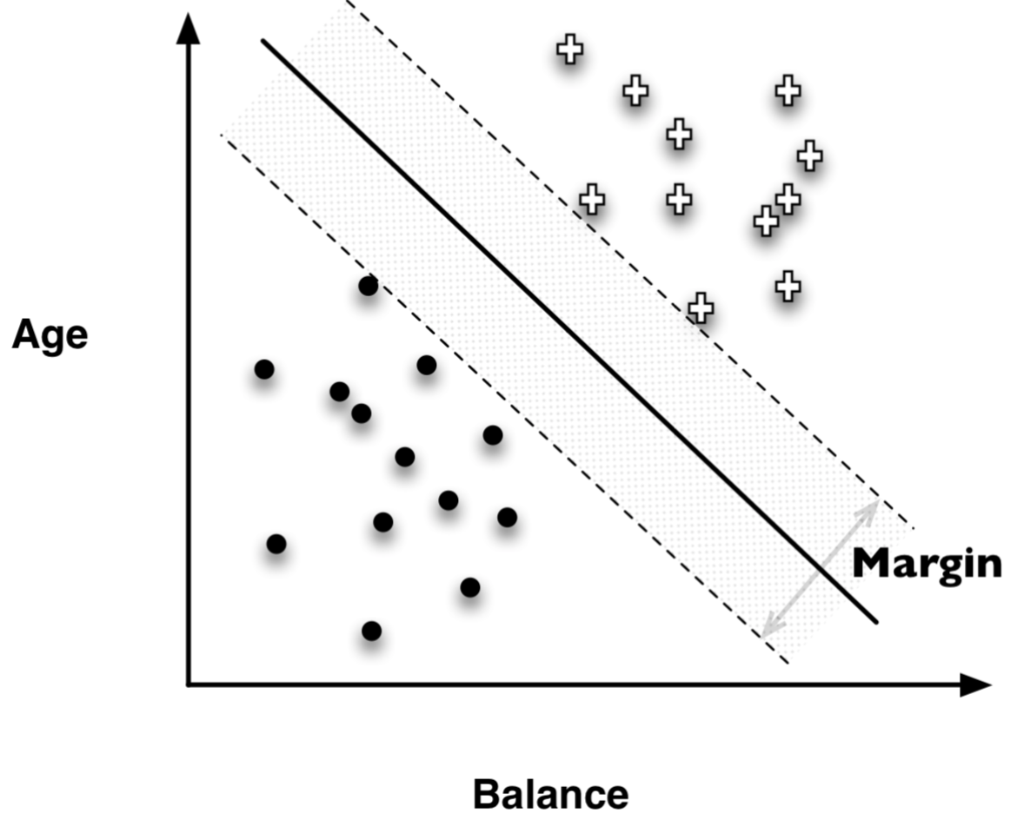
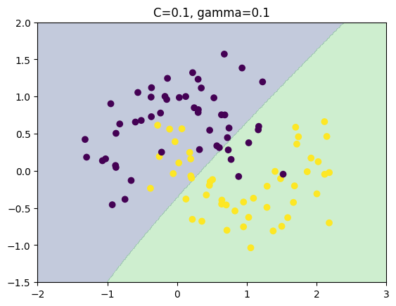
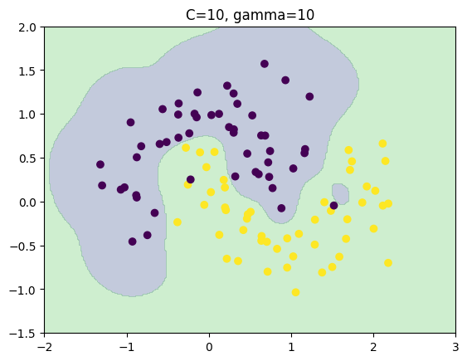
SVM: Maximizing margin:
Of course data is not typically separable, but there are some clever mathematical tricks devised to deal with that
Computationally complex, but
from sklearn import svm
SVM has many tuning parameters:
C: complexity. Higher values fit training data better
Also kernel, degree, gamma (local sensitivity)
Can be slow, and actually perform poorly if not fit with caution
In expert hands, it has shown to be an excellent predictor
But … you may have trouble!!
ISL: Chapter 9.3 – 9.6 has good (🧠) explanation plus python code
Notes:
( Imagine separating h v l value
On age and income
H and V not separable,
But you can unlock a third feature, customer loyalty that allows one to separate.
That is what the “kernel trick” does.l

Slide 10
Time Series and Forecasting

Slide 11
Time Series or Forecasting
🧰
Modelling data with a time component requires some specialized thinking
This field is called Time Series – when the goal is prediction it is called Forecasting
Used widely to forecast sales, markets, production, demand, etc
Time series models need to
Account for seasonality, that is effects of days of week, time of day, or seasons in the year
Account for auto-correlation, the fact that the observations are not independent (today’s stock market price depends on yesterday’s price)
Incorporate features into these models to account for outside influences

Slide 12
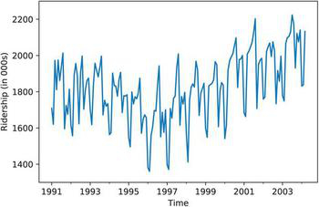
Time Series Example: Amtrak
Monthly ridership of Amtrak trains: 1990-2004
Can see overall ridership, U-shaped trend, and regular seasonality
Need to account for seasonality of multiple types when describing the data or predicting into the future
TSA
Prophet (from facebook)
from statsmodels.tsa import tsatools
from statsmodels.tsa.arima_model import ARIMA
from statsmodels.graphics import tsaplots
from sktime.forecasting import ARDL
from sktime.forecasting import ARIMA
! pip install fbprophet

Slide 13
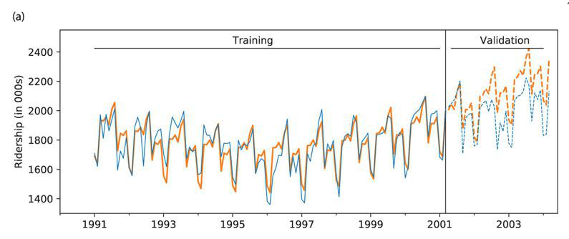
Time Series : Training and Test
When forecasting we do not randomize in order to create training and test
We cannot use the future to predict the past!
Must find a time t, prior to t is the training, and after t is the test, or validation

Slide 14
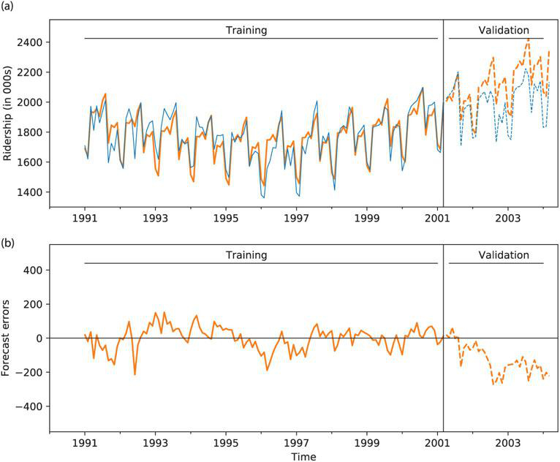
Forecasting - ARIMA
Statistical Forecasting directly uses autocorrelation to make predictions for the future
Autocorrelation is the correlation of a time series with itself
Examples
Positive autocorrelation (lag 1) : each point is highly correlated with the point before it. Trends!
Autocorrelation (lag greater than 1) : cyclical pattern or seasonal effects (e.g. lag-7 would be a weekly effect)
ARIMA models : AutoRegressive Integrated Moving Average models
Accounts for autocorrelation and regression-type trends when making future forecasts
Shmueli Chapter 17
Notes:
example - high sales in one month depletes stock and you get a dip in sales the next month.
poor sales stimulates offers which spike sales the next month.

Slide 15
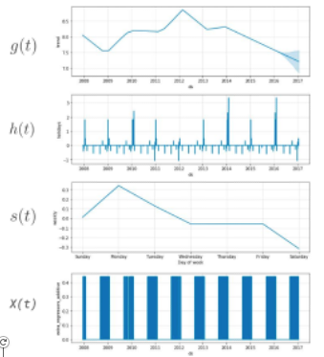
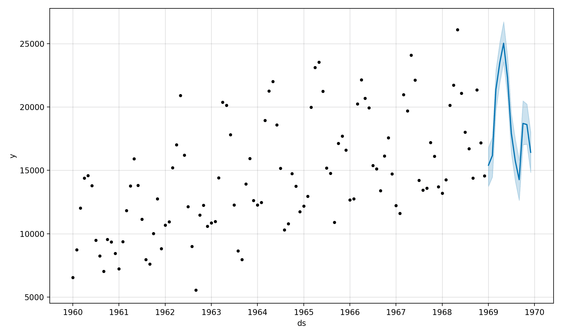
Forecasting - Prophet
Facebook’s prophet library takes a different approach:
Break down time series data into:
Trend (global effects)
Seasonality (regular repeated trends – day/week/season)
Events (specific shocks)
Regressors (impact of other features)
Prophet tutorial on kaggle

Slide 16

Neural Networks - Intro
🧰

Slide 17
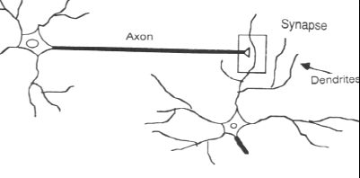
Neural Nets: Inspiration from Biology
Analytic technique inspired by biological nervous systems
Structure of the nervous system:
A large number of neurons (information processing units) connected together
A neuron’s response depends on the states of other neurons it is connected to and to the ‘strength’ of those connections.
The ‘strengths’ are learned based on experience.

Slide 18
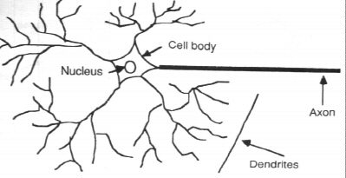
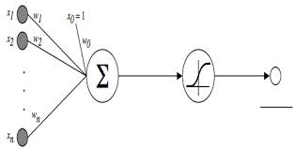
From Real to Artificial
data
data
prediction
output
Activation Function
data

Slide 19
Nodes: A Closer Look
x₁
n₁
bias
Input
features
x₂
n₂
activation
function
output
y
weights
Perceptron:
A fairly simple model (similar to logistic regression)
x_{m}
n_{m}
“hidden” layer
Can be used for both classification and regression!

Slide 20
Neural Network: Architecture
Input
layer
Output
layer
Hidden Layer(s)
MLP = Multi-Layer Perceptron
Big idea: several simple models working together to model a complex function
How many layers? Nodes? What is the function?
from sklearn.neural_network import MLPClassifier
from tensorflow import keras

Slide 21

Neural Networks: The Model
Lots of decisions to make / optimize with neural nets
Architecture
Number of hidden layers
Number of nodes in the input, output and hidden layers
Specification of the activation function(s)
The associated set of weights
This is often an art, not a science!
Weights and complexity can be “learned” from the data
Start simple
One hidden layer, same number of inputs as features
Often criticized as “black box” models

Slide 22

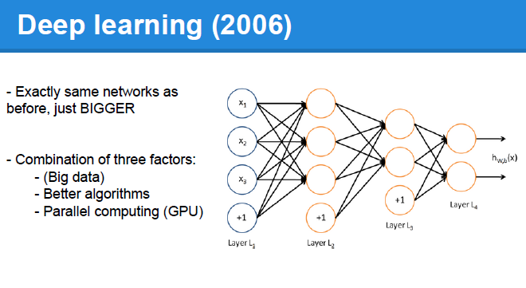
Taking Neural Nets to 11…
Deep learning … RNN … CNN … Transformers… GenAI
More detail in later chapter…

Slide 23
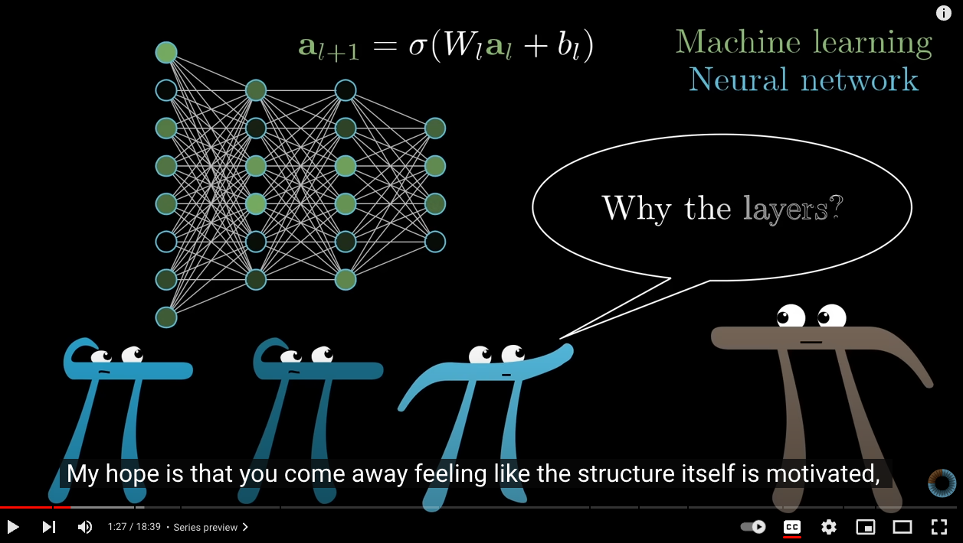
Excellent description of NN
3 Blue 1 Brown YouTube video
But What is a Neural Network??
02:45 => 13:24

Slide 24
Neural Nets Notebook
T6_Basic_Neural_Nets.ipynb

Slide 25
Summary

Slide 26
Building your toolbox
Classification
Decision Trees
Linear Discriminant Models
Support Vector Machines
Logistic Regression
Neural Nets
Regression
Linear regression
With regularization
Quadratic and higher order regression
Regression Trees
Neural Nets
Try one, try a few, or just try them all!

Slide 27

What model do I choose?
Classification v. Regression
Complexity of relationships
Are linear assumptions realistic?
Size of data
Neural nets need more data to train
SVMs can take a long time!
Smaller sets = simpler models
Interpretability vs. accuracy
Do you need to explain the model to someone?
How important is the best model anyway?
Feature engineering and data cleaning are often more important than the model!
The Data Science Way: Try them all, choose the best performer!!

