Slide 1

Topic 9 – Text Modelling
Data Science for Business – Fall 2025
lets talk about text

Slide 2
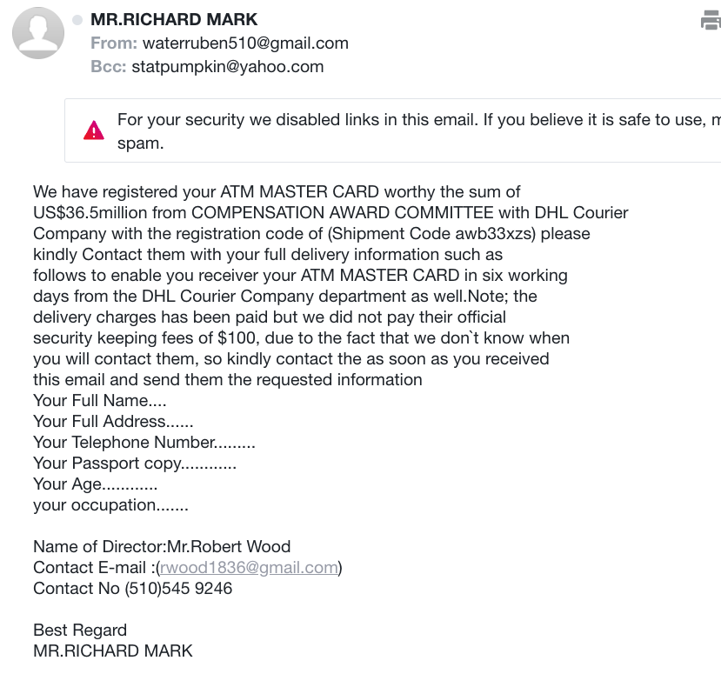
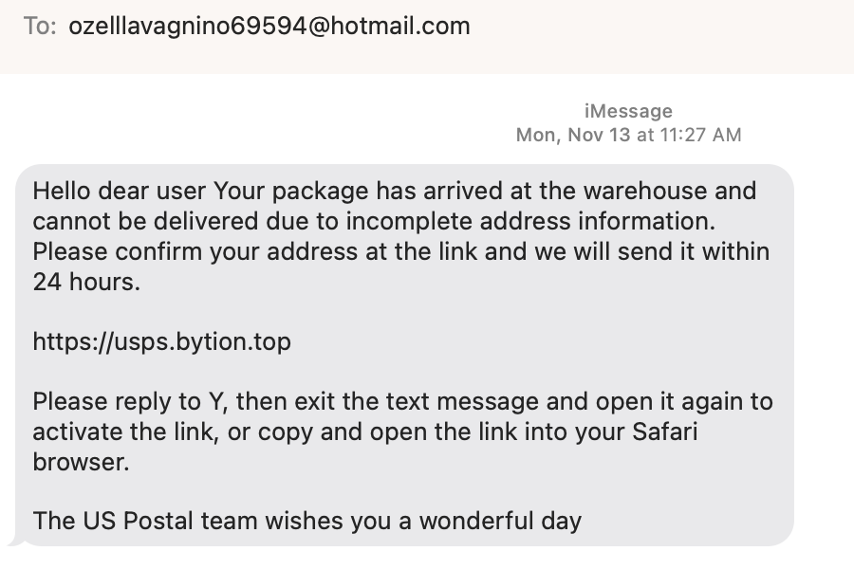
Motivating example: Spam
Recently in my email:
Recently in my texts:
What is the business problem?
What is the data science problem?
What are the costs/benefits?
How would you set a threshold?
What action would you take?
Notes:
Ask them how they think we can detect this as spam

Slide 3
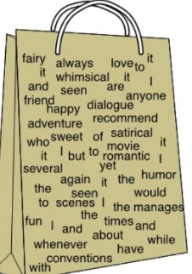
Overview of Text Mining
Automatically extracting meaning from a document
Label a document into one of many known types
E.g. Library categorization
Multi-class classification
Clustering documents into useful groups
Unsupervised learning
Query a set of documents for search or to find most similar ones
E.g. legal precedent, patent searches
Text-based learning often requires a large collection of labelled documents to learn from – a corpus - that needs to be pre-processed significantly before analysis.

Slide 4
Text Analysis is Hard!
“Boston beat San Francisco in the game last night” vs “San Francisco beat Boston in the game last night”
“Hitchcock shot The Birds in Bodega Bay”
“Lets eat, Grandma!”
“I can’t recommend this person highly enough”
Text is more than just words - understanding language (NLP) is a technical field all to itself
NLP has been upended since 2021 by LLMs. Core concepts are still important:
When interpretability is important
For smaller problems
Efficiency and cost
More control for domain-specific problems
Complementary : knowing how to pre-process data before sending to LLM is useful.
Notes:
LLMs are fundamentally different than what you are about to learn, although there are some common tools (e.g. embeddings)

Slide 5
Representing Text for Data Science

Slide 6
Preparing Text for Modelling
Description | Loan Default
This loan request is to reduce credit card debt by receiving a more manageable finance charge and payment schedule than what I am currently paying on a monthly basis. I currently meet all my financial obligations without problems. This allows quicker debt reduction. | 0
This loan will lower my interest rate on about $7000 of debt by 2 percentage points! I have qualified for this great rate by having an outstanding credit score over the last 20 years. Thank you for helping to fund me.<br><br> This short term loan will allow me to lower my interest rate by 2 percentage points. I have qualified for a great rate due to my solid credit score, etc. Thank you for helping me to achieve my goals. | 0
To be financially stable within 3 years. Pay off all bills and concentrating on paying off my house within 10 years of my plan. | 0
To consildate credit card debt | 0
To consolidate bills for one monthly payment.<br><br> To pay off credit card debt and have one monthly payment.<br> | 0
To consolidate credit card bills and be debt free in 5 years<br> | 1
To consolidate credit card debt.<br><br> My loan is to consolidate credit card debt and simplify my payments,<br> | 1
To consolidate some credit cards and assist my son who is graduating from college relocate to the Washington DC area where he has accepted a full time job.<br> | 0
Notes:
How do we get this in a form ready for DS?
Feature engineering!!
Also remind them of the spam example…

Slide 7
Text Mining: Pre-processing
Text Processing | Python library
Unimportant words : Stop-word removal | from nltk.corpus import stopwords
Removing punctuation, case | Regexp; string.tolower()
Rare words – words that only appear 1x | CountVectorizer(min_df=2)
Different versions of the same word: Stemming = find word root: “walking”,”walks” => “walk” Lemmatization = reduce to core: “better” => “good” | from nltk.stem import PorterStemmer
Spell correction | pySpellChecker; textblob
Tokenizing / n-grams: “double play”, “home run” | from nltk.tokenize import word_tokenize
Accounting for similar concepts / synonyms | Embeddings (word2vec, BERT)
Python has built much of this functionality into a few functions:
Vectorizer() tools include case regularization, stopwords, tokens, etc
Note: functions may be domain specific

Slide 8
Simple Analysis: Bag of Words
Each document is simply a bag of words (BoW) using the tokenized data:
Text: “This loan request is to reduce credit card debt by receiving a more manageable finance charge and payment schedule than what I am currently paying on a monthly basis. I currently meet all my financial obligations without problems. This allows quicker debt reduction.”
BAG:{without,what,to,this,than,schedule,request,reduction,reduce,receiving,quicker,problems,payment,paying,on,obligations,my,more,monthly,meet,manageable,loan,is,financial,finance,debt,debt,currently,currently,credit,charge,card,by,basis,and,am,allows,all,a,I}
Tokenizing the data: taking a document and reducing it to its terms
But, this ignores:
Grammar
Word order
Sentence structure

Slide 9
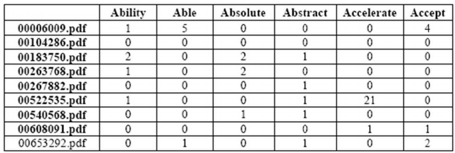
From Unstructured to Structured
After cleaning and now have a structured Term Frequency (TF) table for analysis - which words appear in which documents.
TF(d,t) = # of times term t appears in document d
Simple version – binary matrix – does word exist or not? (0,1)
…
…
Typically hundreds to thousands of columns…
…
…
…
If you have a target for your documents, these are now features for a supervised classifier
Good methods for supervised text models:
Logistic regression (regularized for large feature space)
Naïve Bayes

Slide 10

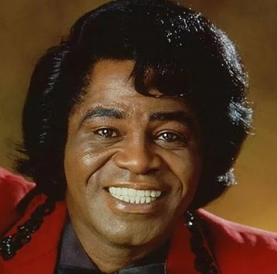



Term-Frequency Table (TF)
Term-Frequency table tells us which words are important in describing a given document
A word that appears in many documents is not as useful!
“LeBron” is more important than “James” in determining context
A term that is too common is not distinguishing, therefore not useful for classification or clustering (stopwords, but others too)

Slide 11
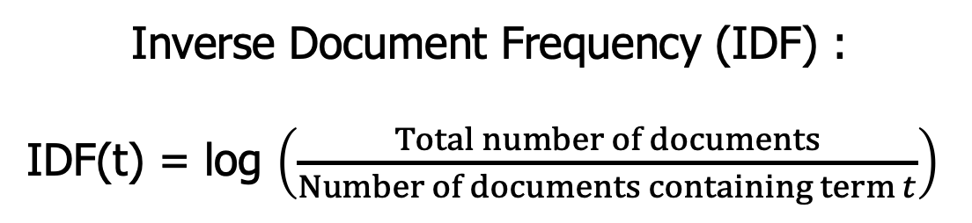
Inverse Document Frequency (IDF)
The fewer documents a word appears in, the more significant it is when it does appear!
Inverse Document Frequency (IDF) :
IDF(t) = log $\left(\frac{Total number of documents}{Number of documents containing term t}\right)$
IDF is the boost a term gets for being rare
Rare terms have high IDF

Slide 12
Representing Text: TFIDF
A term is important for a given document if it has:
High TF: term frequency (it appears a lot)
High IDF (it doesn’t appear in other documents as much)
We combine the TF and IDF matrix by multiplying them:
TFIDF(d,t) = TF(d,t) x IDF(t)
High values of TFIDF(d,t) mean that term t has importance in the context of document d.
Notes:
High

Slide 13
NLP using TFIDF
TF-IDF matrices are the vehicle for doing ML on collections of text
Once you have a TFIDF matrix, you can now think about doing
Classification
Clustering
Similarties between documents
Search
Options:
strip_accents
stop_words
ngram
max_df
min_df
from sklearn.feature_extraction.text import TfidfVectorizer

Slide 14
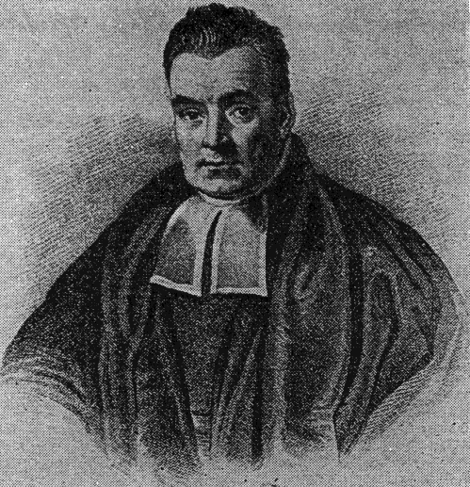
Naïve Bayes: Classification for text
🧰

Slide 15
Naïve Bayes for Classification
Consider an (oversimplified) spam problem:
Letters represent words:
Text | Spam?
a l c | 1
b c d | 0
c e k | 1
a c d | 1
c f g | 1
a c d | 0
a b c | 1
b d f | 0
a b d | ????
Bayes’ Rule:
P(A|B) = P(B|A) x P(A) / P(B)
In general, we can think of all predictive models as conditional probabilities:
What we are trying to calculate: P(Spam = 1 | abd )
Notes:
note complications with new case – values not present in training data

Slide 16

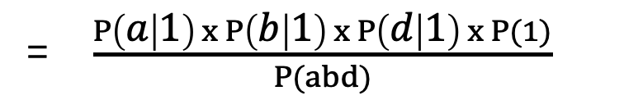



Naïve Bayes for Classification
P( abd | Spam=1) x P(Spam=1)
= $\frac{P\left(a | 1\right) x P\left(b | 1\right) x P\left(d | 1\right) x P(1)}{P(abd)}$
P(Spam = 1 | abd ) =
P(abd )
Bayes’ Part
Applying Bayes rule to “flip the conditional”
Naive’ Part
Assuming the probabilities are conditionally independent
Text | Spam?
a l c | 1
b c d | 0
c e k | 1
a c d | 1
c f g | 1
a c d | 0
a b c | 1
b d f | 0
a b d | ????
Can all be calculated directly from the data!
P(a|1) = 3/5
P(b|1) = 1/5
P(d|1) = 1/5
P(1) = 5/8
P(spam =1 | abd) = $\frac{0.015}{P(abd)}$
P(spam =1 | abd) = $15.3\%$
P(spam =0 | abd) = $\frac{0.083}{P(abd)}$
Notes:
note complications with new case – values not present in training data

Slide 17
Why Naïve Bayes for text??
The conditional independence assumption is very useful for text
Each word is independently giving us information about how likely it is to be pos/neg
The individual probabilities are very easy to calculate
Just counting!
Naïve Bayes can be used for any predictive problem!
Basic NB assumes nominal categorical features (like words!)
Extensions allow for numerics, but have to be normally distributed
Types of NB | Usage
BernoulliNB | Uses Term Occurrence (Binary)
MultinomialNB | Works with raw term frequencies
GaussianNB | Assumes continuous features and normality, not typically used for text
ComplementNB | Best for unbalanced data and TFIDF
Discussion: DSB p261

Slide 18
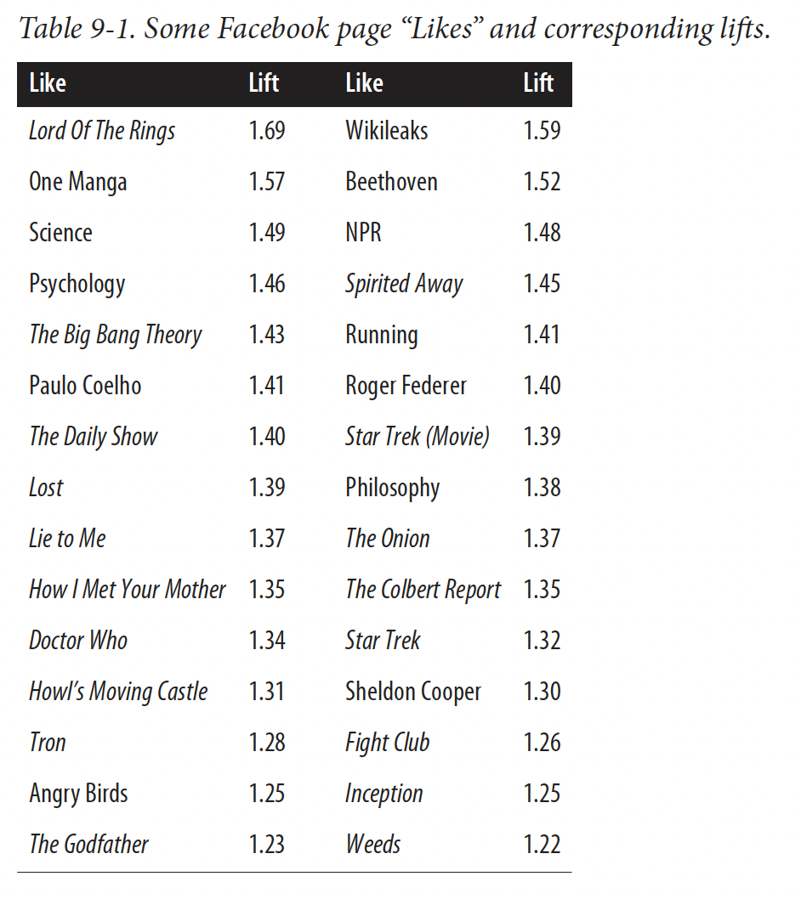
Naïve Bayes Example
DSB p 264
“High IQ” from the PNAS paper
“Likes” are like words
Binary
there are many of them
they are discrete
NB provides a “lift” - the increase in probability given the presence of the feature
Kosinski, et al 2013
Notes:
This difference is important: the act of clicking “Like” on a page is different from simply liking it, and the data we have are on the former and not the latter. It is also important to consider that this is an act of public signaling: a Facebook user is openly declaring to friends that they like something, and the rea‐ sons for this may not be obvious.11

Slide 19
Using TFIDF / Naïve Bayes
T8_Text_Mining.ipynb

Slide 20
NLP: Other Topics
import nltk
import spacy
Gen AI
Notes:
The stuff you just learned just scrathes the surface of NLP, now I will go rapid fire through some other topics…

Slide 21
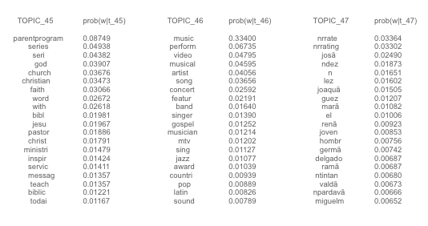
Topic Modelling – LSA/LDA, etc
“topic modelling” is a way of doing unsupervised learning on a set of documents (corpus)
Think of it as a clustering exercise
Similar to Principal Components: reduced dimensions define “topics”\
Typically starts with the TFIDF matrix
Extracts “topics” by finding clusters of words
Methods find “latent” topics
Latent Semantic Indexing (LSI)
Latent Dirichlet Analysis (LDA)
Non-negative Matrix Factorization (NMF)
LDA applied to TV program data

Slide 22
Named Entity Recognition
Move us away from Bags of Words and toward understanding of the data
Knowing what are the proper nouns and names can go a long way to extracting meaning from text
In fact : entities can be very helpful in topic modelling
Christopher Robin is alive and well. He is the same person that you read about in the book, Winnie the Pooh. As a boy, Chris lived in a pretty home called Cotchfield Farm. When Chris was three years old, his father wrote a poem about him. The poem was printed in a magazine for others to read. Mr. Robin then wrote a book

Slide 23
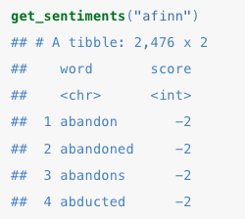
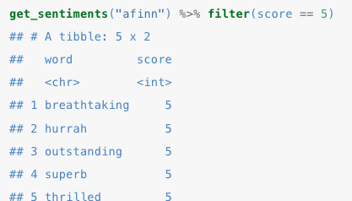
Sentiment Analysis
Many applications attempt to automatically identify text as positive or negative, based on the words used.
This is hard!
“this movie was not a total waste of time!”
“reading this book was so engrossing it destroyed my desire to do anything else”
Nonetheless, we can use:
Existing lists of good:bad words (e.g. AFINN)
Labeled corpuses from existing domains as training data
Other existing tools: (e.g. VADER, textblob) more advanced than just counting words
More advanced methods use …
from nltk.corpus import movie_reviews as reviews
Notes:
Afinn is +5 to -5
-5 is REALLY bad

Slide 24
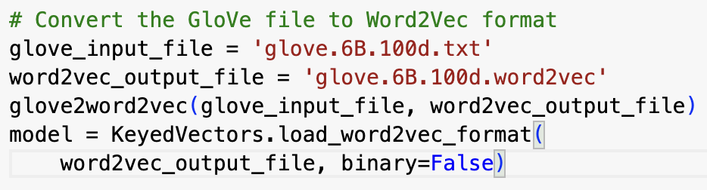
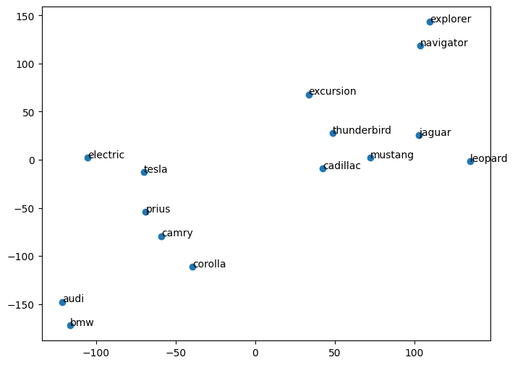
Embeddings
Embeddings are a fairly recent approach to NLP
An alternative to TFIDF
Embeddings work like principal components, reducing a large dimensional space (all unique words) into a smaller one.
Words (sentences/documents) are “embedded” (or projected) into this space – so that they are near other words of similar meaning.
Embedding captures meaning and context of words (and sentences)
Embeddings are learned from training data – so that words that appear together historically are close to each other
Similar words are together (happy ⬄ joyful) but words can also have multiple meanings (Mustang ⬄ Jaguar ⬄ leopard).
e.g. “espresso song” is near “Sabrina Carpenter” even though there are no words in common or synonyms
Notes:
Magic of embeddings is that they are not trained by knowing the definition of words, they simply are trained on gobs of text.
BERT can look at the entire sentence and not just adjacent words – it is one of the foundations of modern generative AI tools.

Slide 25

Why Embeddings?
How to think of embeddings: A mathematical representation of the meaning of text
Useful for
Sentiment analysis of social media or customer feedback
Clustering customer complaints, rep notes, tweets
Recommendation engines (e.g. finding similar products)
Chatbots and virtual assistants
All are easily fit into business pipelines
Pre-trained word embeddings you can use:
Word2vec
gloVe
BERT
Others from Hugging Face
GenAI: Embedding prompts are the input to a complex neural network which predicts the next token.
HuggingFace is a repository of pre-trained embeddings you can use off the shelf
Embeddings differ based on the corpus that trained them
Many different domains, collections, etc.
Notes:
Talk about the difference of TFIDF and embeddings

Slide 26
Topic Modelling and Sentiment - OpenAI API
T9_SOTU.ipynb

Slide 27
Text / NLP : Summary
Text is Data! 📊
TF/IDF enables you to use your toolbox
Pre-processing text is important for success 👩‍💻
Text is messy!
Removing punctuation, numbers, stopwords; stemming, tokenization
Naïve Bayes
A new tool for your toolbox 🧰
Built from conditional probability
Naïve (conditional independence of terms) + Bayes (flip the conditional)
Many applications 📱
Clustering/topic modelling
Summarization
Sentiment
Gen AI?

