Slide 1
Topic 4 – Decision Trees
Statistics and Data Analysis
COR1-GB.1305
Prof: Chris Volinsky
NYU Stern: Fall 2023

Slide 2
Overview
Decision trees are one of the most useful and interpretable ways to build a predictive, supervised machine learning model.
Supervised: there is a very clear, quantifiable target that is of business interest
Predictive: the goal is to make predictions for cases we have not seen yet.
Classification: The target is categorical (typically binary)
We need data to build our model in order to make our predictions

Slide 3
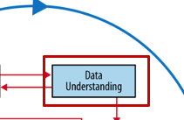
Supervised Classification
Think very hard about your target!
Sometimes it is obvious – (e.g. will this patient develop diabetes?)
But sometimes what you really want to predict is not known ☹
Consider Proxies:
what else can I observe that is very close to the target I really care about???
Target case:
pregnancy is not known
but signing up for a baby shower was known, it is a pretty good proxy for somebody to be pregnant

Slide 4
Supervised Classification
Our goal is to use attributes of our data to allow us to predict something about each instance.
We are separating the population into subgroups (segments) based on the value of our target
We are using the other data we have collected, the attributes, to give us information about which group each instance should be in.
In order to do this, we have to collect knowable, quantifiable attributes which correlate with the target of interest!
Questions to be asking:
How many attributes
Which will be most effective?
How do I know if it is good?

Slide 5
Supervised Classification : Basic Example
N
N
Y
Y
Y
N
Y
N
N
Y
N
Y
12 Bank Customers
Target Variable of interest: Did they buy the product?
Attributes we have:
Head: Circle or Triangle
HeadSize: Large or Regular
Body Type: Oval or Rectangle
Body Shading: Light or Dark
Name | Head | HeadSize | BodyType | BodyShading | Buy?
Amy | Circle | Regular | Oval | Light | N
Bertha | Triangle | Regular | Oval | Dark | N
Crista | Round | Regular | Rectangle | Light | Y
Dante | Round | Regular | Rectangle | Light | Y
Eliza | Round | Regular | Rectangle | Light | Y
Fran | Triangle | Regular | Rectangle | Dark | N
Gianna | Round | Regular | Rectangle | Light | Y
Hector | Round | Large | Oval | Light | N
Irina | Round | Regular | Oval | Light | N
Jaquie | Round | Large | Rectangle | Light | Y
Kendra | Round | Large | Oval | Light | N
LaToya | Triangle | Regular | Oval | Light | Y

Slide 6
Closer look at the data
Attributes
ID (?)
Target
Name | Head | HeadSize | BodyType | BodyShading | Buy?
Amy | Circle | Regular | Oval | Light | N
Bertha | Triangle | Regular | Oval | Dark | N
Crista | Round | Regular | Rectangle | Light | Y
Dante | Round | Regular | Rectangle | Light | Y
Eliza | Round | Regular | Rectangle | Light | Y
Fran | Triangle | Regular | Rectangle | Dark | N
Gianna | Round | Regular | Rectangle | Light | Y
Hector | Round | Large | Oval | Light | N
Irina | Round | Regular | Oval | Light | N
Jaquie | Round | Large | Rectangle | Light | Y
Kendra | Round | Large | Oval | Light | N
LaToya | Triangle | Regular | Oval | Light | Y
Instances,
observations
Are there more attributes we can collect?
Notes:
Head size, letters in name, height, etc.

Slide 7
Separating Classes
How do we build a model to separate those who buy and those who don’t?
What attributes would you use?
What rules would you make?
What criteria do you use?
How do you determine how good it is?
Name | Head | HeadSize | BodyType | BodyShading | Buy?
Amy | Circle | Regular | Oval | Light | N
Bertha | Triangle | Regular | Oval | Dark | N
Crista | Round | Regular | Rectangle | Light | Y
Dante | Round | Regular | Rectangle | Light | Y
Eliza | Round | Regular | Rectangle | Light | Y
Fran | Triangle | Regular | Rectangle | Dark | N
Gianna | Round | Regular | Rectangle | Light | Y
Hector | Round | Large | Oval | Light | N
Irina | Round | Regular | Oval | Light | N
Jaquie | Round | Large | Rectangle | Light | Y
Kendra | Round | Large | Oval | Light | N
LaToya | Triangle | Regular | Oval | Light | Y
Notes:
Maybe introduce the concept of baseline…

Slide 8
Separating Classes
N
N
Y
Y
Y
N
Y
N
N
Y
N
Y
12 Bank Customers
Lets look just at body type:
N
N
N
Y
Y
Y
N
N
Y
N
Y
Y
Notes:
Does it separate well? What criteria do you use?

Slide 9
Separating Classes
N
N
Y
Y
Y
N
Y
N
N
Y
N
Y
12 Bank Customers
What about BodyShading?
Y
N
N
Y
N
Y
N
N
N
Y
Y
Y
Notes:
Which is better? More pure, vs more coverage?

Slide 10
Separating Classes
Lets just look at the circle-bodies
N
N
N
N
Y
N
Are there any rules that make sense here?
You can make a rule here that only applies to this subgroup
Called “recursive partitioning”

Slide 11
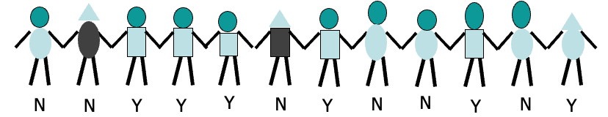
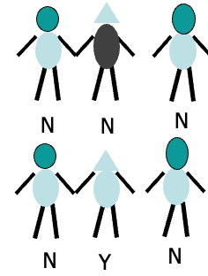
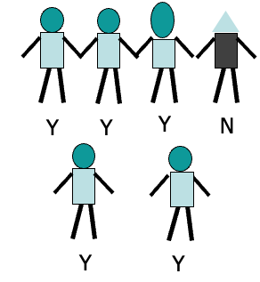
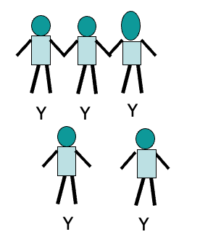
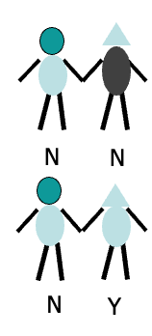
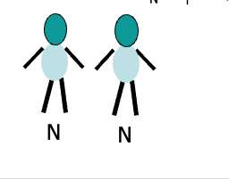
Put it all together
50%
body-shape=circle
body-shape=square
16%
84%
Body-shading=dark
Body-shading=light
Head-size=large
Head-size=normal
N
0%
25%
0%
100%
Notes:
Can we go further?

Slide 12
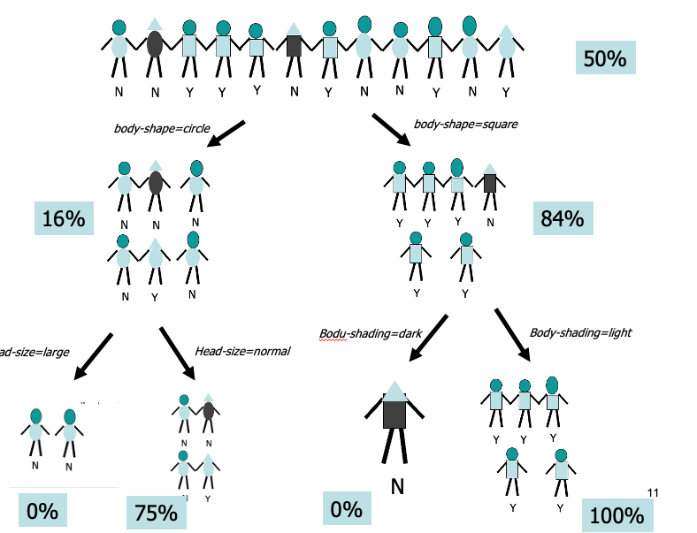
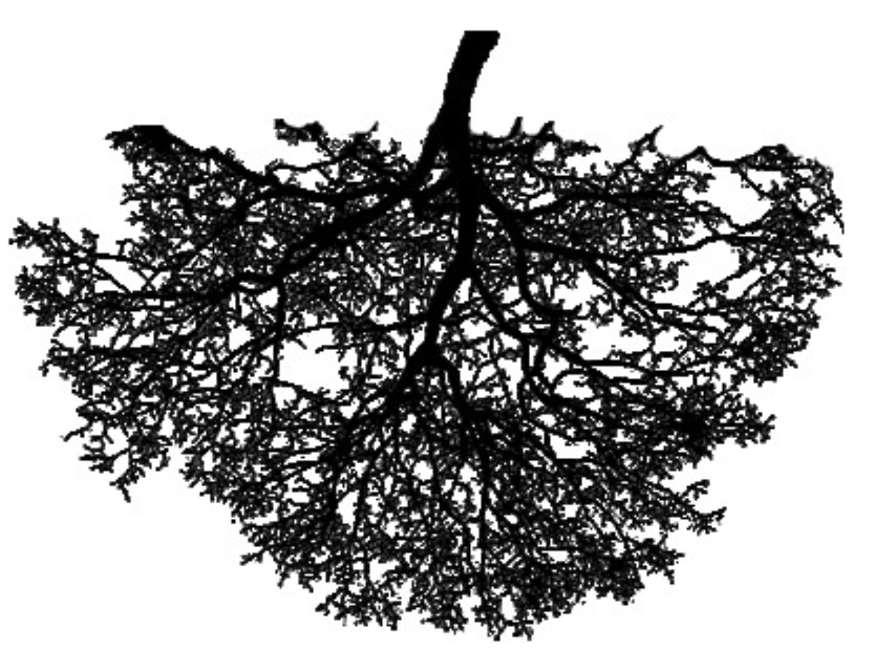
Decision / Classification Tree
This is known as a decision tree or classification tree
Start with all of the data
At each level you create a rule that creates “branches”
Typically 2 branches
Each branch then can get split independently
Each level is defined by a rule
Bottom level are called the “leaves”
Each data point falls in one and only one leaf
Each leaf is defined by a set of rules that got us there
Each leaf gets labelled with the majority class for those that fell in the leaf
New data can now be classified
Every new instance goes to a single leaf
25%

Slide 13
Representing a tree
root
Yes (50%)
body-shape=circle
body-shape=rect
No
Yes
node
Body-shade
=dark
Body-shade
=light
Head-size=norm
Head-size=large
25%
No
No
No
Yes
leaf
What do we predict for this person?

Slide 14
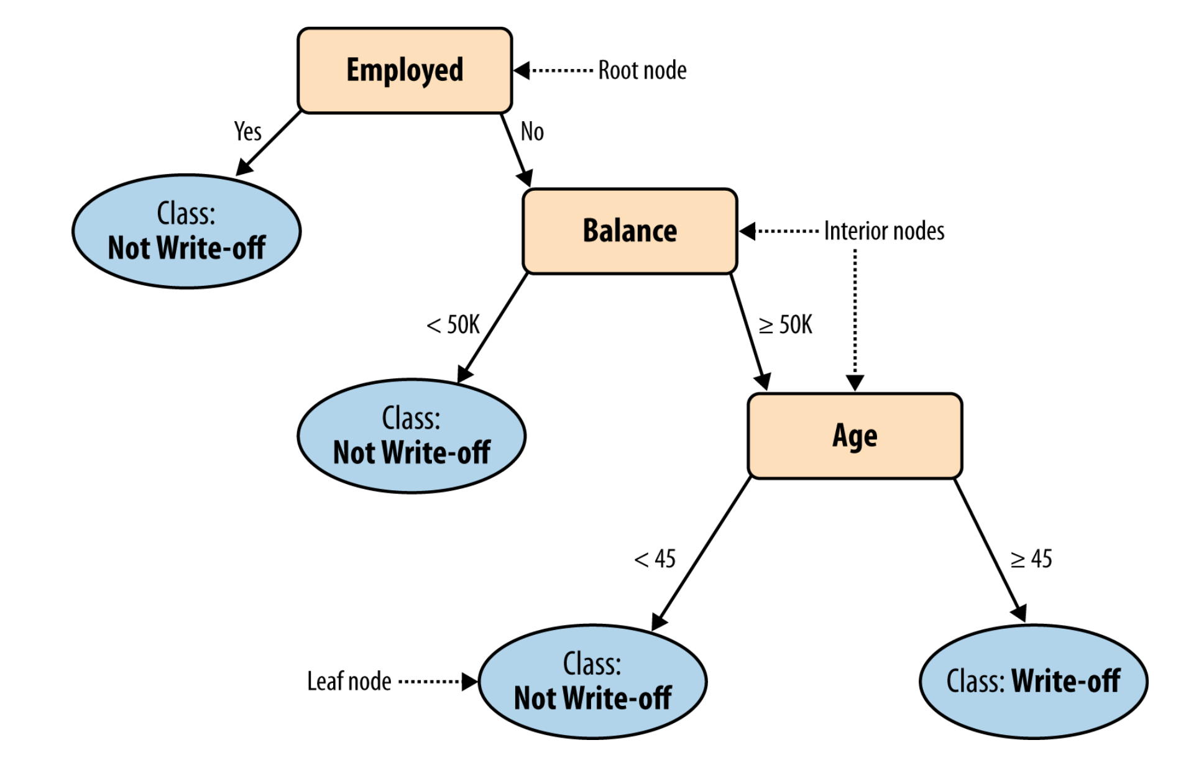
Another example
Model is predicting write-off (default) of a loan from attributes collected on customers
1/10
Nodes:
Each “non-terminal” node represents a test on one attribute
Categorical variable: split on values.
Ordinal vs. Nominal
Numeric attributes are split at an “optimal” spot
Leafs:
Terminal node without split
Prediction made is the maximum class in the tree
1/9
1/8
4/7
Classify Jacob: Balance=115K, 40 years old, not employed
Notes:
You should be able to read and interpret a tree model…

Slide 15
Another example
Classify Jacob: Balance=115K, 40 years old, not employed
1/10
Jacob gets the prediction of the leaf he falls into
We can also assign him a probability of the leaf node he falls into
1/9
1/8
4/7

Slide 16
How do we use the tree in practice
Remember the flow…
To determine the class of a new example: e,g.,
Mark, age 40, works for CitiBank, balance 88K.
The example is routed down the tree according to values of attributes tested successively.
At each node a test is applied to one attribute.
When a leaf is reached, the example is assigned to a class or the probability
What if Mark didn’t have a job?
1/10
1/9
1/8
4/7
Notes:
Now we know the impact of Employment in the model!!!

Slide 17
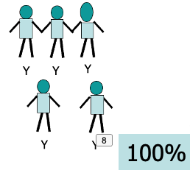
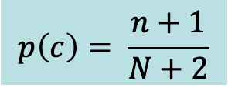
Assigning probabilities
We assign each new case the probability of the leaf they fall into
BUT, what if the leaf has 0 or 100% probability?
Laplace correction:
$$p\left(c\right)= \frac{n+1}{N+2}$$
Where n is the number of examples in the leaf belonging to the class
And N is the total number of cases
Laplace correction is often used in cases with small datasets, to offset the impact of “overfitting” (more on this later)

Slide 18
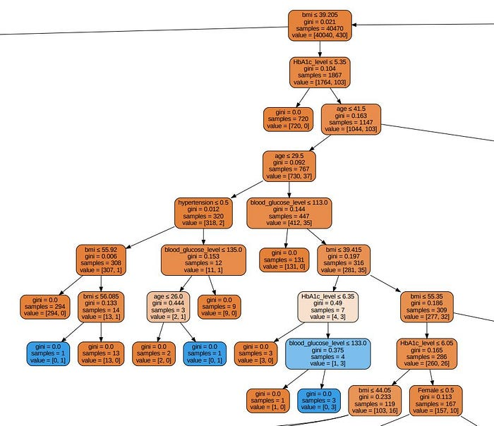
Decision Trees
Predicting heart attack risk from diagnostic variables
Trees can be built to indefinite complexity and go many layers deep!

Slide 19
Why trees?
Trees are one of the most popular models for supervised classification
Trees are:
Easy to understand (when small)
Easy to communicate to executives / non-techinical stakeholders
Pretty powerful and work pretty well
Easy to use
Tree induction (from data):
Easy to implement
Computationally cheap for large data sets
Can handle large sets of attributes easily
Ignores irrelevant variables
Handles missing data well
Doesn’t make any assumptions (compared to regression)
Almost all data science packages include tree induction

Slide 20
How to GROW decision trees

Slide 21
Growing a Tree
Now we know how trees work, but still so many questions!
How do we know which variable to split on ?
How do we know where to split numeric attributes?
How many levels do we build the tree?
How do we evaluate performance?
Algorithms do the work, but we need to make some decisions along the way!

Slide 22
Growing a tree
What makes a good split?
Name | Head | BodyType | BodyShading | Buy?
Amy | Circle | Oval | Light | N
Bertha | Triangle | Oval | Dark | N
Crista | Round | Rectangle | Light | Y
Dante | Round | Rectangle | Light | Y
Eliza | Round | Rectangle | Light | Y
Fran | Triangle | Rectangle | Dark | N
Gianna | Round | Rectangle | Light | Y
Hector | Round | Oval | Light | N
Irina | Round | Oval | Light | N
Jaquie | Round | Rectangle | Light | Y
Kendra | Round | Oval | Light | N
LaToya | Triangle | Oval | Light | Y
Two elements to a good split:
1) “purity” of the branches
2) “coverage” of the data
Notes:
Have them try and answer this question….

Slide 23

1) Measuring Impurity
The more homogeneous (consistent) a group is, the more pure it is
+ good risk – no default
bad risk - default
Very impure group
Less impure
Minimum impurity
Measure this with entropy:
Entropy = - p₁log₂(p₁) - p₂log₂(p₂)
Where p is the probability of a + in that group

Slide 24

Entropy
+ good risk – no default
bad risk - default

Slide 25

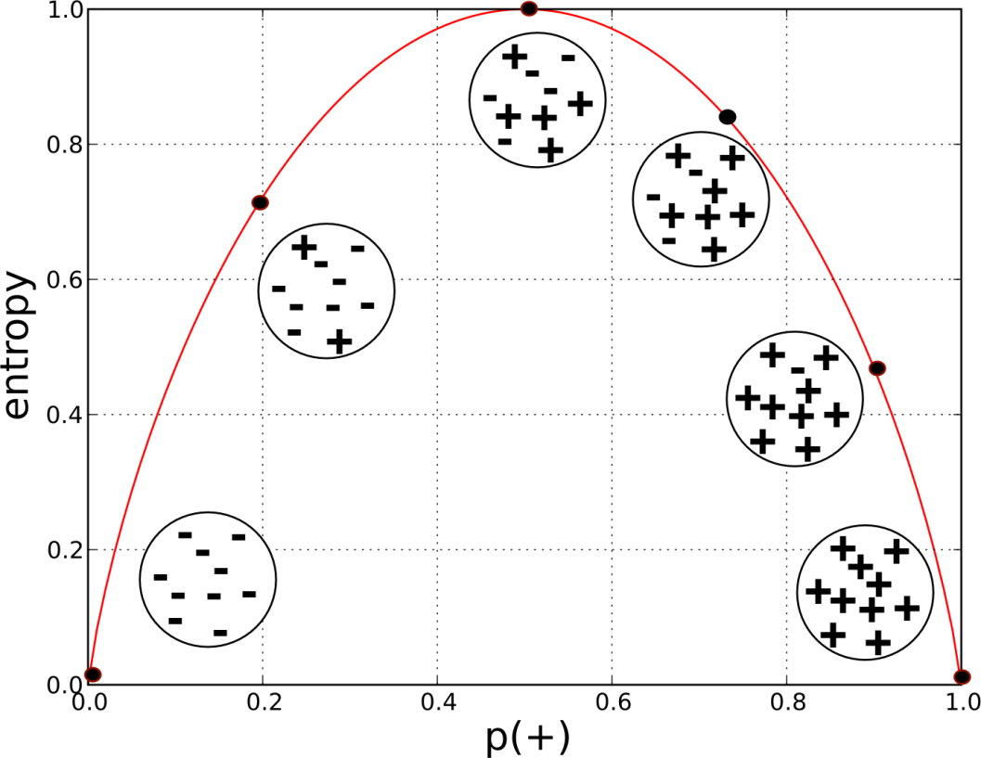
Entropy
Entropy is maximized when classes are equal
Entropy also extends to more than 2 classes

Slide 26
How do we use Entropy?
Split on (Balance > 50K)
Split on (Employed = Y)
Less or equal 50K
Over 50K
Unemployed
Employed
Lower entropy – more information
Notes:
Loan write off example which of these are better

Slide 27
Entropy
Before
A decrease in entropy means more information
After Split
Less or equal 50K
Over 50K
Calculate impurity (entropy) before and after

Slide 28
Evaluate potential split:
Weighted impurity of the children
Entire population (30 instances)
17 instances
Balance>=50K
Balance<50K
13 instances
+ good risk – no default
bad risk - default
Overall entropy of split is a weighted average of the two
Notes:
Started at .96

Slide 29
2) Measuring coverage
Entropy gives us a measure of how helpful a given leaf is in predicting the target
But we need an overall sense of the value of the split!
We want splits that increase our overall information, not just carve off little areas with perfect entropy…
We do this by measuring the overall improvement in entropy across the entire data set for each split:

Slide 30
2) Measuring Coverage
Information Gain = Impurity (parent) – [Impurity (children)]
Gain = 0.38
Impurity(Pre-Split) =0.996
Average Impurity(Post-Split) = 0.615
Balance>=50K
Gain=0.996-0.615=0.38
Impurity = 0.787
Balance<50K
+ good risk – no default
bad risk - default
Impurity = 0.39

Slide 31
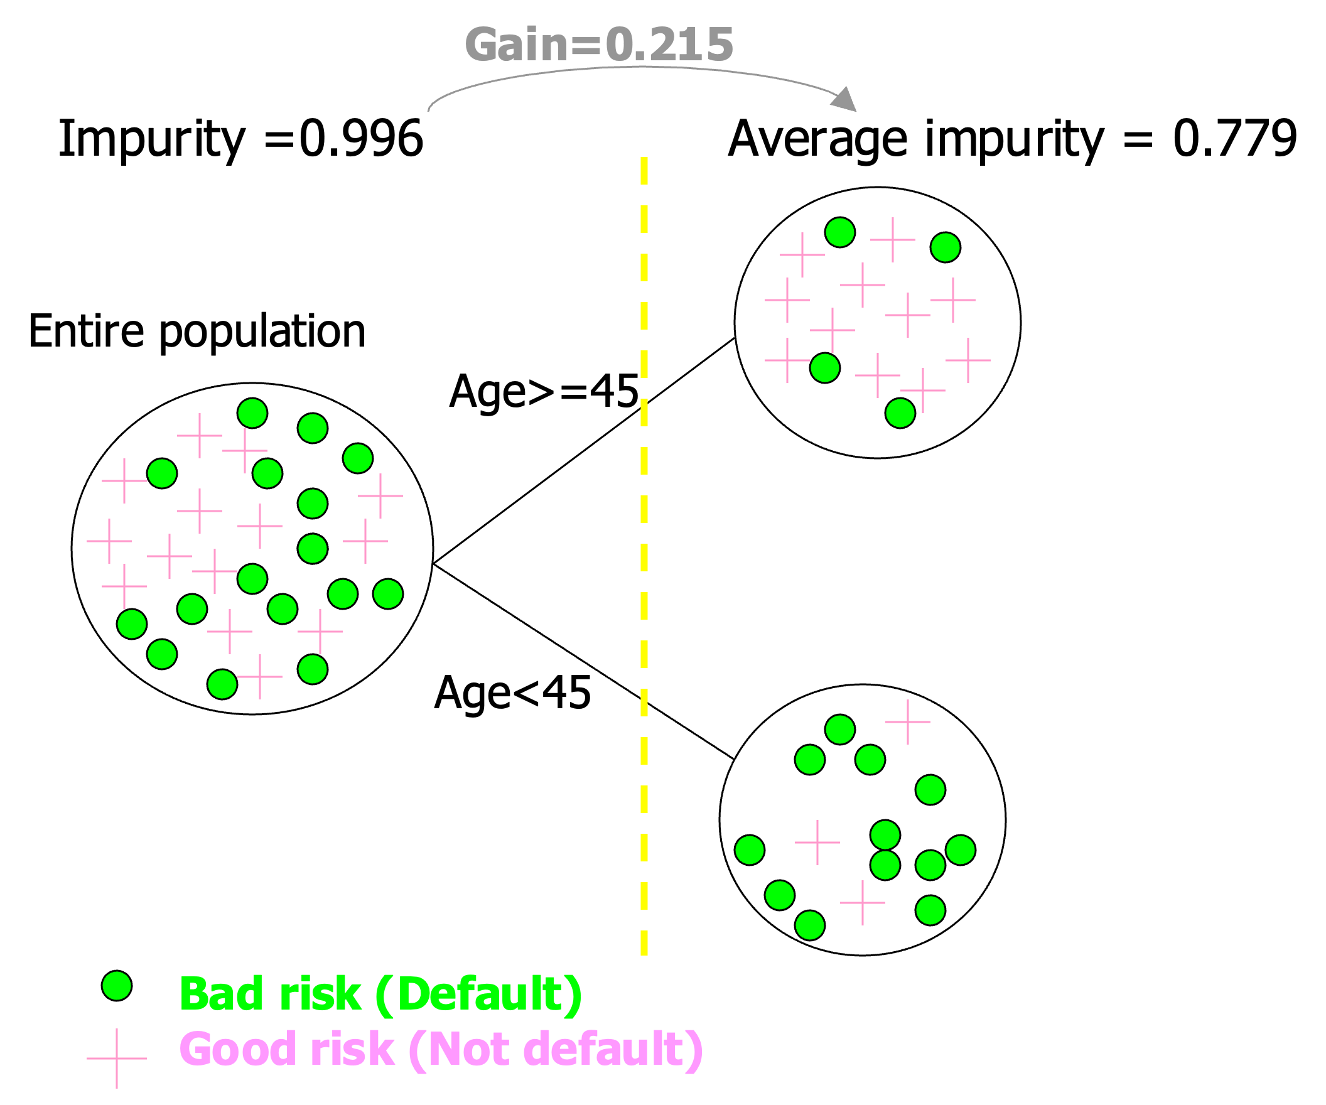
Finding the best split
What if we tried to split over age instead?
Not as good as the split for income!
First, need to find the best place to split the age variable (using information gain)
Then, compare the maximal info gain to other splits
Thankfully we have software to do this!

Slide 32
Finding the best split
At each split, we need to
Find the optimal split point for each numeric attribute
Find the optimal split for any categorical attribute
Compare the information gain of those splits for each attribute
Pick the best one and split

Slide 33

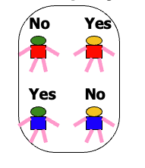
When do we stop growing?
Following the rules above, we can keep splitting and splitting and growing and growing until …
You have perfect purity:
But: we don’t want to grow as far as we can. Why?
Fewer nodes is typically better – more comprehensible, and more accurate
No split can add information:
More about this when we get to overfitting

Slide 34
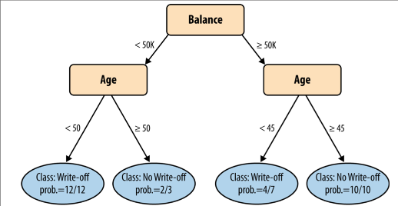
Trees: Geometric Interpreation
50
Age
45
Split over age
Trees split the space with lines that are parallel to the axis
50k
+ good risk – no default
bad risk - default
Balance
Notes:
This interpretation gets dodgy when you start thinking about more than 2 dimenstions…

Slide 35
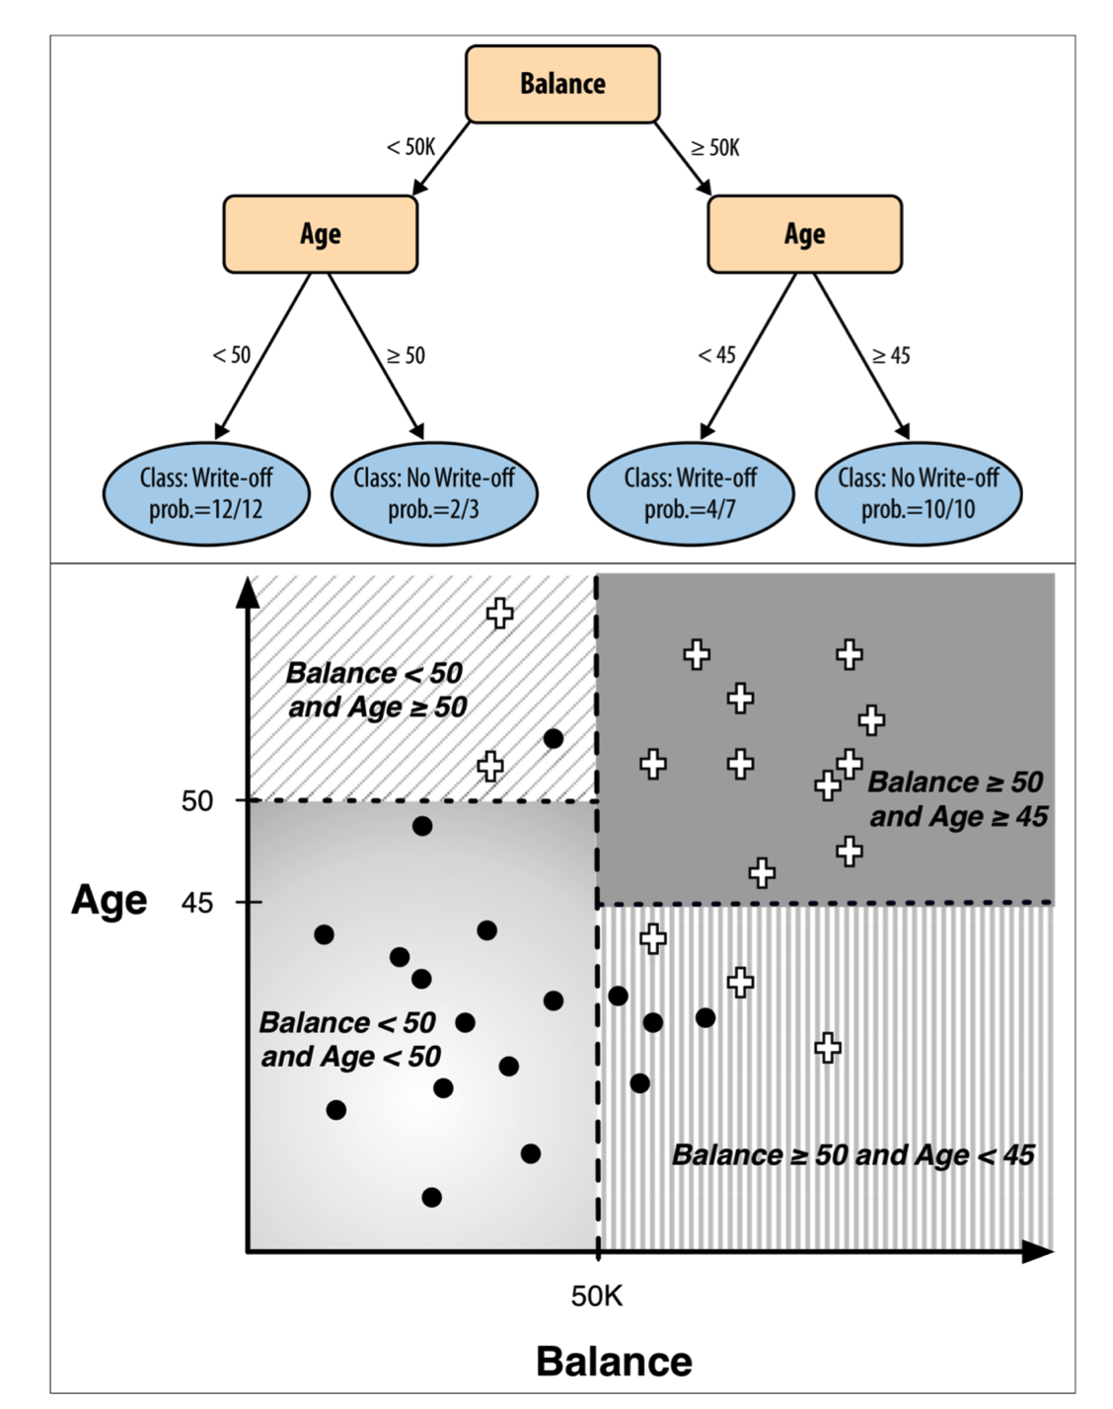
More complex Example of Geometric interpretation
Trees split the space with lines that are parallel to the axis

Slide 36
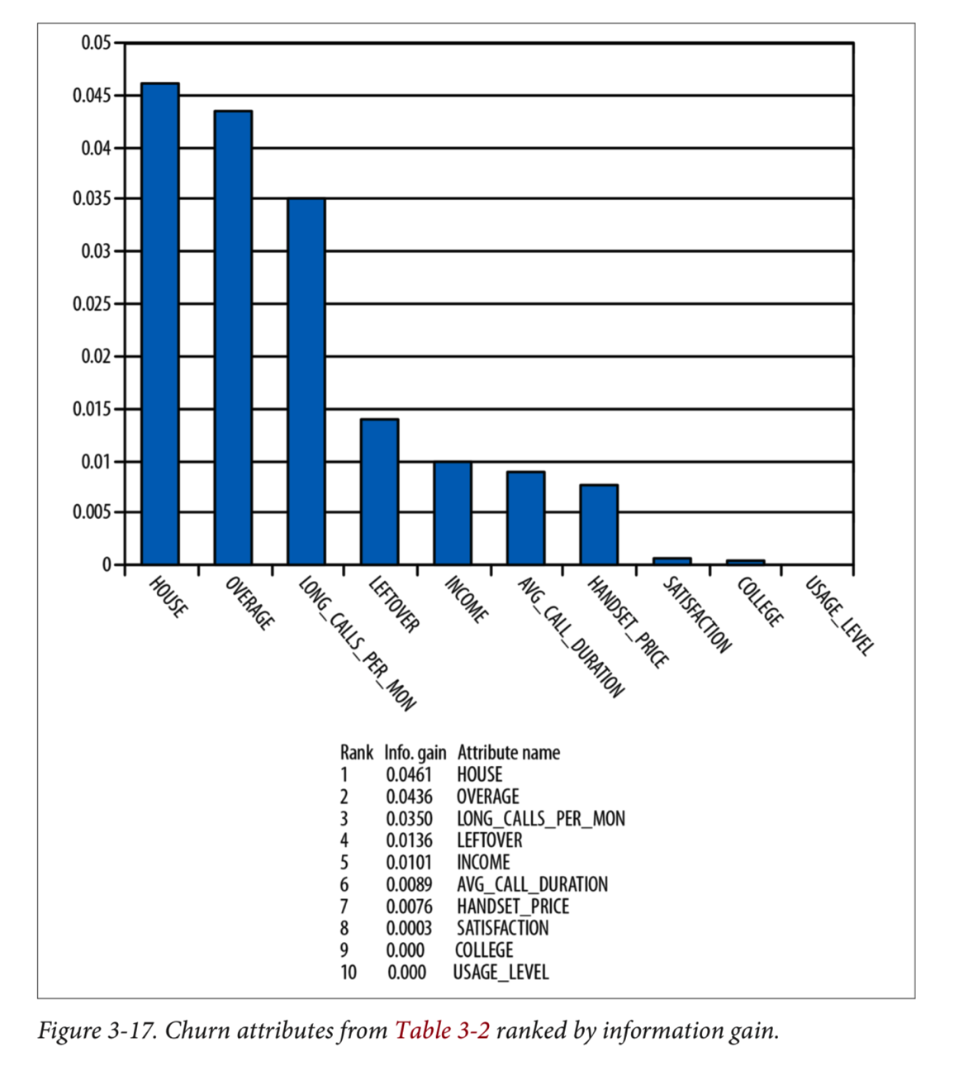
Information gain for insight
Each split results in information gain
Decreasing entropy is increasing information
You can assign the info gain to the attribute used for the split
After the tree building process is over, we can aggregate the gain for each attribute

Slide 37
Tree Summary and Performance
Most basic measure of performance is “accuracy” – strictly how many of your data points you got correct
What is the accuracy in this example?
For two main reasons this is not a good idea
Should use a training/test split
Accuracy depends on the baserate!
1/10
1/9
1/8
4/7
Notes:
28/34

Slide 38
Summary: Tree induction
Recursive algorithm that keeps splitting until done
Every iteration: pick split over all current leaf nodes over all possible attributes - uses information gain as a measure of improved purity
Classification or Probability Estimation
Stopping criteria
Can provide insight by ranking variables on information gain
Geometric interpretation: split space with lines
Now that we understand classification, you can use any algorithm;
Logistic regression
Neural nets
Nearest neighbors
Etc…
More about these later

Slide 39
Decision Trees : Module
Module2_Supervised:
Decision_Trees.ipynb

