Slide 1
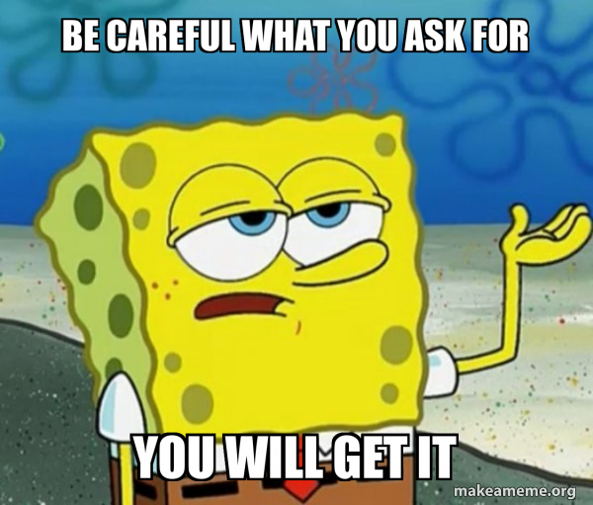
Class Feedback
Class is too fast
And too slow
(early content too slow)
More python
Smaller (more?) HW and small examples
More hands on
Modules are (mostly) popular
Class discussions are (mostly) popular
Quiz – not enough time, too long
More guidance on project
Textbooks – meh.

