Slide 1
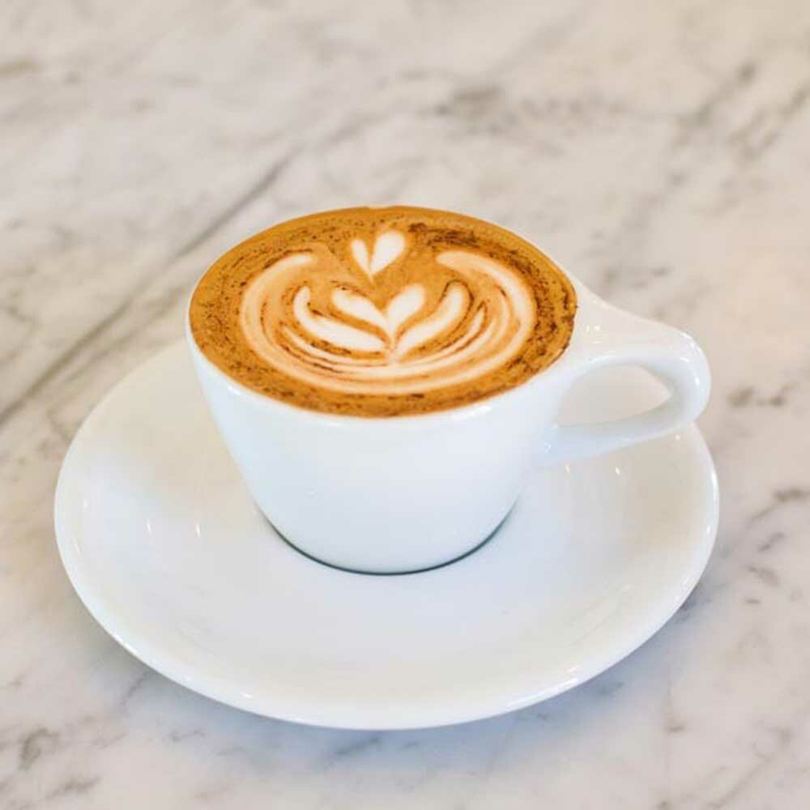
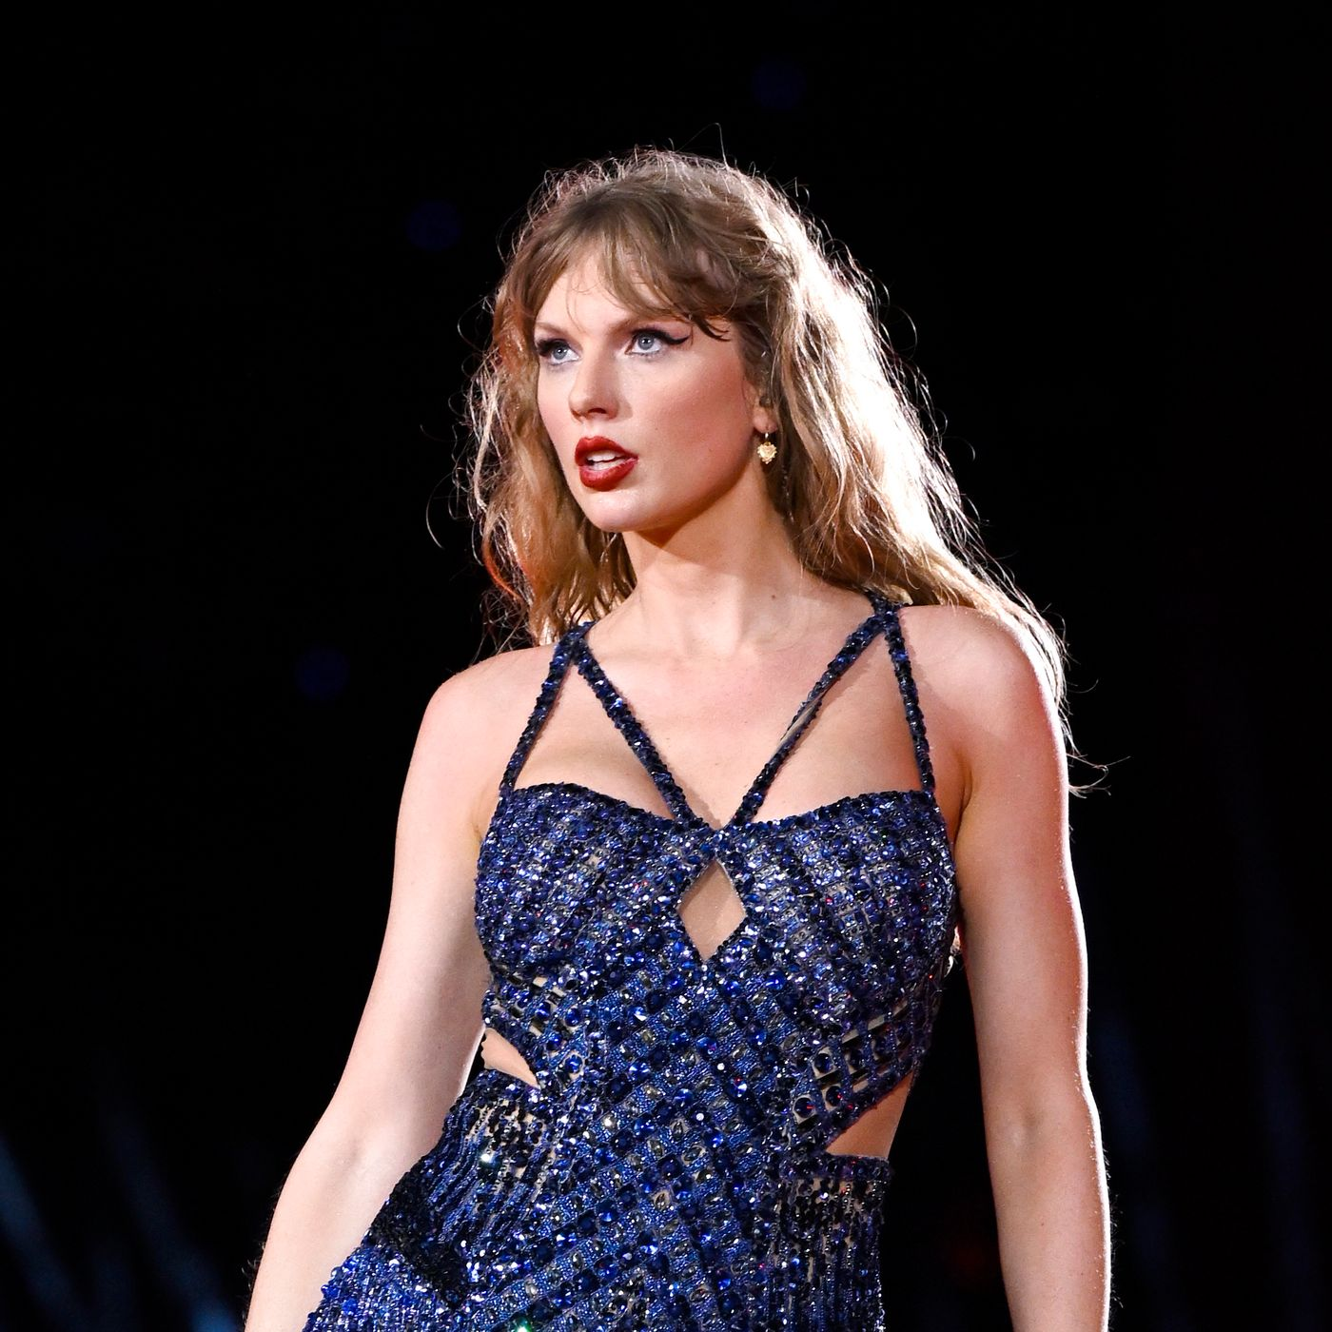
Across 2 sections:
Matto | 10
Starbucks | 6
La Cabra | 6
Blank Street | 4
Whistle and Fizz | 3
Think Coffee | 3
Irving Coffee Roasters | 3
Qahwah House | 2
Librae | 2
Joe Coffee | 2
HeyTea | 2
Cafe Reggio | 2
Cafe Lyria | 2
Don't care / Not a fan | 29
1989 | 11
Red | 9
Fearless | 6
Speak Now | 4
Lover | 4
Midnights | 3
Reputation | 2
Folklore | 2
Tortured Poets Department | 1
Evermore | 1

