Slide 1
Random Access Data Structures
Arrays and Linked Lists provide access to any location in the structure.
For a known location, arrays provide O(1) access, and Linked Lists provide O(n) access.
Locating data is O(n) in both structures.
Internal modifications are O(n) in arrays and O(1) in Linked Lists.

Slide 2
Restricted Access Data Structures
Access to random locations not permitted.
Accessors and mutators provide entry to structures in specific patterns.
Attributes used for implementation should be private!
Enforce data access patterns for specific applications.

Slide 3
Stack ADT: Last In, First Out
In a stack, you can only access the element on top.
The item most recently added in the only visible element.
Seems quite simple, but is extremely powerful. Lots of examples.

Slide 4
Stack Operations
push(val) #add item to the top of the stack.
pop() #remove item from the top of the stack.
peek() #look at the top item, but don't remove it.
size() #count the number of items in the structure.

Slide 5
Balancing Symbols
For a string containing parentheses or other group delimiters, do those symbols pairwise match?
Scan the string from left to right, ignoring non-delimiting characters.
Push opening delimiters onto the stack.
When you see a closing delimiter, it must match the one on the top of the stack, or the string is imbalanced.

Slide 6
{(([])[()])}

Slide 7
{(([][)()])}

Slide 8
Balancing Symbols
Seems trivial, but consider applications for text processing.
HTML validation
Partial program syntax validation

Slide 9
<!DOCTYPE html> <html> <head> <meta charset="UTF-8"> <title>Title of the document</title> </head> <body> Content of the document...... </body> </html>

Slide 10
Arithmetic Expression Evaluation
Order of operations can be a pain in the.
5 + 6 + 2 * 4
We know that multiplication takes precedence over addition, so it is easy for humans.
Computers want to process in order, yielding incorrect result.

Slide 11
Postfix Notation
Expressions in postfix notation can be evaluated left-to-right without ambiguity or order of operations.
5 + 6 + 2 * 4 becomes 5 6 + 2 4 * +
Scan left to right, pushing operands onto the stack.
When you encounter an operator, pop b then a from the stack, compute a operator b, and push the result.
Last (and only) value in the stack is the result.

Slide 12
6 5 2 3 + 8 * + 3 - *

Slide 13
Infix To Postfix Conversion
Scan the expression left to right.
Operands go directly to output
Operators modify a stack depending on precedence.

Slide 14
Infix To Postfix Conversion
For token k:
if k is an operand, output it
if k is a ')', pop operators from the stack and output them until you pop '('. Ignore the parentheses.
If k is any other operator, pop and output while the top operator is not a '(' and is of greater or equal precedence than k, then push the new operator.
After all characters have been read, pop and output the rest of the stack.

Slide 15
a + b * c * ( d - e - f ) * g
For token k:
if k is an operand, output it
if k is a ')', pop operators from the stack and output them until you pop '('. Ignore the parentheses.
If k is any other operator, pop and output while the top operator is not a '(' and is of greater or equal precedence than k, then push the new operator.
After all characters have been read, pop and output the rest of the stack.

Slide 16
Sequence Reversal
Given a sequence of values, create a new sequence with the same values, but in reverse order.
Push each item from the sequence onto a stack, then pop them off, one a time, into the new sequence.

Slide 17
Palindromes
A string of characters that is the same forwards and backwards.
A man, a plan, a canal: Panama!
Rise to vote, sir!
Are we not drawn onward to new era?
Live not on evil.

Slide 18
LIVENOTONEVIL

Slide 19
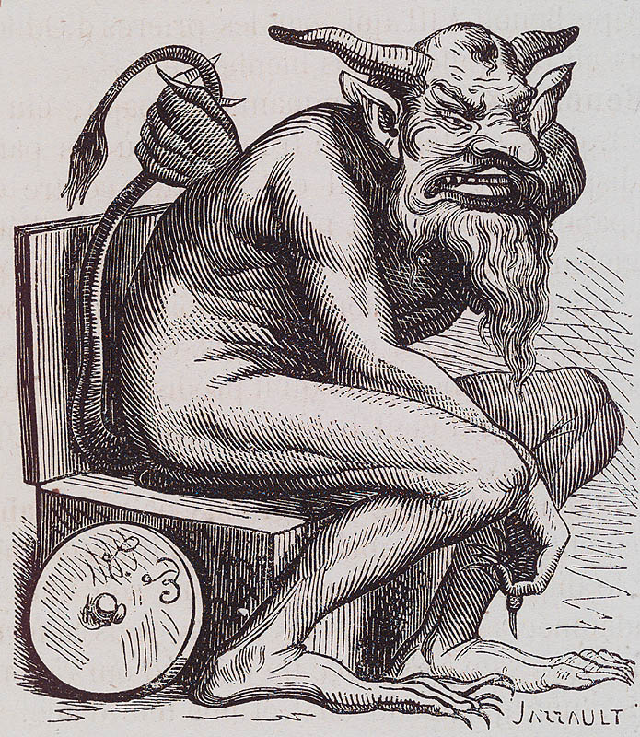
Palindromic Primes (because math)
757, 13331, 15451 (infinitely many?)
Beastly palindromic primes, such as Belphegor's Prime: 1000000000000066600000000000001
Triply palindromic primes: number p is prime and a palindrome, number of digits q in p is prime and a palindrome, and number of digits r in q is prime and a palindrome. First example in base ten is 10000500001.

Slide 20
Stack Implementations
Array-based approach. Top of stack is at end of data.
0
1
2
3
4
5

Slide 21
Stack Implementations
Linked List-based approach. Top of stack is at head or tail.
H
3
-8
T
7

Slide 22
Thought Homework: How do function calls work?

