Slide 1
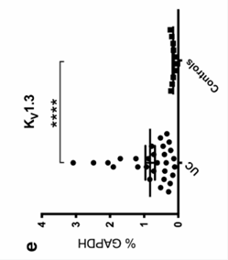
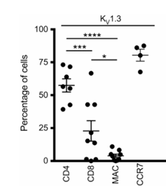
KV1.3 target tissue expression
In the colonic mucosa of active ulcerative colitis (UC), KV1.3 is markedly upregulated and selectively expressed on infiltrating CD4⁺ and CD8⁺ T cells, particularly within effector memory T cell (TEM)-like populations. Its expression levels correlate strongly with local TNF-α and IL-17A production as well as the severity of tissue inflammation. Notably, pharmacological blockade of KV1.3 in human primary T cells effectively suppresses the production of IFN-γ, TNF-α, and IL-17A. Collectively, these data establish KV1.3 as both a candidate biomarker for mucosal inflammatory activity and a targeted immunomodulatory node. Its therapeutic potential lies in its ability to suppress excessive T-cell activation and cytokine output, rather than inducing broad-spectrum lymphocyte depletion.
DOI: 10.1016/j.crohns.2014.04.003

Slide 2
Competitive landscape of KV1.3 targeting assets
The preclinical Kv1.3 program leverages a gut-restricted, high-selectivity small molecule design​ to specifically target pathogenic TEM cells in IBD, directly addressing the systemic exposure risks seen in legacy programs and positioning us to capture the first-mover advantage in oral immunotherapy for inflammatory bowel disease.
Drug Name | Disease | Research Institution | Latest Global Development Stage | Drug Category III | Drug Label | Country/Region of Origin
YR-001 | Atopic Dermatitis, Psoriasis, Alopecia (Differentiated Diseases) | Yirui Pharma (Originator) | Phase II Clinical (2024-03-13) | Small Molecule | Differentiated Diseases | China (Mainland)
LY3972406 | Plaque Psoriasis | Eli Lilly (Top 20 MNC) | Phase II Clinical (2023-12-20) | Other | Potential First-in-Class | United States
ZP9830 | Autoimmune Diseases, Inflammatory Bowel Disease | Zealand Pharma (Originator) | Phase I Clinical | Peptide | N/A | Europe
si-544 | Atopic Dermatitis, Psoriatic Arthritis (Differentiated Diseases), Plaque Psoriasis, Cutaneous T-Cell Lymphoma (Differentiated Diseases) | SelectIon (Originator) | Phase I Clinical | Peptide | Differentiated Diseases | United States
DES-7114 | Autoimmune Diseases | Eli Lilly (Top 20 MNC); DESRES (Originator) | Phase I Clinical | Other | N/A | United States

Slide 3
Safer than JAK inhibitors with comparable efficacy index.
The core advantage of this program lies in its extreme "gut-enriched, systemically stealthy" PK profile: in both rat and beagle models, drug concentrations in the colon and ileum are tens to hundreds of times higher than those in plasma and are sustained well within the effective concentration window. Meanwhile, distribution to critical off-target organs such as the brain, heart, and spleen is negligible. This design—characterized by a high unbound tissue-to-plasma partition coefficient (K_{p,uu})—ensures localized immunomodulation strictly at the inflammatory site, fundamentally mitigating the risks of infection and cardiovascular events associated with the high systemic exposure of traditional immunosuppressants (e.g., JAK inhibitors).
Leveraging this unique PK profile, we have validated exceptional efficacy and speed of onset in rat colitis models: following oral administration, the high local concentrations within the intestinal lamina propria (far exceeding the functional IC₅₀for pathogenic T_{EM}cells) rapidly translate into potent anti-inflammatory activity. This not only significantly reverses body weight loss and Disease Activity Index (DAI) scores but also demonstrates superior improvement in colon shortening and histopathological damage compared to the marketed standards Tofacitinib and Ozanimod. These results prove that precise blockade of pathogenic effector memory T cells (T_{EM}) can achieve mucosal healing that is non-inferior or even superior to standard therapies, delivered via a safer, gut-restricted modality.

Slide 4
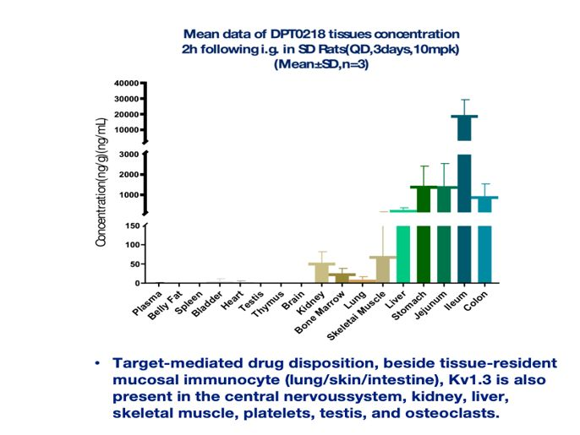
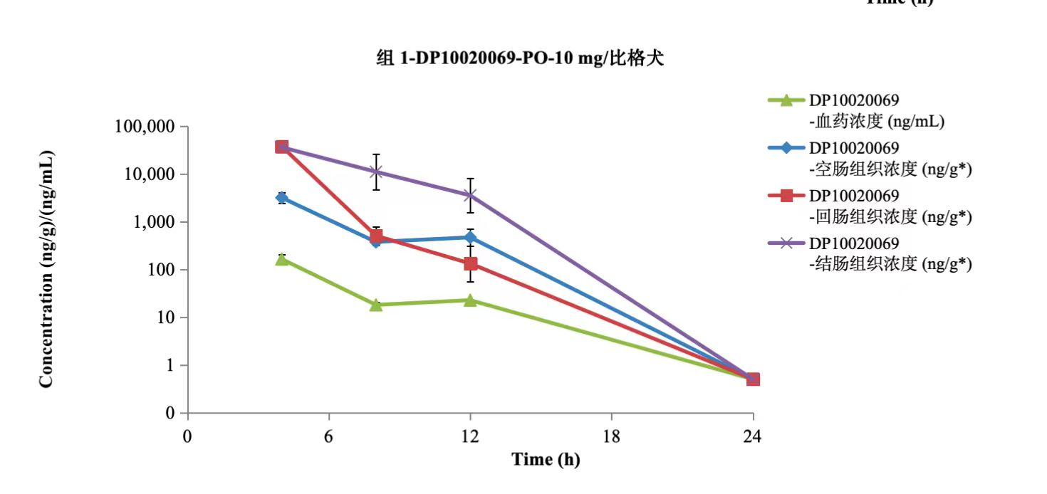
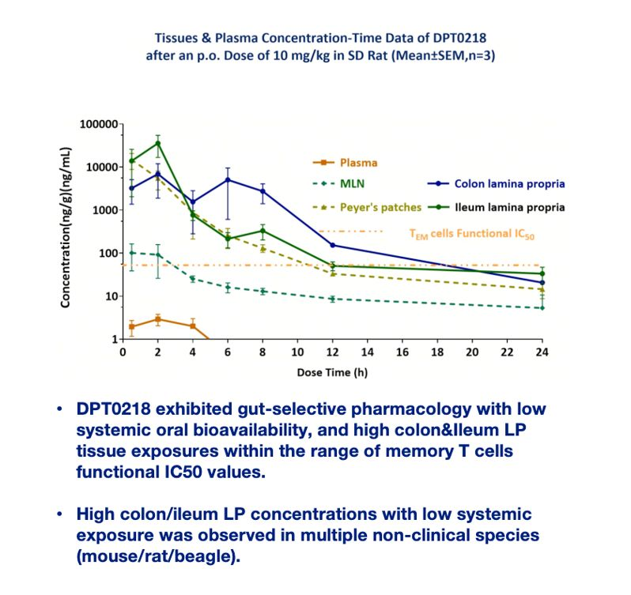
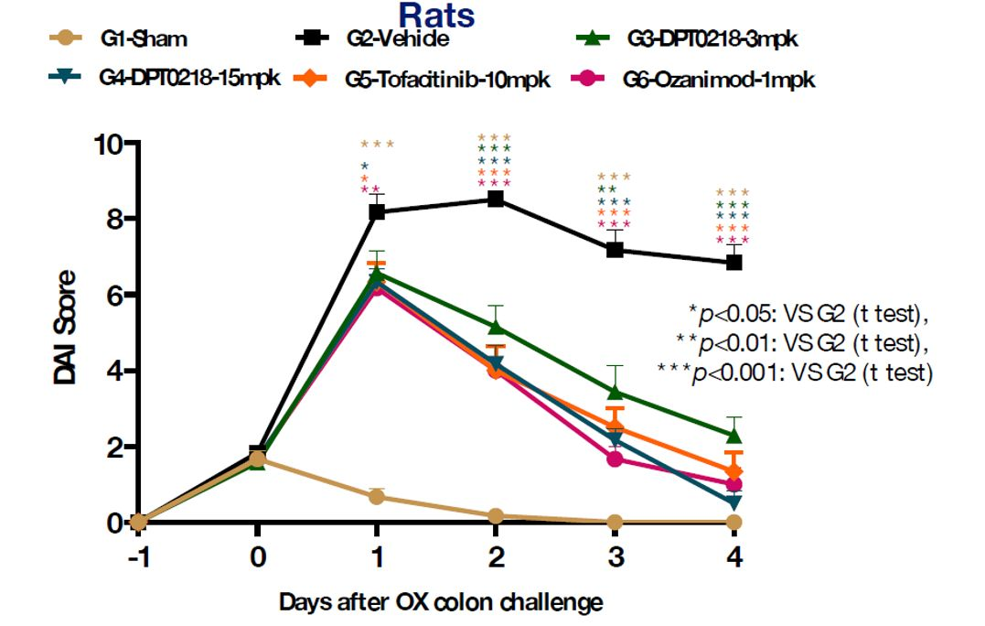

Slide 5
Development timeline
 |  | 2026 |  |  |  |  |  |  | 2027
 |  | 6 | 7 | 8 | 9 | 10 | 11 | 12 | 1 | 2 | 3 | 4 | 5 | 6 | 7 | 8
CMC | salt types and crystal forms
 | Process Optimization
 | API
 | Formulation Development
 | Forced Degradation Studies
pharmacology | efficacy
ADME/PK | Analytical Method Development and validation
 | ADME
 | PK
Tox | Acute Toxicity Study
 | Long-term Toxicity
 | etc
Safety Pharmacology | CNS
 | Respiratory System
 | Cardiovascular System
clinical | Protocol Drafting
Regulatory Affairs | IB, CMC sections, Non-clinical
IND | FDA & NMPA

