Slide 1
Coffee 101 Update
Slides by Demetrius Ross

Slide 2
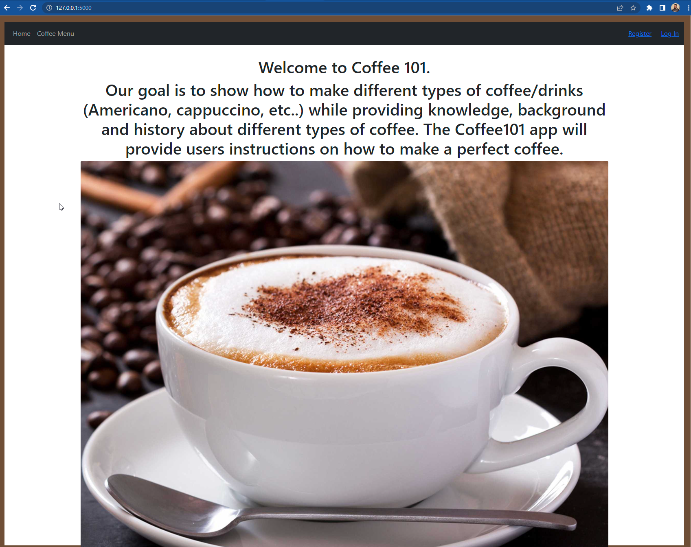
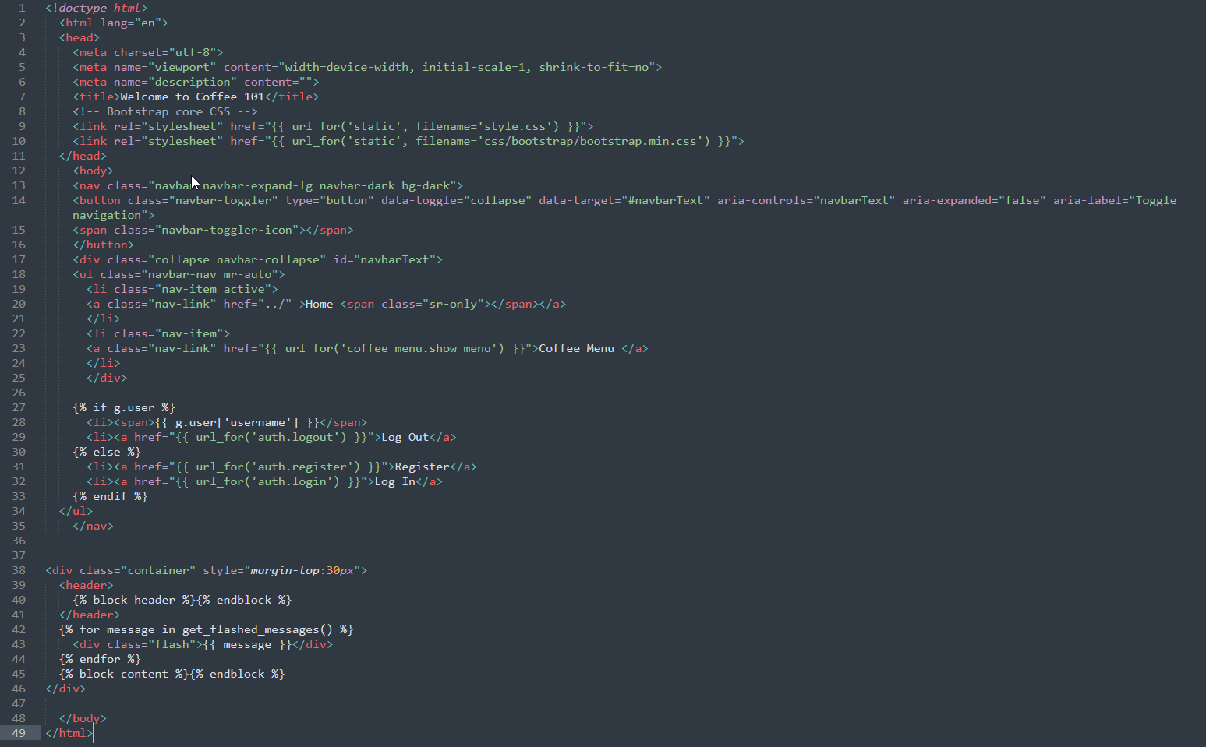
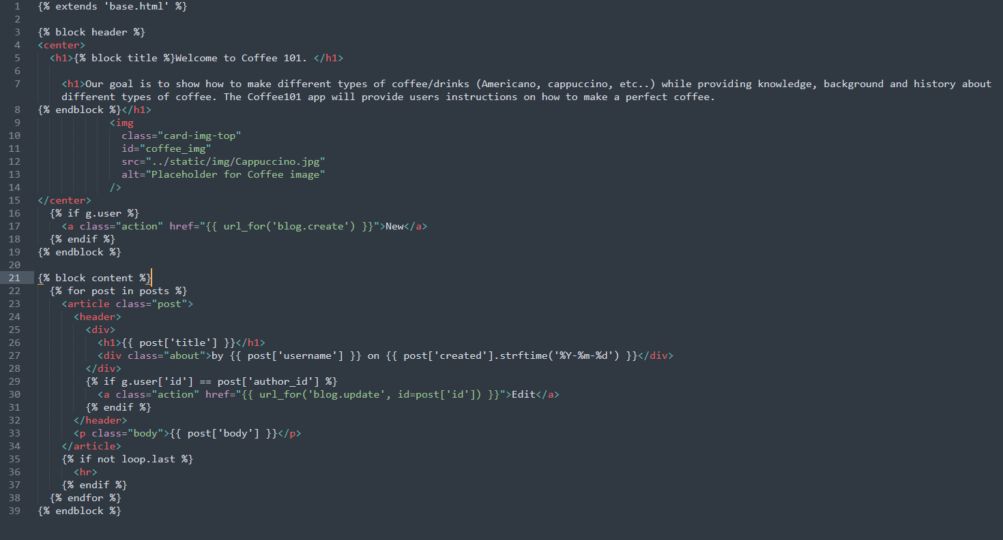
Updated Home Page

Slide 3
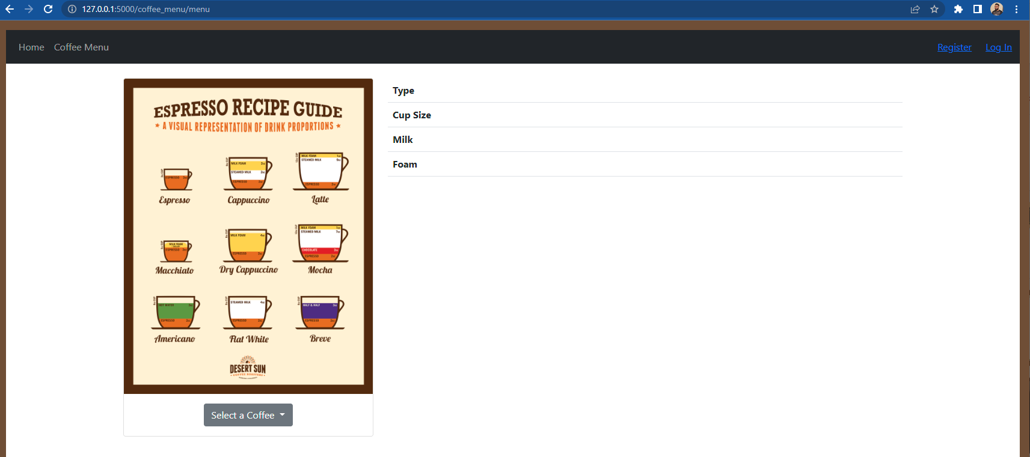
Added Coffee Menu

Slide 4
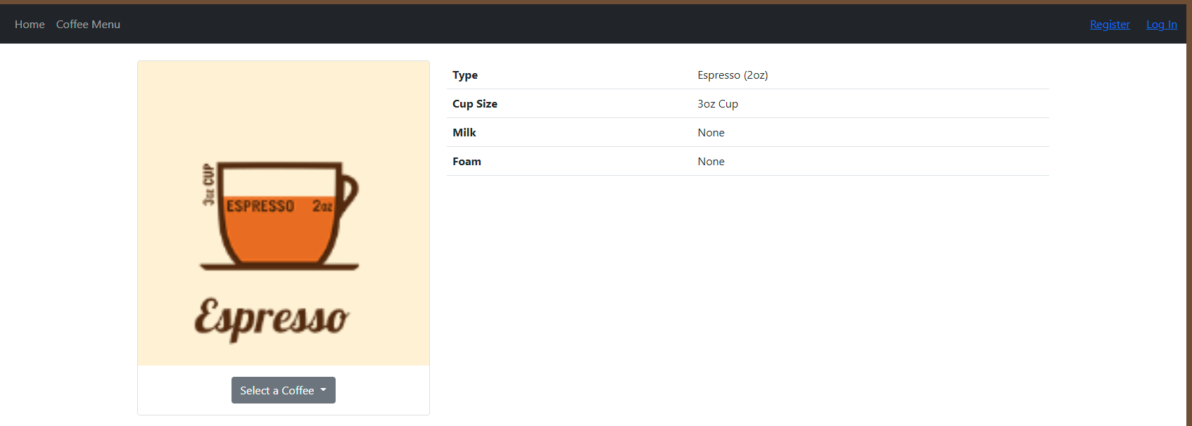
Added Coffee Menu

Slide 5
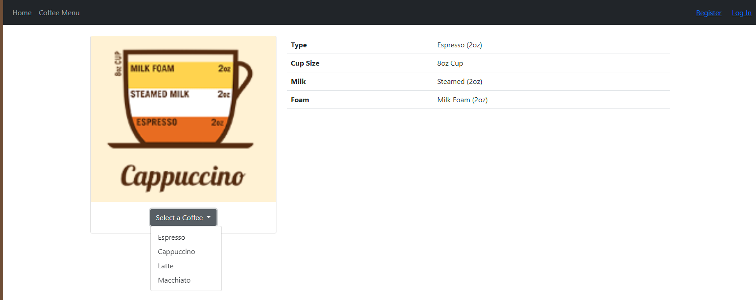
Added Coffee Menu

Slide 6
Added Coffee Menu
Created new menu instance in __init__.py
Created menu directory in templates that connects to base.html
Updated links pointing to menu page
Created .js script to populate the menu
Added images to the menu

