Slide 1
Evaluating Optimized Container Networking Solutions

Slide 2


Goals
Evaluate optimized container networking solutions
Freeflow (TCP and RDMA)
Slim
SR-IOV
Convert OpenStudio-server to Kubernetes container orchestration.
Address OpenStudio-server architecture issues
Evaluate performance gain by adopting Freeflow / Slim / SR-IOV.

Slide 3
OpenStudio Server Background
OpenStudio is a cross-platform (Windows, Mac, and Linux) collection of software tools to support whole building energy modeling using EnergyPlus and advanced daylight analysis using Radiance. OpenStudio is an open source project to facilitate community development, extension, and private sector adoption. OpenStudio includes graphical interfaces along with a Software Development Kit (SDK).
OpenStudio-server is a cloud based solution to run parallel model simulations runs in the cloud. The infrastructure can be deployed as a stand alone by individual energy modelers an customized to their needs.

Slide 4
OpenStudio Server Issues
Issue #1
The current OpenStudio-server runs docker swarm and the cloud cluster is setup using individual VMs, VPC subnets, firewall rules using the ruby aws-sdk-gem and can only be ran in AWS cloud.
Redis
MongoDB
Worker
Clients
AWS load balancer
Web (rails frontend)
Worker
Worker
Web (rails frontend)
(back end)
rails backend http API

Slide 5
OpenStudio Server Issues
Issue #2
Workers pods can not dynamically scale (only static assignment on startup). Waste of compute resources when not using.
Redis
MongoDB
Worker
Clients
AWS load balancer
Web (rails frontend)
Worker
Worker
Web (rails frontend)
(back end)
rails backend http API

Slide 6
OpenStudio Server Issues
Issue #3
Bottleneck between rails back-end API and worker response due to large data exchange. Leads to data loss and or API non-responsive state. Due to API processing, network bandwidth under very large simulation with large data sets.
Redis
MongoDB
Worker
Clients
AWS load balancer
Web (rails frontend)
Worker
Worker
Web (rails frontend)
(back end)
rails backend http API

Slide 7
OpenStudio Server Solutions
Issue #1
The current OpenStudio-server runs docker swarm and the cloud cluster is setup using individual VMs, VPC subnets, firewall rules using the ruby aws-sdk-gem and can only be ran in AWS cloud.
Proposed Solution
Convert existing cluster to use Kubernetes and package with helm chart. This provided a agnostic approach so clients can deploy to most cloud providers that support Kubernetes (AWS, Google, Azure).

Slide 8
OpenStudio Server Solutions
Issue #2
Workers pods can not dynamically scale (only static assignment on startup). Waste of compute resources when not using.
Proposed Solution
Leverage Kubernetes built-in auto scaling feature and create a horizontally auto-scale worker deployment and use CPU as threshold to scale and expand node size upon trigger.
Node
Node
Node
Node
Worker
Worker
Worker
Worker

Slide 9
OpenStudio Server Solutions
Issue #3
Bottleneck between rails back-end API and worker response due to large data exchange. Leads to data loss and or API non-responsive state. Due to API processing, network bandwidth under very large simulation with large data sets.
Proposed Solution
Create a high performance NFS server using high speed NVMe SSD disks and mount to API back-end, front-end, and worker nodes. This was not previously done due to poor network throughput and disk I/O speeds. Remove the transport of data from worker to API and rather send message via Redis the job is done.

Slide 10
OpenStudio Server Issues
Proposed Solution
Create a high performance NFS server using high speed NVMe SSD disks and mount to API back-end, front-end, and worker nodes. This was not previously done due to poor network throughput and disk I/O speeds. Remove the transport of data from worker to API and rather send message via Redis the job is done.
Worker
Redis
MongoDB
Clients
AWS load balancer
Web (rails frontend)
Worker
Worker
SSD
NFS
Web (rails frontend
(back end)
rails backend http API

Slide 11
Container Optimization Options
 | Freeflow (RDMA) | Freeflow (TCP) | Slim (TCP) | SR-IOV | Host
Throughput | ✅✅ | ✅ | ✅ | ✅ | ✅
Latency | ✅✅ | ✅ | ✅ | ✅ | ✅
Portability | 🆇 | ✅ | 🆇 | 🆇 | 🆇
Cloud Provider | ✅ | ✅ | ✅ | 🆇 | ✅
CNI Network Plugins (e.g. weave, flannel) | ✅ | ✅ | 🆇 | ✅ | ✅

Slide 12
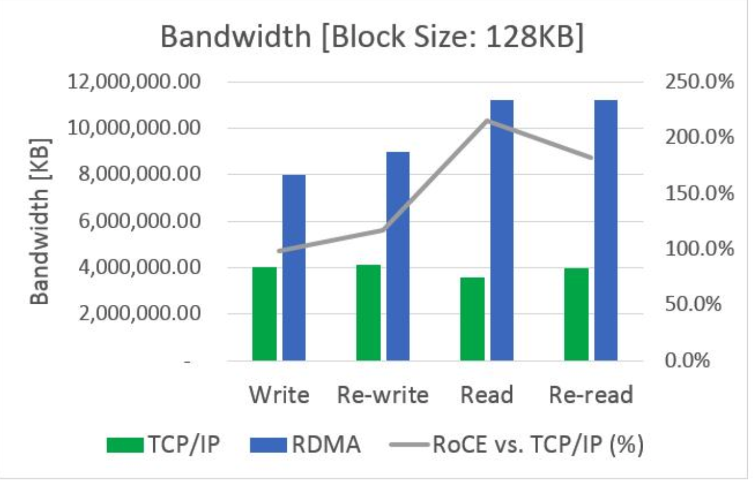
Container Optimization Options
Motivator!
Img Source: https://blog.mellanox.com/2018/06/double-your-network-file-system-performance-rdma-networking/

Slide 13
Container Optimization Options
Microsoft Azure Test bed using RDMA H-series enabled NIC machines

Slide 14
Container Optimization Options
Microsoft Azure Test bed using RDMA H-series enabled NIC machines
Size | vCPU | Processor | Memory (GB) | Memory bandwidth GB/s | Base CPU frequency (GHz) | All-cores frequency (GHz, peak) | Single-core frequency (GHz, peak) | RDMA performance (Gb/s) | MPI support | Temp storage (GB) | Max data disks | Max Ethernet NICs
Standard_H8 | 8 | Intel Xeon E5 2667 v3 | 56 | 40 | 3.2 | 3.3 | 3.6 | - | Intel 5.x, MS-MPI | 1000 | 32 | 2

Slide 15
Container Optimization Options
TCP FreeFlow Optimized
$ iperf3 -b 0 -P 50 -c 10.240.0.5
...
[ 92] 0.00-10.00 sec 359 MBytes 301 Mbits/sec 2119 sender
[ 92] 0.00-10.00 sec 357 MBytes 300 Mbits/sec receiver
[ 94] 0.00-10.00 sec 255 MBytes 214 Mbits/sec 1965 sender
[ 94] 0.00-10.00 sec 254 MBytes 213 Mbits/sec receiver
[ 96] 0.00-10.00 sec 229 MBytes 192 Mbits/sec 1560 sender
[ 96] 0.00-10.00 sec 228 MBytes 191 Mbits/sec receiver
[ 98] 0.00-10.00 sec 286 MBytes 240 Mbits/sec 2183 sender
[ 98] 0.00-10.00 sec 285 MBytes 239 Mbits/sec receiver
[100] 0.00-10.00 sec 265 MBytes 222 Mbits/sec 1732 sender
[100] 0.00-10.00 sec 264 MBytes 222 Mbits/sec receiver
[102] 0.00-10.00 sec 277 MBytes 232 Mbits/sec 1469 sender
[102] 0.00-10.00 sec 275 MBytes 231 Mbits/sec receiver
[SUM] 0.00-10.00 sec 13.9 GBytes 11.9 Gbits/sec 99421 sender
[SUM] 0.00-10.00 sec 13.8 GBytes 11.9 Gbits/sec receiver

Slide 16
Container Optimization Options
TCP FreeFlow Non-Optimized
$ iperf3 -b 0 -P 50 -c 10.240.0.5
...
[ 92] 0.00-10.00 sec 289 MBytes 242 Mbits/sec 1815 sender
[ 92] 0.00-10.00 sec 288 MBytes 242 Mbits/sec receiver
[ 94] 0.00-10.00 sec 293 MBytes 246 Mbits/sec 1789 sender
[ 94] 0.00-10.00 sec 292 MBytes 245 Mbits/sec receiver
[ 96] 0.00-10.00 sec 343 MBytes 288 Mbits/sec 2091 sender
[ 96] 0.00-10.00 sec 341 MBytes 286 Mbits/sec receiver
[ 98] 0.00-10.00 sec 248 MBytes 208 Mbits/sec 1155 sender
[ 98] 0.00-10.00 sec 248 MBytes 208 Mbits/sec receiver
[100] 0.00-10.00 sec 296 MBytes 248 Mbits/sec 1428 sender
[100] 0.00-10.00 sec 294 MBytes 247 Mbits/sec receiver
[102] 0.00-10.00 sec 239 MBytes 201 Mbits/sec 1151 sender
[102] 0.00-10.00 sec 238 MBytes 200 Mbits/sec receiver
[SUM] 0.00-10.00 sec 13.2 GBytes 11.3 Gbits/sec 73596 sender
[SUM] 0.00-10.00 sec 13.1 GBytes 11.3 Gbits/sec receiver

Slide 17
Container Optimization Options
TCP FreeFlow Optimized
root@iperf3-7f689b5db-znwxz:/# ping 10.244.0.12
PING 10.244.0.12 (10.244.0.12): 56 data bytes
64 bytes from 10.244.0.12: icmp_seq=0 ttl=62 time=0.445 ms
64 bytes from 10.244.0.12: icmp_seq=1 ttl=62 time=0.372 ms
64 bytes from 10.244.0.12: icmp_seq=2 ttl=62 time=0.391 ms
64 bytes from 10.244.0.12: icmp_seq=3 ttl=62 time=0.381 ms
64 bytes from 10.244.0.12: icmp_seq=4 ttl=62 time=0.336 ms
64 bytes from 10.244.0.12: icmp_seq=5 ttl=62 time=0.384 ms
64 bytes from 10.244.0.12: icmp_seq=6 ttl=62 time=0.372 ms
64 bytes from 10.244.0.12: icmp_seq=7 ttl=62 time=0.349 ms
64 bytes from 10.244.0.12: icmp_seq=8 ttl=62 time=0.423 ms
64 bytes from 10.244.0.12: icmp_seq=9 ttl=62 time=0.360 ms
64 bytes from 10.244.0.12: icmp_seq=10 ttl=62 time=0.344 ms
64 bytes from 10.244.0.12: icmp_seq=11 ttl=62 time=0.367 ms
64 bytes from 10.244.0.12: icmp_seq=12 ttl=62 time=0.387 ms
64 bytes from 10.244.0.12: icmp_seq=13 ttl=62 time=0.407 ms
64 bytes from 10.244.0.12: icmp_seq=14 ttl=62 time=0.348 ms
64 bytes from 10.244.0.12: icmp_seq=15 ttl=62 time=0.361 ms

Slide 18
Container Optimization Options
TCP FreeFlow Non-Optimized
root@iperf3-7f689b5db-znwxz:/# ping 10.244.0.12
PING 10.244.0.12 (10.244.0.12): 56 data bytes
64 bytes from 10.244.0.12: icmp_seq=0 ttl=62 time=0.410 ms
64 bytes from 10.244.0.12: icmp_seq=1 ttl=62 time=0.456 ms
64 bytes from 10.244.0.12: icmp_seq=2 ttl=62 time=0.451 ms
64 bytes from 10.244.0.12: icmp_seq=3 ttl=62 time=0.419 ms
64 bytes from 10.244.0.12: icmp_seq=4 ttl=62 time=0.456 ms
64 bytes from 10.244.0.12: icmp_seq=5 ttl=62 time=0.469 ms
64 bytes from 10.244.0.12: icmp_seq=6 ttl=62 time=0.416 ms
64 bytes from 10.244.0.12: icmp_seq=7 ttl=62 time=0.484 ms
64 bytes from 10.244.0.12: icmp_seq=8 ttl=62 time=0.441 ms
64 bytes from 10.244.0.12: icmp_seq=9 ttl=62 time=0.465 ms
64 bytes from 10.244.0.12: icmp_seq=10 ttl=62 time=0.470 ms
64 bytes from 10.244.0.12: icmp_seq=11 ttl=62 time=2.647 ms
64 bytes from 10.244.0.12: icmp_seq=12 ttl=62 time=0.469 ms
64 bytes from 10.244.0.12: icmp_seq=13 ttl=62 time=0.450 ms
64 bytes from 10.244.0.12: icmp_seq=14 ttl=62 time=0.512 ms
64 bytes from 10.244.0.12: icmp_seq=15 ttl=62 time=0.489 ms

Slide 19
Challenges
FreeFlow Challenges
Freeflow provides very little documentation
LD_PRELOAD=/freeflow/libfsocket.so crashes on k8s startup
Only works with TCP socket. No UDP
Compile to Mellanox RDMA NIC using support driver difficult
Doesn’t seem to have too much traction in support
Should see more throughput on a true 40GB link
Tools such as traceroute to show VXLAN encapsulation
Other Challenges
Cloud providers not clear on exact network speeds (Google, Azure (based on # nics)
Rate limiting (e.g. DS_vs instances rate limited to 2G for VMs)

