Slide 1
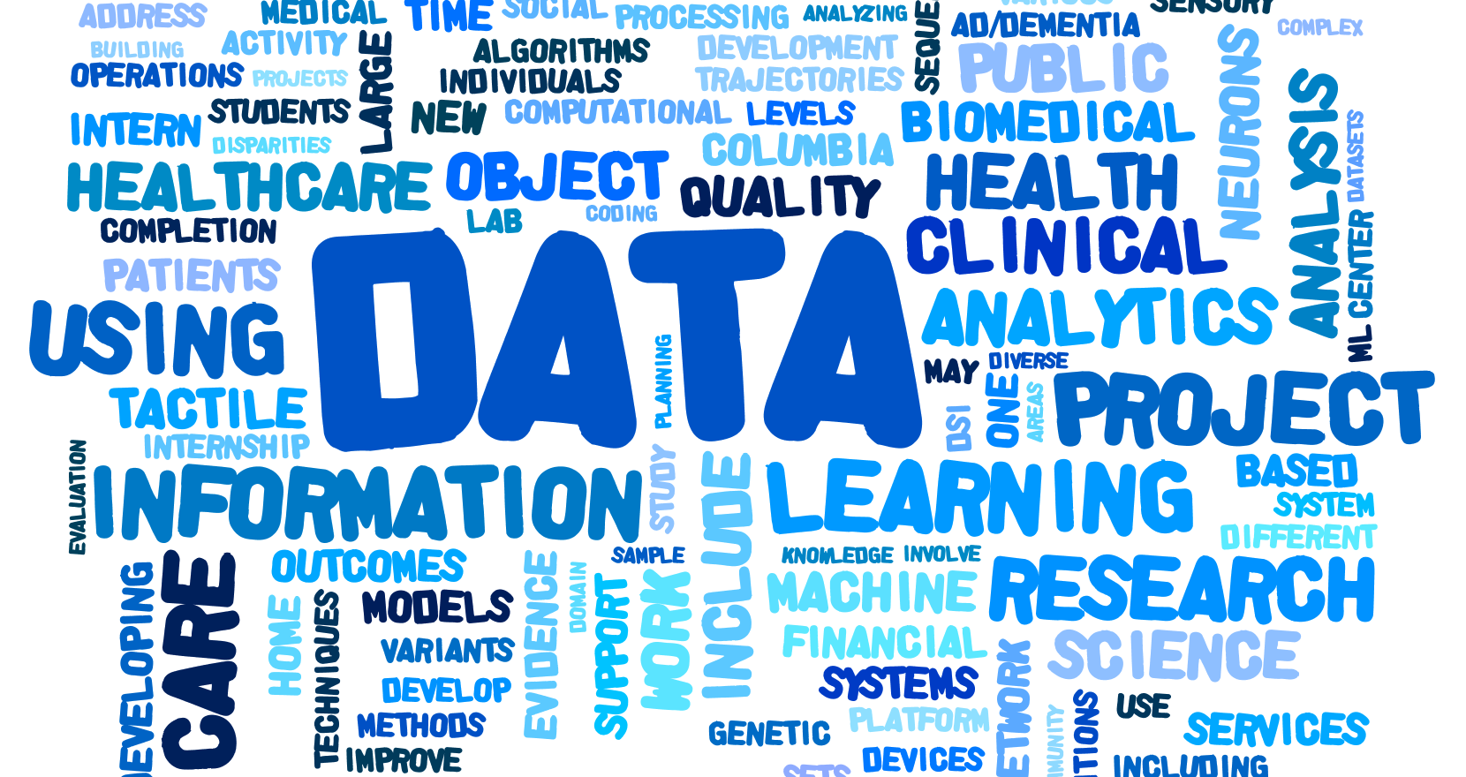
Apply by
2/15/2018
DSI Scholars Program
Enriched research experience in Data Science for the next generation of scholars
http://bit.ly/DSI-scholars2018
dsi-scholars@columbia.edu

Slide 2
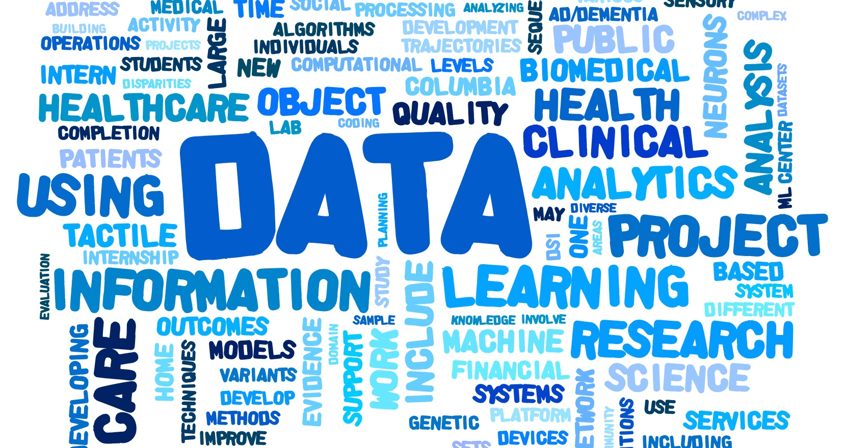
Apply by
2/15/2018
DSI Scholars Program
Enriched research experience in Data Science for the next generation of scholars
http://bit.ly/DSI-scholars2018
dsi-scholars@columbia.edu

