Slide 1

Matlab import/export Packaging

Slide 2
Importing

Slide 3
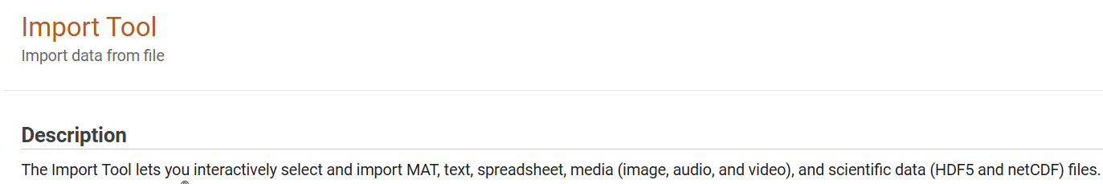
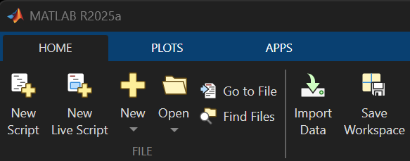
https://www.mathworks.com/help/matlab/ref/importtool.html
Will work for most file types

Slide 4
May need to specific import functions or toolboxes for
special file types (i.e., DICOM / NIFTI / NWB).
Typical files most use?

Slide 5
Exporting

Slide 6
For continued use in Matlab – save as .mat file
Exporting back into specific formats can be arduous
depending on the meta data and formatting
For most tabular data formats, ‘writetable’ is quite robust

Slide 7
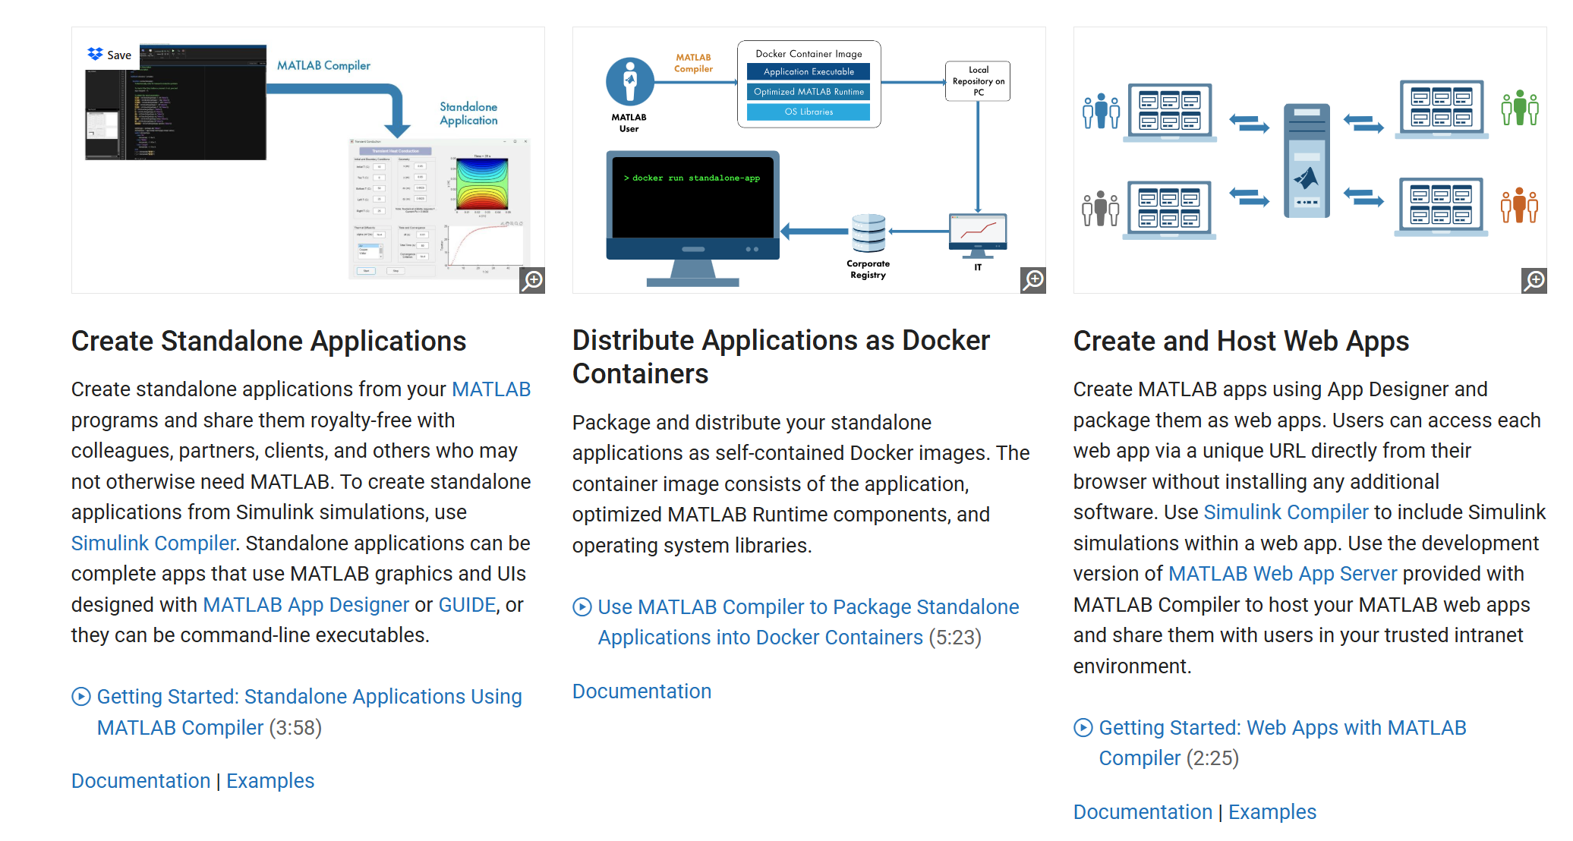
Packaging

