Slide 1
Functions and Control Flow
June 19, 2023

Slide 2
Control Flow
Control Statements
Branching
Looping
Jumping
if
elseif
switch
while
for
continue
break
return

Slide 3
Control Flow: ‘if’
program…
if condition
action
end
If condition is TRUE/met…
Then action is executed
Tip: Use a condition which outputs 1 or 0
Simple: if y == 10
Complex: if letter == ‘y’ || letter == ‘Y’

Slide 4
Control Flow: conditional formatting
radius = 10; height = 8
if radius || height <= 0
disp(‘OK’)
else
disp(‘NOT OK’)
end

Slide 5
Control Flow: ‘if-else’
program…
x = 10
if condition
action1
else
action2
end
if mod(x,2) == 0
disp(‘even’)
else
disp(‘odd’)
end
‘if else’ good for choosing between 2 actions

Slide 6
Control Flow: ‘elseif’
program…
3 explicit conditions…
if condition
action1
elseif condition
action2
else
action3
end
if x == 1
disp(‘Exp1’)
elseif x == 2
disp(‘Exp2’)
else
disp(‘Control’)
end
‘elseif’ good for choosing between more than 2 actions

Slide 7
Control Flow: ‘switch’
switch sw_exp
case 1
action_1
case 2
action_2
case 3
action_3
otherwise
action_o
end
if x == 1
disp(‘Exp1’)
elseif x == 2
disp(‘Exp2’)
elseif x == 3
disp(‘Exp3’)
else
disp(‘Control’)
end
=
Best practice is to use ‘switch’ rather than multi ‘elseif’

Slide 8
Control Flow: ‘for’ loop (aka ‘counted’)
for loop_var = range
action
end
Variable that is modified
May or may not use loop_var
Typically consecutive, but…
MUST be INTEGERS
Example
Example
for i = 1:5
disp(i)
end
>>1
2
3
4
5
for i = 1:3
disp(‘I love pizza’)
end

Slide 9
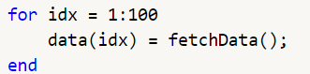
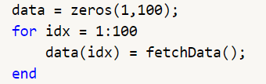
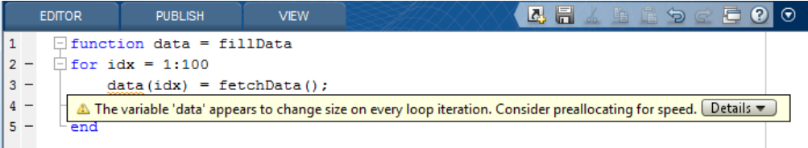
Control Flow: ‘for’ loop (aka ‘counted’)
Preallocation of stored variable within for loop action
Before
After

Slide 10
Control Flow: ‘for’ loop (aka ‘counted’)
Nested for loops
Example
x = randi(100,2,5)
rows = 2
cols = 5
for i = 1:rows
for j = 1:cols
out(j,i) = x(i,j)
end
end
for loop_v1 = range1
action1
for loop_v2 = range2
action2
end
end
Often used to loop through the rows/columns of matrix

Slide 11


Control Flow: ‘while’ loop (aka ‘conditional’)
Loop only breaks if condition is NOT met
while condition
action1
end
i = 0
while i < 3
disp(i)
i = i + 1
end
i = 2
i = 3
i = 1
i = 0
Only exists loop if false
Similar to ‘for’ may or may
not use an iterator
Initiate outside of loop
Update within loop
MUST include terminable condition in loop
Most instances of a ‘while’ loop can be solved with ‘if/else’

Slide 12
Functions

Slide 13
Functions
1. Improves modularity and reusability
2. Self-contained workspace

Slide 14
Functions
Syntax:
OutputVar = FunctionName(InputVar);
Example:
average = mean(1:10);
Our description of Functions so far…
Input
Black Box
Output

Slide 15

Functions: How do they differ from Scripts
Both are called m files.
Differ in their use of the Workspace
2a. Differ in their use and
designation of inputs/outputs
2b. Scripts can lead to
unintentional data overwriting
Syntax in code of each file will determine its identity

Slide 16


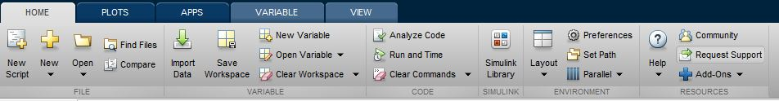

Differ in their use of the Workspace
Functions: Path, Workspace
PATH
Directory folder location (C:/Desktop)
Files (images, documents, etc.,)
m-files (scripts, functions)
>> myFunction(2,’mean’)
>> load myData.xlsx

Slide 17
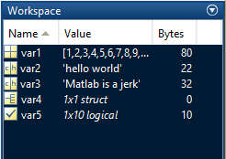
Functions: Path, Workspace
Current Workspace
Base Workspace
=

Slide 18
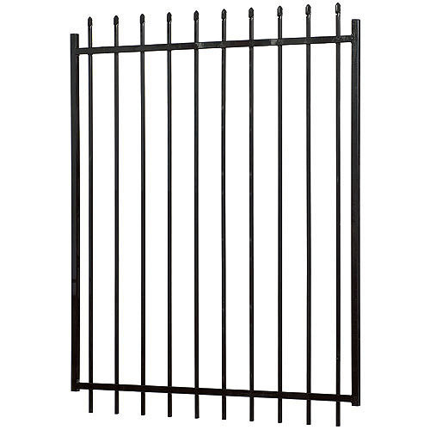
Functions: Path, Workspace
Base Workspace
func1 Workspace
var1
var1
var2
var2
func2 Workspace
var3
var1
var4
var2
func3 Workspace
var1
var2
SCRIPTS

Slide 19
Functions: Path, Workspace
SCRIPT
func1 WS
Base WS
var1
var1
var1 = 10
var2
var2 = 30
var3
var3 = 40
varN1
varN1 = func1(var1)

Slide 20
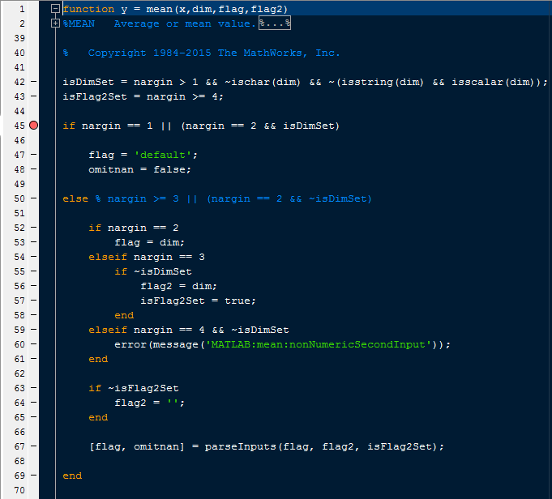
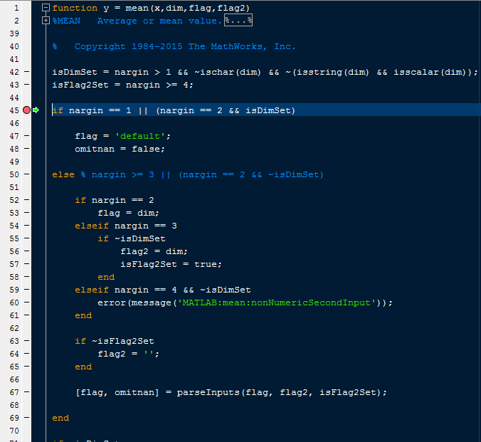
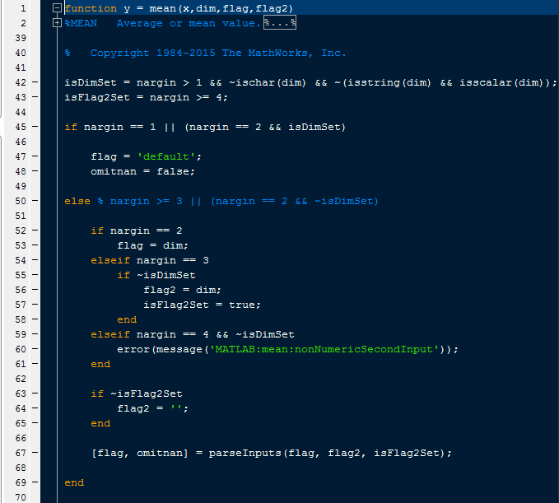
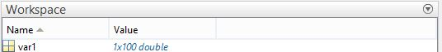
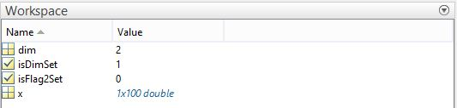
Functions: Path, Workspace
Let’s test this out in Matlab
Create var1 = 1:100;
Type >>edit mean
Set break point at Line 45
Type >> mean(var1,2)
Base Workspace
‘mean’ Workspace
Base Workspace

Slide 21
Functions: Anatomy of a Function
Naming inputs/outputs vs calling inputs/outputs
function [xOut, yOut] = myfunction(xIn, yIn)
yOut = yIn + 2;
xOut = xIn * 2;
end
>> [pizza, hamburger] = myfunction(blue, tapier)

Slide 22
Functions fundamentals
Functions with Sub-functions
function [xOut, yOut] = myfirstfunction(xIn, yIn)
% Main Function
yOut = yIn + 2;
xOut = doubleVal(xIn);
end
% Sub Function
function [output] = doubleVal(input)
output = input*2;
end

Slide 23
Functions must consist of the following
1. The reserved word ‘function’
2. The name of the function = name of .m file
3. ‘end’ at the End of the function
Optional:
Inputs
Outputs
Body of function

Slide 24
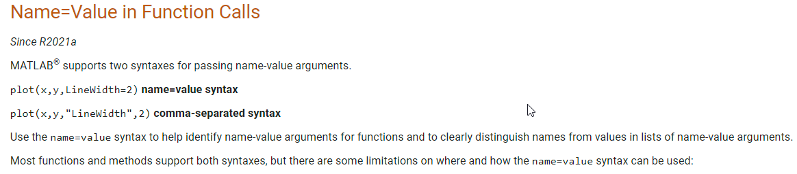
Rules for inputs and outputs of functions
OUTPUTS – Order is important
[output1, output2] = functionName()
‘~’ is used as a place holder if you do not want outputs
Example: [~ , output2 ] = functionName(input1)
INPUTS - Order matters in most cases for INPUTS
functionName(input1,input2)
INPUTS – Also use paired inputs (VERY SIMILAR to set/get)
Example:
functionName(‘argumentName’, argumentValue)

Slide 25
Functions fundamentals
What would the following commands return?
a = zeros(2,4,8);
» D = size(a)
» [m, n] = size(a)
» [x, y, z] = size(a)
» m2 = size(a,2)

Slide 26
Practice!

