Slide 1

EM Colorimeter & Meson structure
David Zarta

Slide 2

My group
My mentor is Doctor Tanja Horn.
I will be focusing on a projects that consist of me and Richard Trotta in the projections of meson structures at the electron-ion-collider.
I will also be focusing in another with project with Doctor Petr Stepanov in scientific modeling of novel EM Calorimeter (Monte Carlo methods).

Slide 3
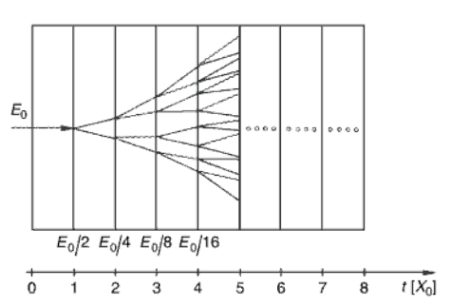
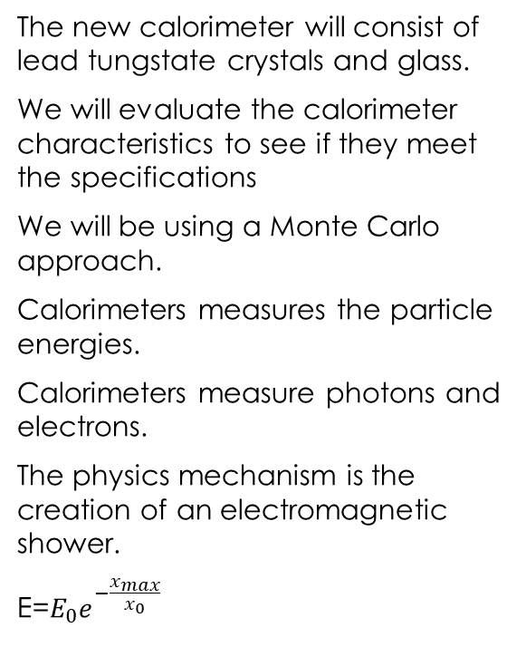
Novel EM Calorimeter
The new calorimeter will consist of lead tungstate crystals and glass.
We will evaluate the calorimeter characteristics to see if they meet the specifications
We will be using a Monte Carlo approach.
Calorimeters measures the particle energies.
Calorimeters measure photons and electrons.
The physics mechanism is the creation of an electromagnetic shower.
E=$E_{0}e^{−\frac{x_{max}}{x_{0}}}$

Slide 4

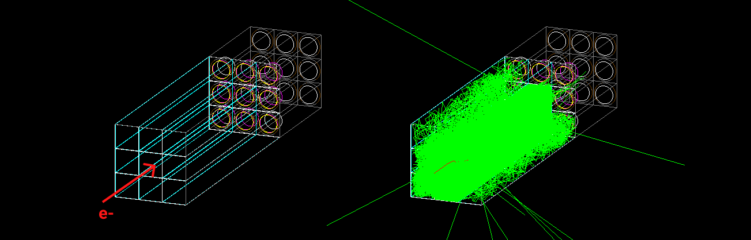
Research Outline
A Geant4 based program code is utilized to simulate the passage of particles through the
assembly of scintillation material. Simulation investigates application of the novel scintillation.
material (SciGlass) for EIC detector project.
injecting one 100 MeV electron in 3x3 the assembly of SciGlass scintillation material
Following information can be studied:
Energy deposition in the scintillation material. Energy resolution of the detector assembly.
Ratio of the Cherenkov to scintillation optical photons produced in the simulation.
Number of the photo-electrons (PE) registered by corresponding detector. Determined by: optical emission
spectrum, transmittance spectrum and size of the crystal, and quantum efficiency curve of the detector.

Slide 5


Research Objective
Understand the Geant4 basics.
Get familiar with capabilities of the Geant4 framework. Learn how to launch the program and control the simulation workflow.
Here is a good introductory tutorial on YouTube.
Learn Command Line, maybe some programming.
Program code is written in C++ language and must be executed on the Jlab computing environment.
This interactive tutorial is good for a start.
Get familiar with ROOT framework.
Geant4 outputs information in the ROOT file format. CERN ROOT framework is
applied to extract, plot and analyze data obtained from the simulation.
More specific research tasks will be provided by P. Stepanov (petrs@jlab.org) and T. Horn (hornt@jlab.org) soon.

Slide 6
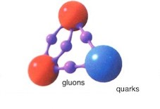
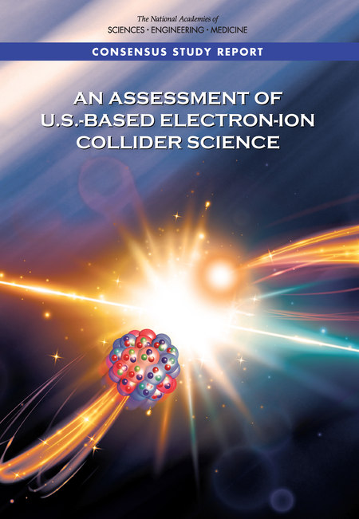
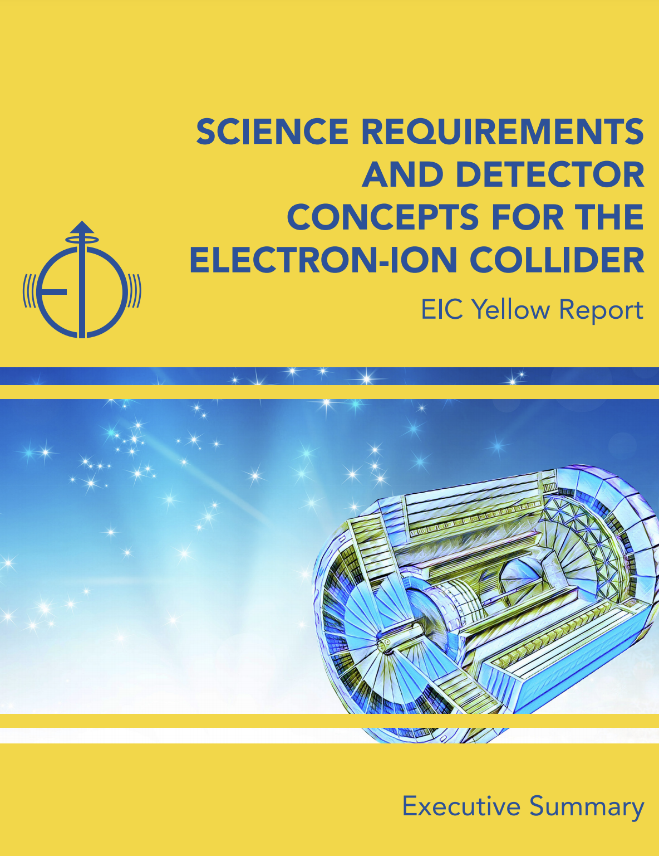
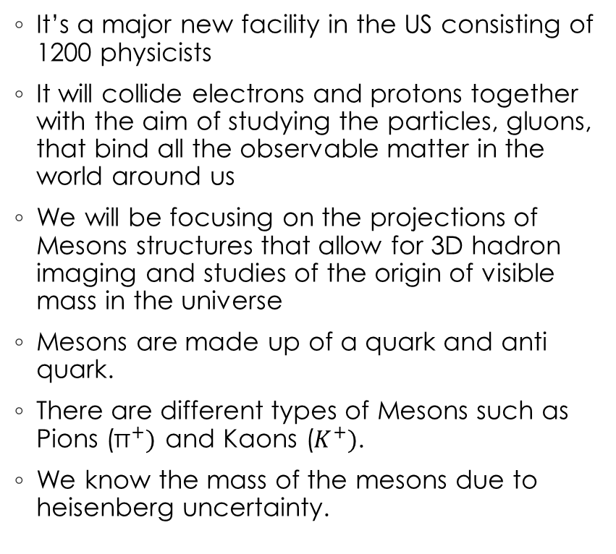
Electron Ion Collider (EIC)
It’s a major new facility in the US consisting of 1200 physicists
It will collide electrons and protons together with the aim of studying the particles, gluons, that bind all the observable matter in the world around us
We will be focusing on the projections of Mesons structures that allow for 3D hadron imaging and studies of the origin of visible mass in the universe
Mesons are made up of a quark and anti quark.
There are different types of Mesons such as Pions (${\text{π}}^{+})$ and Kaons ($K^{+})$.
We know the mass of the mesons due to heisenberg uncertainty.
More information on the EIC in the National Academies of Science Study and the EIC Yellow Report

Slide 7
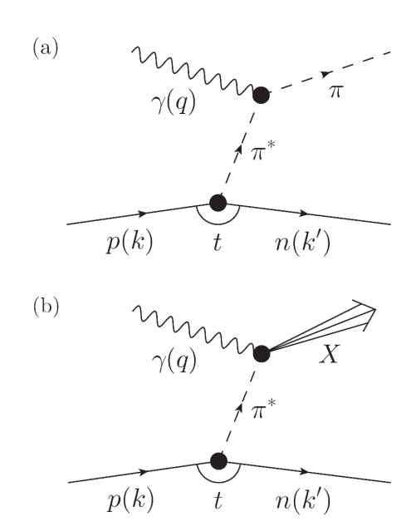
Objectives
Analyze all the different properties of pion/kion production
Produce an experiment that is going to give us large amounts of data in the fastest way possible to lower the uncertainty.
To understand the quarks and gluons and how all mass is generated by quark and gluon interactions.

Slide 8
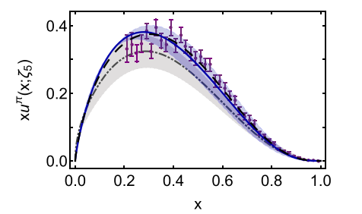
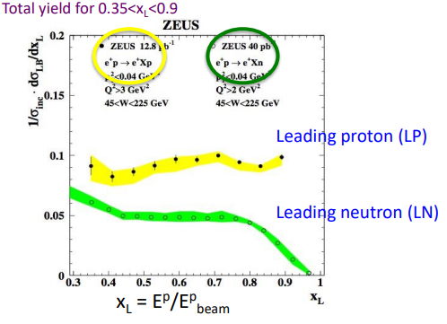
Research objectives
Been getting familiar with Meson, quarks, and QCD.
Been getting familiar with Monte Carlo simulations.
Sullivan process.
Getting familiar with python and Root

Slide 9
References
Hushchyn, M. (2021). Calorimeters. Coursera. Retrieved June 3, 2021, from https://www.coursera.org/lecture/hadron-collider-machine-learning/ calorimeters-XNa3Y
Jlab. (2021, April 19). General EEEMCal meeting summary. Jlab. Retrieved June 3, 2021, from https://wiki.jlab.org/cuawiki/index.php/ General_EEEMCal_Meeting_Summary_4/19/21
Zymphonies. (2018). The electron ion collider. Electron-ion Collider User Group. Retrieved June 3, 2021, from http://www.eicug.org/web/content/ electron-ion-collider#Strong%20force

