Slide 1
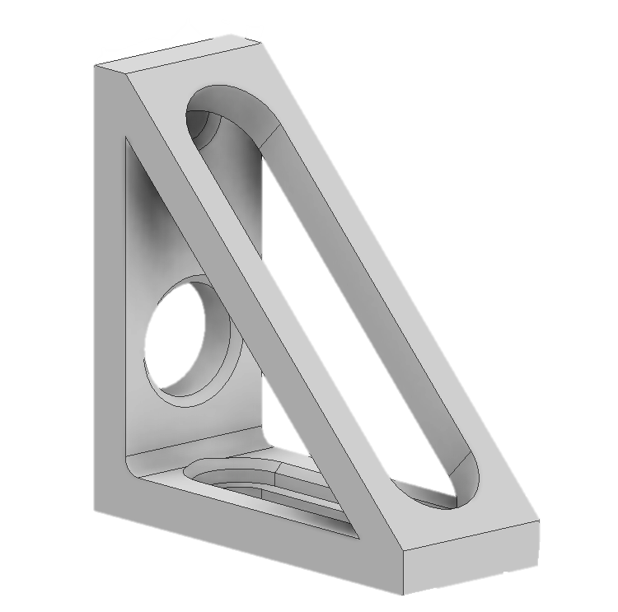
Introductory Model Design and Simulation
Familiarization with Autodesk Inventor
Using Autodesk Inventor to create 3D models
Use those models to test structural simulation for stress, and deformation
Investigate the Aerogel model and the simulation parameters used so far.

Slide 2
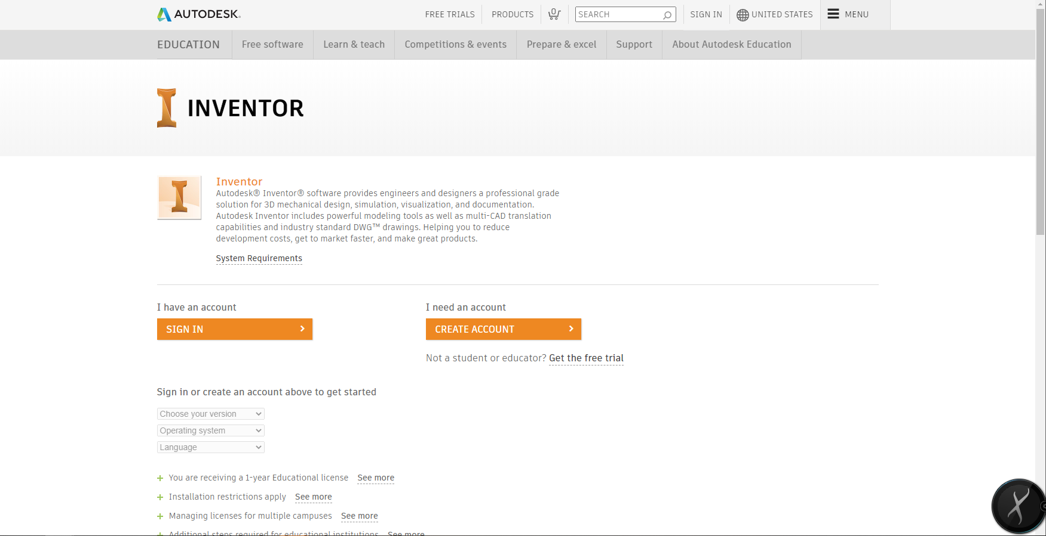
Autodesk Inventor: Download
https://www.autodesk.com/education/free-software/inventor-professional

Slide 3

Get Educational Liscence
Educational license requires a .edu email
Student or Teacher
Autodesk Inventor System Requirements
8 GB Ram
40 GB Disk Space
64-bit Windows 0S
Mac Users
Autodesk Fusion 360

Slide 4
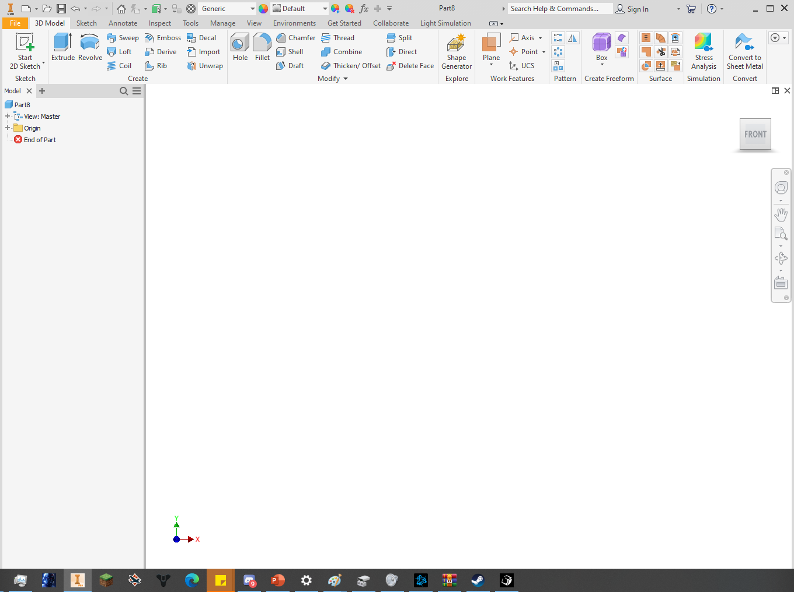
Autodesk User Interface
Toolbar
View Cube
Model Browser
Navigation Bar
Current Model Tabs

Slide 5
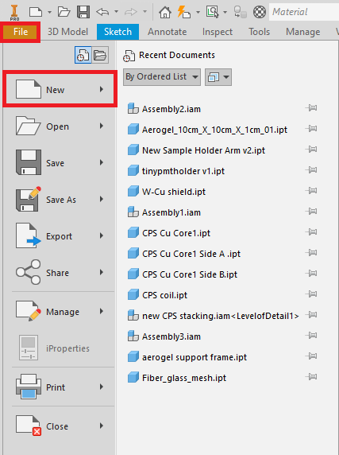
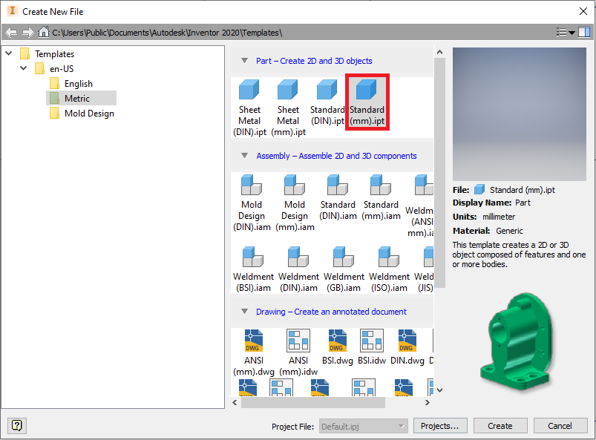
How to Create a New Model File

Slide 6
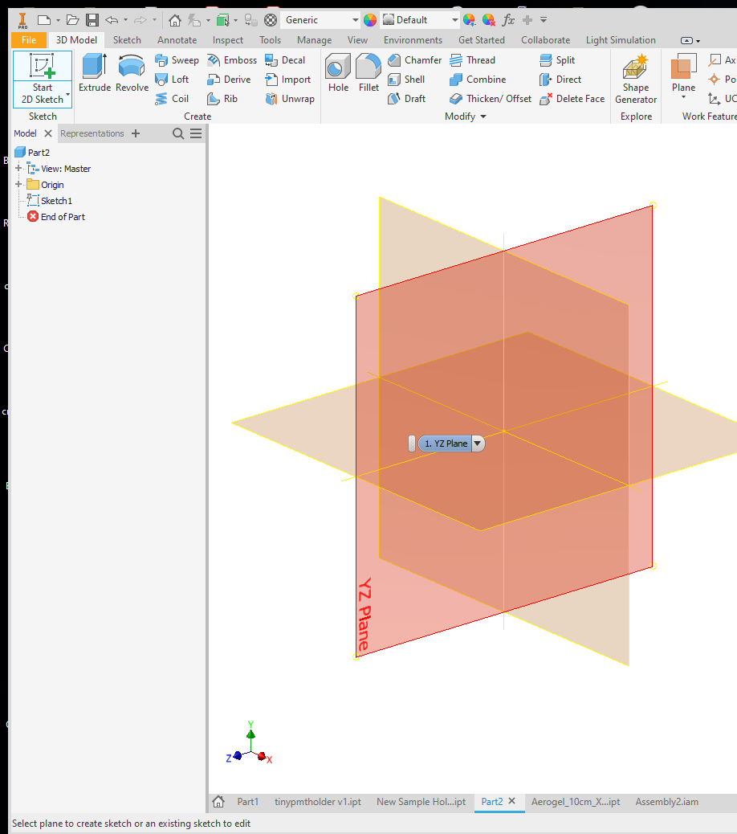
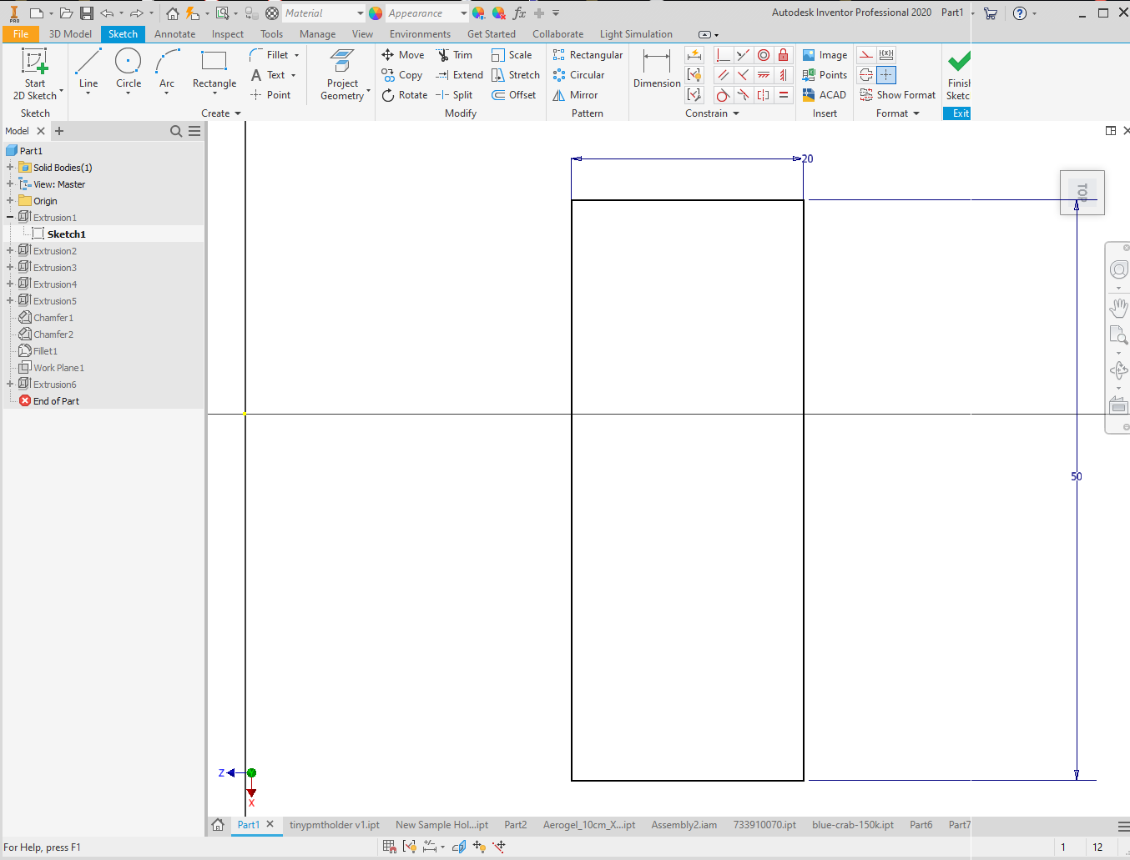
Start a 2D Sketch

Slide 7
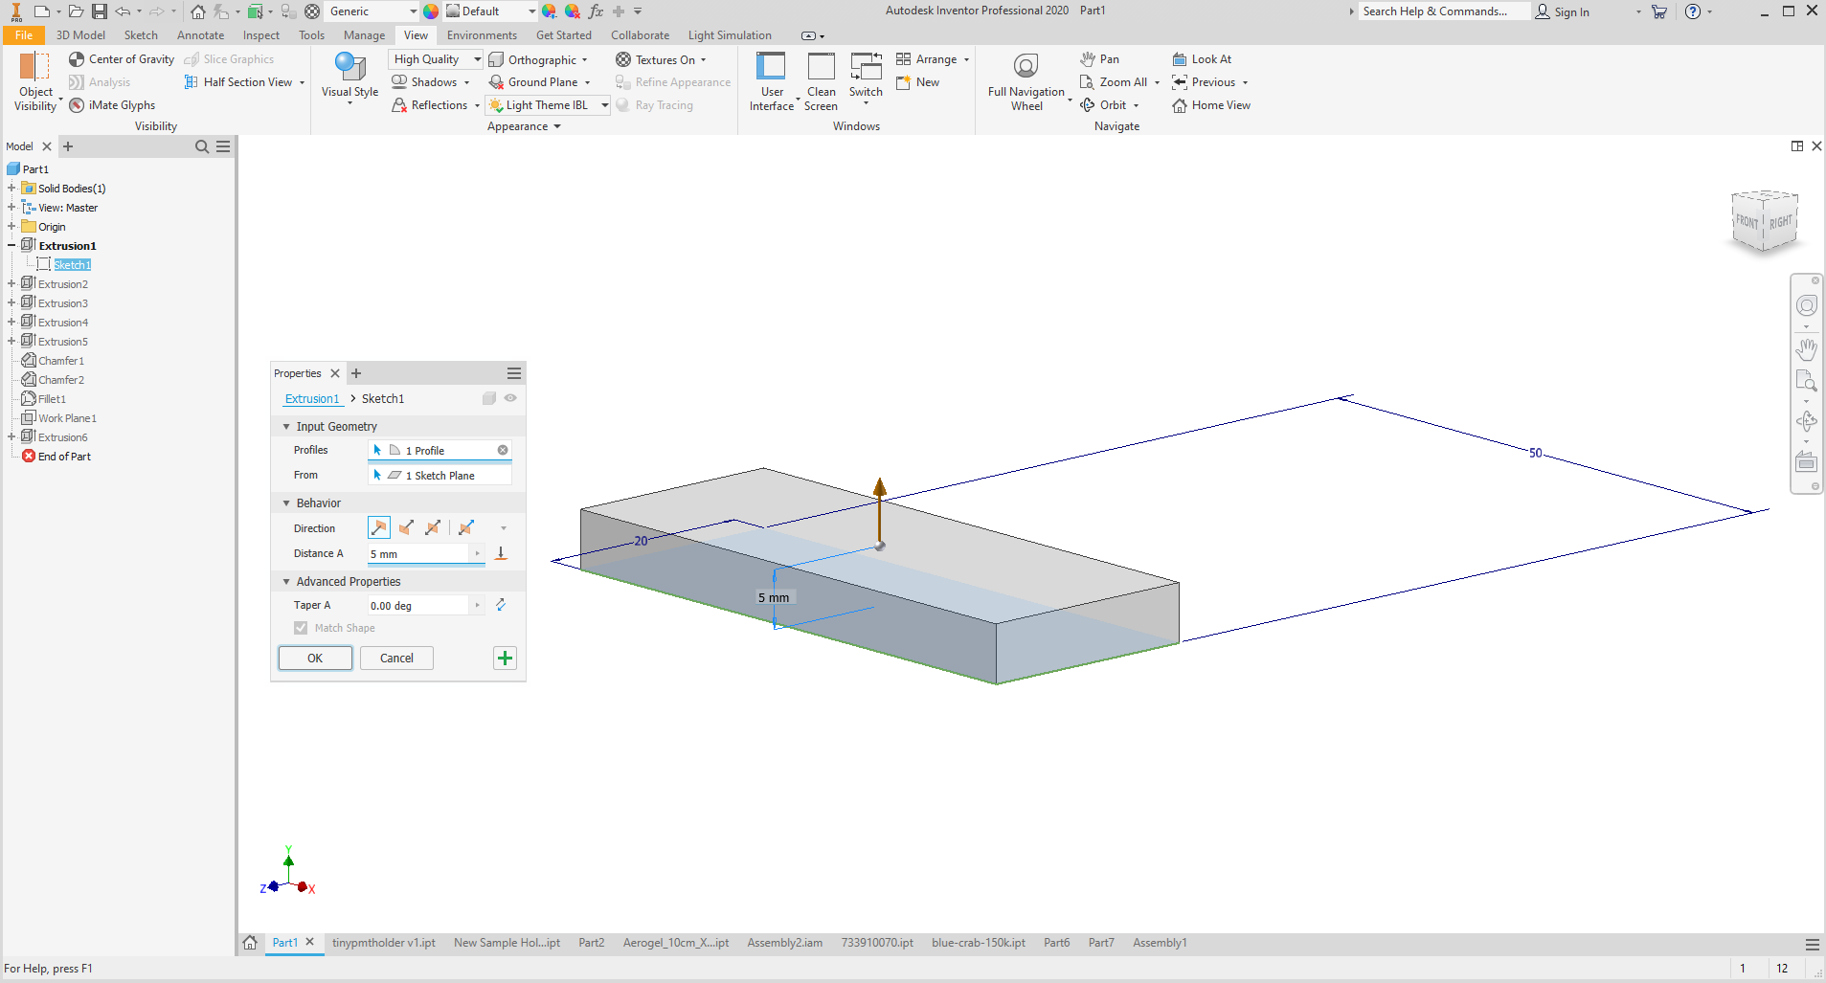
Extrude 2D Sketch into 3D

