Slide 1
Used for highlighting a key portion of portion of the user interface
Menus
Used for highlighting a step (step 2 in this example)
2
All screenshots from PowerPoint taken with zoom level in PowerPoint at 100%
All screenshots from other applications are scaled to 75% in PowerPoint. Other scales can be used when necessary for clarity.
User Task
Decision
Yes
Program Task
Start
End
No
+
Fork/Join

Slide 2
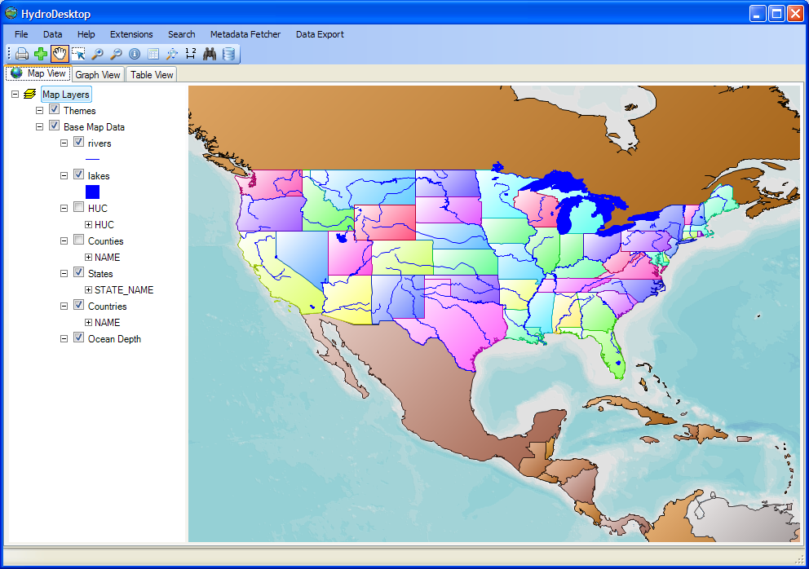
Menus
Tools
Tabs
Map Layers
Map

Slide 3
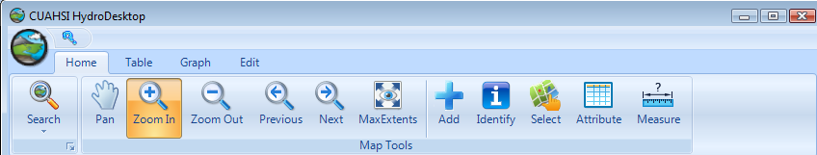
OrbMenu
Quick Access Toolbar
RibbonTab
RibbonPanel
RibbonButton

Slide 4
1. PanelManager View Layout
2. SeriesView Layout
SeriesSelector
Ribbon
Ribbon
Control added by Plugin
Control added by Plugin
PanelManager
PanelManager
SeriesView

