Slide 1
CUAHSI Domain Subsetter
Dr. Tony Castronova
Consortium of Universities for the Advancement of Hydrologic Sciences, Inc

Slide 2
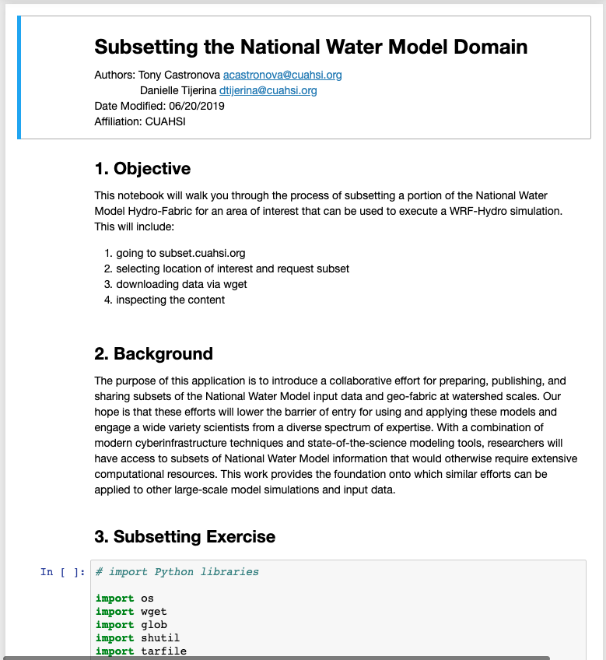
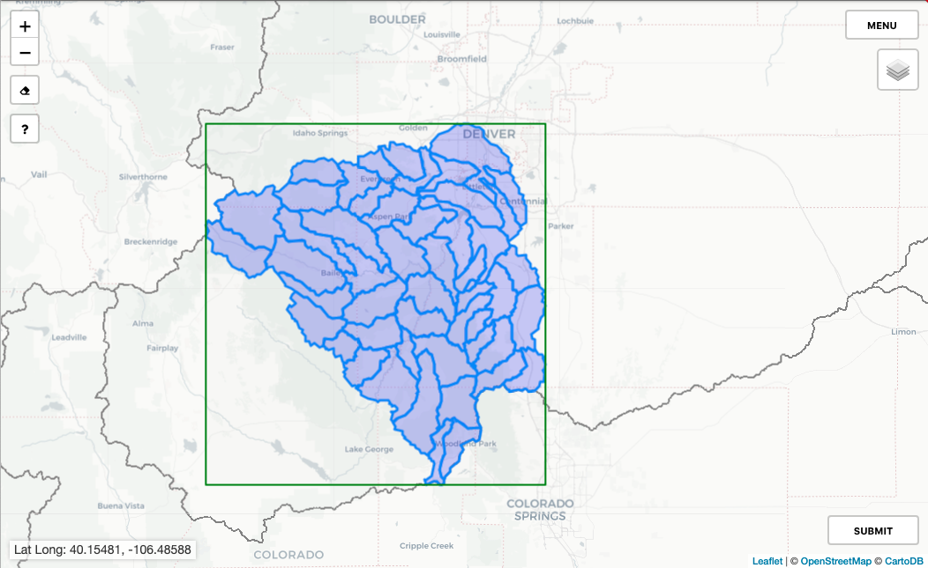
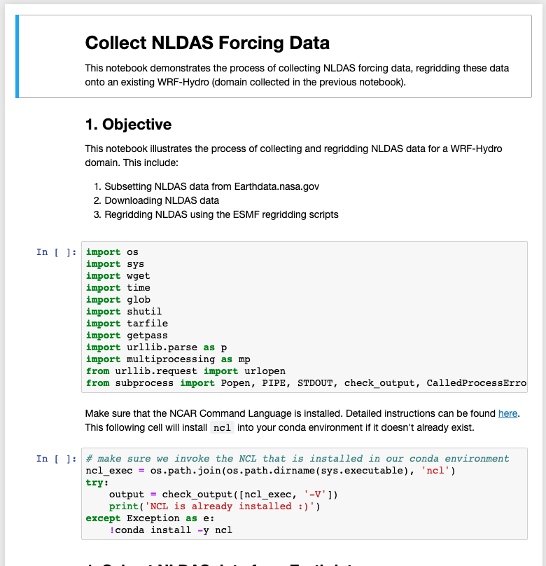
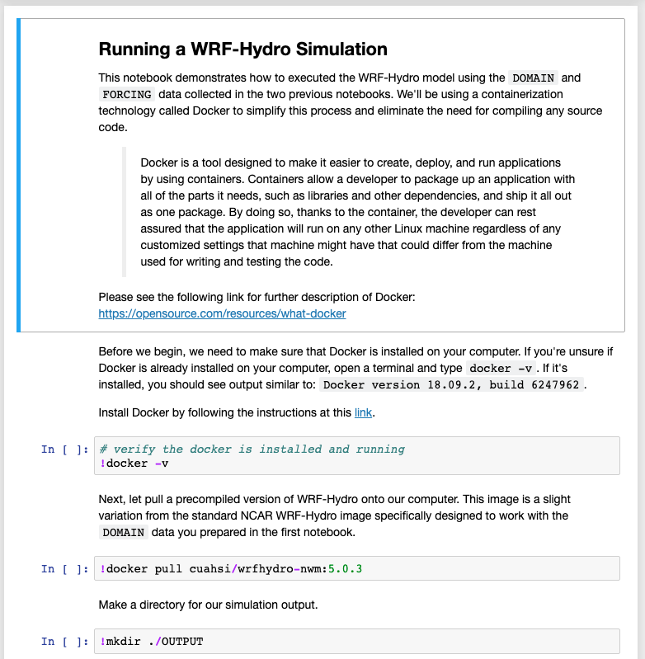
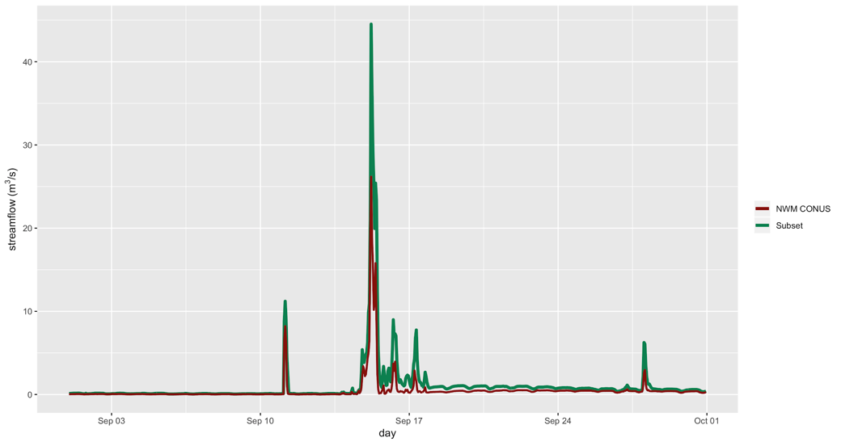
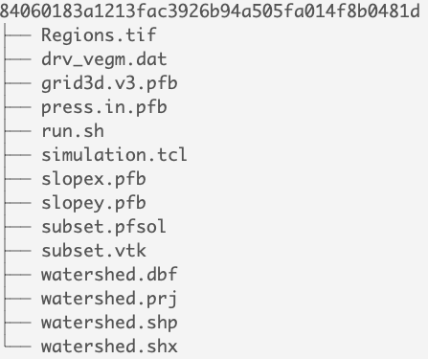
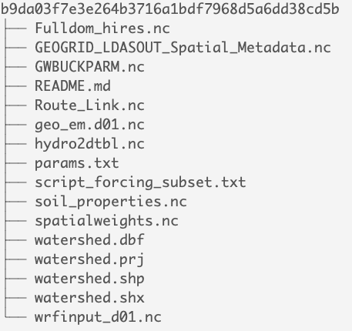
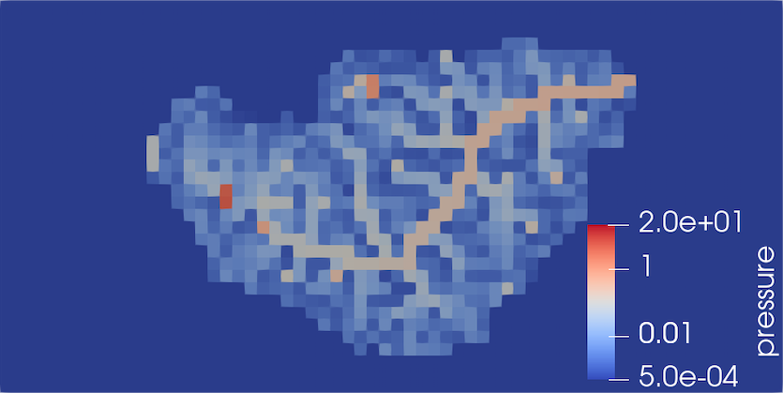
http://subset.cuahsi.org
Web interface for selecting area-of-interest
Jupyter notebooks for preparing and executing model simulations
Extracted domain datasets for NWM 1.2.2 and ParFlow-CONUS 1.0
Execute model simulations locally using Docker containers and visualize output

