Slide 1
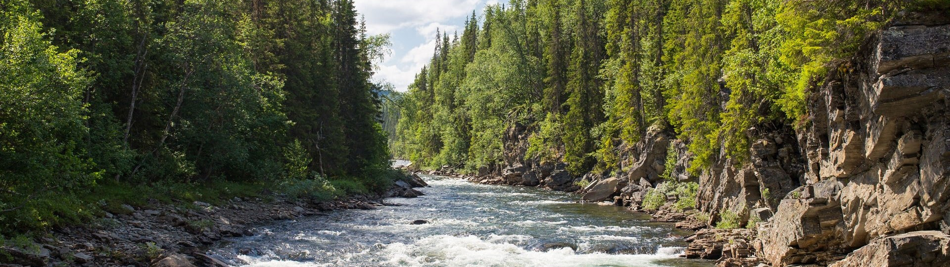


Session 1 · Module 1
Data best practices
Reproducible Workflows with Open Water Data: NASA, NOAA, USGS River Data Access
November 3, 2026
Lindsay Platt (she/her)
Environmental Data Scientist
lplatt@cuahsi.org
Notes:
TYPE: session-title
EXAMPLE SLIDE: copy it and replace the content; keep positions, fonts and colours. Session number and module on the first line, module title on the second. Date top right. Presenter block bottom right.

Slide 2





Program Schedule
November 2026
Reproducible Workflows with Open Water Data
NASA, NOAA, USGS River Data Access
Modules 1–2
Data best practices
Nov 3
2:00 ET
Federal water data landscape
Nov 5
2:00 ET
Module 3 – Access
and retrieval
NASA SWOT
Nov 10
2:00 ET
NOAA NWM
Nov 12
2:00 ET
UP NEXT
USGS WDFN
Nov 17
2:00 ET
Module 4 – Synthesis
Nov 19
2:00 ET
Peer review and demos
Dec 1, Dec 3
2:00 ET
Notes:
TYPE: program-schedule
EXAMPLE SLIDE: copy it and replace the content; keep positions, fonts and colours. Past sessions greyed out; today's session gets the green outline and UP NEXT. Move the outline each session; don't redraw the slide.

Slide 3
Learning objectives for today
Session 1 · Module 1
Data best practices
Explain open science, FAIR principles, and reproducibility best practices, and their benefits to science products and the science community.
Outline the key elements of a data management plan and articulate the benefits of publishing scientific data in an appropriate repository.
Notes:
TYPE: lesson-objectives
EXAMPLE SLIDE: copy it and replace the content; keep positions, fonts and colours. "Learning objectives for today": the session name, then the module's learning objectives copied word for word from its overview page. The only place in the deck the objectives appear.

Slide 4
Some good practices for sharing reusable code
Describe all code files in a README file
Think through (and document!) the end goal and the intended audience
  E.g., providing a step-by-step guide for readers of your published study interested in adapting parts of your workflow
Understand and document the constraints for using code
  Computational constraints (e.g., package and programming language versions)
  Application-specific constraints (e.g., spatial or temporal subsetting)
Try to limit the amount of dependencies and specialized packages
Notes:
TYPE: content-text
EXAMPLE SLIDE: copy it and replace the content; keep positions, fonts and colours. Plain title, up to 6 bullets; bold the key phrase in a bullet.

Slide 5
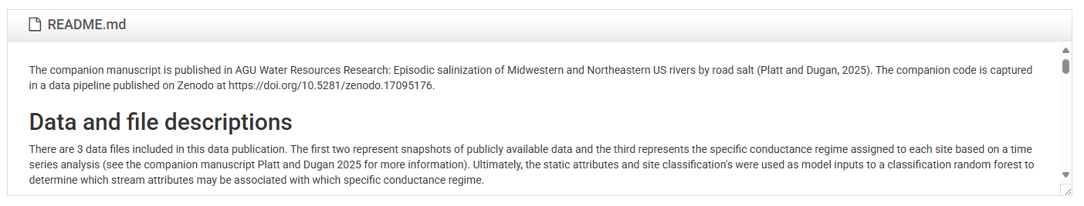
What is a README file?
The homepage of your dataset!
  Called a “README” because it invites you to “READ ME FIRST”
  Common in coding repositories, such as GitHub and software libraries
HydroShare will automatically render a preview of the README if included
Give your users a quick overview of the files, introduction to what the resource contains and how they can use it, and other metadata as you see fit.
Notes:
TYPE: content-figure
EXAMPLE SLIDE: copy it and replace the content; keep positions, fonts and colours. Slate header bar with a white title, one figure or screenshot below. Credit line in small grey text at the bottom if the figure is borrowed.

Slide 6
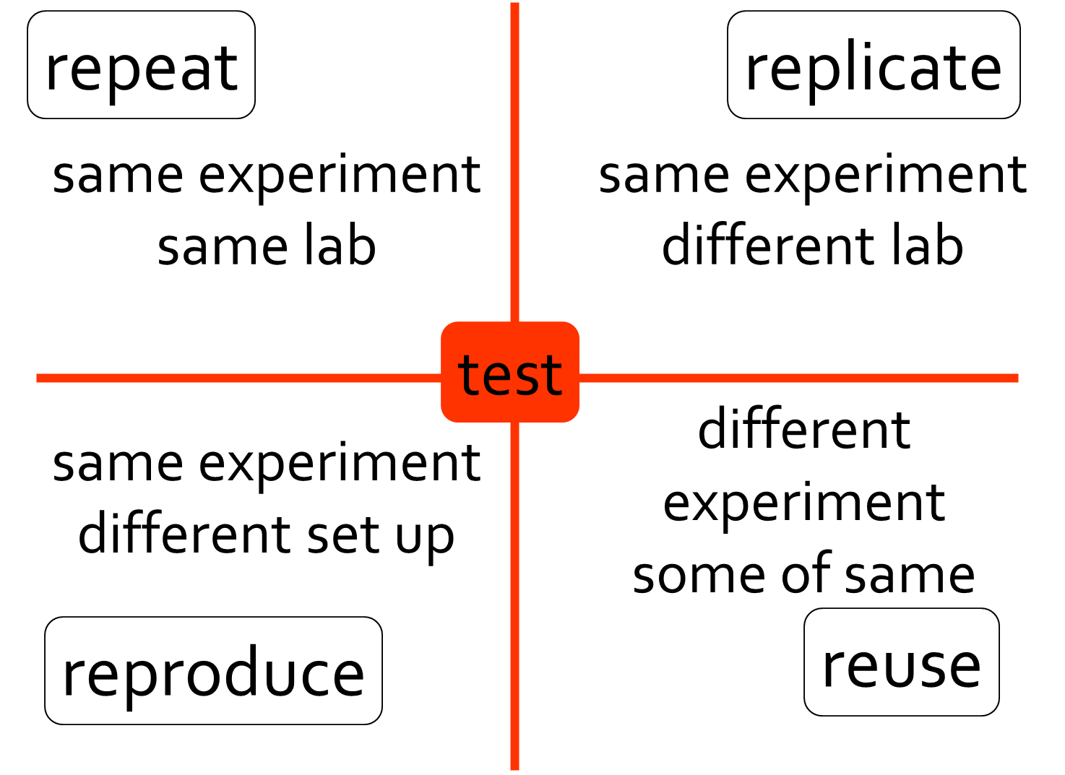
Computational science is hard to make truly reusable
CUAHSI compute services help enable reusability
Figure by Carole Goble adapted from Drummond C, Replicability is not Reproducibility: Nor is it Good Science, online
and Peng RD, Reproducible Research in Computational Science Science 2 Dec 2011: 1226-1227.
Notes:
TYPE: content-highlight
EXAMPLE SLIDE: copy it and replace the content; keep positions, fonts and colours. A figure with one outline (no fill) drawing the eye to the part being discussed, plus a short side note. Use this pattern for spotlight builds.

Slide 7
A couple primer questions!
Does your research group have existing best practices for reusability of data analysis workflows?
Notes:
TYPE: statement
EXAMPLE SLIDE: copy it and replace the content; keep positions, fonts and colours. Slate, centred: a heading and one or two sentences (italic for the question or turn).

Slide 8
Meet NASA SWOT
Notes:
TYPE: section-divider
EXAMPLE SLIDE: copy it and replace the content; keep positions, fonts and colours. Slate, one large bold title. Opens a lesson or a block of topics.

Slide 9
Activity 1
Upload a file or folder to your HydroShare resource.
Choose something smallish for now.
You can always delete and rename this later after we get through the organizational best practices.
Notes:
TYPE: activity
EXAMPLE SLIDE: copy it and replace the content; keep positions, fonts and colours. "Activity N" large and bold, then the task with its time and short steps.

Slide 10
Live coding: find SWOT data
Run the sections "Find datasets" to "Find RiverSP granules over the Ohio at Louisville".
module-03_lesson-01_retrieve-nasa-swot-data.ipynb
Notes:
TYPE: live-coding
EXAMPLE SLIDE: copy it and replace the content; keep positions, fonts and colours. Like an activity: the notebook file, and the sections to run. Points to make go in the notes.

Slide 11
Find datasets
Find cloud-hosted river datasets over the site; keep the SWOT ones:
# Datasets matching "river" that are in the cloud and cover the site during the window
river_datasets = earthaccess.search_datasets(
keyword="river",
cloud_hosted=True,
bounding_box=site_bbox,
temporal=(start, end),
)
short_names = [d["umm"]["ShortName"] for d in river_datasets]
print(len(short_names), "datasets;", "SWOT ones:")
sorted(name for name in short_names if name.startswith("SWOT"))
Notes:
TYPE: code
EXAMPLE SLIDE: copy it and replace the content; keep positions, fonts and colours. At most 12 lines, copied from the lesson, in the black block (Courier New, white). One sentence above it saying what the code does.

Slide 12
Organizing files and folders for reuse
Key takeaways
Think like a future user
Name files clearly and consistently
Group logically
Avoid overly compressed abbreviations or define them in your metadata
Use consistent naming patterns to reflect relationships and workflow
Group files to organize by how someone would use them and reduce clutter
Include contextual or “informational” files (e.g., shapefiles, metadata tables).
station01_nitrate.csv
Station01_ph.csv
station01_temp.csv
station02_nitrate.csv
station02_ph.csv
station02_temp.csv
station03_nitrate.csv
station03_ph.csv
station03_temp.csv
...
temperature/
station01_temp.csv
station02_temp.csv
station03_temp.csv
nitrate/
station01_nitrate.csv
station02_nitrate.csv
station03_nitrate.csv
pH/
station01_ph.csv
station02_ph.csv
Notes:
TYPE: before-after
EXAMPLE SLIDE: copy it and replace the content; keep positions, fonts and colours. The problem in dark red, an arrow, the fix in dark green. Here inside a Key takeaways reveal build: the takeaways stay put, one example is added per slide.

