Slide 1
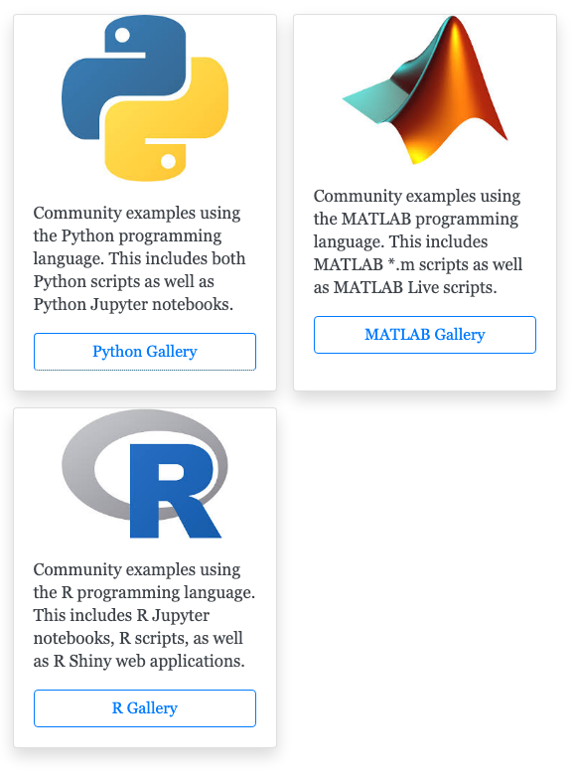
Compute and Modeling Gallery
Gallery of community examples
Jupyter Notebooks (Python, R)
MATLAB Live Scripts (*.mlx, *.m)
Web applications (R Shiny)
Multiple sub-categories
Instructional, Reproducible Science, Research-oriented, Practitioner-oriented
Community curated
Clear guidelines for contributing content
Dissemination, Outreach, and Education
Browse examples by sub-category for the chosen programming language.
Notes:
The compute gallery is a website designed for published code and workflows.
Content in this gallery will initially feature code and workflows that use CUAHSI data services (e.g. HIS and HydroShare), CUAHSI compute services (e.g. JupyterHub, MATLAB Online)
Over time this may be expanded to feature content that does not use CUAHSI services. This will be evaluated by community demand.
Gallery content is organized into subcategories for each searching:
Instructional: education-focus content, e.g. data analysis, modeling, scientific libraries, course material, etc.
Reproducible Science: content that aims to satisfy the “R” in F.A.I.R., e.g. published research
Research-oriented: scientific research that doesn’t fit into the “Reproducible Science” category and topics that focus on general research topics, e.g. modeling with WRF-Hydro, Parflow, or SUMMA.
Practitioner-oriented: content focused on water-science discipled-specific topics.
One goal of this gallery is to establish a framework (and SOP) that encourages the CUAHSI community to contribute examples and maintain some level of ”ownership”
High-level Goals
Dissemination of scientific findings, published research, and satisfying FAIR principals.
Improving CUAHSI’s ability to engaging with the water science community regarding ongoing compute/modeling efforts
Establish a community repository for educational reference materials that can be use by instructors, students, and practitioners

