Slide 1

Using Machine Learning for Pharmacovigilance:
A Systematic Review
2022.05.24
발표자 : 하희정

Slide 2
1. Background & Research objective

Slide 3
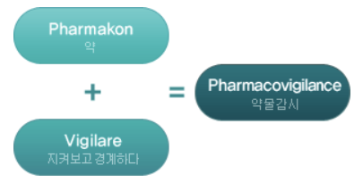
1. Background & Research objective
1. Background
Pharmacovigilance
“ The science and activities relating to the detection, assessment, understanding, and prevention of adverse effects or any other drug-related problems ” (FDA, 2017)
의약품 등의 이상사례 또는 안전성 관련 문제의 탐지·평가·해석·예방에 관한 과학적 활동
“ 의약품의 안전성정보 수집에서부터 위해 관리에 이르기까지 의약품의 전 주기를 거쳐서 이어지는 활동 “ (한국의약품안전관리원)

Slide 4
1. Background & Research objective
1. Background
Traditional Pharmacovigilance System
Reporting to the authorities, pharmaceutical companies, or medical professionals.
[Limitations]
Not obligation (for patients)
Collecting information about Second-hand experience
Significant cost
“The Korea Adverse Event Reporting System (KAERS)”
한국의약품안전관리원

Slide 5
1. Background & Research objective
“ Improving Pharmacovigilance Using Natural Language Processing (NLP)“
NLP: powerful methods and algorithms , which enabled the processing and understanding of human-generated text
vast amounts of textual data are generated on blogs, forums, and social media
→ “ user-generated content “
Sentiment analysis
Summarization
Clustering texts
Classification
Predicting words or other lexical units (as part of a word processor or chatbot)
Extraction of concepts, entities, and the relationships between them

Slide 6
1. Background & Research objective
“ Improving Pharmacovigilance Using Natural Language Processing (NLP)“
Text Preprocessing
2) Feature Vectorization
3) Machine Learning Modeling
Using Machine Learning for Pharmacovigilance: A Systematic Review

Slide 7
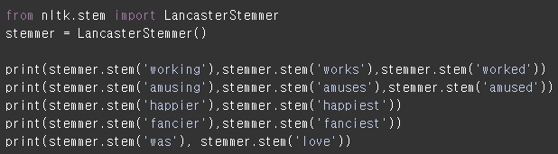
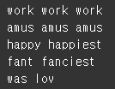
1. Background & Research objective
Text Preprocessing
• many standard NLP techniques cannot be applied to unstructured textual data
• Text mining is applied as pre-processing for unstructured data
(a) Text Tokenization
the separation of text into smaller units, like words, characters, or sub-words (n-grams)
(b) Stop word removal (불용어 제거)
the removal of words carrying very little meaning; and such as pronouns
ex) the, a, an, is, I, my 등과 같이 문장을 구성하는 필수 요소지만 문맥적으로 큰 의미가 없는 단어
제거
(c) Stemming & Lemmatization (어간 추출, 표제어 추출)
the process of reducing the complexity of text, “단어의 원형을 찾는 것”
•stemming: 단어로 부터 어간(Stem)을 추출
•lemmatization: 품사와 같은 문법적인 요소와 더 의미적인 부분을 감안, 더 정확히 어근 추출
Using Machine Learning for Pharmacovigilance: A Systematic Review

Slide 8
2. Article example

Slide 9

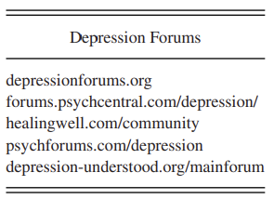
2. Article example
A) Initial Data Search and Collection
Assessing Antidepressants Using Intelligent Data

Slide 10
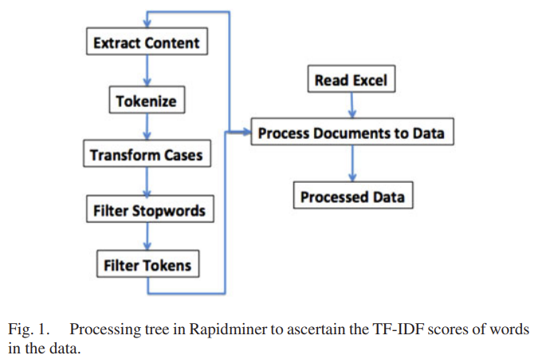
2. Article example
B) Text Mining, Preprocessing, and Tagging
Text Mining
the analysis of textual data, such as unstructured or semi-structured text, with the purpose to extract hidden patterns and information
Assessing Antidepressants Using Intelligent Data

Slide 11
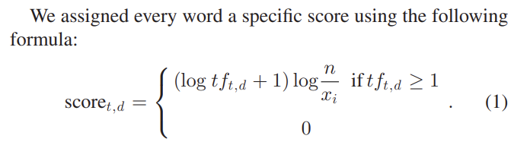

2. Article example
TF-IDF
(Term Frequency - Inverse Document Frequency)
“We represented the data with a vector set that contained the term’s TF-IDF scores
in the wordlists”
Assessing Antidepressants Using Intelligent Data
Notes:
TF-IDF는 개별 문서에서 자주 등장하는 단어에 높은 가중치를 주되, 모든 문서에서 전반적으로 자주 등장하는 단어에 대해서는 페널티를 주는 방식으로 값을 부여합니다.
모든 문서에서 자주 등장하는 단어에는 페널티를 주고, 해당 문서에서만 자주 등장하는 단어에 높은 가중치를 주는 방식입니다.
그렇게 함으로써 해당 단어가 실질적으로 중요한 단어인지 검사하는 것입니다.
문서의 양이 많을 경우에는 일반적으로 카운트 기반의 벡터화보다 TF-IDF 방식의 벡터화를 사용합니다.

Slide 12
2. Article example
C) Semantic Similarity of User Postings
we viewed a TF-IDF vector as the semantic profile of each post
Various measures of similarities can be derived to reflect how close the semantic profiles of two posts are, e.g., Euclidian distance or correlation
Clustering analysis can be performed to identify groups of similar semantic profiles
→ We used k-means clustering to roughly group the semantic profiles of all posts
from our forum

Slide 13
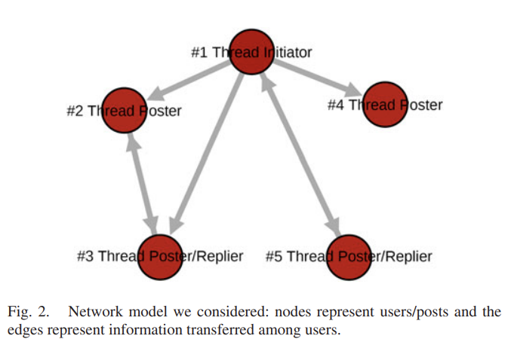
2. Article example
D) Network-Based Modeling of Forum Postings
• The modeling approach aimed at reflecting
user interactions while simultaneously considering the posts’ semantic content.
context
• A reading of the posts that were connected
with the larger weighted degrees has revealed
a similarity in the choice of topics discussed.
direct
“Reply” option
How user-generated content on a depression-related forum can be used for modeling the exchange of information between users about drug-related treatments for depression

Slide 14
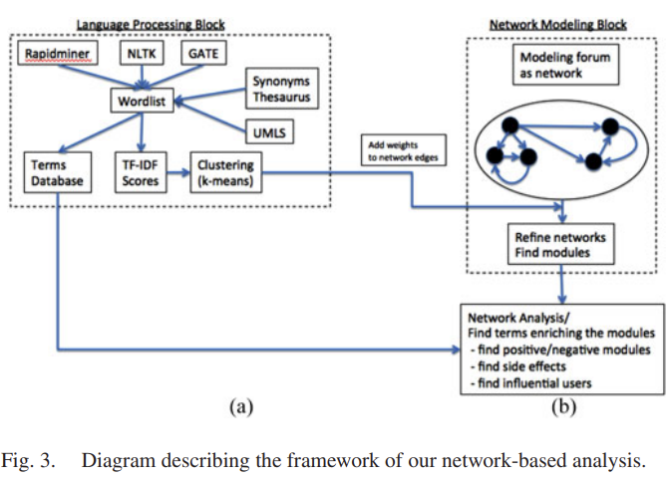
2. Article example

Slide 15
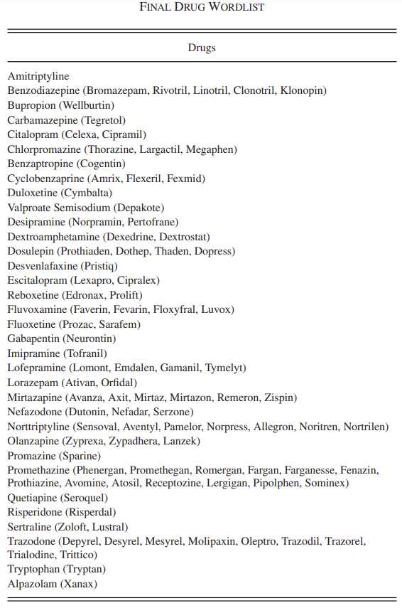
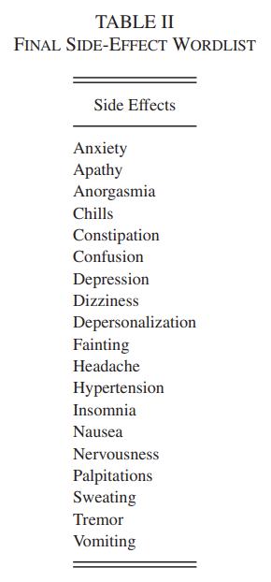
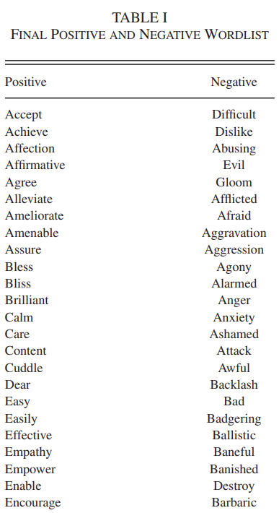
2. Article example

Slide 16
THANK YOU
FOR YOUR
ATTENTION
Notes:
네 이상, 발표를 마치겠습니다. 감사합니다.

