Slide 1

CUAI 개인연구 발표
2022.05.31
발표자 : 김병찬

Slide 2

Audio Data
Introduce
Feature Extraction
Classification
To next

Slide 3
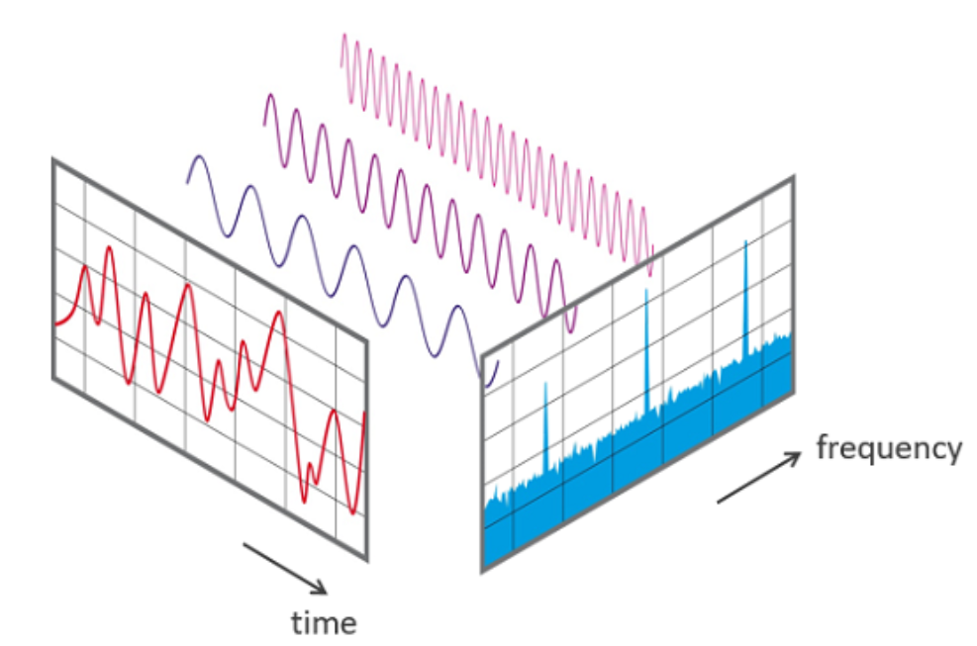

Introduce
Height
Channel
Width

Slide 4
Feature Extraction
- High level
- Instantaneous
Temporal
Scope
Level of
Abstraction
- Segement-level
- Mid level
- Low level
- Gloabal
- Zero crossing rate
- Band energy ratio
Time
Domain
- Amplitude envelope
Frequency
Domain
- Spectral centroid
- RMS energy
- Spectral flux
- Spectogram
Time + Frequency
Domain
- MFCC

Slide 5
Feature Extraction
- High level
- Instantaneous
Temporal
Scope
Level of
Abstraction
- Segement-level
- Mid level
- Low level
- Gloabal
- Zero crossing rate
- Band energy ratio
Time
Domain
- Amplitude envelope
Frequency
Domain
- Spectral centroid
- RMS energy
- Spectral flux
- Spectogram
Time + Frequency
Domain
- MFCC

Slide 6
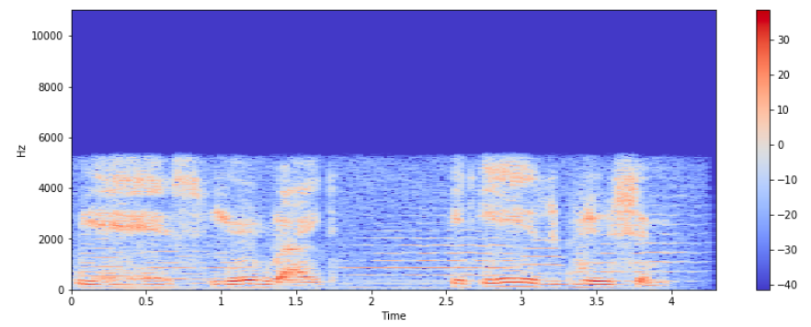
Spectrogram
Visual way of representing the signal strength, or “loudness”, of a signal over time at various frequencies present in a particular waveform.
A spectrogram is usually depicted as a heat map

Slide 7
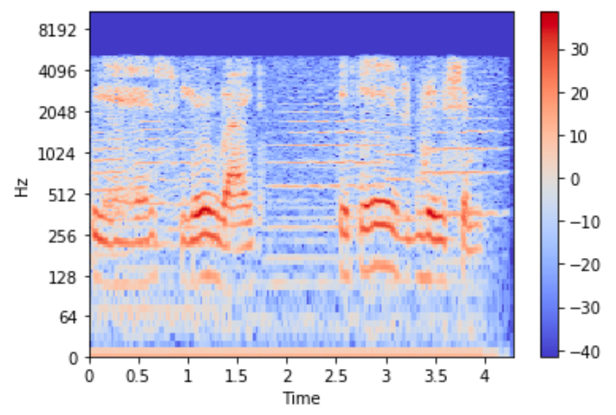
Spectrogram
Visual way of representing the signal strength, or “loudness”, of a signal over time at various frequencies present in a particular waveform.
A spectrogram is usually depicted as a heat map

Slide 8
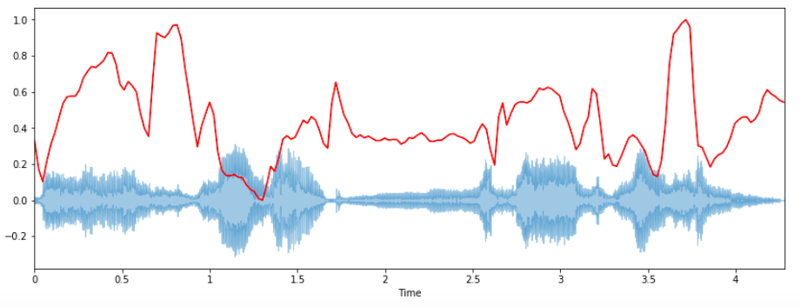
Spectral Centroid
The spectral centroid indicates at which frequency the energy of a spectrum is centered upon or in other words
It indicates where the ” center of mass” for a sound is located.

Slide 9
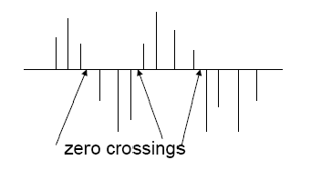
Zero crossing rate
- Signal changes from positive
to 0 to negative or from nega-
tive to zero to positive
- Its value has been widely us-
ed in both speech recognition
and music information retrie-
val

Slide 10
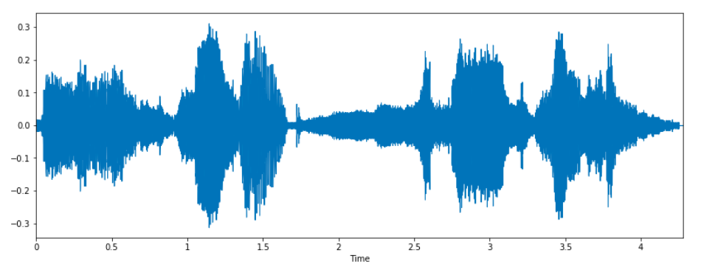
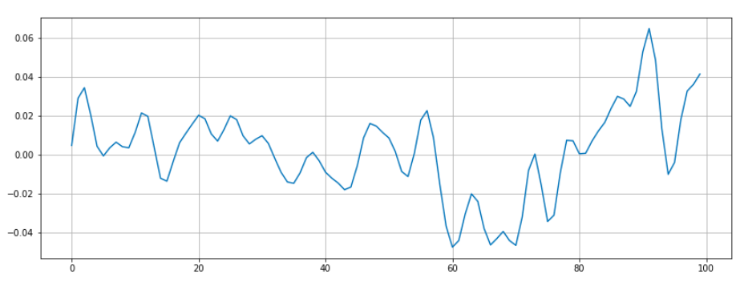
Zero crossing rate
- Signal changes from positive
to 0 to negative or from nega-
tive to zero to positive
- Its value has been widely us-
ed in both speech recognition
and music information retrie-
val

Slide 11
Classification
Goal :
Music Genre Classification
Dataset : Musical genre classification of audio signals” by G. Tzanetakis and P. Cook in IEEE Transactions on Audio and Speech Processing 2002
: 1000 audio tracks each 30 seconds long. It contains 10 genres, each represented by 100 tracks. The tracks are all 22050 Hz monophonic 16-bit audio files in .wav format.

Slide 12
Classification
Goal :
Music Genre Classification
1. Convert the audio files into spectrograms
2. From these spectrograms, extract the
meaningful feautures
3. Once feature extracted, adapt the neural
model

Slide 13
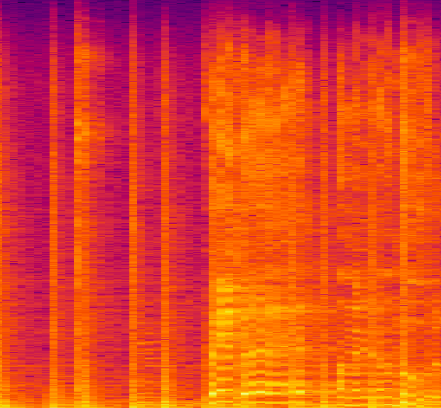
Classification
y, sr = librosa.load(songname, mono=True, duration=5)
plt.specgram(y, NFFT=2048, Fs=2, Fc=0, noverlap=128, cmap=cmap,
sides='default', mode='default', scale='dB’);
plt.axis('off’);
plt.savefig(f'img_data/{g}/{filename[:-3].replace(".", "")}.png’)
plt.clf()
Blues spectrogram

Slide 14
Classification
for filename in os.listdir(f'./drive/My Drive/genres/{g}’):
songname = f'./drive/My Drive/genres/{g}/{filename}’
y, sr = librosa.load(songname, mono=True, duration=30)
rmse = librosa.feature.rmse(y=y)
chroma_stft = librosa.feature.chroma_stft(y=y, sr=sr)
spec_cent = librosa.feature.spectral_centroid(y=y, sr=sr)
spec_bw = librosa.feature.spectral_bandwidth(y=y, sr=sr)
rolloff = librosa.feature.spectral_rolloff(y=y, sr=sr)
zcr = librosa.feature.zero_crossing_rate(y)
mfcc = librosa.feature.mfcc(y=y, sr=sr)

Slide 15
Classification
model = Sequential()
model.add(layers.Dense(256,activation='relu’,
input_shape=(X_train.shape[1],)))
model.add(layers.Dense(128, activation='relu'))
model.add(layers.Dense(64, activation='relu'))
model.add(layers.Dense(10, activation='softmax’))
classifier = model.fit(X_train,
y_train,
epochs=100,
batch_size=128)
After 100 epochs, Accuracy: 0.67!!

Slide 16
Classification
import librosa
import pandas as pd
import numpy as np
import matplotlib.pyplot as plt
Import tensorflow as tf
%matplotlib inline
import os
from PIL import Image
import pathlib
import csv
from sklearn.model_selection import train_test_split
from sklearn.preprocessing import LabelEncoder, StandardScaler
from tensorflow import keras
from keras import layers
from keras.models import Sequential
import warnings
warnings.filterwarnings('ignore')

Slide 17
Classification
cmap = plt.get_cmap('inferno’)
plt.figure(figsize=(8,8))
genres = 'blues classical country disco hiphop jazz metal pop reggae rock'.split()
for g in genres:
pathlib.Path(f'img_data/{g}').mkdir(parents=True, exist_ok=True)
for filename in os.listdir(f'./drive/My Drive/genres/{g}’):
songname = f'./drive/My Drive/genres/{g}/{filename}’
y, sr = librosa.load(songname, mono=True, duration=5)
plt.specgram(y, NFFT=2048, Fs=2, Fc=0, noverlap=128, cmap=cmap,
sides='default', mode='default', scale='dB’);
plt.axis('off’);
plt.savefig(f'img_data/{g}/{filename[:-3].replace(".", "")}.png’)
plt.clf()

Slide 18
Classification
header = 'filename chroma_stft rmse spectral_centroid spectral_bandwidth
rolloff zero_crossing_rate'
for i in range(1, 21):
header += f' mfcc{i}'
header += ' label'
header = header.split()
genres = 'blues classical country disco hiphop jazz metal pop
reggae rock'.split()

Slide 19
Classification
for g in genres:
for filename in os.listdir(f'./drive/My Drive/genres/{g}’):
songname = f'./drive/My Drive/genres/{g}/{filename}’
y, sr = librosa.load(songname, mono=True, duration=30)
rmse = librosa.feature.rmse(y=y)
chroma_stft = librosa.feature.chroma_stft(y=y, sr=sr)
spec_cent = librosa.feature.spectral_centroid(y=y, sr=sr)
spec_bw = librosa.feature.spectral_bandwidth(y=y, sr=sr)
rolloff = librosa.feature.spectral_rolloff(y=y, sr=sr)
zcr = librosa.feature.zero_crossing_rate(y)
mfcc = librosa.feature.mfcc(y=y, sr=sr)
to_append = f'{filename} {np.mean(chroma_stft)} {np.mean(rmse)}
{np.mean(spec_cent)} {np.mean(spec_bw)} {np.mean(rolloff)} {np.mean(zcr)}’
for e in mfcc:
to_append += f' {np.mean(e)}’
to_append += f' {g}’
file = open('dataset.csv', 'a', newline=‘’)
with file:
writer = csv.writer(file)
Writer.writerow(to_append.split())

Slide 20
Classification
data = pd.read_csv('dataset.csv')
data.head()# Dropping unneccesary columns
data = data.drop(['filename'],axis=1)#Encoding the Labels
genre_list = data.iloc[:, -1]
encoder = LabelEncoder()
y = encoder.fit_transform(genre_list)#Scaling the Feature columns
scaler = StandardScaler()
X = scaler.fit_transform(np.array(data.iloc[:, :-1], dtype = float))
X_train, X_test, y_train, y_test = train_test_split(X, y, test_size=0.2)

Slide 21
Classification
model = Sequential()
model.add(layers.Dense(256, activation='relu’,
input_shape=(X_train.shape[1],)))
model.add(layers.Dense(128, activation='relu'))
model.add(layers.Dense(64, activation='relu'))
model.add(layers.Dense(10, activation='softmax’))
model.compile(optimizer='adam’,
loss='sparse_categorical_crossentropy’,
metrics=['accuracy’])
classifier = model.fit(X_train,
y_train,
epochs=100,
batch_size=128)
model.evaluate(X_test, y_test)

Slide 22

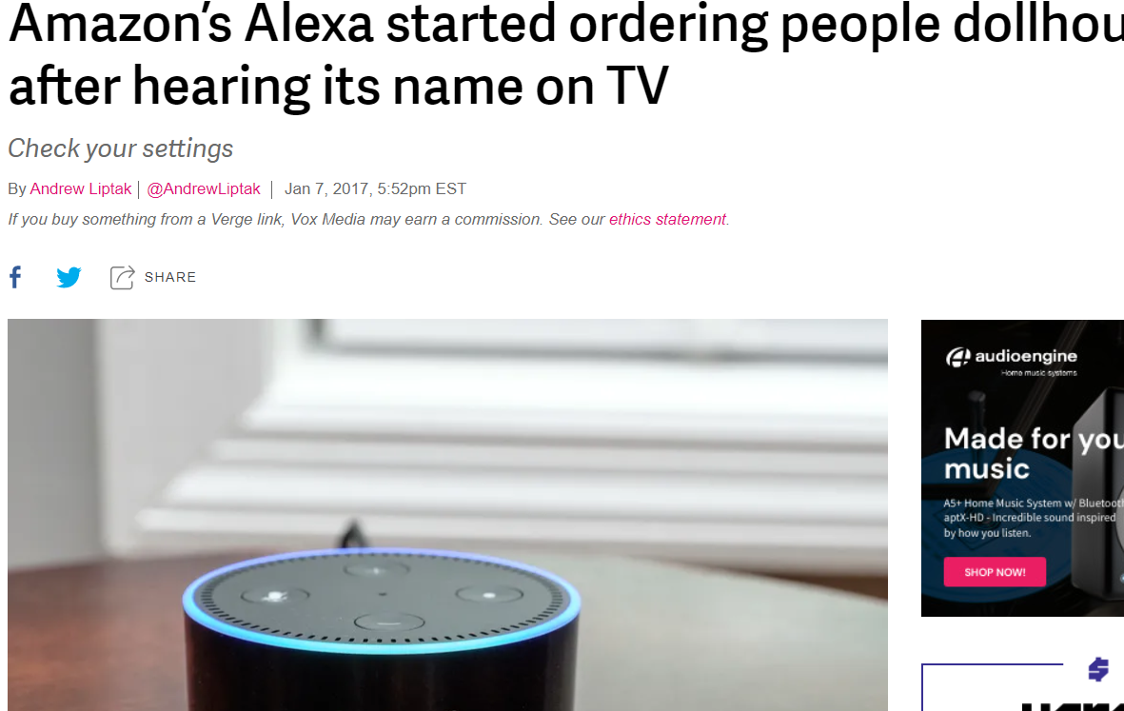
To Next

