Slide 1
Predictive Auxiliary Classifier Generative Adversarial Network for Estimating Stock Prices
Jiwook Kim
Minhyeok Lee

Slide 2
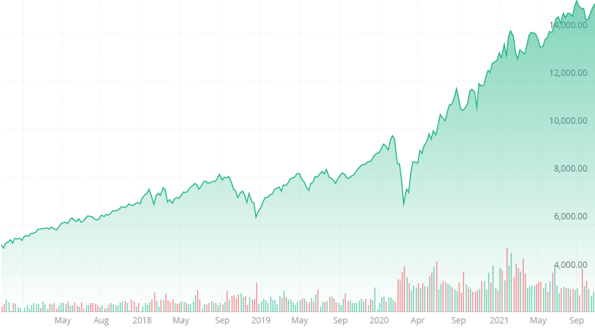
What to solve
We want to predict stock prices.

Slide 3
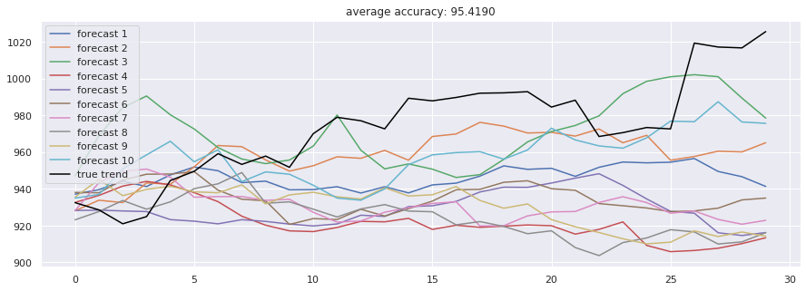
What to solve
Prediction of LSTM.

Slide 4
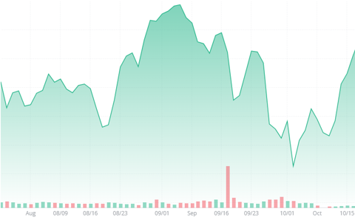
What to solve
present
We want to predict red circle’s price.
But conventional deep learning methods are point estimation.

Slide 5

What to solve
present
By using GAN, we can output by form of distribution.

Slide 6
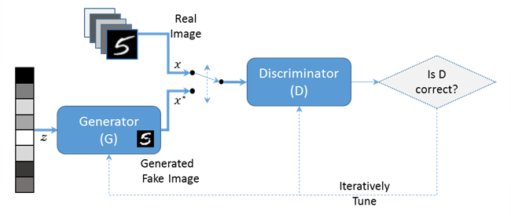
Generative Adversarial Nets (GAN)
GAN is composed of a generator and discriminator.
The generator is trained to deceive the discriminator and the discriminator is trained to distinguish successfully.

Slide 7
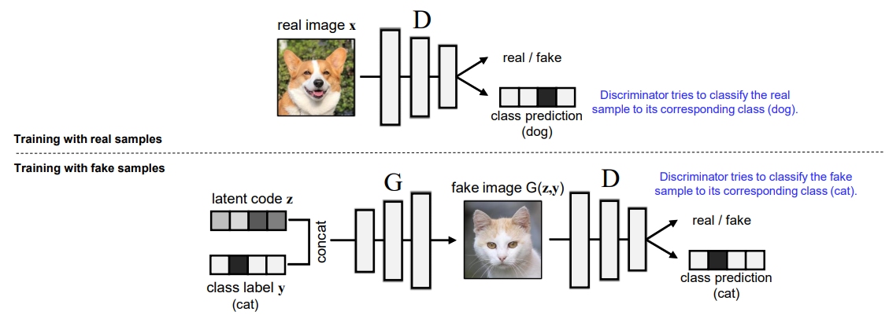
Auxiliary Classifier Generative Adversarial Network (ACGAN)
Class labels can be put into the generator.
Class labels are reconstructed in the discriminator.

Slide 8
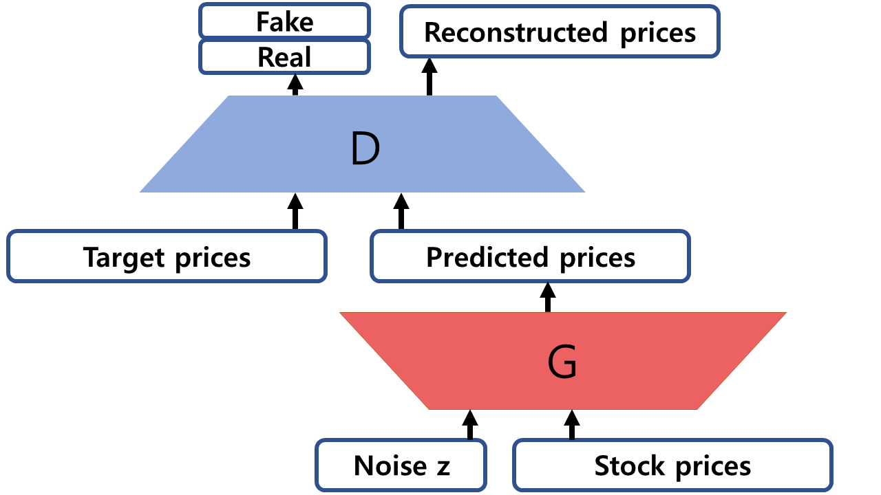
PredACGAN
Our model outputs by form of distribution.

Slide 9
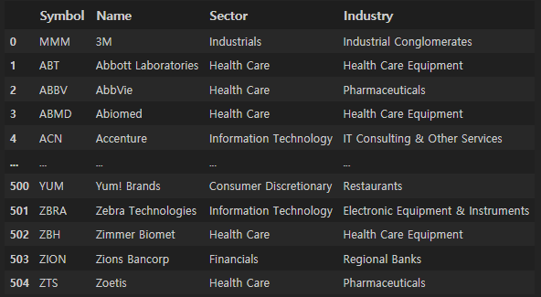
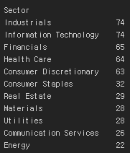
Experiment
S&P 500 data is composed of 500 large companies.
Stock prices from 1990 to 2010 were train sets.
Stock prices from 2011 to 2021 were test sets.

Slide 10
Performance
Model | correlation | rank - correlation
PredACGAN | 0.100 | 0.032
Hist Gradient Boosting | 0.027 | 0.022
Multi-Layer Perceptron | 0.002 | 0.002
Ridge | -0.017 | 0.002
Lasso | -0.017 | 0.002
Extra Tree Regressor | 0.010 | 0.006

Slide 11

Future work
We want to expand this research to portfolio optimization.

Slide 12
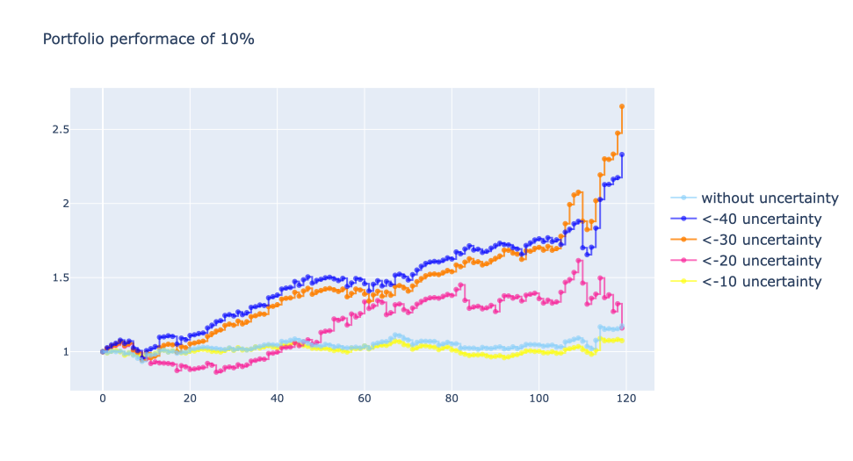
Future work

Slide 13
Reference
Generative Adversial Nets - Ian J. Goodfellow et al.
ACGAN – Augustus Odena et al.
Github - huseinzol05
Email address
tom919@cau.ac.kr

