Slide 1

T
CUAI 딥러닝 논문 구현 스터디 CV 2팀
2024.11.05
발표자 : 임현오

Slide 2
스터디원 소개 및 만남 인증
스터디원 1 : 양지훈
전자전기공학부
스터디원 2 : 임현오
응용통계학과
스터디원 2 : 정현석
전자전기공학부

Slide 3
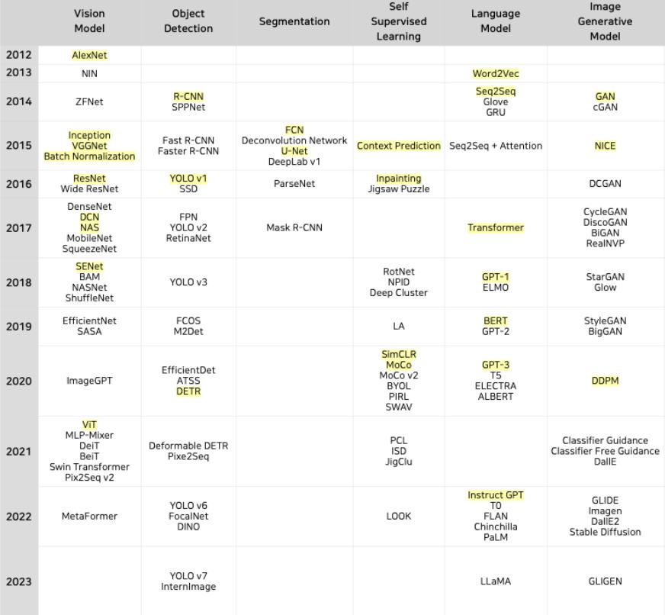
Vision Model
Object Detection
Segmentation
Image Generative Model

Slide 4
- ImageNet Classification with Deep Convolutional Neural Networks(AlexNet)
- Going Deeper with Convolutions
- Very Deep Convolutional Networks for Large-Scale Image Recognition
- Batch Normalization: Accelerating Deep Network Training by Reducing Internal Covariate Shift
- Deep Residual Learning for Image Recognition
An Image is Worth 16x16 Words: Transformers for Image Recognition at Scale
.
.
.

Slide 5



논문 리딩
논문 구현
피드백

Slide 6
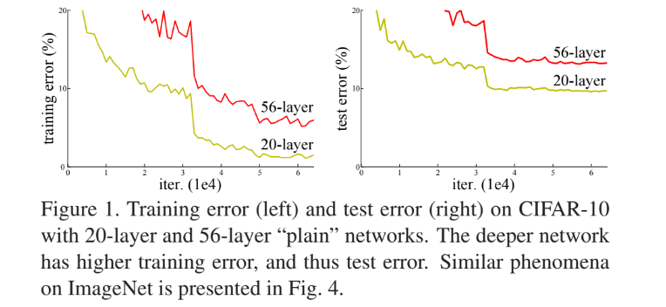
Resnet
기존 접근 방식의 문제점을 해결하기 위해 등장
Vanishing or
Exploding Gradients
Problem

Slide 7
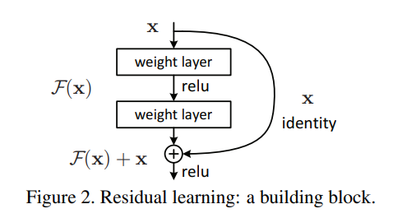
Resnet
Shortcut Connection or Skip Connection

Slide 8
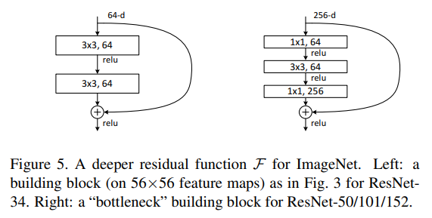
Resnet
Bottleneck

Slide 9
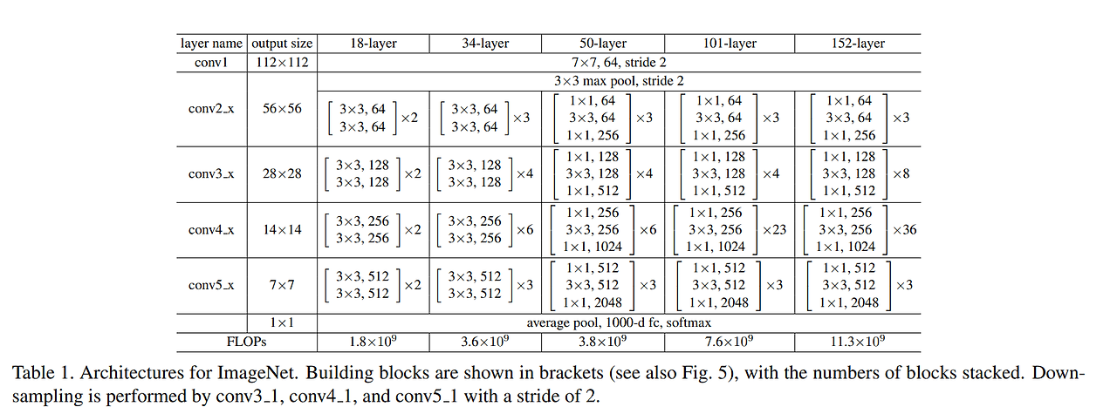
Resnet

Slide 10
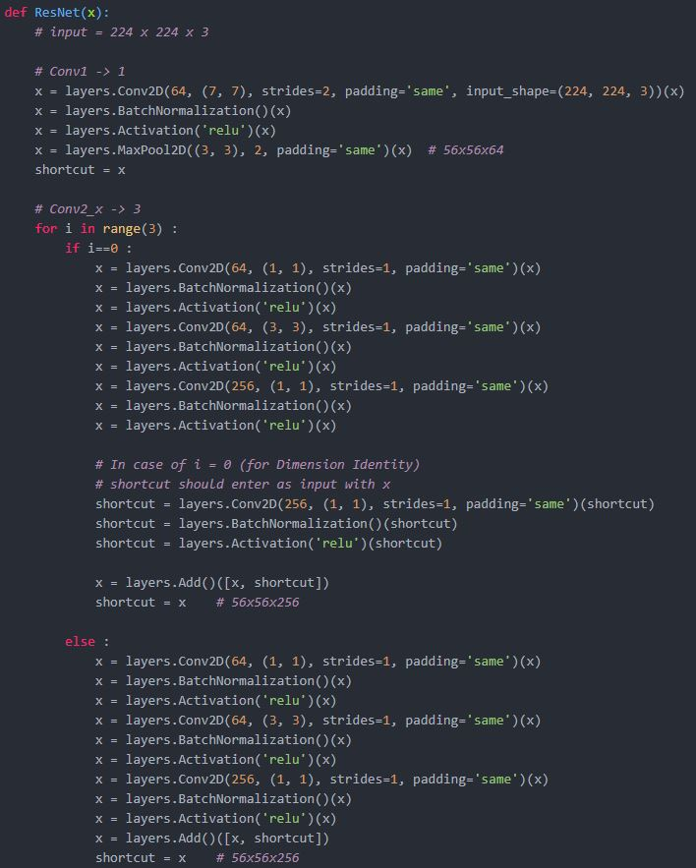
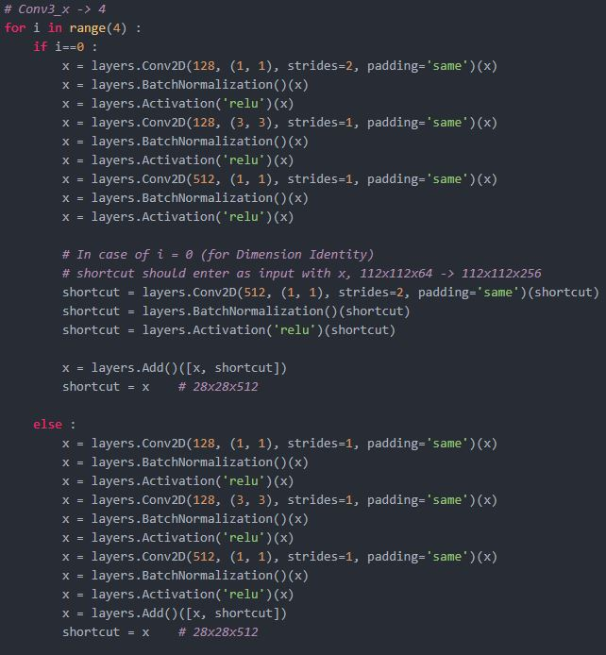
Resnet

Slide 11
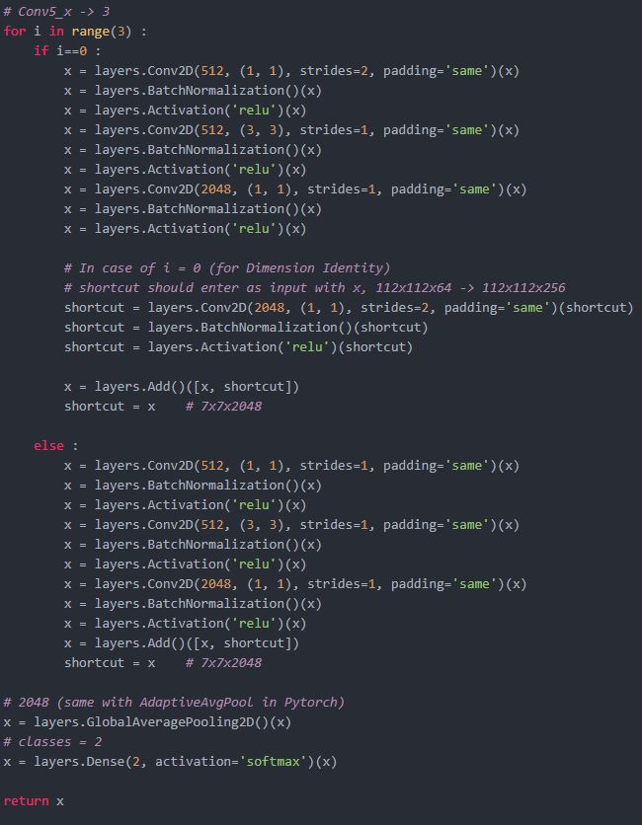
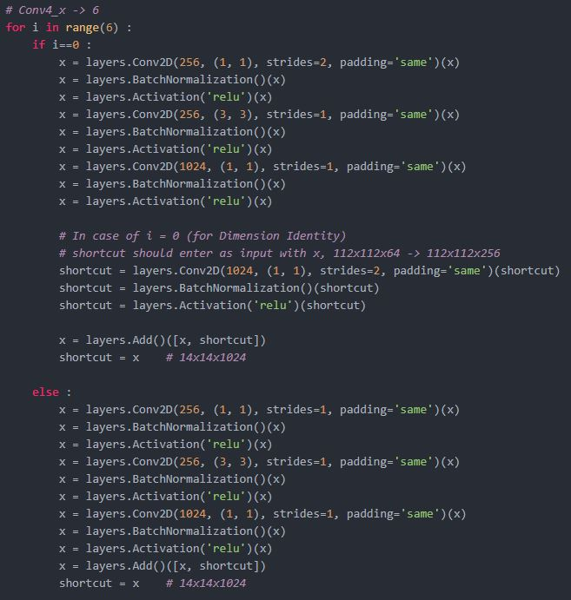
Resnet

Slide 12
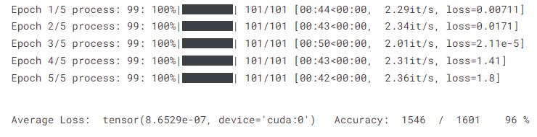
Resnet

