Slide 1

CUAI 스터디 핸즈온 3팀
2022.05.03
발표자 : 김진우

Slide 2
스터디원 소개 및 만남 인증
까먹음
스터디원 1 : 김태윤
스터디원 2 : 유창준
스터디원 3 : 유상준
스터디원 4 : 김진우

Slide 3
목차
1.Training Models
2.Support Vector machine
3.코드 리뷰

Slide 4
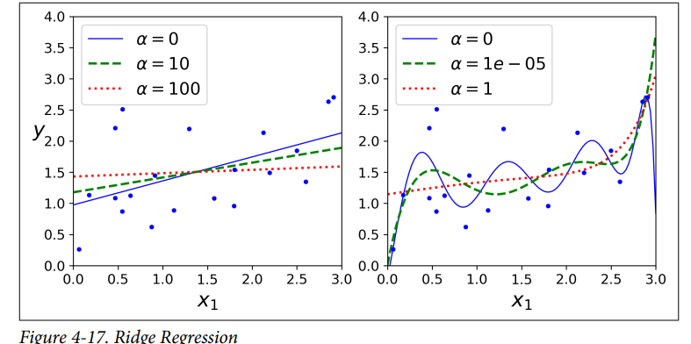
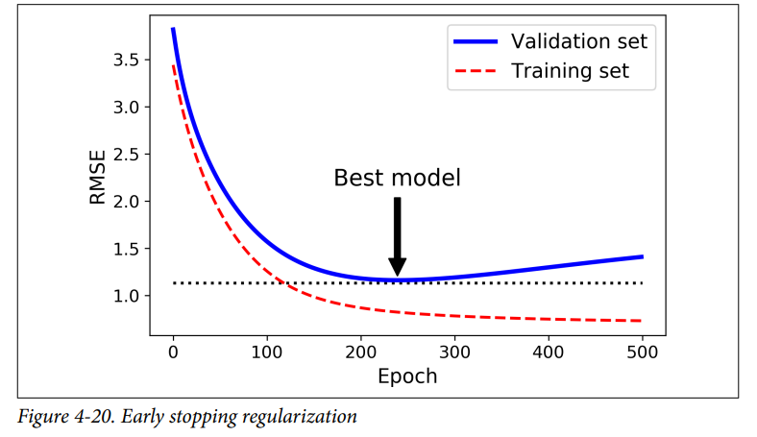
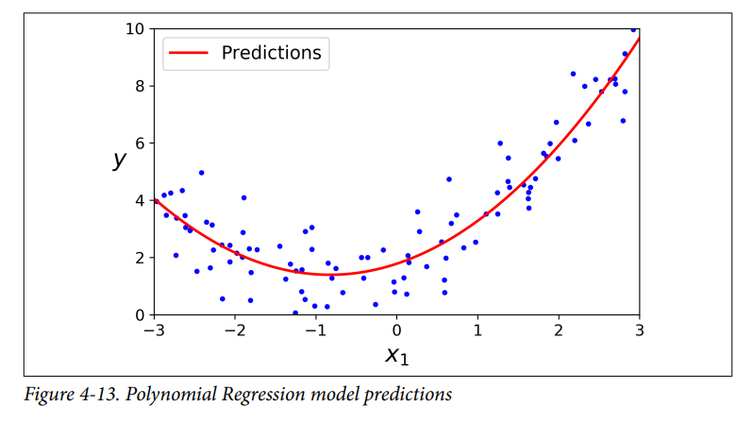
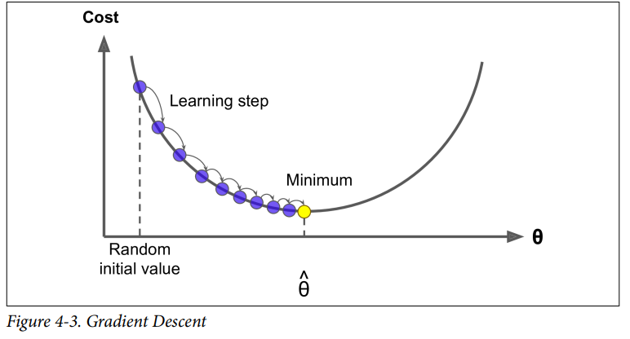

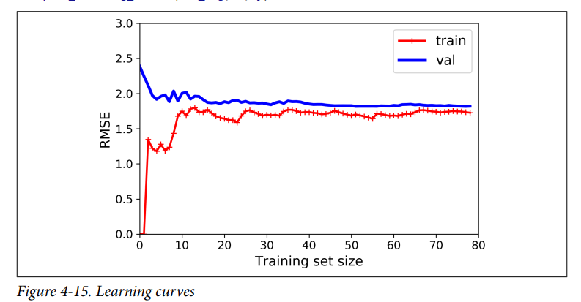
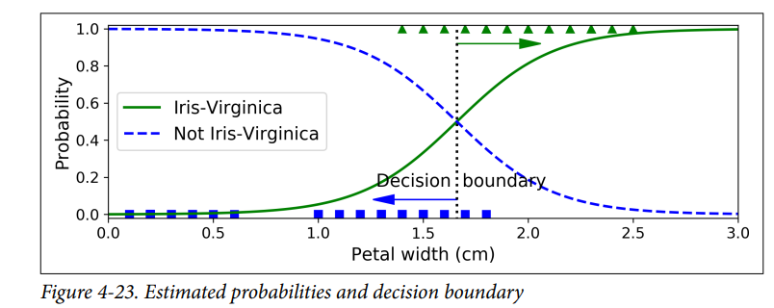
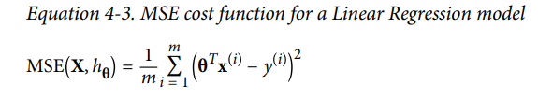
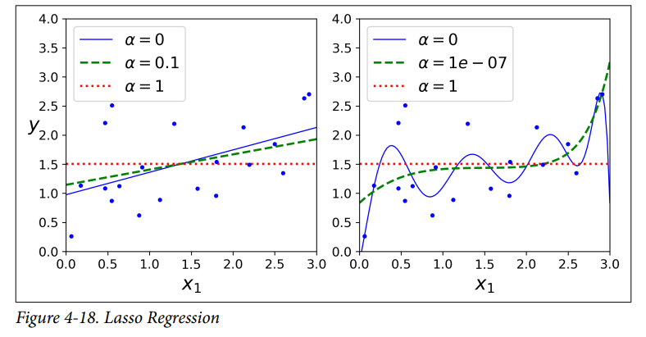

1.Training Models
1) Linear Regression
2) Gradient Descent
3) Polynomial Regression
4) Learning Curves
5) Regularized Regression Models
6) Logistic Regression

Slide 5
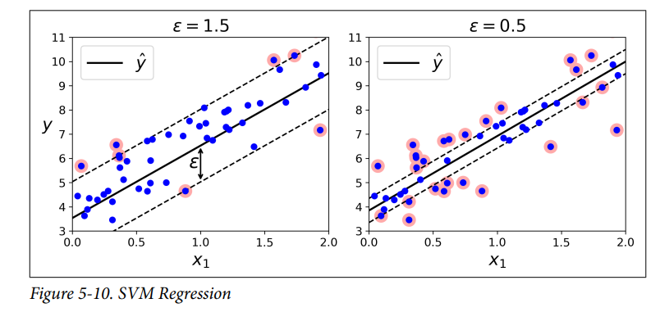
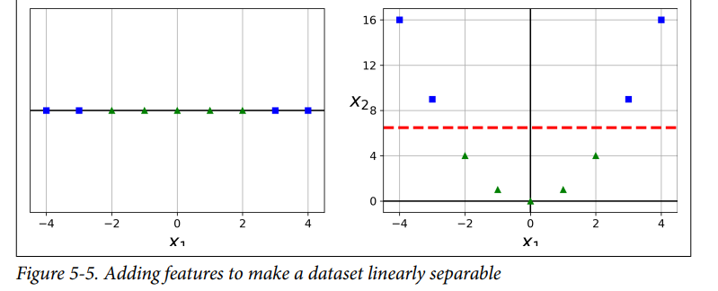
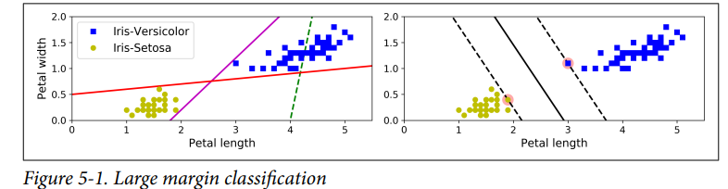
2.Support Vector machine
1) Linear SVM Classification
2) Nonlinear SVM Classification
3) SVM Regression
4) Under the hood

Slide 6
코드 리뷰
1.타이타닉(https://github.com/CUAI-CAU/HandsOn-ML-Study-T3_2022/blob/main/titanic/%ED%83%80%EC%9D%B4%ED%83%80%EB%8B%89.ipynb)
2.소득 예측(https://github.com/CUAI-CAU/HandsOn-ML-Study-T3_2022/blob/main/income_classification/Income_classification.ipynb)
3.(https://github.com/CUAI-CAU/HandsOn-ML-Study-T3_2022/tree/main/TaeYunKim)

