Slide 2
Explanation for palustrine environment
Las Tablas de Daimiel
Frame broader geologic Q
What environmental factors influence the timing and extent of precipitation of carbonates in palustrine settings?

Slide 3
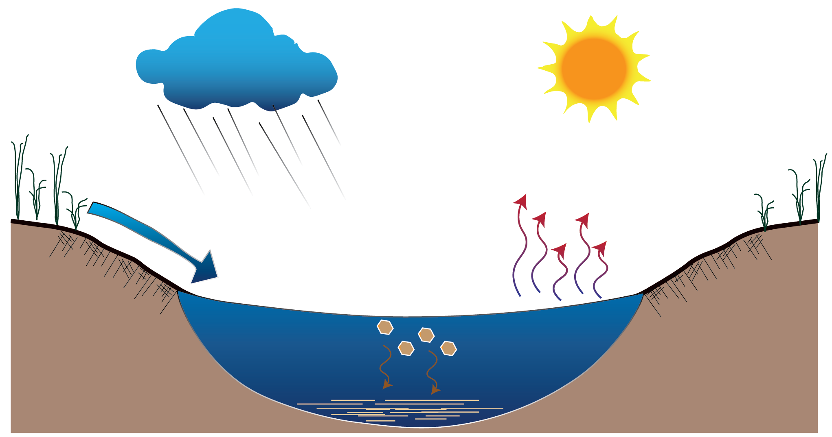
System Schematic… Palustrine ecosystem, i.e. shallow wetland environments
Precipitation
Evaporation
River In-Flow
Calcite
Crystallization

Slide 4









Box Model… Open, Steady-State System
Inputs
Main Reservoir
Outputs
$$φ_{Precip, Palus}$$
$$φ_{palus, evap}$$
Palustrine Basin
i.e. Shallow Pond
$$δ^{18}O_{precip}$$
$$δ^{18}O_{evap}$$
$$φ_{River, Palus}$$
$$δ^{18}O_{palus}$$
$$φ_{palus,carb}$$
$$δ^{18}O_{river}$$
$$δ^{18}O_{carb}$$

Slide 5
Equations

Slide 6
Parameters

