Slide 1
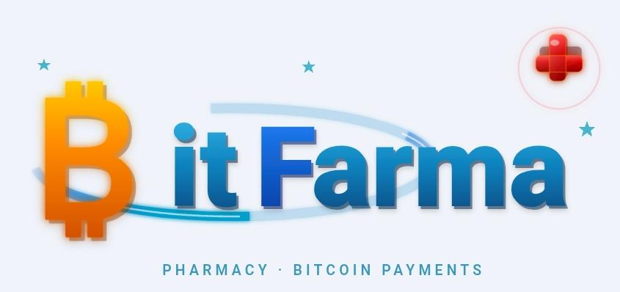
CUBO+ GRADUATION PROJECT · UPDATED v2.0
An AI-Powered Pharmacy Platform for the Bitcoin Economy
⚡ Tiankii Lightning Payment — LIVE & Confirmed
✅ LIVE
⚡ LIVE
🌿 NEW
🚚 NEW
App on Railway
Lightning Payment
Natural Products
Delivery Network
Confidential · El Salvador · 2026

Slide 2
AGENDA
Key topics covered today — 15 minutes
01
The Problem
02
The Solution
Market gap in El Salvador
BitFarma — Bitcoin-only digital pharmacy
03
How It Works
04
Technical Stack
3 roles · complete digital workflow
OpenClaw AI · Railway · Clone & Adapt
05
Achievements Reached
UPDATED
06
Bitcoin Payments
UPDATED
⚡ Tiankii LIVE · App in production
Tiankii QR · Lightning Network status
07
Health Sovereignty
UPDATED
08
Business Model
Traditional meds + Natural products
Revenue streams · projections · Bitcoin
09
Supply Chain
UPDATED
10
Next Steps
Drugstores + Naturals · Comodato · Delivery
Updated roadmap to commercial launch
BitFarma · Cubo+ Graduation Project · El Salvador 2026

Slide 3
THE PROBLEM
Why El Salvador needs BitFarma right now
#1
0
0
Country with Bitcoin
as Legal Tender
Bitcoin-only
pharmacies
Online prescription
platforms
Bitcoin Law 2021
In all of El Salvador
Available to patients
Key Pain Points Identified:
No Bitcoin-native pharmacy exists in El Salvador despite legal framework supporting it
Prescription management is fully analog — paper, manual processes, no patient visibility
Pharmacy inventory managed with no real-time stock alerts or digital controls
Home delivery of medications not integrated with any prescription management system
Bitcoin adoption in essential-goods sectors (healthcare) remains completely untapped
No access to natural health products under a unified digital sovereign ecosystem
BitFarma · Cubo+ Graduation Project · El Salvador 2026

Slide 4
THE SOLUTION
BitFarma — El Salvador's first AI-powered, Bitcoin-only pharmacy platform
El Salvador's first AI-powered, Bitcoin-only pharmacy platform
PHASE 1 — VALIDATION
PHASE 2 — COMMERCIAL
Institutional Proof
BitFarma Private
Full pharmacy management app modeled on ISSS Social Security pharmacy workflow. 3-role system: Admin, Pharmacist, Patient. Deployed on Railway. ✅ COMPLETE.
Codebase cloned and adapted for private pharmacy. Bitcoin-only payments via Tiankii QR Lightning. Live application accessible from any device. ✅ PAYMENTS LIVE.
💊 Traditional Medications + 🌿 Natural Health Products + ⚡ Bitcoin Payments + 🚚 Home Delivery

Slide 5



HOW IT WORKS — 3 USER ROLES
One complete digital workflow from prescription to delivery
ADMINISTRATOR
PHARMACIST
PATIENT
Full inventory control
Review uploaded prescriptions
Upload prescription (PDF/JPG)
Stock alerts & tracking
Dispense from inventory
Add special instructions
User management
Auto-generate PDF labels
Provide delivery address
Consumption reports
Manage workflow states
Track order in real-time
Workflow reporting
Record delivery address
Pay with Bitcoin QR
📤 Received
→
⚗️ In Preparation
→
✅ Ready
→
⚡ Paid
→
🚚 Delivered

Slide 6



TECHNICAL STACK
Built with AI · Deployed on the cloud · Designed to scale
OpenClaw
Railway
Clone & Adapt
AI-Assisted Development
Cloud Deployment
Modular Architecture
Entire application designed and built using OpenClaw, an AI-powered development environment. A single developer can architect and build complex multi-role production systems at startup speed.
Production deployment via Railway PaaS. Auto-deploy from GitHub, persistent database, SSL, and custom domain. The app is live — not just a prototype — accessible from any device worldwide.
The ISSS codebase was cloned and adapted for BitFarma in minimal time. New pharmacies can be onboarded by replicating the architecture with low overhead — the foundation for the SaaS licensing model.
💡 AI-assisted development is not just a tool — it is a paradigm shift for solo founders and lean startups.
BitFarma · Cubo+ Graduation Project · El Salvador 2026

Slide 7


ACHIEVEMENTS REACHED
From prototype to production — current project status
Application Deployed on Railway
🔄 IN PROGRESS
BitFarma is live, accessible from any device worldwide. This is not a prototype — it is a fully functional system running in production on Railway cloud infrastructure.
Workflow Auto-Update
The Tiankii webhook confirms payment successfully. The next step is for the order to automatically advance to 'Delivered' status without any manual action from the pharmacist.
Tiankii Lightning Integration LIVE
Bitcoin Lightning QR code is automatically generated when the pharmacist marks an order as 'Ready'. Full Tiankii API integration is operational and tested in the live environment.
Payment Confirmation — Webhook Received
⚡
The Tiankii webhook fires correctly. BitFarma receives the InvoiceSettled event confirming Bitcoin payment. The payment pipeline from patient to merchant is fully functional end-to-end.
Lightning Network
Code Architecture Validated
Bitcoin payments LIVE
3-role system (Admin, Pharmacist, Patient) tested. PDF label generation functional. Clone-and-adapt methodology validated — ready to onboard additional pharmacy licensees.
BitFarma · Cubo+ Graduation Project · El Salvador 2026

Slide 8
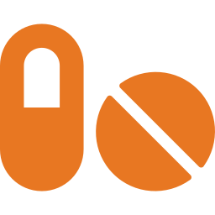
BITCOIN PAYMENTS — TIANKII INTEGRATION
QR generation ✅ · Payment confirmation ✅ · Workflow auto-update 🔄
01
02
03
04
→
→
→
Prescription Ready
QR Code Generated
Patient Scans & Pays
Confirmed & Dispatched
Pharmacist marks order as 'Ready' in BitFarma
Tiankii API generates BOLT11 invoice → QR displayed to patient
Any Lightning wallet: Blink, Chivo, Phoenix, Blue Wallet
Tiankii webhook fires InvoiceSettled → BitFarma receives confirmation
Why Bitcoin Only?
First-mover differentiation in El Salvador's Bitcoin legal tender market
Lightning Network = near-zero fees, instant settlement, no chargebacks
Mission-driven: making Bitcoin useful for daily healthcare transactions
BitFarma · Cubo+ Graduation Project · El Salvador 2026

Slide 9




HEALTH SOVEREIGNTY
BitFarma serves two customer types — prescription medication & natural wellness
TRADITIONAL MEDICATIONS
NATURAL HEALTH PRODUCTS
For chronic patients seeking to digitize their pharmacy
For those who want to take control of their own health
Herbal supplements and vitamins
Diabetes · Hypertension · Thyroid · Cholesterol
Alternative and integrative medicine products
Monthly recurring purchase — refill with 1 click
Nutraceuticals and superfoods
Ages 35–70 with smartphone access
Preventive health and wellness products
Banked and unbanked patients (Bitcoin removes barriers)
All paid in Bitcoin Lightning
Family members managing a patient's medications
Both product lines on one platform · Bitcoin payments · Home delivery · Digital prescription
BitFarma · Cubo+ Graduation Project · El Salvador 2026

Slide 10

BUSINESS MODEL
Updated revenue streams — medications + naturals + Bitcoin
Medication Sales
Natural Products
Delivery Fees
Platform Licensing
25–35% margin over wholesale price. Monthly auto-refill for chronic patients drives recurring revenue.
Herbal supplements & nutraceuticals. Estimated 35–50% margin. Growing market, high loyalty segment.
$2.50–$5.00 per order charged to customer. Managed via Pedidos Ya / Urban Express partnership.
SaaS model: license BitFarma to independent pharmacies. $150–300/month per licensee client.
$251M
~4,500
$270K
$0
National pharmacy
market (Statista 2025)
Estimated active
customers — Year 1
Projected gross
revenue — Year 1
Upfront inventory cost
(comodato model)
⚡ Bitcoin Lightning: 0% processing fee vs 2–4% card fees = $5,400–$10,800 in additional margin at $270K annual revenue
BitFarma · Cubo+ Graduation Project · El Salvador 2026

Slide 11

SUPPLY CHAIN & PARTNERSHIPS
Drugstores · Natural Providers · Delivery · Comodato Agreement
💊 PHARMACEUTICAL SUPPLIERS
🌿 NATURAL PRODUCTS + 🚚 DELIVERY
Droguería Americana
Natural Products Distributors
San Salvador · ventas@americana.com.sv · Ranked #1 IMS Health · Pfizer, Merck, Novartis
Herbal supplements · vitamins · nutraceuticals · organic certified wellness products
Droguería Santa Lucía
Pedidos Ya
Colonia Roma No.238, S.S. · (503) 2250-6200 · 1,500+ distribution points · Hospitals & pharmacies
El Salvador's largest delivery platform. Home delivery with real-time tracking. Partnership target.
Droguería Integral
Urban Express
Urb. San Francisco, Calle Los Abetos · drogueriaintegral.com.sv · Decades of track record
Urban courier service in San Salvador. Same-day urgent deliveries — ideal for medications.
COMODATO AGREEMENT — Capital-efficient supply model
💰 Zero upfront inventory investment
📦 BitFarma pays only what it sells
🔄 Unsold stock returned — zero risk
📈 Scalable as order volume grows
BitFarma · Cubo+ Graduation Project · El Salvador 2026

Slide 12
NEXT STEPS — ROADMAP TO LAUNCH
Updated milestones toward commercial launch
1
COMPLETE
Tiankii Lightning QR Payment
Full integration complete. QR auto-generated. InvoiceSettled webhook confirmed. Bitcoin QR payment LIVE.
2
IN PROGRESS
Workflow Auto-Update
On payment confirmed → order automatically advances to 'Delivered'. No manual pharmacist action required.
3
IN PROGRESS
Drugstore Comodato Agreement
Active negotiations with Droguería Americana and Santa Lucía. Initial medication catalog being defined.
4
NEXT
Last-Mile Delivery Partnership
Integration with Pedidos Ya / Urban Express for home delivery of medications and natural products.
5
NEXT
Natural Products Line
Onboarding suppliers for herbal supplements, nutraceuticals, and natural health products catalog.
6
PLANNED
Community Launch
Go-live for the Bitcoin community in El Salvador via meetups, conferences, and social media.
BitFarma · Cubo+ Graduation Project · El Salvador 2026

Slide 13
"Fix the money. Fix the world.
Start with healthcare."
✅ Working app — deployed on Railway
⚡ Tiankii integration — QR Lightning LIVE
✅ Payment confirmation — webhook active
🔄 Workflow auto-update — in progress
🌿 Natural products line — in development
🚚 Delivery network — alliances in progress
Cubo+ Graduation Project · El Salvador · 2026

