Slide 1




BestBuy QUERY
Machine Learning and Big Data
Greg, Lei, Lexie, Liang & Masha

Slide 2
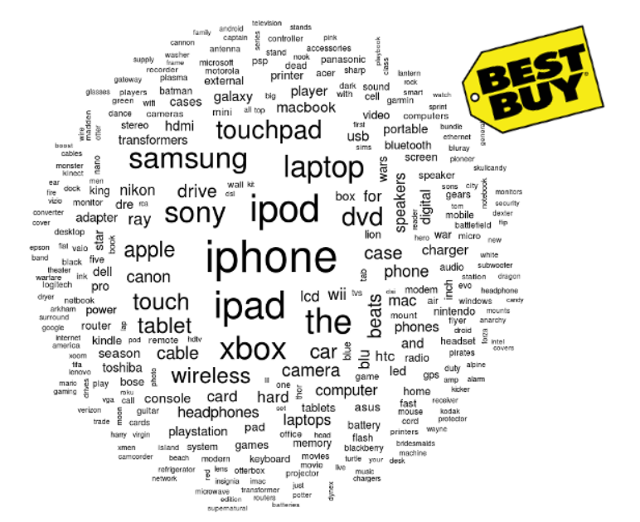
Project Description
Our project is to complete the Best Buy Data Mining Hackathon on the 7GB data set.
Here is the link for the Kaggle Bestbuy Contest:
http://www.kaggle.com/c/acm-sf-chapter-hackathon-big

Slide 3
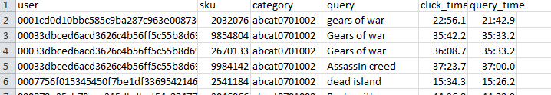
Project Description
This is how data look like:
Our goal is to predict the sku#.

Slide 4


Outline
Data Description
Machine Learning Techniques
Data Cleansing
Feature Selection
Naïve Bayes Classification
Solr Search
Handle Big Data
Hadoop, MongoDB, Solr
Future Expectation

Slide 5
Data Description
Rows: 1865269
Unique Users: 1268702
Unique SKU: 69858
Unique Categories: 1540

Slide 6
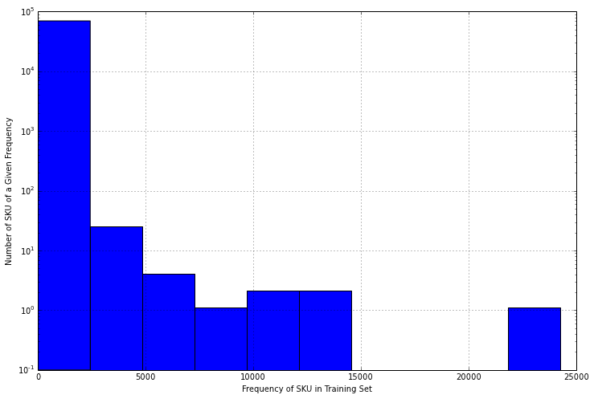
Data Description-SKUs
Frequency of SKUs in Training Set

Slide 7
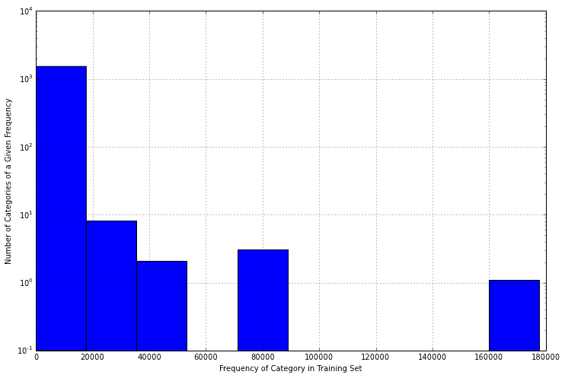
Data Description-Categories
Frequency of Categories in Training Set

Slide 8

How to predict – Naïve Bayes
Naïve Bayes Classifier
Well suited to text classification (query)
Predict popular SKUs given a query term
Filter on Category
Ignore UserID
Query/Click time is an open question
Efficient: linear complexity

Slide 9
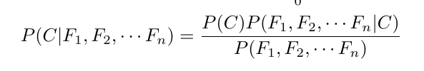
Naïve Bayes
Naïve Bayes is a powerful machine learning algorithm for big data. Here is the idea for the Naïve Bayes:
The goal is to maximize the probability.
In our project, sku# will be our class label. And after preprocessing, the feature we choose is the query term.

Slide 10
Machine Learning Model
Preprocess data-Data Cleansing
Google Refine.
Preprocess and Tokenize Query Terms
Feature Selection
Select most frequent unigrams and bigrams (choose 10000 here)
Or LSA (poor accuracy!)
Multinomial NB
Feature Set: td-idf terms of words
Label Set: SKUs
Return 5 most possible SKUs
Solr Search: reorder the SKUs

Slide 11

How good is our model?
Benchmark Result: 0.3 @ MAP
Test on 100 elements:
Total MAP score is 0.57
Total MAX score is 0.82
time is 13.5274701118
Test on 1000 elements:
Total MAP score is 0.52
Total MAX score is 0.711
time is 144.144557953

Slide 12

Data is TOOO… BIG
Export Data into MongoDB
Naïve Bayes classifiers do not fit into RAM
Only load the portion for a given category to RAM
Parallelize classification function
Training Classifiers in Multiprocessing
Heavy workload for testing data-read intensive
Map-Reduce in data
Hadoop
Solr search on Cluster

Slide 13
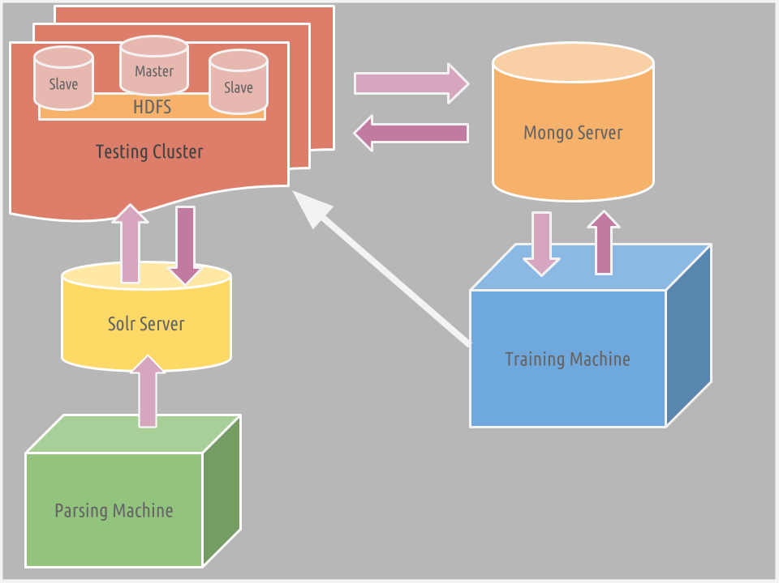
Architecture Diagram

Slide 14

Deliverable - Website
http://lexiemartin.com/query/index.html

Slide 15

Thank you and Questions

