Slide 1

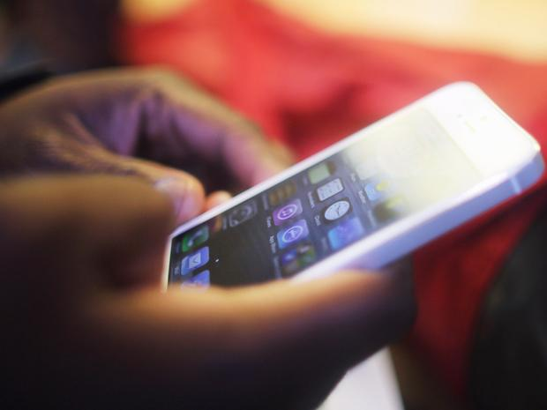

MOBILE QUERY
Machine Learning and Big Data
Greg, Lei, Lexie, Liang & Masha

Slide 2

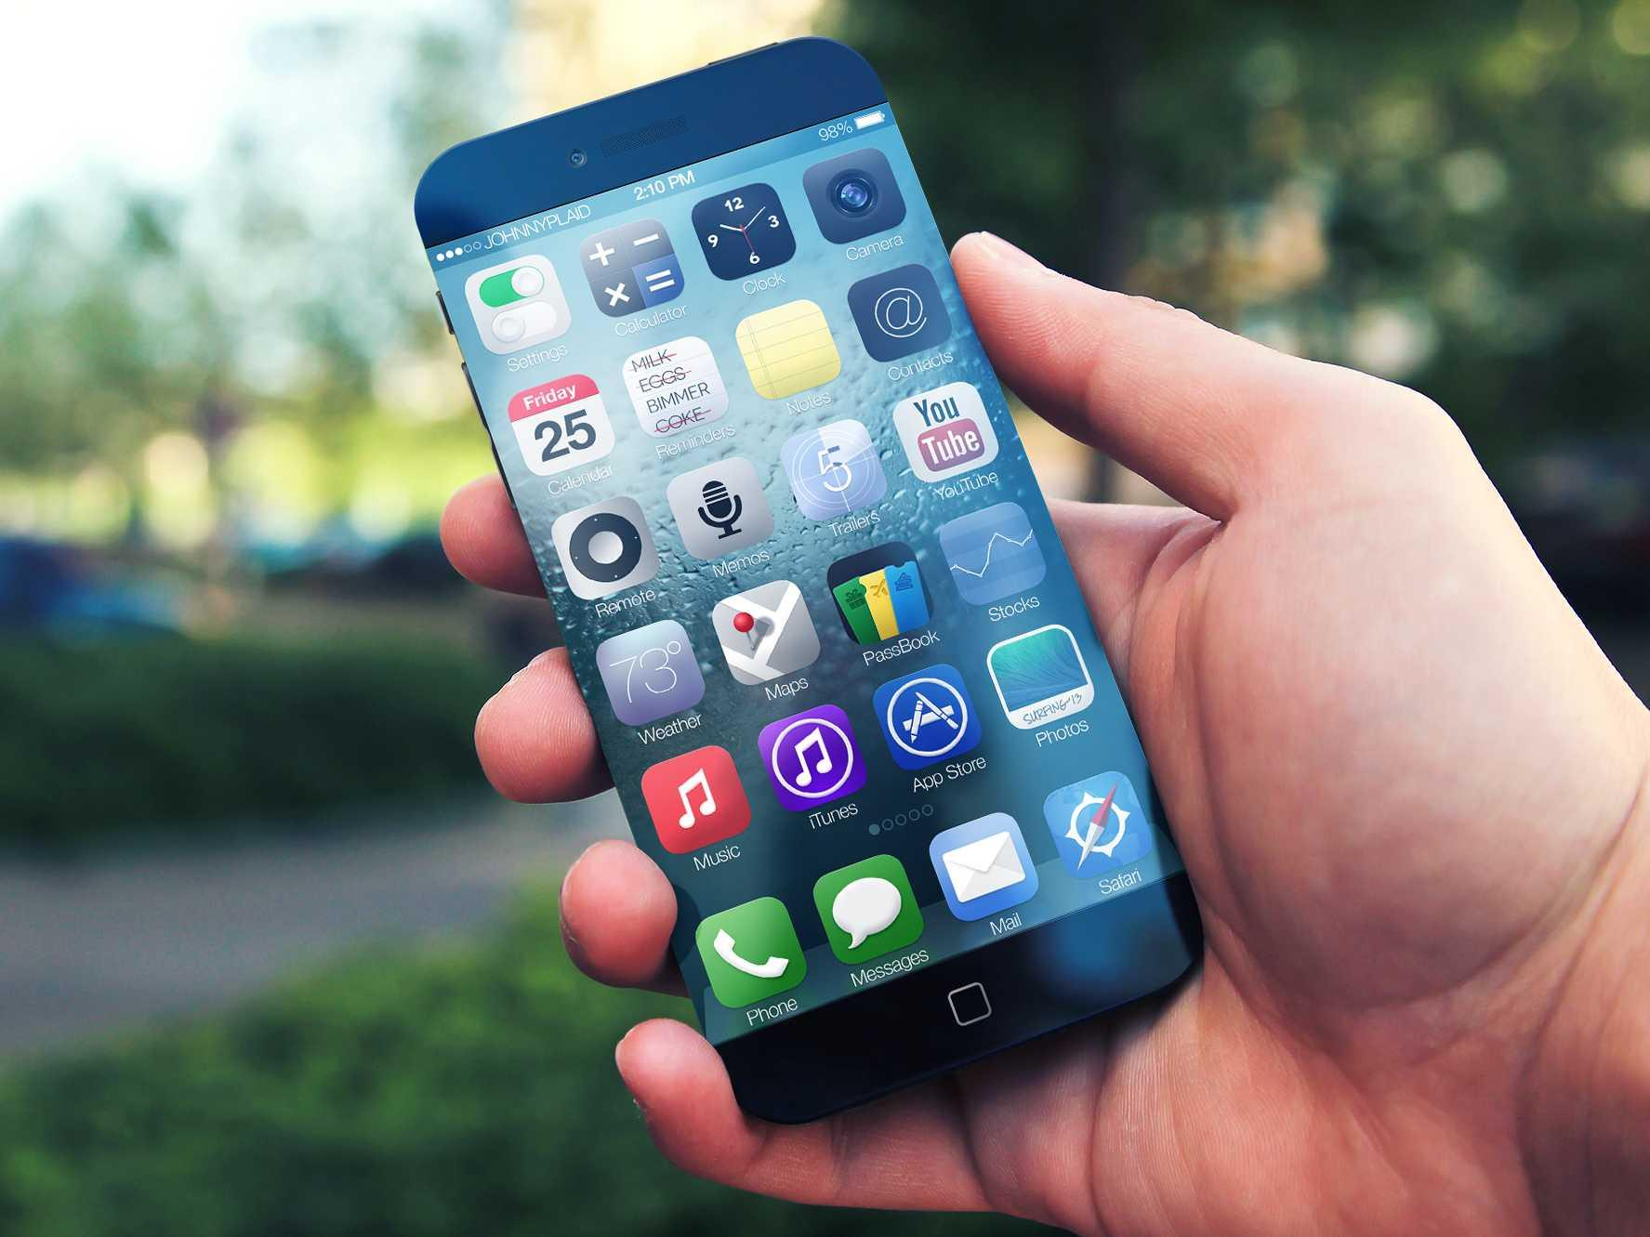

Hi there.
I’m the first slide!
This is where text goes.
Look at us saying smart things.
We’re smart.
Better text will be here soon.
Lexie is tired now.

Slide 3


Let’s include some sample code.
Yay sample code!
Simplified algorithm
for (this:thing)
if (condition)
result.add(1);

Slide 4

THE END
We get As now.

