Slide 1
GITHUB ANALYZER
KODE KALLAS
KARTHIK SIDDARAMANNA
SHREYAS GOPALAKRISHNA
SIDDARTHA SHANKAR
VISHWANATH KULKARNI

Slide 2
PROJECT DETAILS
System to analyse, visualize and monitor Github Organization’s Hierarchy.
System which solves
How Organizations are developed
Popular Languages used in the Organization
Countries contributing for the Organization
Issue suggestions
Overview of Contributors and Languages of Repositories
A scalable system which is orchestrated to analyse large amounts of data.

Slide 3
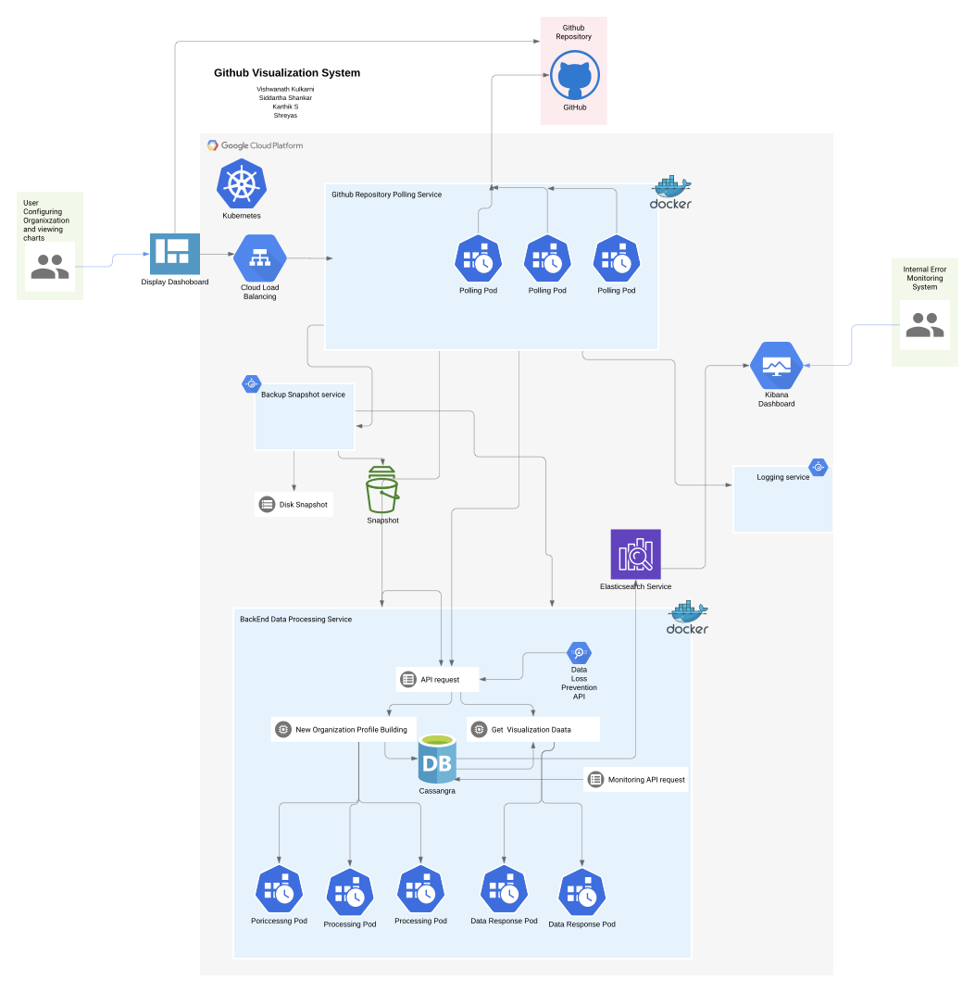
ARCHITECTURE

Slide 4
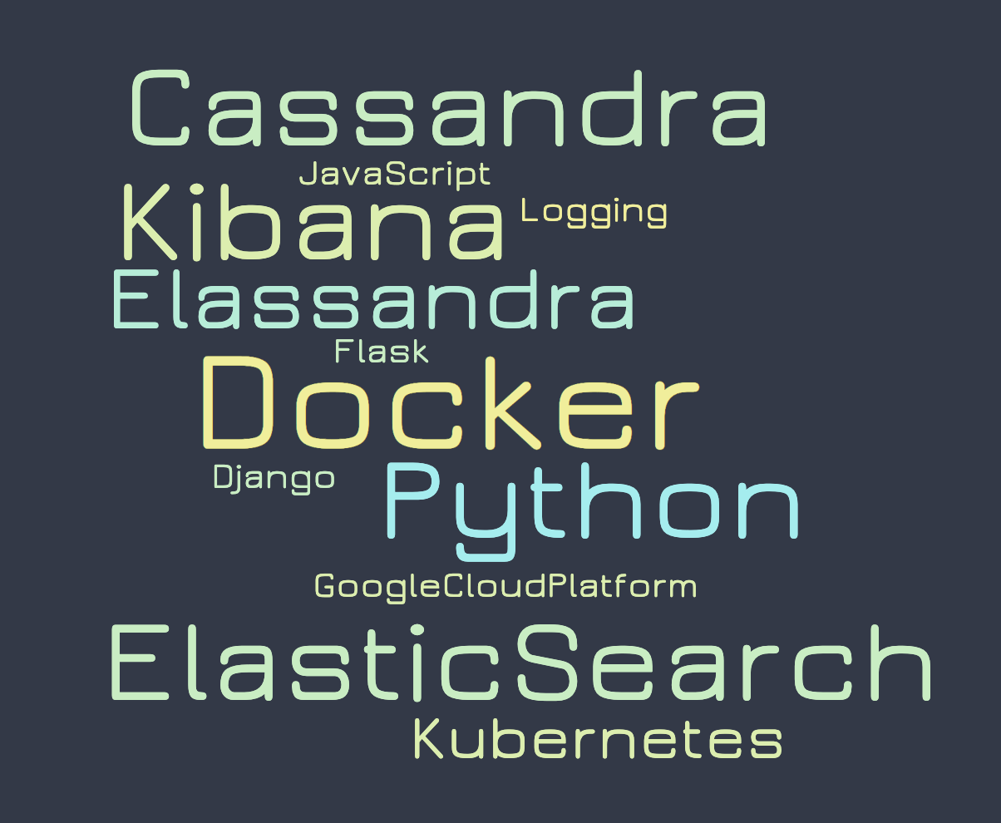
TECHNOLOGIES
SCALABILITY
Cassandra - Fast Writes
Scaled by adding nodes
Elasticsearch - Fast Indexing and Fast Reads
Scaled by adding clusters
3 Flask Backend MicroService Pods
Github Data Crawler
Cassandra APIs
Github Analytics
Scaled by adding pods
Notes:
We are using Cassandra since it offers faster writes, cassandra is scaled by adding nodes and data is replicated across nodes.
Elasticsearch is used to index and have fast reads of our data.
We have 3 microservices, 1 pull data from github, 2 inserting into cassandra and 3 for analytics on data reading from elastic.

Slide 5
TECHNOLOGIES
SCALABILITY
Django based MicroService for frontend
Docker - Containerizing for all
Kubernetes - Container Orchestration system
Notes:
The Django Frontend is also a microservice.
All our services are contanarised using Docker and they are scaled by adding more pods in Kubernetes.

Slide 6
DEMO - https://drive.google.com/file/d/1FGF9Y5ypGD4oJEKtMcEm63x2uqqsFlRG/view

Slide 7
CHALLENGES
LEARNINGS
Limited documentation for cassandra-driver libraries in python and almost no support in forums. All bugs had to be resolved by going through library code.
Pulling data using APIs and data movement across databases takes lot of time.
Elassandra uses an older version of Elasticsearch and Kibana.
Github rate limit of 5000 request per developer per day.
Kubernetes pods setup and microservice communication
Java has better support in forums. A Springboot application would have been better for elassandra-apis.
Used Multithreading to improve latency time to get data and move across databases.
Elassandra vs custom deployment of Elasticsearch and Cassandra should be evaluated.
Pooled Data extraction by rotating Github Token among 4 developers
Kubernetes Internal Communication and IP address assignment for External Access

Slide 8
THANK YOU

