Slide 1

Real-time Indoor Consumer Tracking
& RFID Checkout
Notes:
Tanner opens us up. Talk about goals.

Slide 2
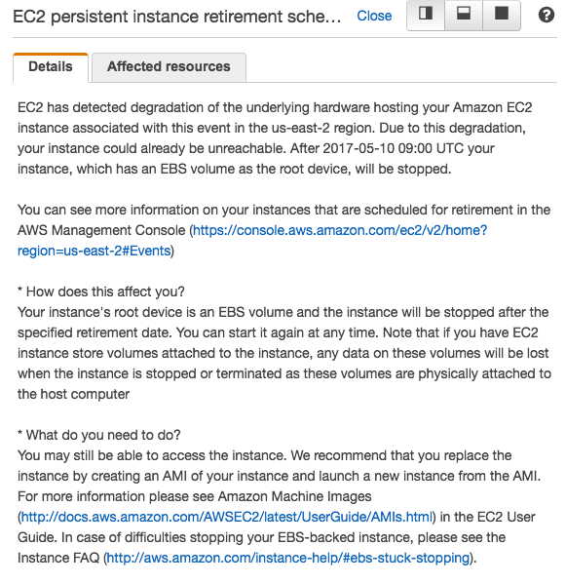
Our Database Crashed Two Hours Ago

Slide 3
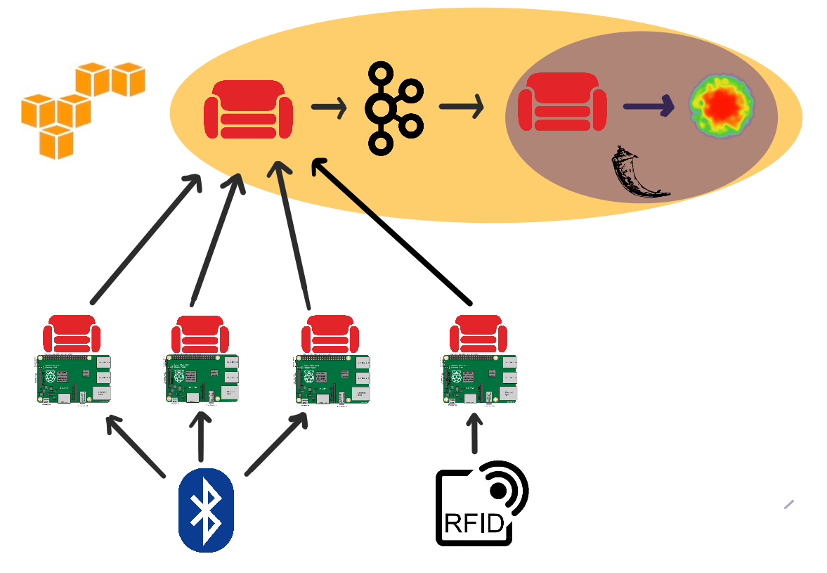
We are real-time
by using AWS
and CouchDB
Notes:
Drew talks architecture

Slide 4
Notes:
Frank starts demo, talks front end and firebase. Brandon leads Greg to sign up, walk around, check email, check out, check email again.

Slide 5
How it Works
Receivers get signal strength (RSSI)
Rolling median of ten RSSI values for each receiver
Corner determined by receiver with smallest rolling median
Corner determinations must be the same for past fifteen readings
Notes:
Jeff talks about trilateration and what we learned

Slide 6
What We Tried To Do
Create an indoor positioning system using the RSSI values
Notes:
Jeff talks about trilateration and what we learned

Slide 7
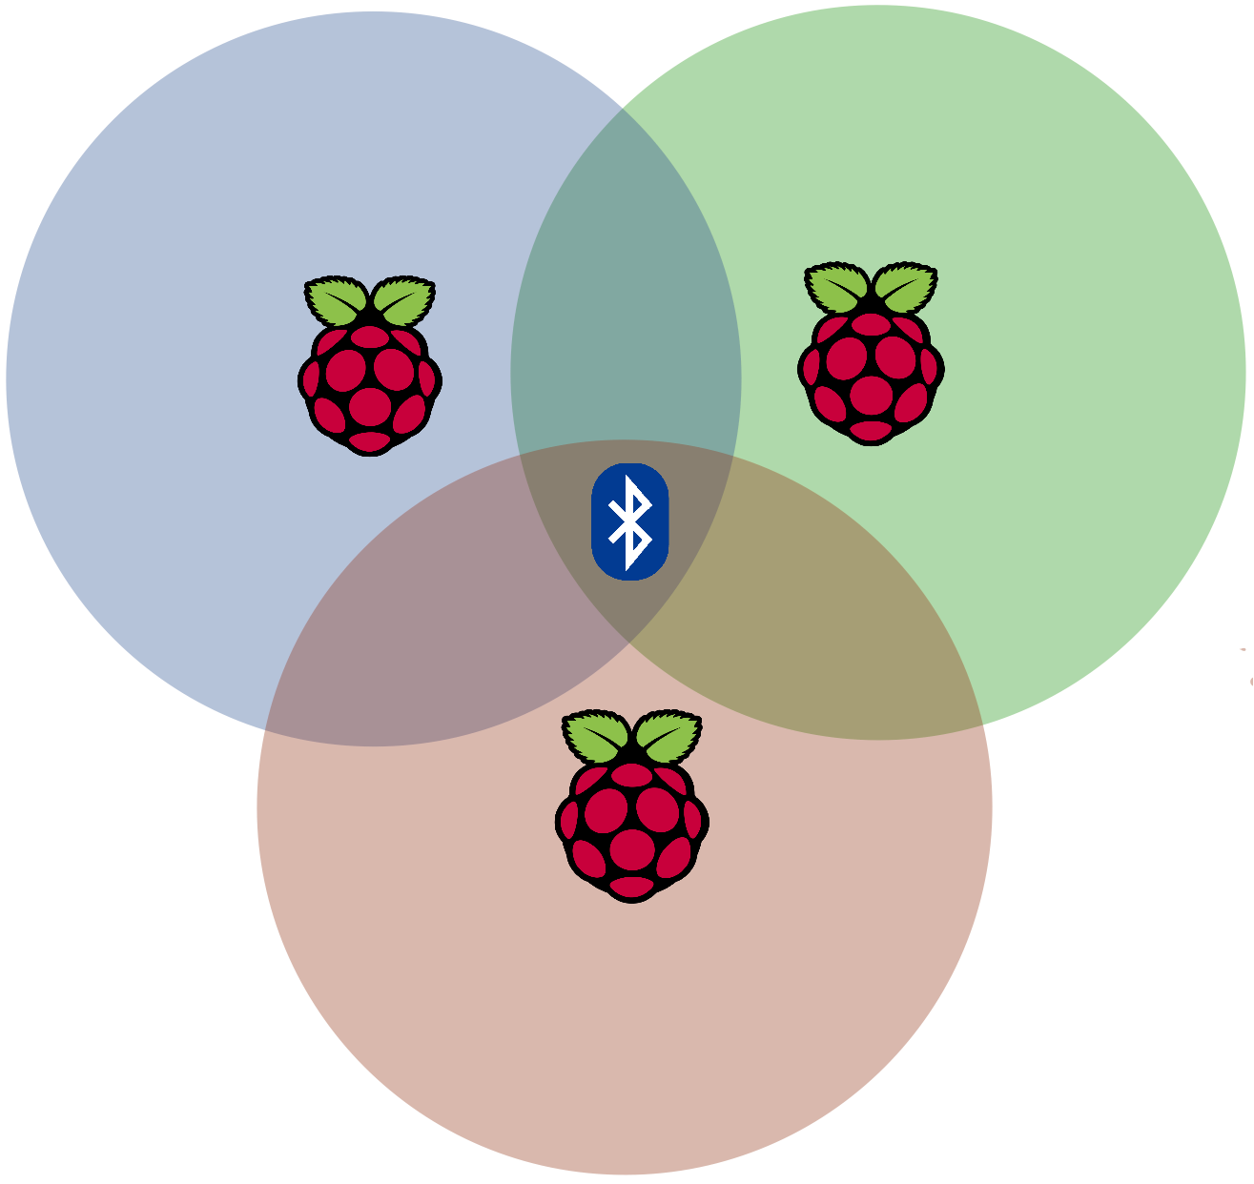

Slide 8
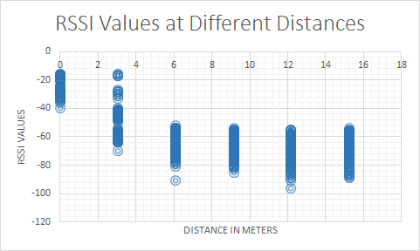

Slide 9
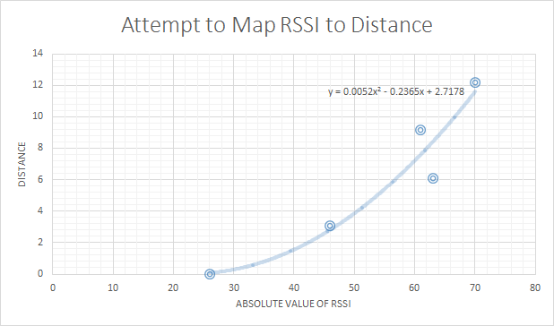

Slide 10
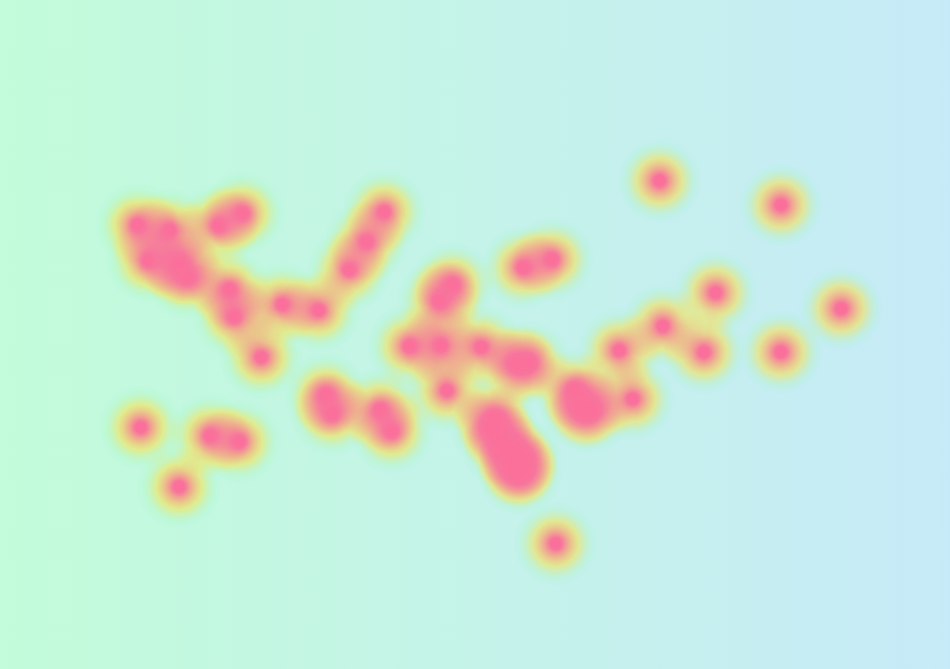

Slide 11
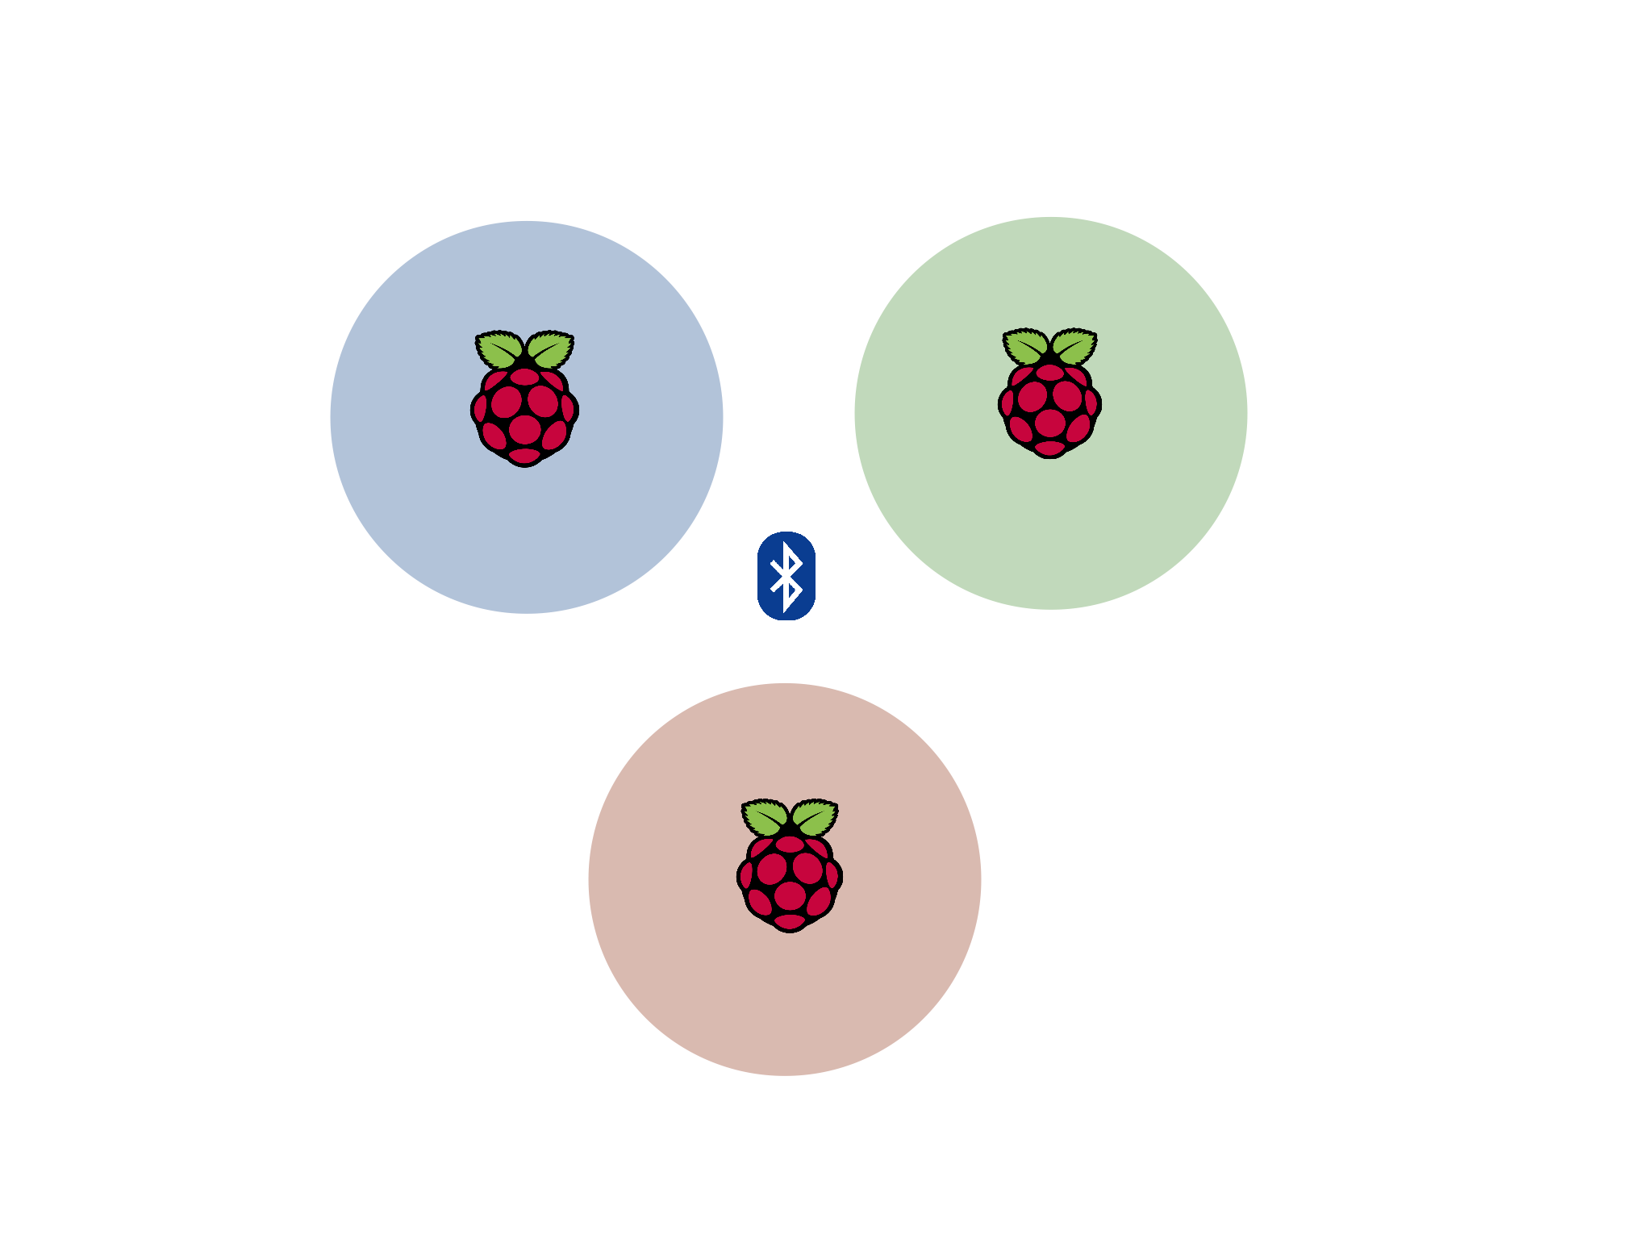

Slide 12
Future Improvements
Replace beacon on basket with smartphone app
BLE signal then linked with user’s information
Higher Resolution Bluetooth Detection
Signal smoothing algorithms only go so far…
May have to wait for BLE technology to improve
Longer Distance RFID Scanning
Scan Entire Shopping Basket
Higher gain antenna
Clustering of Kafka/CouchDB
Notes:
Jeff talks about trilateration and what we learned

Slide 13
Potential Use Cases
Smart Cities
City-scale Fitbits
Smart Labs
“Funul” data from lab equipment/medical devices and pipe into automated data analysis
Streamline data collection and analysis
Plug and Play Sensor Networks
Raspberry Pi IoT hub can act as a cloud gateway for any wireless protocol
What data will you pipe in?
Notes:
Drew closes out

